Slide 1
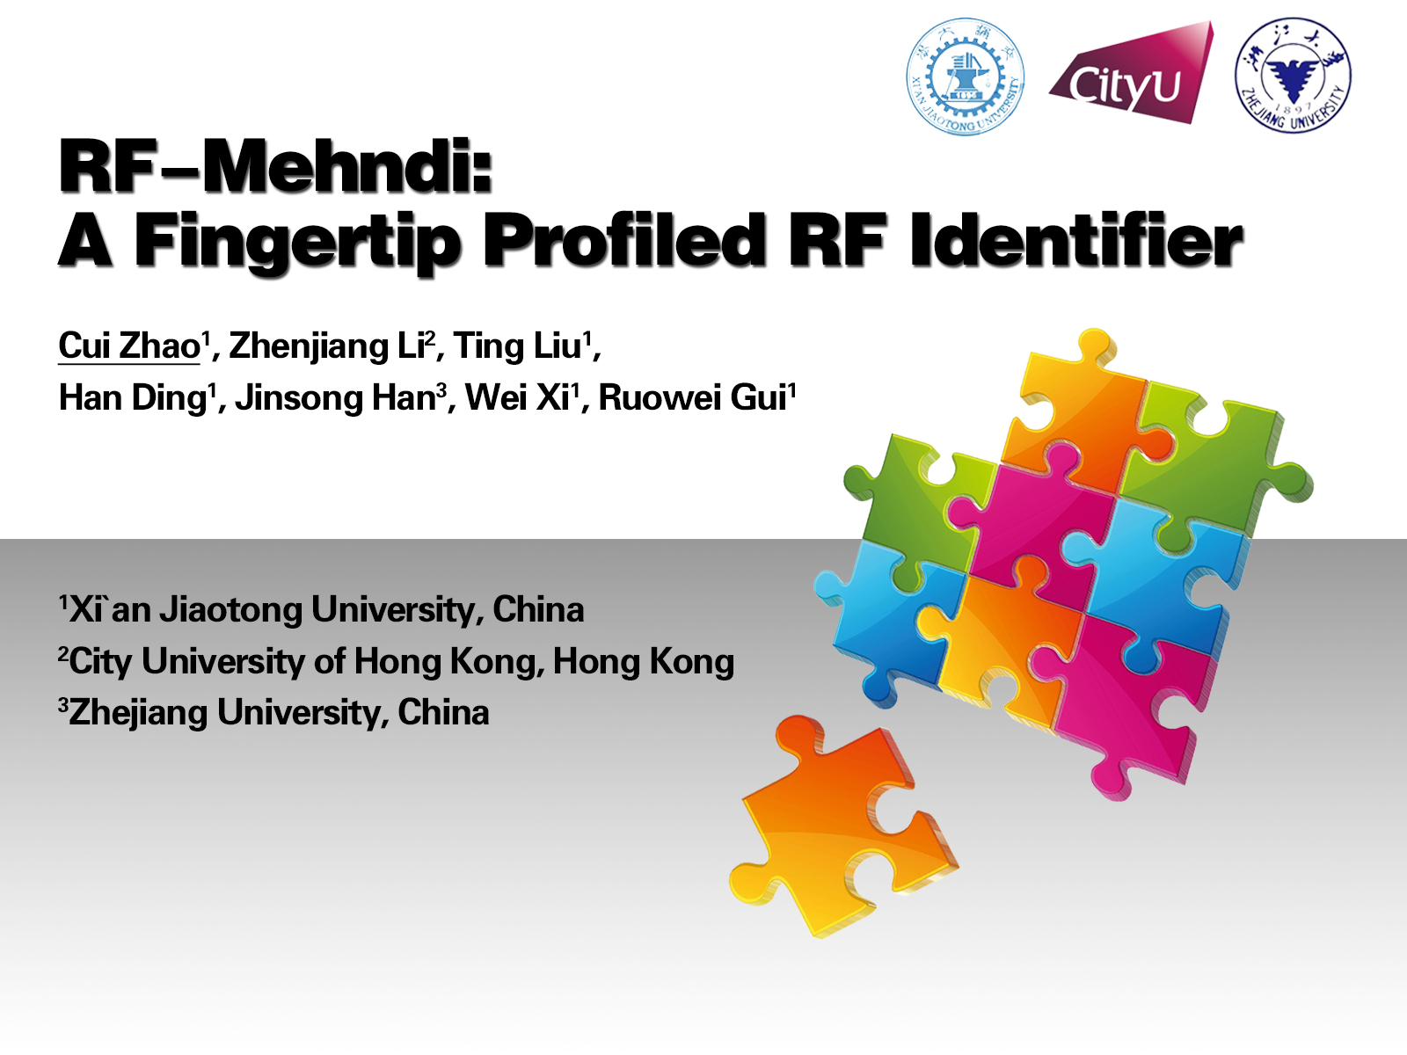

Slide 2
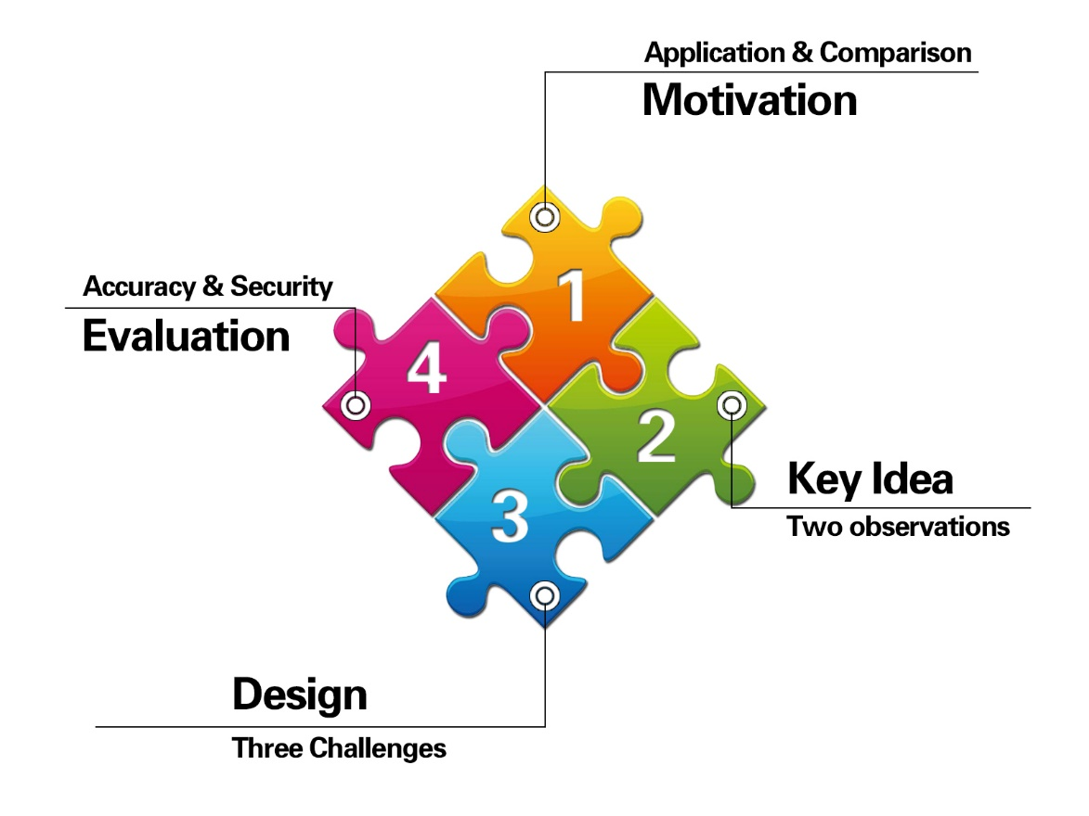

Slide 3

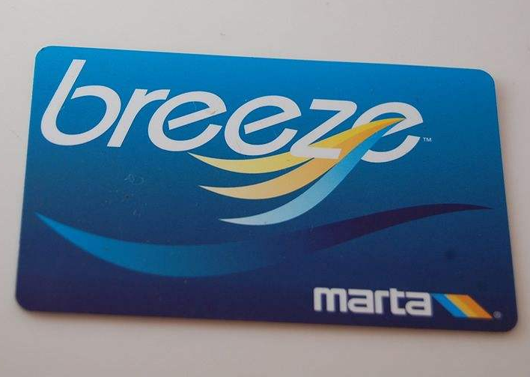
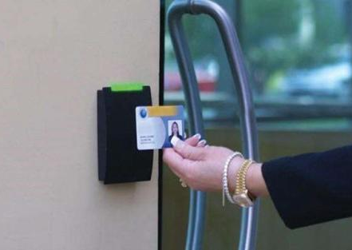
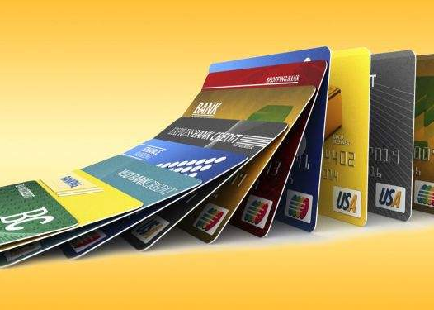
Transportation Card Access Card Credit Card
Any potential security risk with these cards?

Slide 4



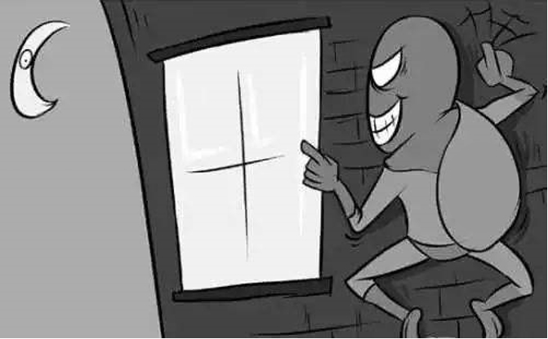

Thievery Loss
Why can’t these cards resist loss and thievery?

Slide 5



Sth you have?
Who are you?

Slide 6


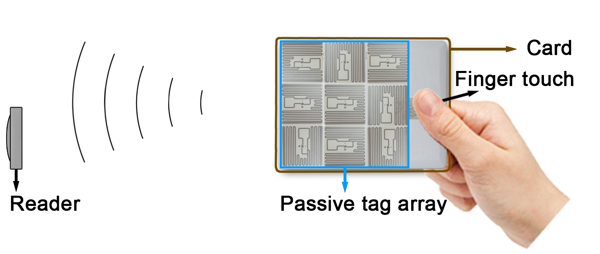
Different users → Different signals
User-dependent

Slide 7

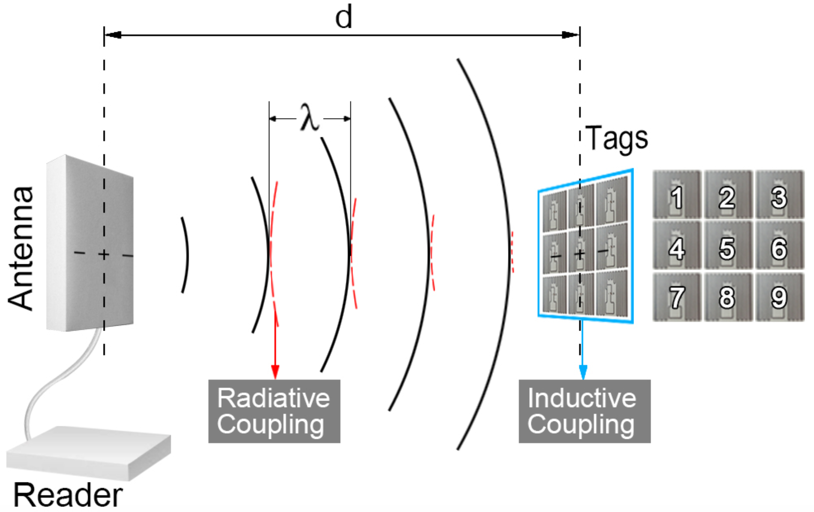
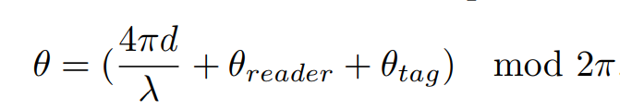
Radiative & Inductive coupling

Slide 8
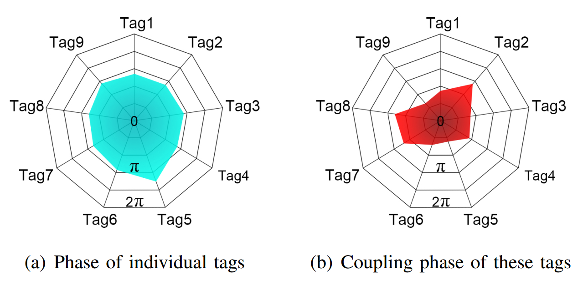
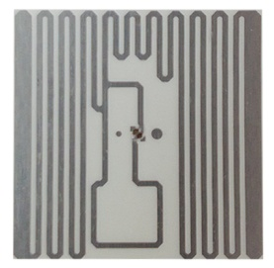
Observation 1
--- Impact of tag coupling
Tags in a vicinity → Their phases change
Phase of individual tags

Slide 9
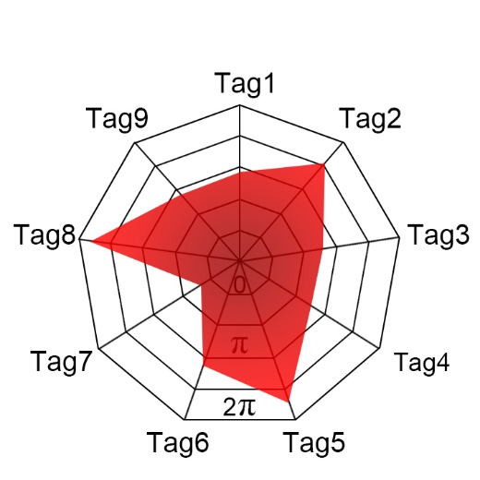
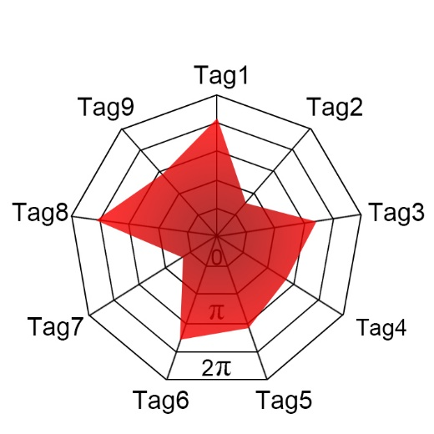
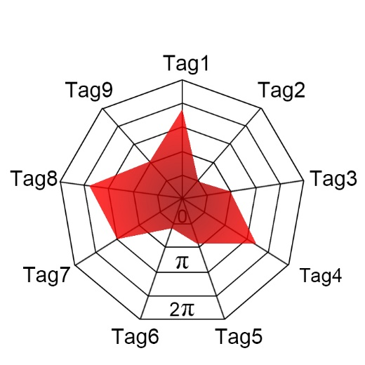
Observation 1
--- Impact of tag coupling
What will happen if we rotate some of the tags in the array?
Coupling phases of tags

Slide 10
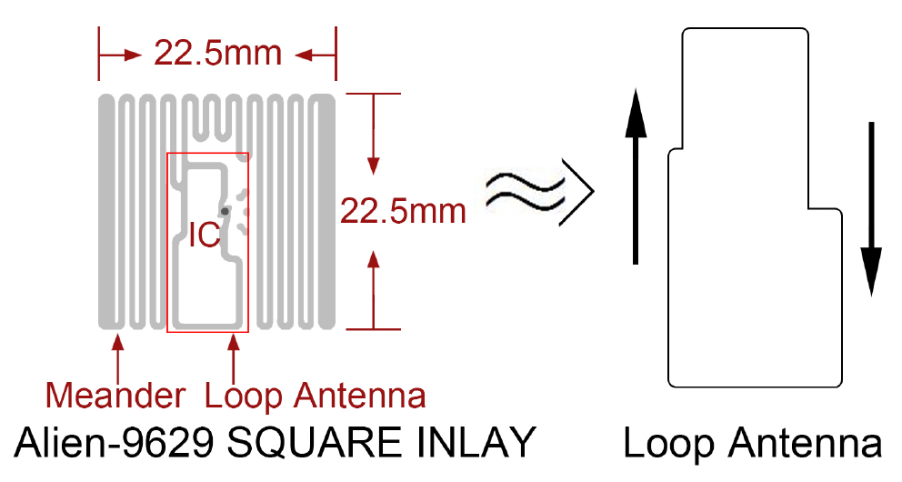
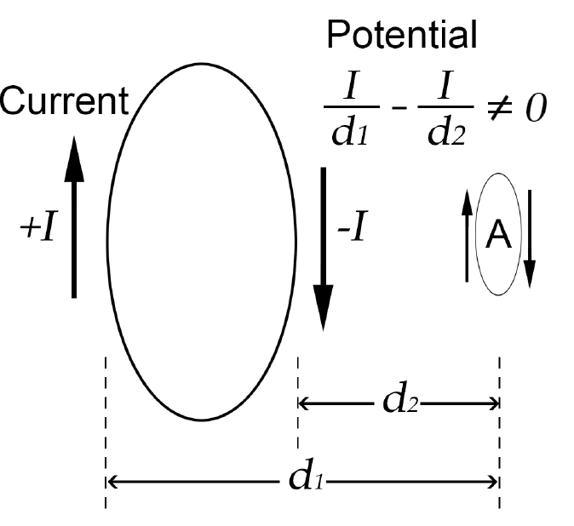
Why does the phase change due to coupling?

Slide 11
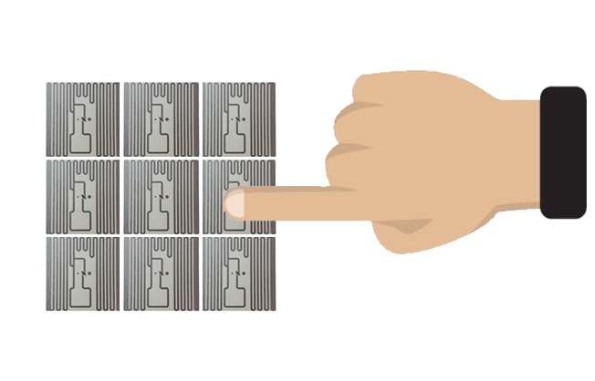
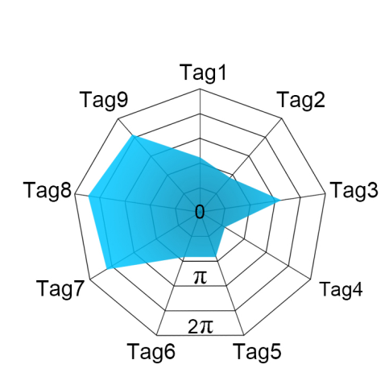
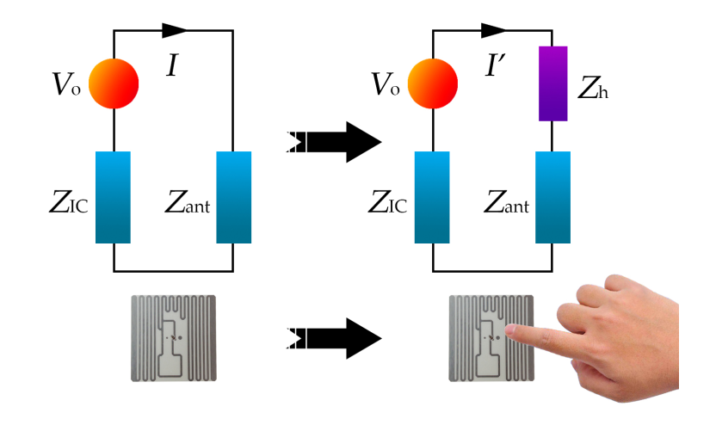
Observation 2
Impact of human impedance

Slide 12
Why does phase change with fingertip touch?

Slide 13

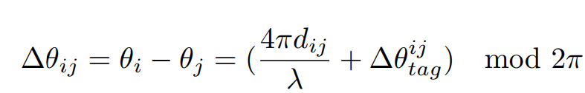
Phase of individual tags
Coupling phases of tags
User-dependent & Unique
Phase Fingerprint
Phase Difference of Tags (PDoT)

Slide 14

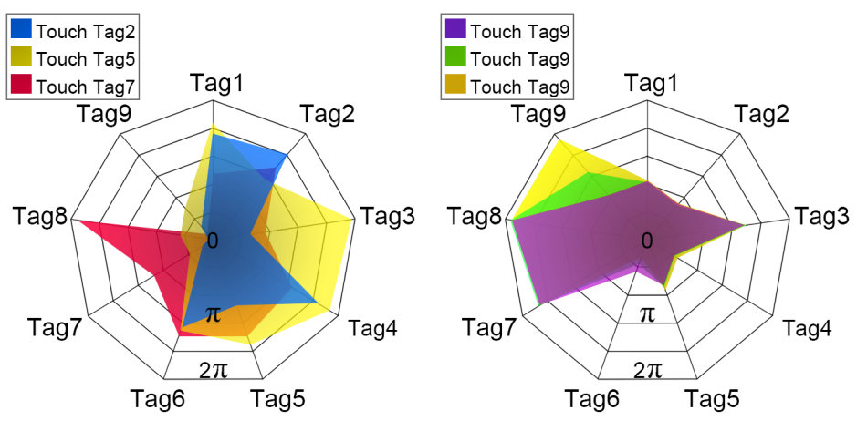
Challenge 1
The impact of touching is unstable.
Touch different tags
Touch Tag9 3 times
without conductor

Slide 15
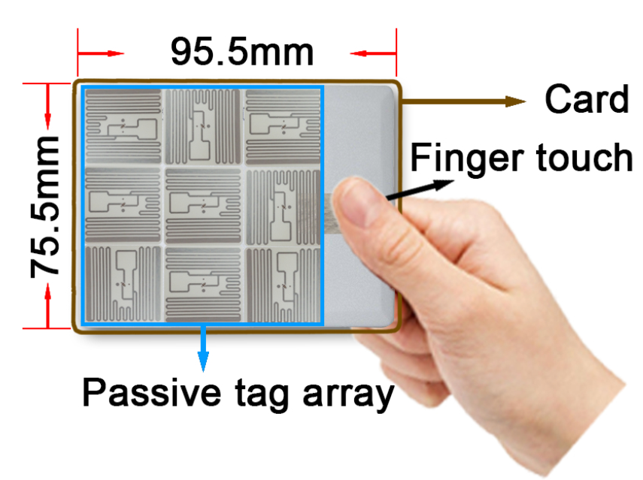
Tackle with challenge 1
Introduce a conductor
Complexity of coupling：Distance between all tags is minimized that phases become more complex.
Size of array：Maximum distance of any two tags should be within half of wavelength.

Slide 16
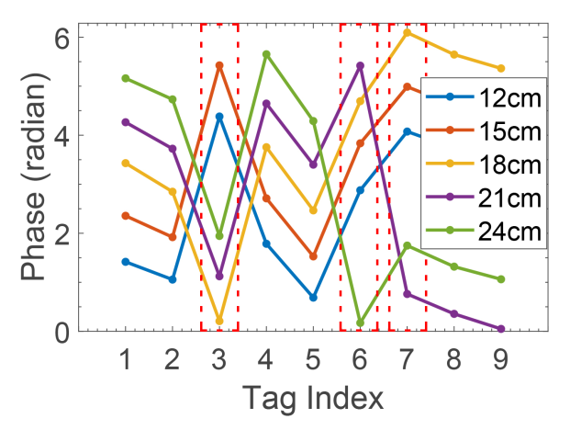
Challenge 2
Phases change with distance.

Slide 17
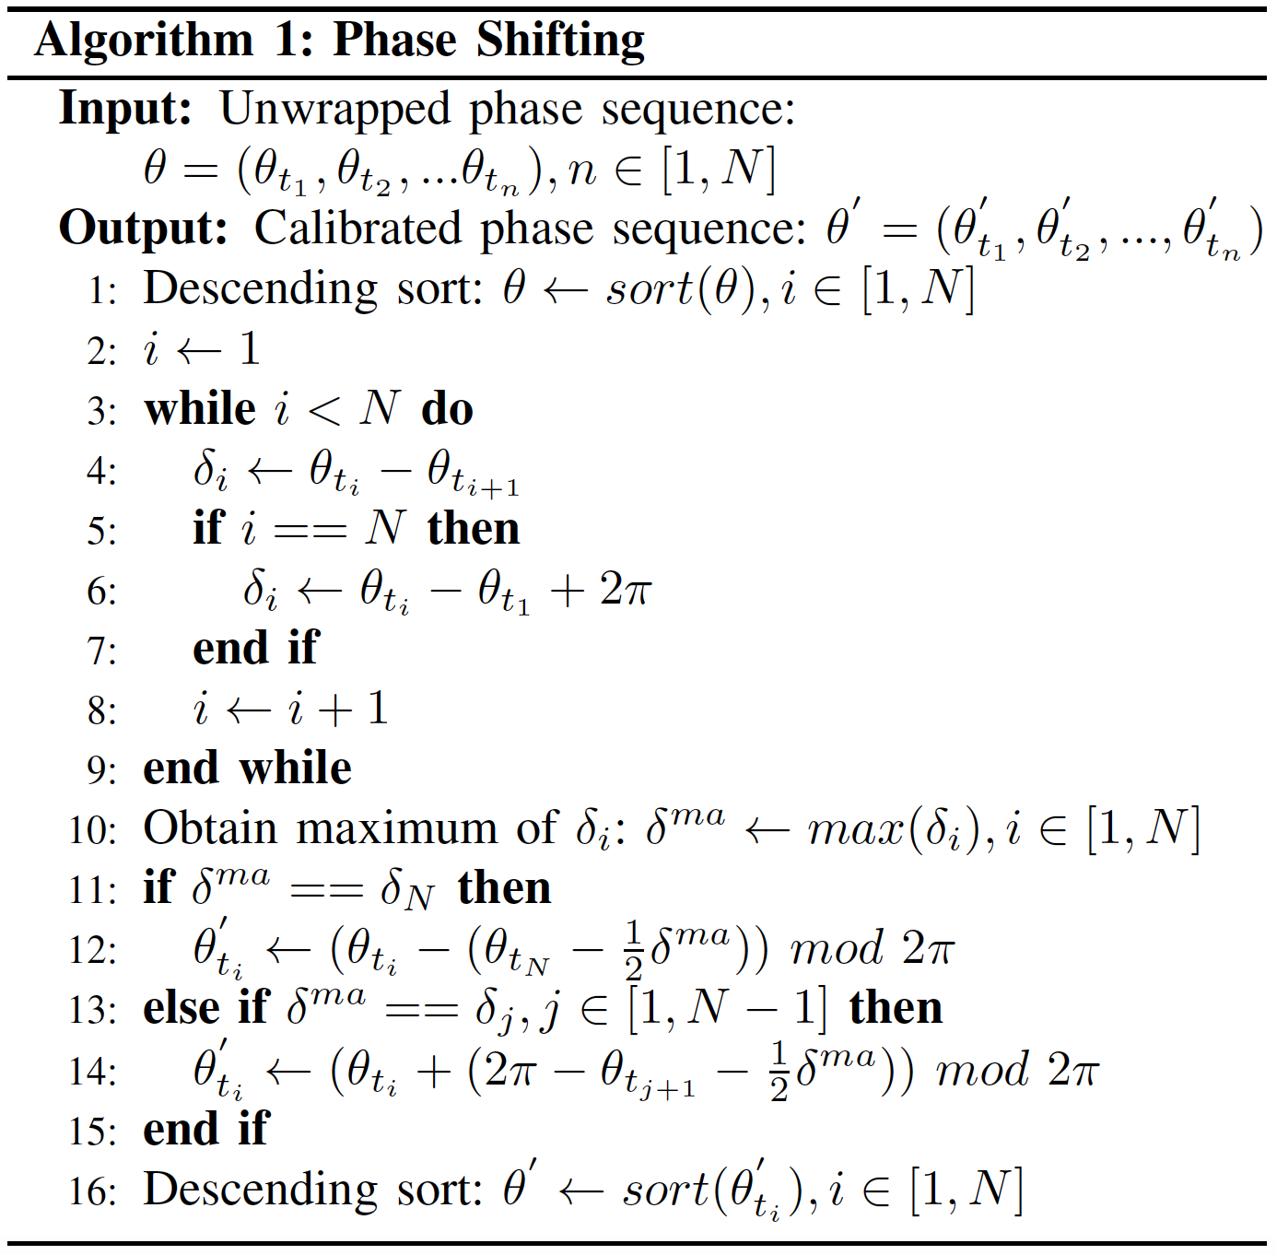
Tackle with challenge 2
Phase shifting algorithm

Slide 18
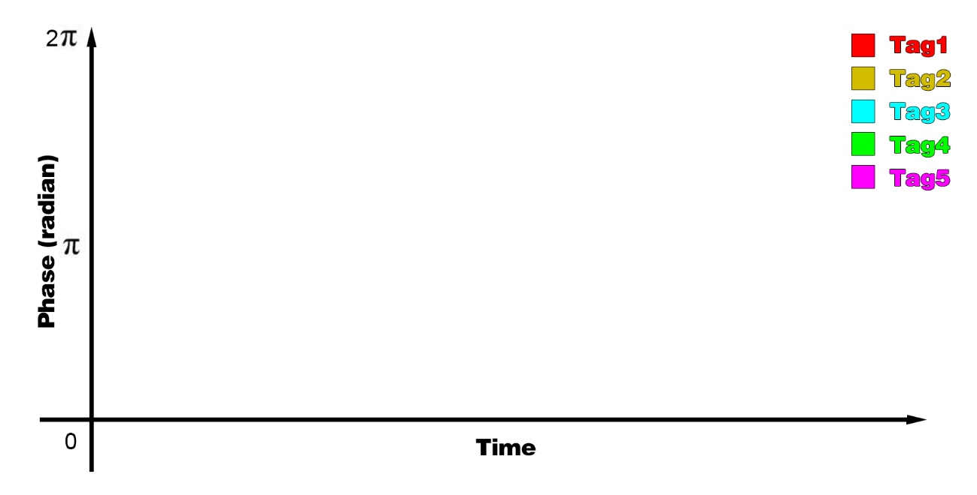


Tackle with challenge 2
Phase shifting algorithm
$\frac{1}{2}$ Max PDoT
Get phase fingerprint at this status
Max PDoT
$\frac{1}{2}$ Max PDoT

Slide 19
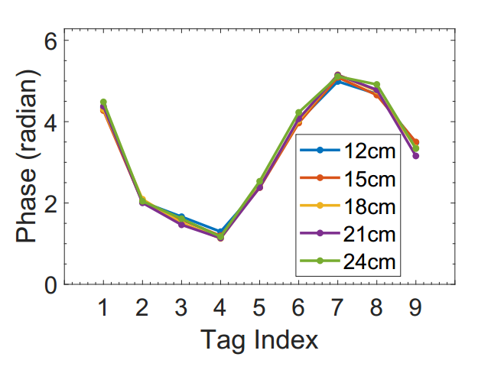
Tackle with challenge 2
Phase shifting algorithm

Slide 20

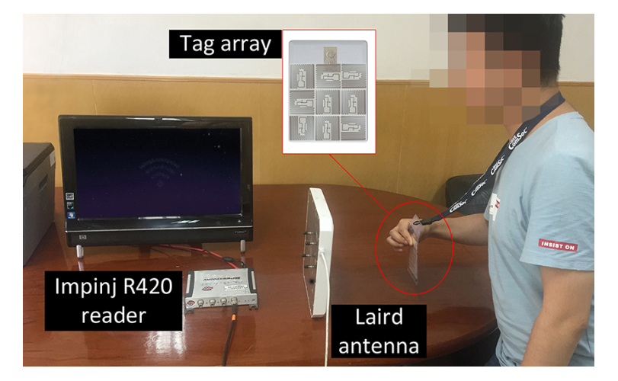
1. Impinj R420 reader
2. Larid antenna A9028
3. Alien-9629 tag

Slide 21
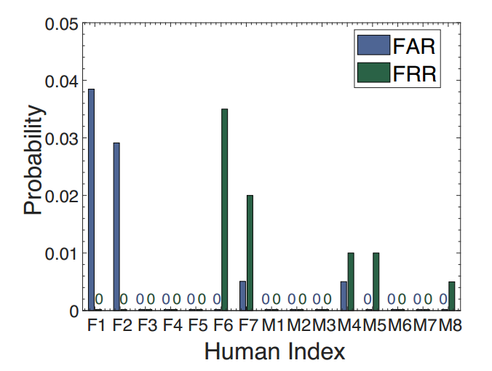
Overall accuracy vs. Human diversity
7 females + 8 males
15 representative tag array layouts
Accuracy > 99%
FAR: Incorrectly accept an access of an unauthorized user
FRR: Incorrectly rejects an access of an authorized user

Slide 22
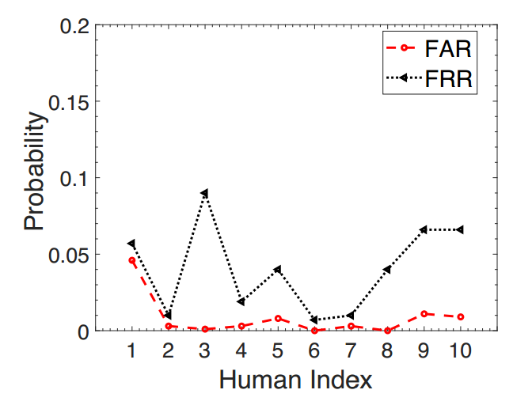
Resisting impersonation attack
Attackers try to use an authorized user’s credential to access the system.
Maximum FRR < 0.1
FAR < 0.05

Slide 23
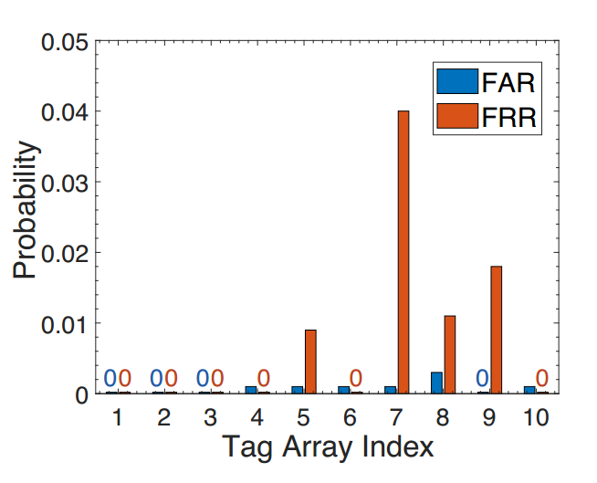
Resisting counterfeiting attack
Attacker produces a counterfeited array with the same tag model and layout.
90 Alien-9629 tags
10 arrays
Average FAR < 0.01
FRR < 0.005

Slide 24
Resisting replay attack
Effective read range < 30cm
Tolerable space angle of tag rotation < 10°
(w.r.t. x-y-z axis)

Slide 25
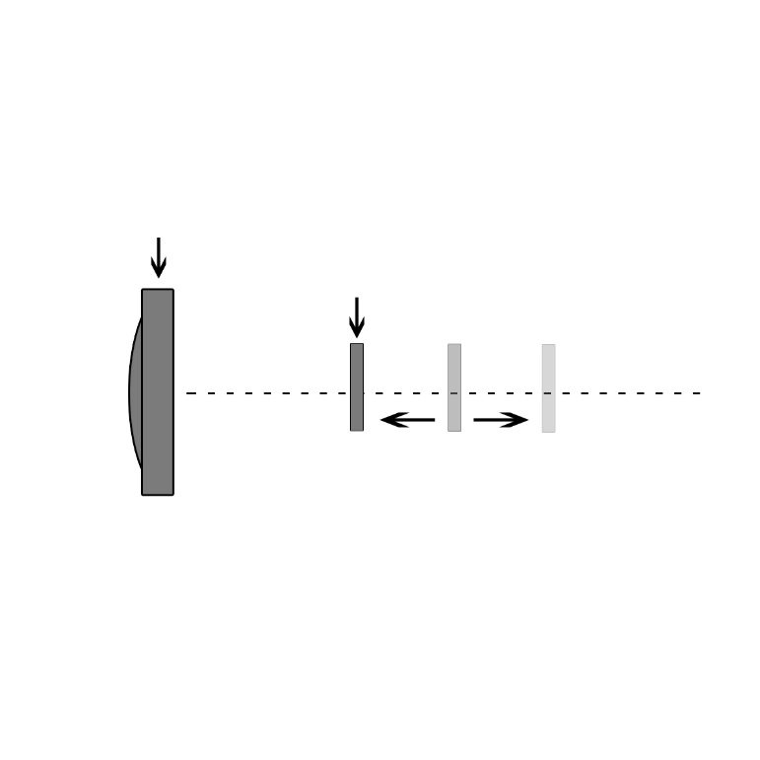
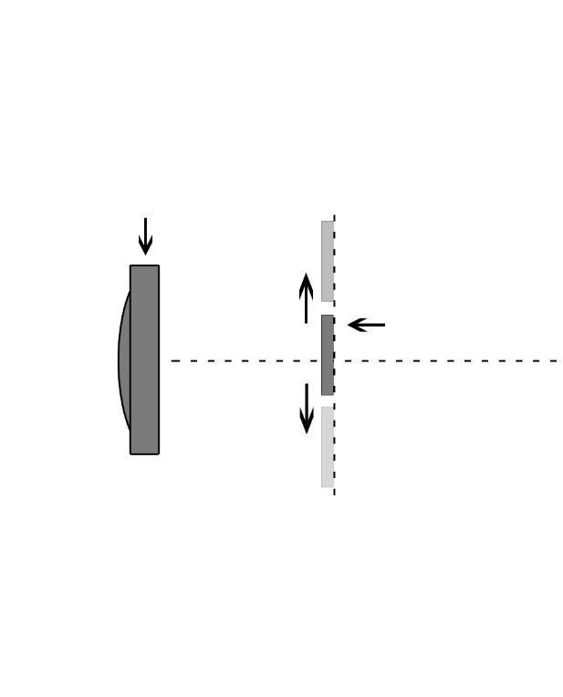
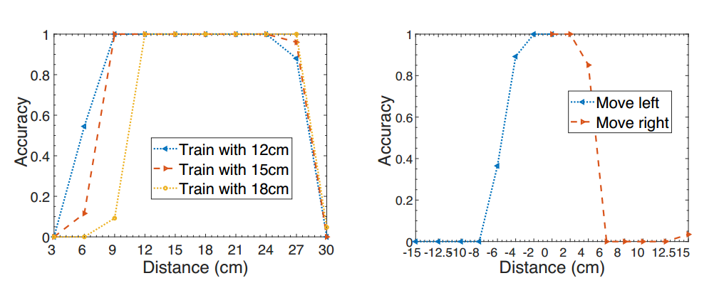

Accuracy vs. distance
Reader antenna
Reader antenna
Tag
Tag
Vertical distance
Horizontal distance
Effective range $≈$ 15cm
±4cm region > 90% accuracy

Slide 26
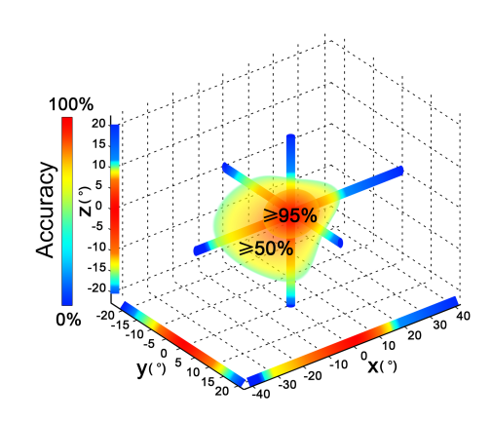
Accuracy vs. rotation
Tolerable space angle < 10°

Slide 27

Converting an array of tags attached on a card into an effective authentication credential.
Light-weight, low-cost, universal solution for a fingertip profiled RF identifier, authenticating both the card and its holder’s identity simultaneously.
Demonstrated a working system implemented purely based on COTS RFID devices.

Slide 28


