Slide 1
QoS-Aware Task Offloading in Distributed Cloudlets with Virtual Network Function Services
Mike Jia, Weifa Liang and Zichuan Xu
Research School of Computer Science
Australian National University
Canberra, ACT 2601, AUSTRALIA

Slide 2
A new computing paradigm – cloudlets
Mobile devices have undergone a transformation from bulky gadgets with limited functionalities to indispensable everyday accessories
The computing capacity of mobile devices however remains very limited, due to their portable size by considering their weight, size, battery life, ergonomics, and heat dissipation
Cloud computing provides promising technologies to alleviate such limitations by enabling mobile devices offloading their applications to remote clouds

Slide 3
A new computing paradigm – cloudlets
Although mobile devices can access remote clouds by offloading their workload to remote clouds, this could lead to long access delay, thereby degrading mobile user experiences
To mitigate the response delay, cloudlets were proposed as an alternative solution. Cloudlets are resource-rich server clusters co-located with wireless Access Points (APs) in a local network, and mobile users can offload their tasks to local cloudlets for processing
The physical proximity between mobile users and cloudlets means that the cloudlet access delay on task offloading is greatly reduced, thereby significantly improving user experiences

Slide 4
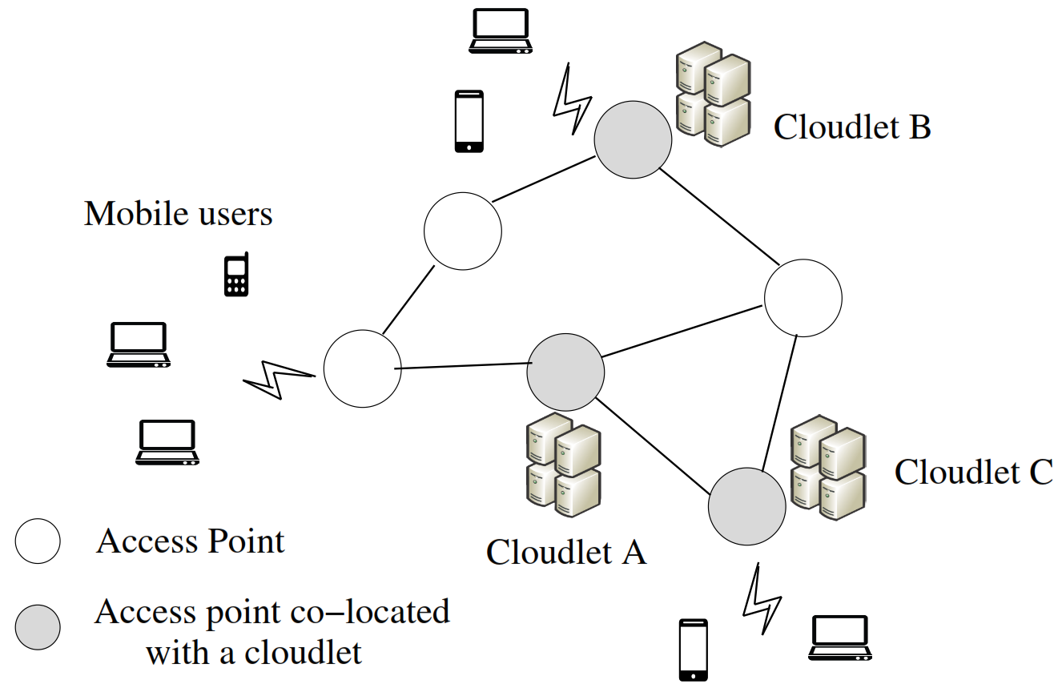
A new computing paradigm – cloudlets

Slide 5
Motivations
As the options for user applications are too numerous for server components to be stored in the cloudlet, most studies assumed the use of a personal virtual machines (VM) for each user as a platform for task offloading of the user
A VM image of a mobile device is transferred to the cloudlet, and tasks are remotely executed on the VM in the cloudlet, using task offloading operations
However, many emerging applications and services using Augmented Reality (AR) will be location-specific

Slide 6

Motivation
Notes:
Augmented Reality can be used in museums to digitally restore broken artefacts, and make exhibits more engaging.
A user turns on his mobile device's camera to capture a scene. The
location and direction of the camera are calculated for each captured
video frame and the data is sent to a nearby cloudlet where a rendering
process generates the 2D image of a virtual exhibit, which is then
overlayed on top of the original video frame. The resulting image
is then sent back to the user's device for display, creating the impression
of seeing the virtual exhibit in the real world through the camera
viewport.

Slide 7

Motivation
Notes:
Augmented reality tourism application can point out local attractions, and provide information and directions.

Slide 8

Motivation
Notes:
Augmented Reality can reveal public digital artwork by local artists in spaces.

Slide 9
Motivation
Each of these applications are location-specific and a virtual network function (VNF) instance running on a nearby cloudlet can serve multiple nearby users without instantiating multiple VNFs for users
However, it becomes a challenge to assign different users to existing VNF instances, or create additional instances to serve more users while ensuring the QoS requirement of each user is met
Notes:
.

Slide 10
Contributions
We first formulate a novel QoS-aware task offloading problem in a wireless metropolitan area network
We then devise an efficient online algorithm for offloading requests through a non-trivial reduction that reduces the problem to a series of minimum-weight maximum matching problems in auxiliary bipartite graphs
We also investigate offloading request patterns over time, and develop an effective prediction mechanism that can predict the numbers of instances of each network function at different cloudlets to meet the need of future offloading task requests
Experimental part

Slide 11
System Model
Consider a wireless metropolitan area network consisting of cloudlets which provides VNF services to users
Assume some VNF istances have already been instantiated in its cloudlets, ready to serve customers, while others can be dynamically created if there are sufficient resources in cloudlets
However each VNF instance occupies cloudlet resources while the resource at each cloudlet is limited
Each user task requests a specific VNF, and if admitted, its specified end-to-end delay requirement must be meet

Slide 12
Problem Definition
Given G=(V,E), a set of user requests S(t) at time slot t with each request having an end-to-end delay requirement, and a finite time horizon T
The operational cost minimization problem in G is to find a schedule of request admissions such that as many of them are admitted during the monitoring period of T while the cumulative operational cost for their admissions is minimized, subject to the computing resource capacity constraint and the end-to-end delay requirement of each user request

Slide 13
Algorithm for A Single Time Slot
We first consider admissions of requests in S(t) in time slot t
The basic idea behind is to reduce the operational cost minimization problem to a series of minimum weight maximum matching problems in a set of auxiliary bipartite graphs
Each matched edge in the maximum matching corresponds to an assignment of offloading requests to cloudlets in G, where the end-to-end delay requirement of each admitted request can be met.

Slide 14
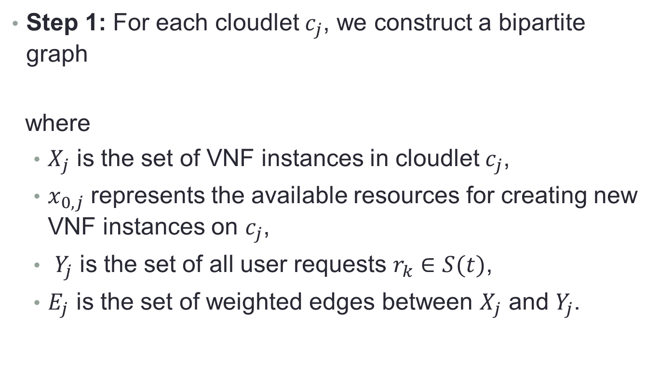
Algorithm for A Single Time Slot
Step 1: For each cloudlet $c_{j}$, we construct a bipartite graph
where
$X_{j}$ is the set of VNF instances in cloudlet $c_{j}$,
$x_{0,j}$ represents the available resources for creating new VNF instances on $c_{j}$,
$Y_{j}$ is the set of all user requests $r_{k}∈S(t)$,
$E_{j}$ is the set of weighted edges between $X_{j}$ and $Y_{j}$.

Slide 15
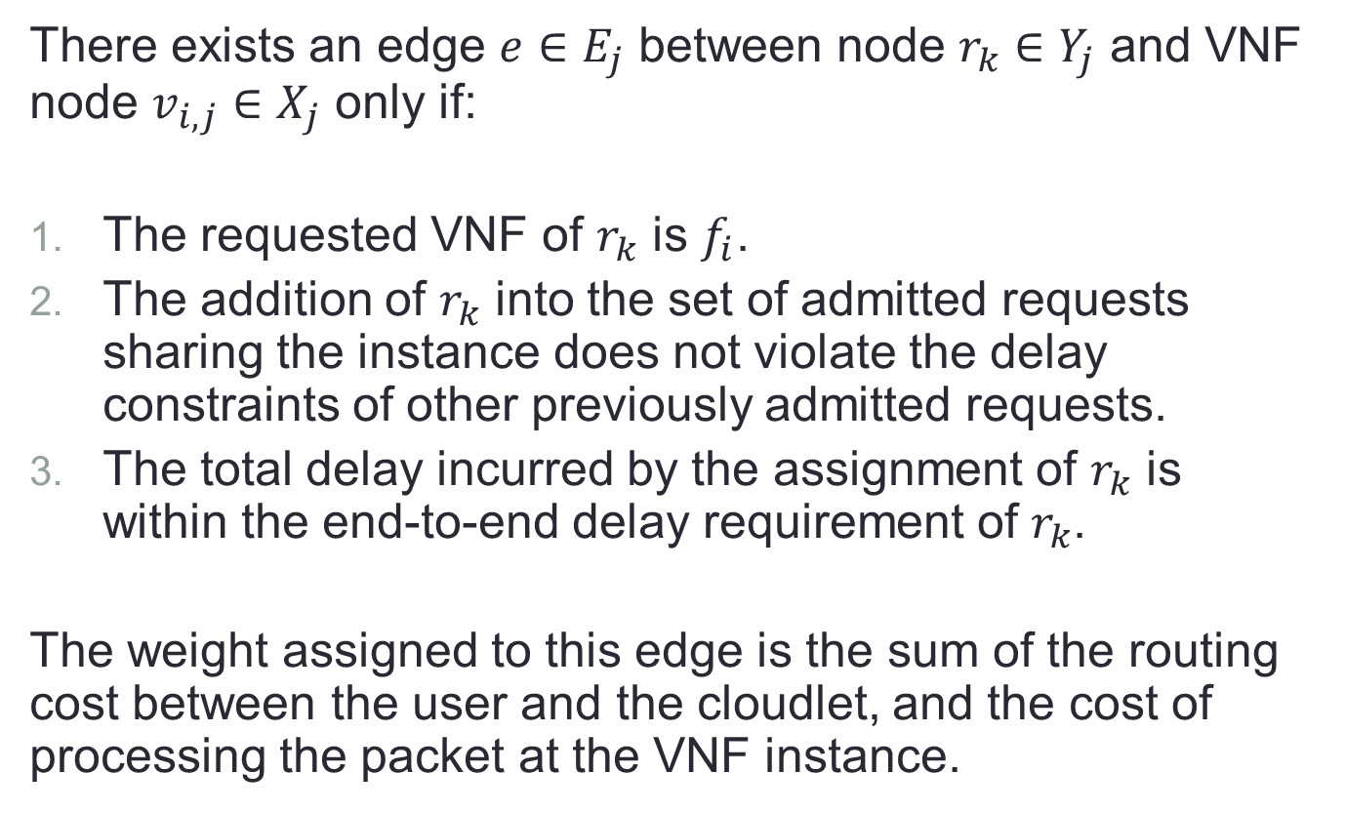
Algorithm for A Single Time Slot
There exists an edge $e∈E_{j}$ between node $r_{k}∈Y_{j}$ and VNF node $v_{i,j}∈X_{j}$ only if:
The requested VNF of $r_{k}$ is $f_{i}$.
The addition of $r_{k}$ into the set of admitted requests sharing the instance does not violate the delay constraints of other previously admitted requests.
The total delay incurred by the assignment of $r_{k}$ is within the end-to-end delay requirement of $r_{k}$.
The weight assigned to this edge is the sum of the routing cost between the user and the cloudlet, and the cost of processing the packet at the VNF instance.

Slide 16
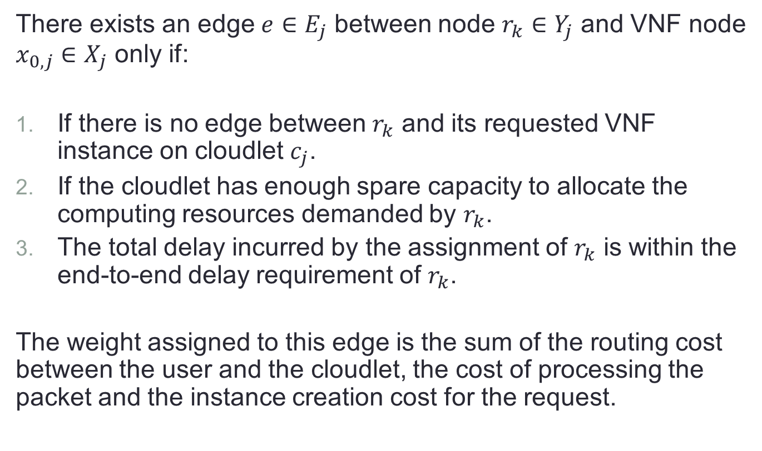
Algorithm for A Single Time Slot
There exists an edge $e∈E_{j}$ between node $r_{k}∈Y_{j}$ and VNF node $x_{0,j}∈X_{j}$ only if:
If there is no edge between $r_{k}$ and its requested VNF instance on cloudlet $c_{j}$.
If the cloudlet has enough spare capacity to allocate the computing resources demanded by $r_{k}$.
The total delay incurred by the assignment of $r_{k}$ is within the end-to-end delay requirement of $r_{k}$.
The weight assigned to this edge is the sum of the routing cost between the user and the cloudlet, the cost of processing the packet and the instance creation cost for the request.

Slide 17
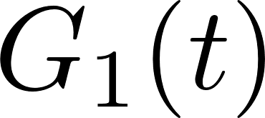
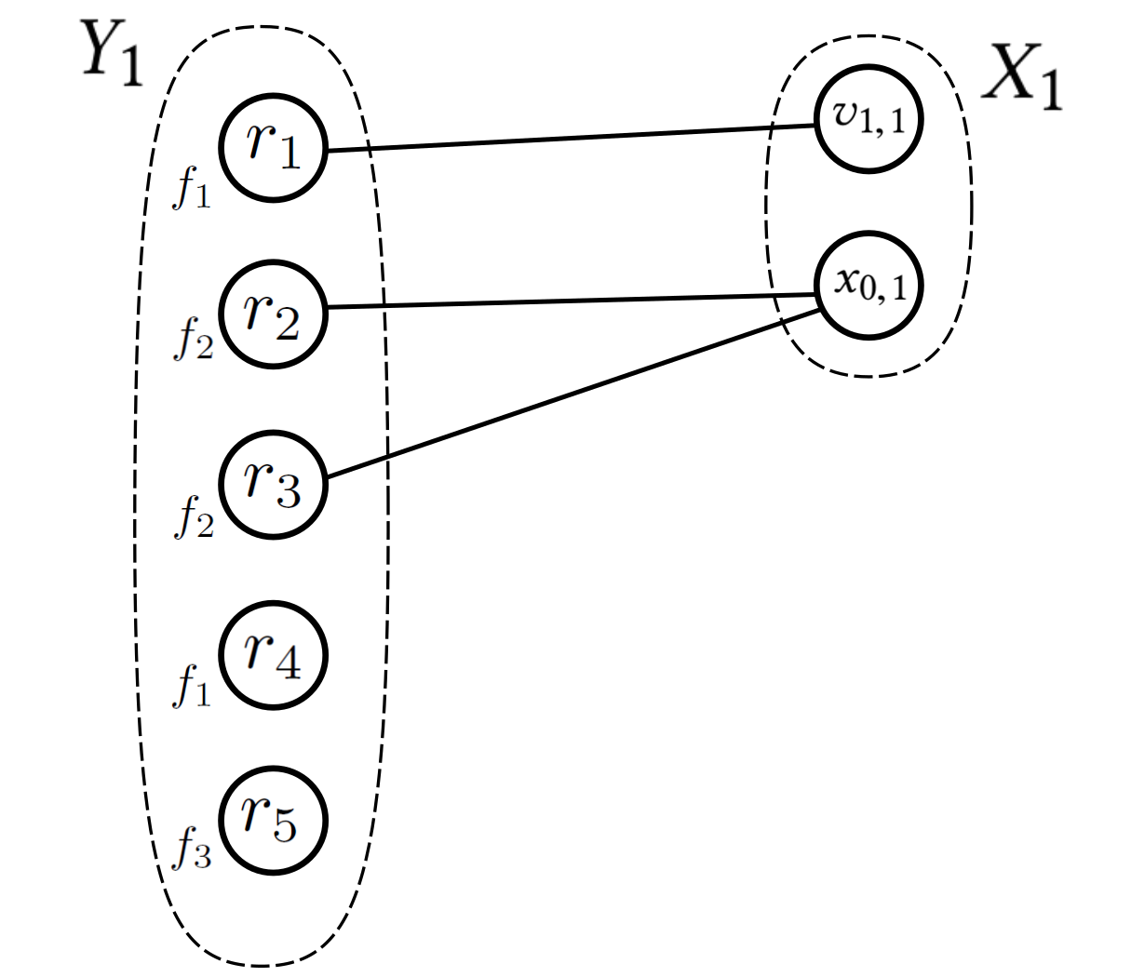
Algorithm for A Single Time Slot
Notes:
There exists a VNF instance on cloudlet 1, for function 1. As request r 2 requires function 2, there is an edge to x_0,1 to request the creation of a function 2 instance. R 4 and r 5 are too far away from cloudlet 1 to meet their end-to-end delay requirement.

Slide 18
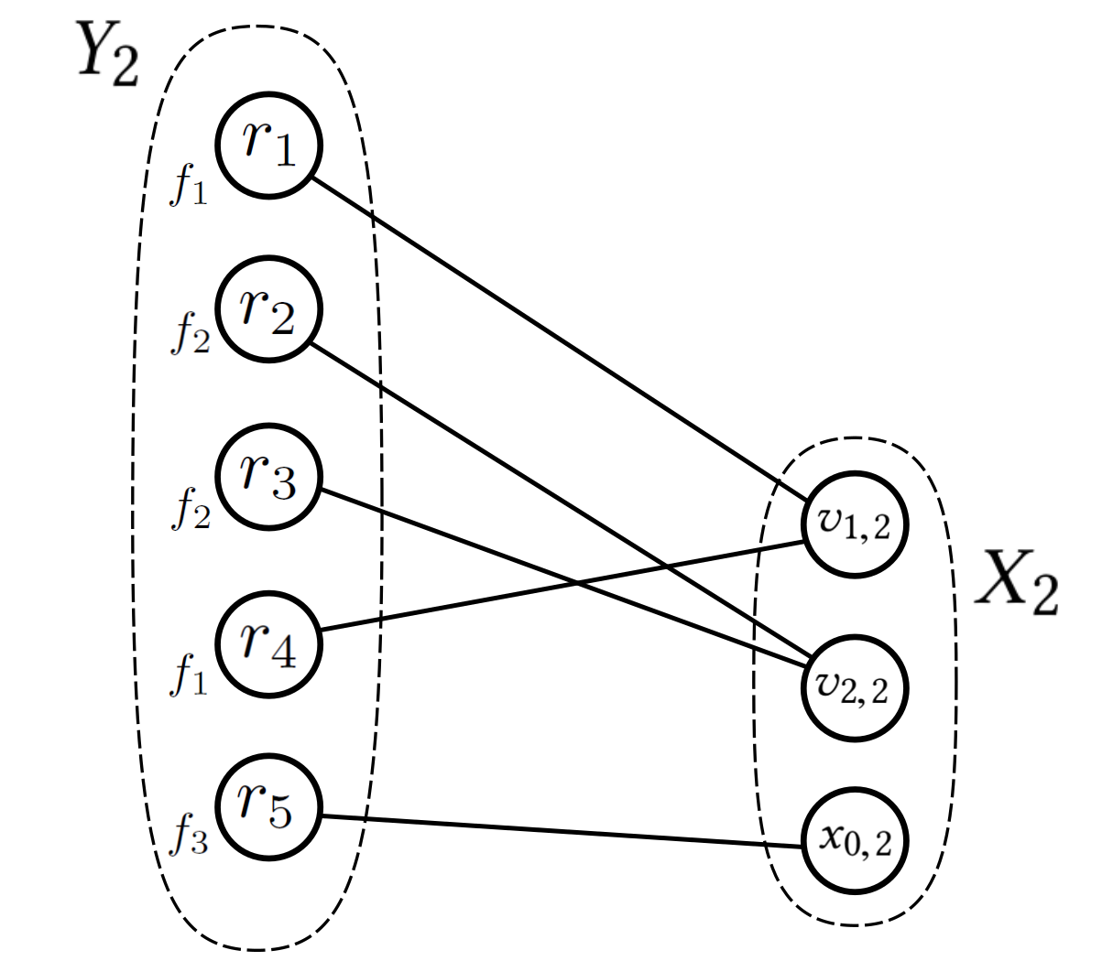
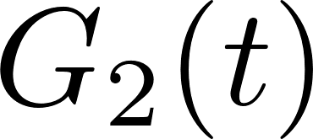
Algorithm for A Single Time Slot
Notes:
On cloudlet 2, there exist VNF instances for function 1 and 2.

Slide 19


Algorithm for A Single Time Slot
Step 2: Assume there are m cloudlets in G.
An auxiliary bipartite graph is then derived,
where
Notes:
We then construct auxiliary bipartite graph G(t) by combining the bipartite graph of each cloudlet.

Slide 20
Algorithm for A Single Time Slot
Notes:
Using our previous example, we combine G1(t)…

Slide 21
Algorithm for A Single Time Slot
Notes:
And G2(t)…

Slide 22
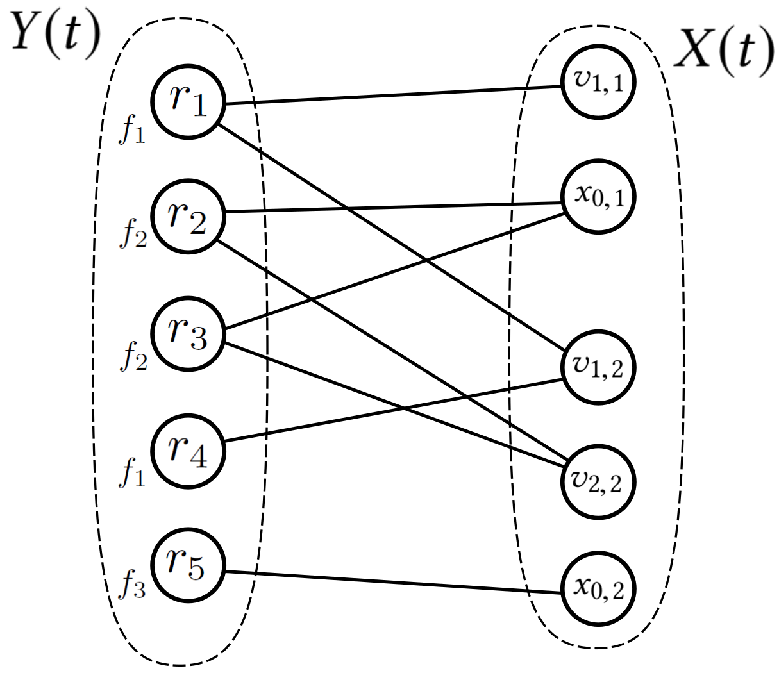
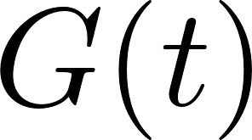
Algorithm for A Single Time Slot
Notes:
To create our final auxiliary graph.

Slide 23
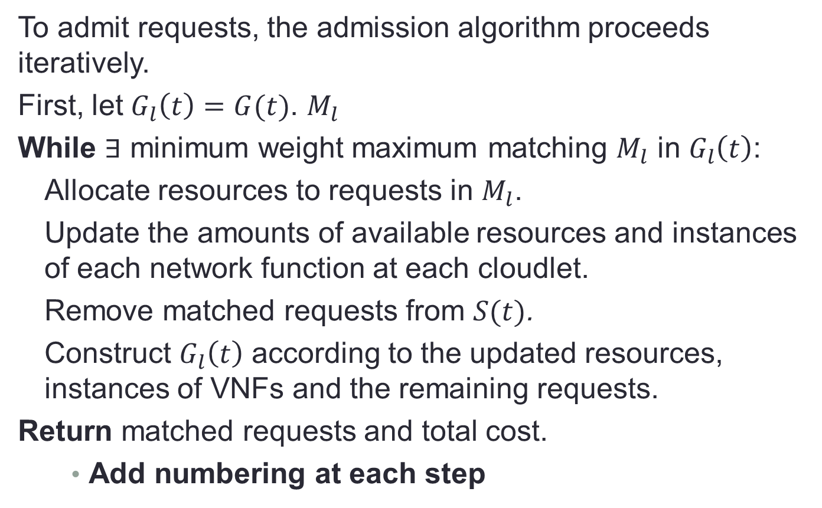
Algorithm for A Single Time Slot
To admit requests, the admission algorithm proceeds iteratively.
First, let $G_{l}\left(t\right)=G(t)$. $M_{l}$
While $∃$ minimum weight maximum matching $M_{l}$ in $G_{l}\left(t\right)$:
Allocate resources to requests in $M_{l}$.
Update the amounts of available resources and instances of each network function at each cloudlet.
Remove matched requests from $S(t)$.
Construct $G_{l}\left(t\right)$ according to the updated resources, instances of VNFs and the remaining requests.
Return matched requests and total cost.
Add numbering at each step

Slide 24
Algorithm for A Finite Time Horizon
We have considered the admission of offloading requests within one time slot, but in reality, requests arrive and depart from the system dynamically.
As time goes by, some VNF instances will become idle.
How and when should we release idle VNF instances back to the system?
We first look at two simple solutions.

Slide 25
Algorithm for Multiple Time Slot
Do not release any VNF instances in case they are needed in future
We expect some VNF instances will be shared with subsequent admitted requests.
However more and more VNF instances will become idle, while available resources will become scarce.
Release the VNF instances immediately once they become idle.
We avoid the maintenance cost of idle VNF instances.
However, an instance may be demanded immediately after its release, incurring an instantiation cost and possibly causing the delay requirement to be violated.

Slide 26

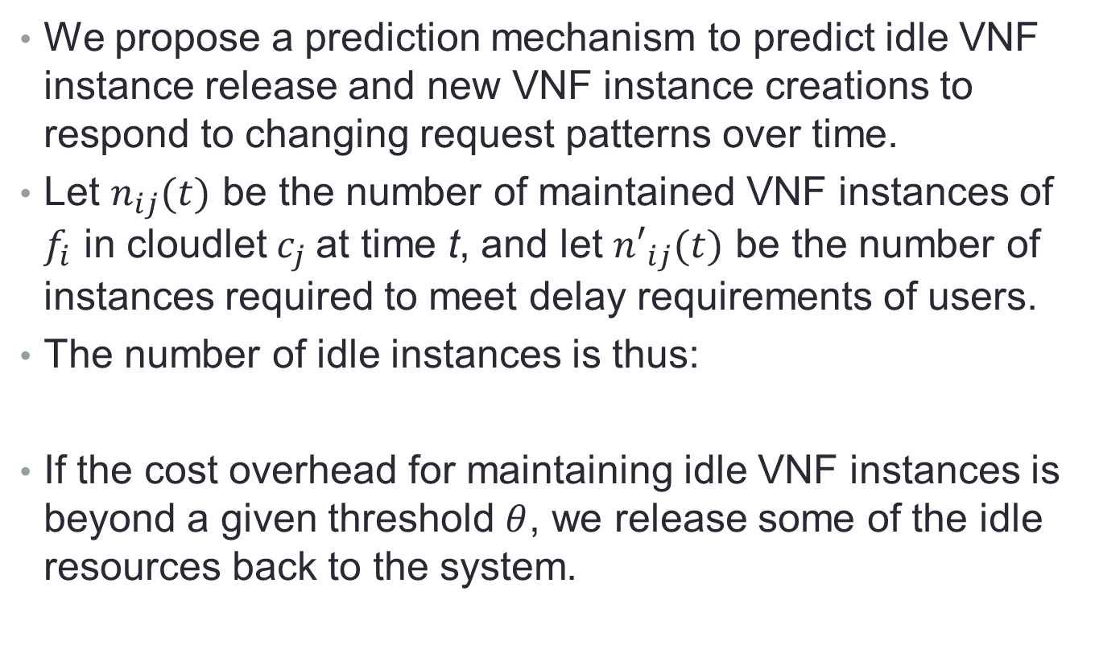
Algorithm for Multiple Time Slot
We propose a prediction mechanism to predict idle VNF instance release and new VNF instance creations to respond to changing request patterns over time.
Let $n_{ij}(t)$ be the number of maintained VNF instances of $f_{i}$ in cloudlet $c_{j}$at time t, and let ${n′}_{ij}(t)$ be the number of instances required to meet delay requirements of users.
The number of idle instances is thus:
If the cost overhead for maintaining idle VNF instances is beyond a given threshold $θ$, we release some of the idle resources back to the system.

Slide 27
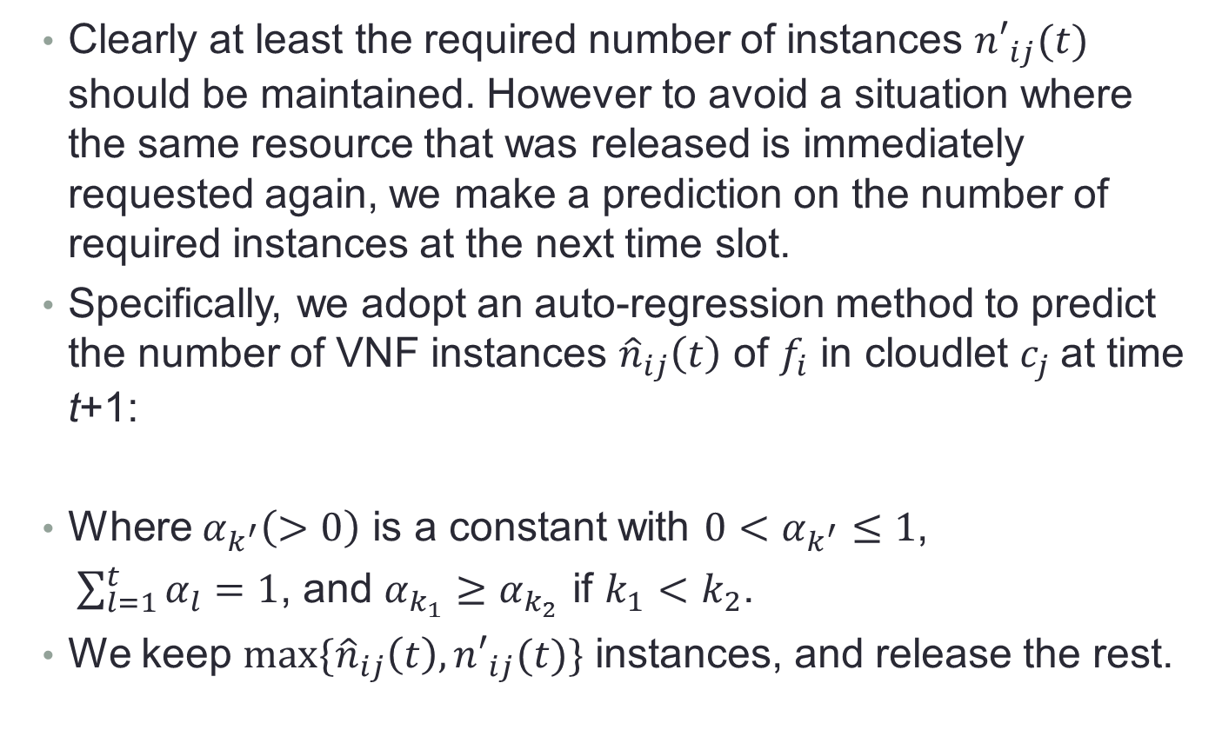
Algorithm for Multiple Time Slot
Clearly at least the required number of instances ${n′}_{ij}(t)$ should be maintained. However to avoid a situation where the same resource that was released is immediately requested again, we make a prediction on the number of required instances at the next time slot.
Specifically, we adopt an auto-regression method to predict the number of VNF instances ${\hat{n}}_{ij}\left(t\right)$ of $f_{i}$ in cloudlet $c_{j}$at time t+1:
Where $α_{k^{′}}\left(>0\right)$ is a constant with $0<α_{k^{′}}≤1$,
$\sum_{l=1}^{t}{α_{l}}=1$, and $α_{k_{1}}≥α_{k_{2}}$ if $k_{1}<k_{2}$.
We keep $max⁡\{{\hat{n}}_{ij}\left(t\right),{n′}_{ij}(t)\}$ instances, and release the rest.

Slide 28
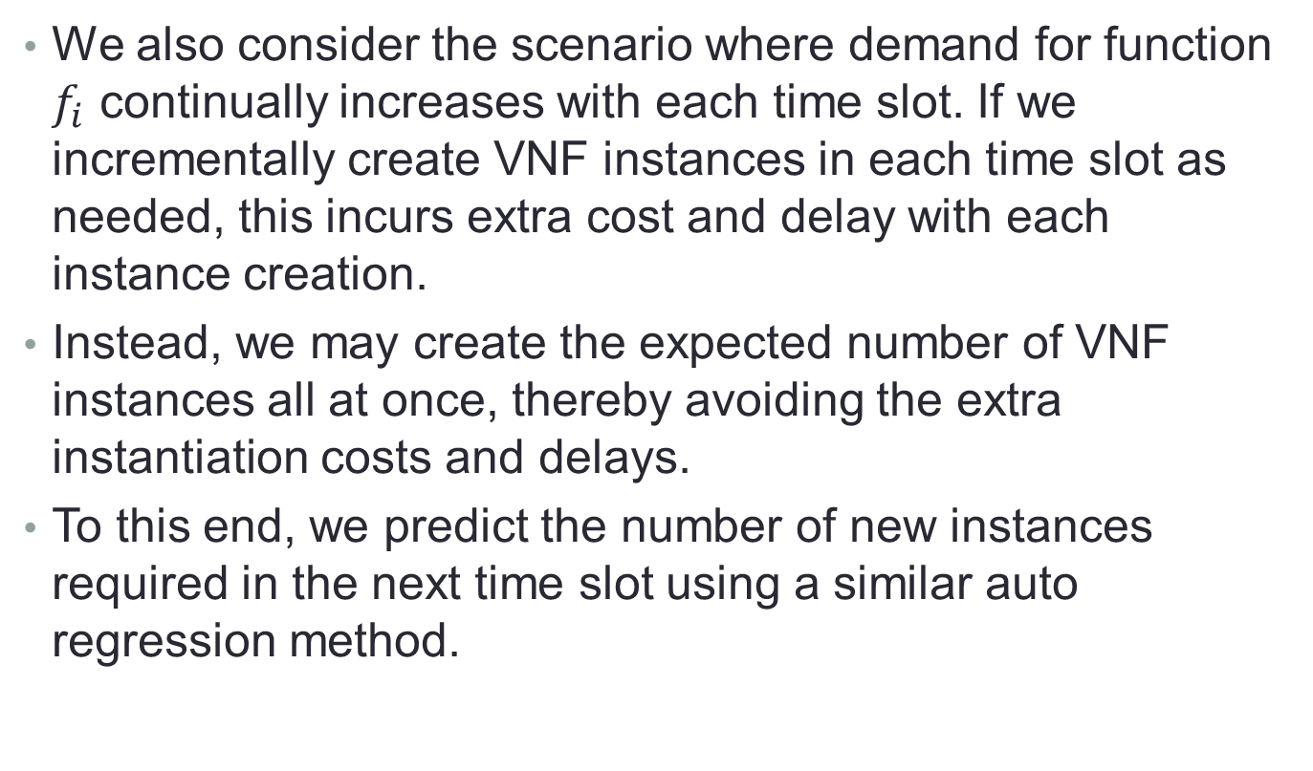
Algorithm for Multiple Time Slot
We also consider the scenario where demand for function $f_{i}$ continually increases with each time slot. If we incrementally create VNF instances in each time slot as needed, this incurs extra cost and delay with each instance creation.
Instead, we may create the expected number of VNF instances all at once, thereby avoiding the extra instantiation costs and delays.
To this end, we predict the number of new instances required in the next time slot using a similar auto regression method.

Slide 29
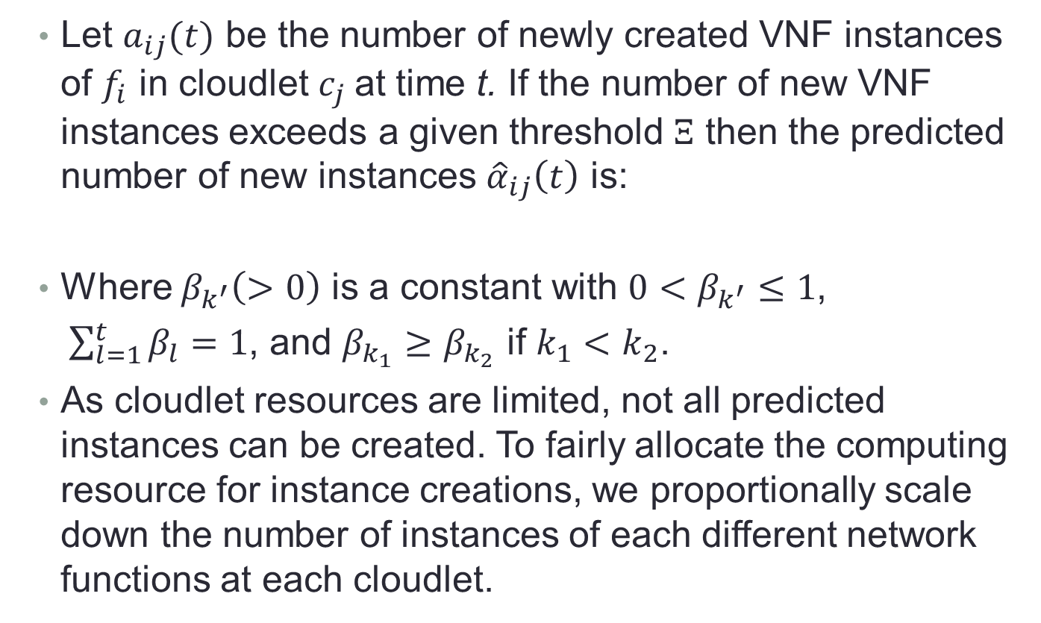
Algorithm for Multiple Time Slot
Let $a_{ij}(t)$ be the number of newly created VNF instances of $f_{i}$ in cloudlet $c_{j}$at time t. If the number of new VNF instances exceeds a given threshold $Ξ$ then the predicted number of new instances ${\hat{α}}_{ij}\left(t\right)$ is:
Where $β_{k^{′}}\left(>0\right)$ is a constant with $0<β_{k^{′}}≤1$,
$\sum_{l=1}^{t}{β_{l}}=1$, and $β_{k_{1}}≥β_{k_{2}}$ if $k_{1}<k_{2}$.
As cloudlet resources are limited, not all predicted instances can be created. To fairly allocate the computing resource for instance creations, we proportionally scale down the number of instances of each different network functions at each cloudlet.

Slide 30
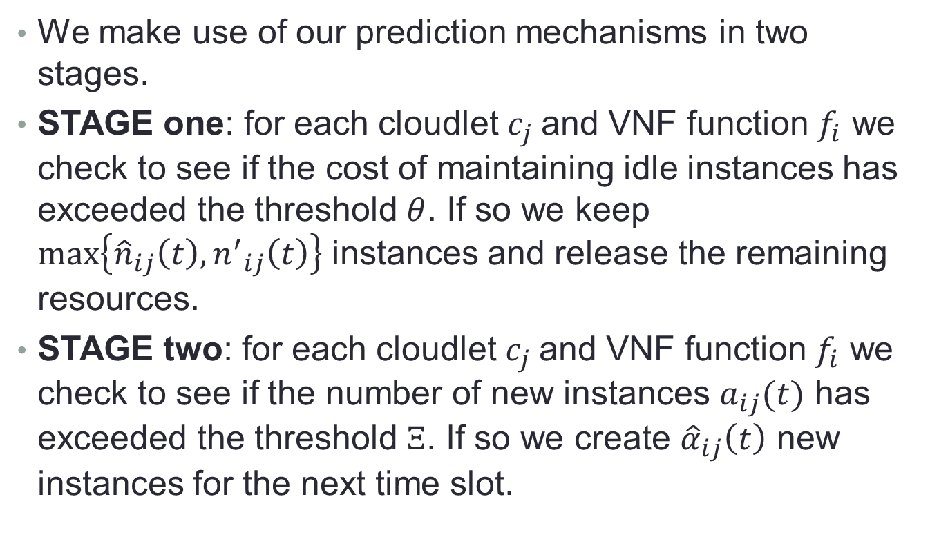
Algorithm for Multiple Time Slot
We make use of our prediction mechanisms in two stages.
STAGE one: for each cloudlet $c_{j}$and VNF function $f_{i}$ we check to see if the cost of maintaining idle instances has exceeded the threshold $θ$. If so we keep $\max\left\{{\hat{n}}_{ij}\left(t\right),{n^{′}}_{ij}\left(t\right)\right\}$ instances and release the remaining resources.
STAGE two: for each cloudlet $c_{j}$and VNF function $f_{i}$ we check to see if the number of new instances $a_{ij}(t)$ has exceeded the threshold $Ξ$. If so we create ${\hat{α}}_{ij}\left(t\right)$ new instances for the next time slot.

Slide 31
Experimental Settings
The WMAN G consists of 100 Aps, where the network is generated using the Barabasi-Albert Model.
There are 20 cloudlets randomly deployed in G. Each cloudlet capacity has computing capacity between 2000MHz to 4000MHz.
We allow 20 network functions to be available on the cloudlets, where each function requires between 40 and 400MHz.
The default number of requests per time slot is 1,000, and each request has a packet rate between 10 and 80 packets, and end-to-end delay requirement between 0.2 and 1.2 seconds.
The delay between each AP link in G is between 2 and 5 milliseconds.

Slide 32
Greedy Benchmark
We evaluate the proposed algorithms against a greedy baseline which is described as follows. The greedy algorithm assigns each request to the cloudlet with the highest rank in terms of the product of its available number of service chain instances and the inverse of the implementation cost of admitting the request in the cloudlet.
The rationale of this method is to find a cloudlet with high number of available service chain instances and low implementation cost, such that as many as requests are admitted while the implementation cost is minimized.

Slide 33
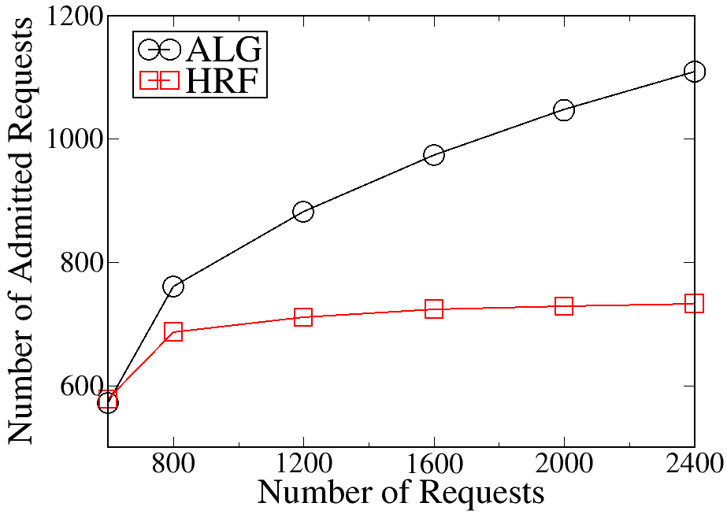
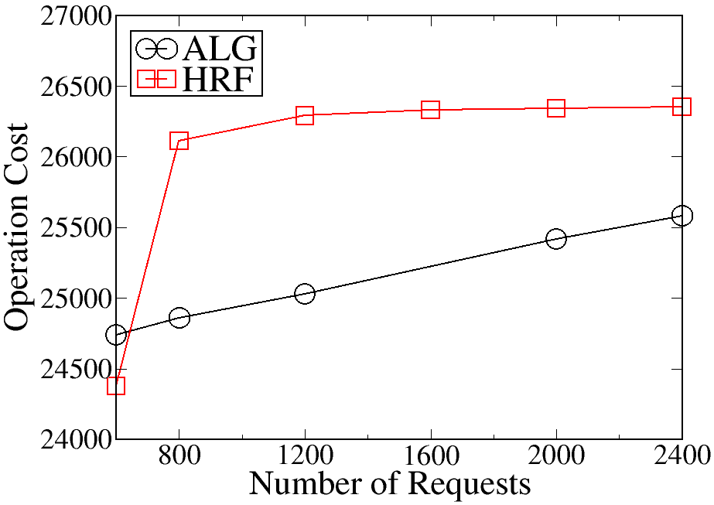
Algorithm Performance within Single Time Slot
Performance of proposed algorithm ALG and benchmark HRF when changing the number of new requests during time slot
fig. A
fig. B

Slide 34
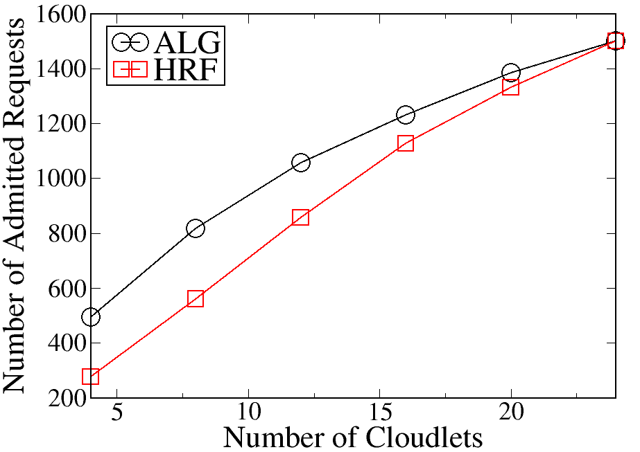
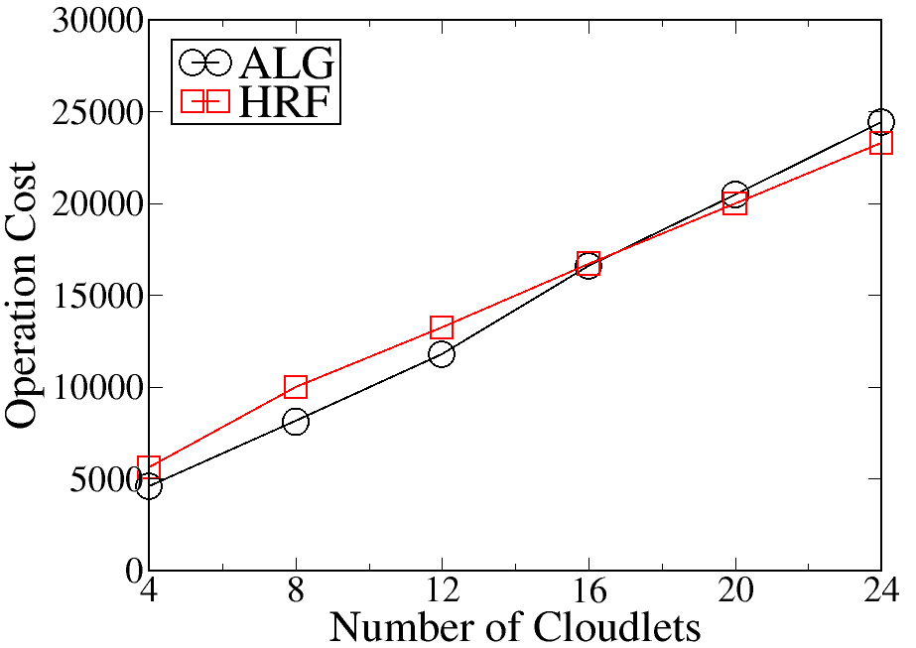
Algorithm Performance within Single Time Slot
Performance of proposed algorithm ALG and benchmark HRF when changing the number of cloudlets in G
fig. A
fig. B

Slide 35
Algorithm Performance within Single Time Slot
Performance of proposed algorithm ALG and benchmark HRF when changing the number of cloudlets in G
fig. A
fig. B

Slide 36
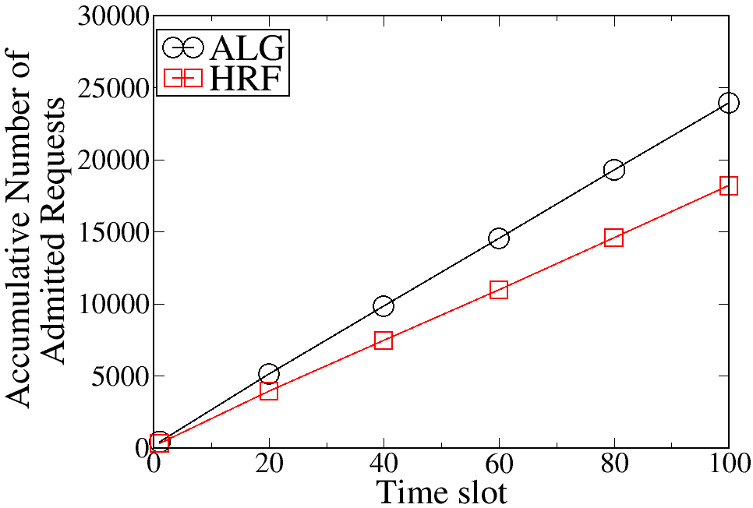
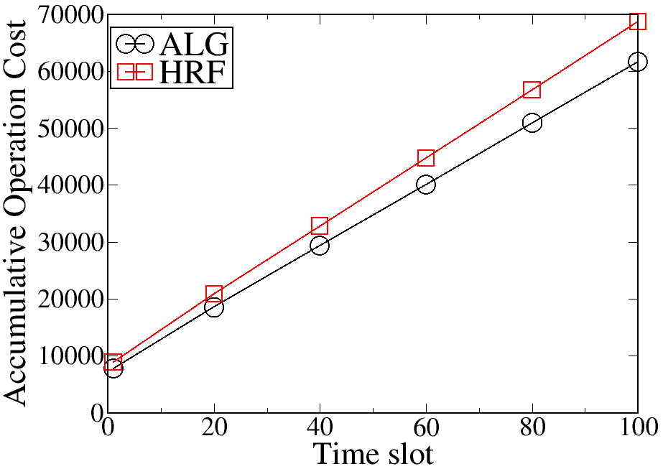
Algorithm Performance over Finite Time Horizon
Performance of proposed algorithm ALG with predictive mechanisms and benchmark HRF over 100 time slots
fig. A
fig. B

Slide 37
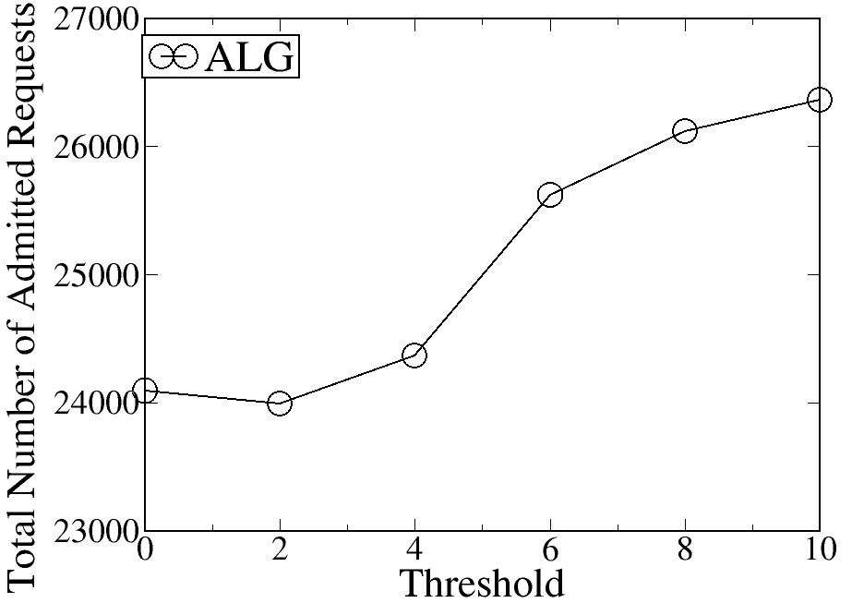
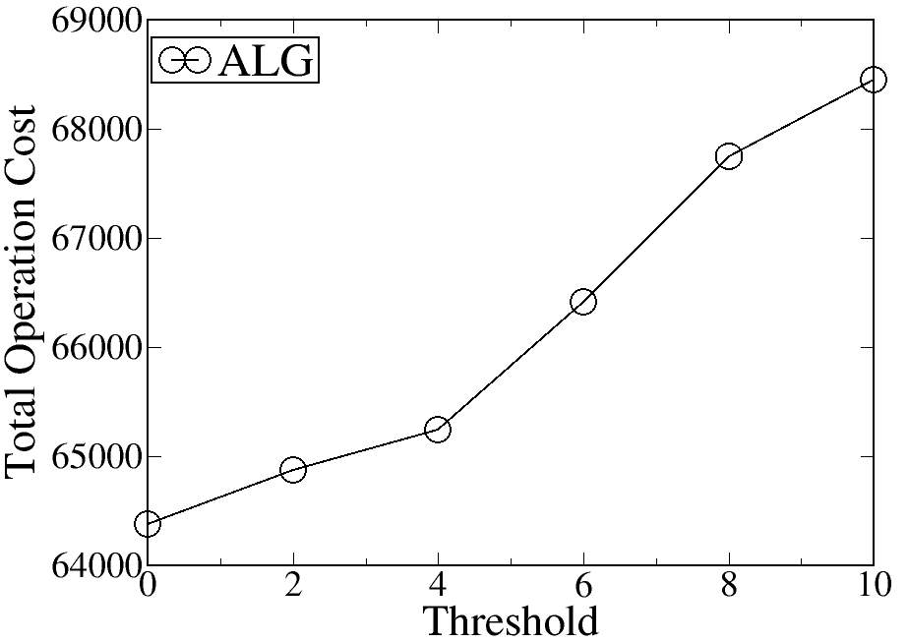
Algorithm Performance over Finite Time Horizon
Performance of proposed algorithm ALG with predictive mechanisms and benchmark HRF over 100 time slots when adjusting idle cost threshold
fig. A
fig. B

Slide 38
Conclusion
We studied a novel task offloading problem in a wireless metropolitan area network, where each offloading task has a maximum tolerable delay and different requests need different types of services from the cloudlets in the network.
We focused on maximizing the number of offloading request admissions while minimizing their admission cost within a given time horizon.
We developed an efficient algorithm for the problem through a novel reduction that reduces the problem to a series of minimum weight maximum matching problems in auxiliary bipartite graphs.
We devised an effective prediction mechanism to predict instance releases and creations in different cloudlets within the network for further cost savings.
We finally evaluated the performance of the proposed algorithm through experimental simulations. Experimental results indicate that the proposed algorithm is promising.

Slide 39
Q&A

