Slide 1
Searchable Encryption and Privacy-Preserving Task Recommendation in Crowdsourcing
Xiaohua Jia
City University of Hong Kong
Notes:
Two parts of my talk: …

Slide 2
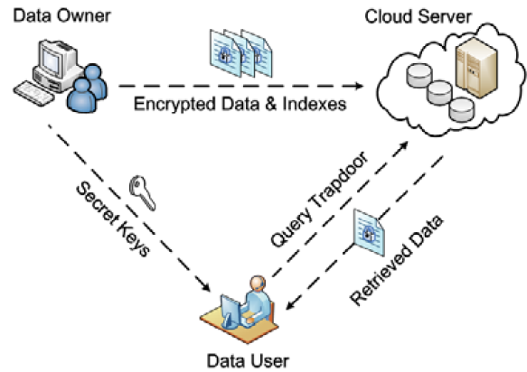
Search over Encrypted Data
Searchable encryption (SE) is a technique that allows clients to securely search over encrypted data stored on untrusted servers
Data owner stores data on a server in encrypted form
Data user sends a trapdoor of a keyword to the server for search
Server returns encrypted data matching the keyword
Notes:
Cloud storage and Data outsourcing: since cloud servers are not fully trustable, the right thing to do is to encrypt data before uploading them to the cloud
Problem: how to search encrypted data…making it as easy as we do google search or database query
In the entire process, cloud server cannot learn any information about data nor keyword

Slide 3




An Example of Searchable Encryption
token
k1
1
4
2
k1
k2
3
6
4
2
k3
5
1
F1
F2
F3
F4
F5
F6
Leak no more information than below:
Search pattern: whether a search query is repeated
Access pattern: pointers to (encrypted) files that satisfy a search query
Notes:
index: keywords to file indexes, encrypted by the data owner and uploaded to the cloud, together with the encrypted files
User generates a token (trapdoor) for search
Server returned matched files (encrypted)
Deterministic encryption: user = owner, or owner give secret keys to all users
Search pattern
Access matching between query and file

Slide 4
Major Techniques for Searchable Encryption
Searchable symmetric encryption (SSE)
Data owner generates indexes and encrypts it by a secret key. The encrypted index is then uploaded to server
Data user must use the same key to generate trapdoor of keywords for search (Single-owner and Single-user)
Public-key encryption with keyword search (PEKS)
Multiple data owners generate indexes and encrypt them by the targeted user’s public key
Data user uses its own private key to generate trapdoor for search (Multi-owner and Single-user)
Notes:
PEKS: multiple data owners want to share data with a single user
Single-owner multi-users: broadcast secret key to multiple users (SSE)

Slide 5
Research Issues in Searchable Encryption
Similerity search (fuzzy search)
Secure range queries
Secure conjunctive queries
Search with dynamic data updates
……
Notes:
similarity search: similarity distance in plaintext cannot be preserved in ciphertext: example of “similerity”…
Range queries: difficult to compare numbers in ciphertext : “greater”, “less” relations cannot be preserved in ciphertext
Conjunctive search…

Slide 6
Privacy-Preserving Task Recommendation in Crowdsourcing
Crowdsourcing is a paradigm that enables users (requesters) to outsource tasks to an undefined and large group of people (workers) via an online platform
Task recommendation is to recommend suitable tasks to matched workers
Privacy requirements in task recommendation
Notes:
Due to privacy concern, requester encrypts requirement; workers encrypt interets;
Our task is: broker can only do matching operation on ciphertext
Difficulty: M/M: users have different keys, the same keyword encrypted by different workers and by requesters produces different ciphertext ->

Slide 7
Difficulties in Privacy-preserving Task Recommendation
Multi-requester/Multi-worker (M/M)
Scalability: large number of task-requesters and workers
Dynamics of task-requesters and workers
Dynamic task publications and workers revocation
No owner-enforced search authorization
Expressiveness and conjunctive queries
Rich expressions of task requirements or worker interests
Conjunctive queries with Boolean operations
User collusions
Notes:
Challenge: M/M: multi-requesters or multi-workers, all having different keys. the same keyword encrypted by different workers and by requesters produces different ciphertext!!!
No owner authorizes users: workers are un-defined group of dynamic people

Slide 8
Proxy Re-encryption Scheme for Secure Task Recommendation
We propose a proxy re-encryption scheme for secure task matching
It is keyword-based matching between task requirements and worker interests
KMS generates a pair of keys for each user, one for the user and the other for the broker
The broker re-encrypts the ciphertexts encrypted by task-requesters or workers, and performs matching over the re-encrypted ciphertexts
Notes:
Goal: the broker can tasks and workers in ciphertext, encrypted by different keys!

Slide 9
System Model
Notes:
Task-requester upload two things: task requirement and task content
Workers upload: interests
Broker: matching
Key-management-server: generate a pair of keys for each user (task-requester or worker): facilitate broker re-encryption: after re-encryption, the broker can do matching, but cannot learn anything!
After successful matching, broker sends matched workers task-content (encrypted). Then worker communicated with requester sub-sequently

Slide 10
Steps of Secure Task Recommendation
Registration of users (task-requesters and workers)
Worker submits interests (encrypted keywords)
Broker builds indexes of workers
Task requester publishes task with requirement (encrypted keywords)
Broker generates trapdoor from task requirement
Broker performs task-workers matching and recommends tasks to matched workers
Worker decrypts content of matched tasks
Notes:
Two difficulties: 1. how broker builds indexes for different users based on encrypted interests
2. How broker can match tasks with workers on encrypted data

Slide 11
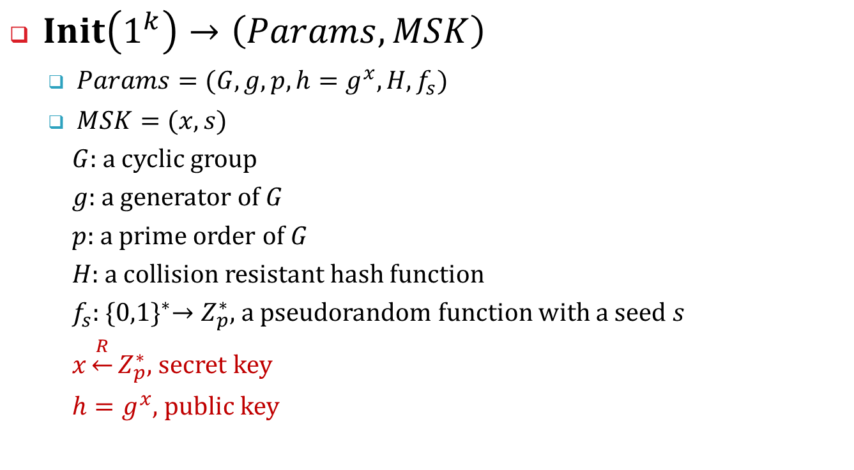
System Initialization
$Init\left(1^{k}\right)→\left(Params, MSK\right)$
$Params=(G,g,p,h=g^{x},H,f_{s})$
$MSK=(x,s)$
$G$: a cyclic group
$g$: a generator of $G$
$p$: a prime order of $G$
$H$: a collision resistant hash function
$f_{s}$:${ \{0,1\}}^{∗}→Z_{p}^{∗}$, a pseudorandom function with a seed $s$
$x\underset{←}{R}Z_{p}^{∗}$, secret key
$h=g^{x}$, public key
Notes:
Init by KMS
x: secret key of KMS;
s: seed
h: public key
Params are public; MSK: master secret key

Slide 12




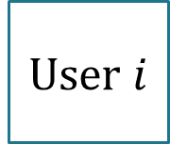
User Registration (Key Generation)
$KeyGen\left(MSK,i\right)→\left(K_{u_{i}},K_{b_{i}}\right)$
KMS chooses $x_{i,1}\underset{←}{R}Z_{p}^{∗}$ and computes $x_{i,2}=x−x_{i,1}$:
User side key: $K_{u_{i}}=(x_{i,1},s)$
Broker side key: $K_{b_{i}}=x_{i,2}$
The broker builds a table for user-key mapping $(i,K_{b_{i}})$
user-key
userID | Broker side key
$$i$$ | $$K_{b_{i}}$$
$$j$$ | $$K_{b_{j}}$$
.. | …
User $i$
KMS
Broker
$$K_{u_{i}}$$
$$(i,K_{b_{i}})$$
Notes:
Notice: xi1, xi2 = x – xi1; one for user (requester or worker), the other for broker; x1 and x2 are complement!!!
User-key mapping database (table)

Slide 13
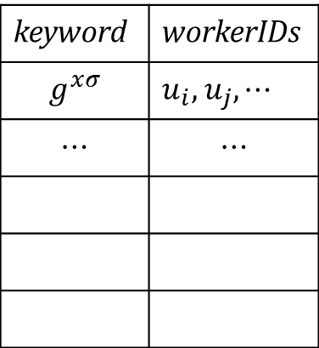
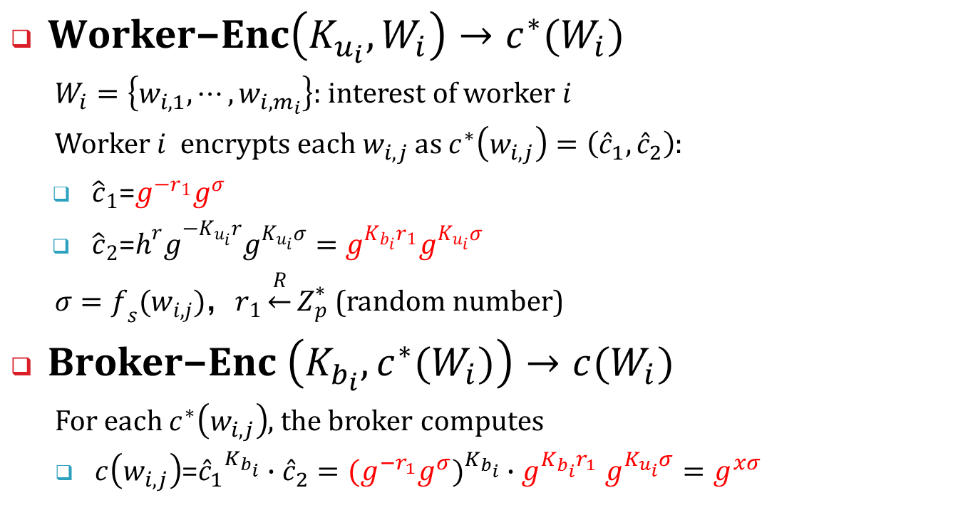
Workers Submit Interests (Keywords)
$\text{Worker}\text{−}\text{Enc}\left(K_{u_{i}},W_{i}\right)→c^{∗}(W_{i})$
$W_{i}=\left\{w_{i,1},⋯,w_{i,m_{i}}\right\}$: interest of worker $i$
Worker $i$ encrypts each $w_{i,j}$ as $c^{∗}\left(w_{i,j}\right)=\left({\hat{c}}_{1},{\hat{c}}_{2}\right)$:
${\hat{c}}_{1}$=$g^{−r_{1}}g^{σ}$
${\hat{c}}_{2}$=${h^{r}g}^{−K_{u_{i}}r}g^{K_{u_{i}}σ}=g^{K_{b_{i}}r_{1}}g^{K_{u_{i}}σ}$
$σ=f_{s}(w_{i,j})$，$r_{1}\underset{←}{R}Z_{p}^{∗}$ (random number)
$\text{Broker}\text{−}\text{Enc} \left(K_{b_{i}},c^{∗}(W_{i})\right)→c(W_{i})$
For each $c^{∗}\left(w_{i,j}\right)$, the broker computes
$c\left(w_{i,j}\right)$=${{\hat{c}}_{1}}^{K_{b_{i}}}∙{\hat{c}}_{2}={{(g}^{−r_{1}}g^{σ})}^{K_{b_{i}}}{∙g}^{K_{b_{i}}r_{1}}g^{K_{u_{i}}σ}=g^{xσ}$
I (key , value)
keyword | workerIDs
$$g^{xσ}$$ | $u_{i},$ $u_{j},⋯$
$$⋯$$ | $$⋯$$
Notes:
1. To facilitate keyword matching between requester and worker, and between different workers, we take the proxy-encryption approach. That’s to encrypt keyword twice…
2. Worker Encrypts wij and submits it to broker. g^x in c^2 is public key. Note: : Kbi = x – Kui
3. Broker re-encrypt c*(wij) and transform it to a user independent keyword ciphertext
c(wij) = g^xro, which is independent to workers (\ro is derived from wij). That’s, for the same keyword from different workers, it has the same ciphertext.
4. That’s why it can build a (key, value) table
Indexes consists of keyword and users with this keyword; \sigma = fs(wij), derived from keyword wij
Note: broker couldn’t understand ciphertext c(wij), but can build a indexes of keywords - users

Slide 14
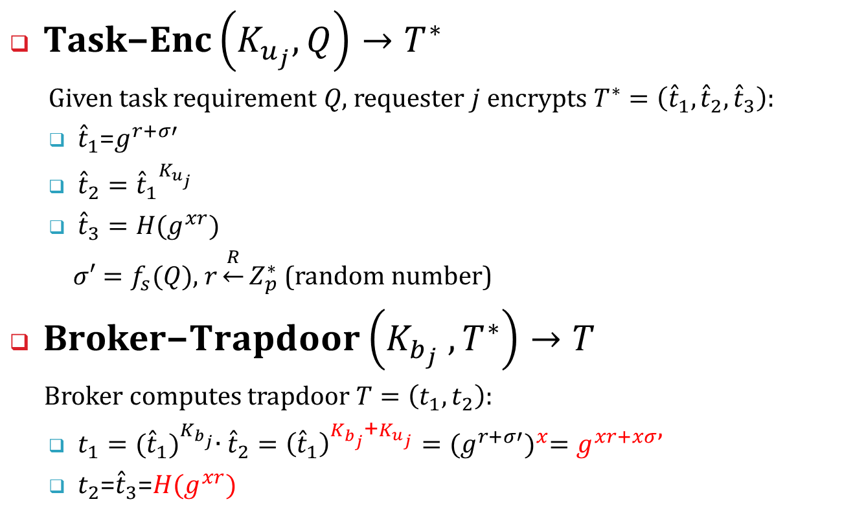
Task Encryption and Trapdoor Generation
$\text{T}\text{ask}\text{−}\text{Enc}\left(K_{u_{j}},Q\right)→T^{∗}$
Given task requirement 𝑄, requester $j$ encrypts $T^{∗}=\left({\hat{t}}_{1},{\hat{t}}_{2},{\hat{t}}_{3}\right)$:
${\hat{t}}_{1}$=$g^{r+σ′}$
${\hat{t}}_{2}={{\hat{t}}_{1}}^{K_{u_{j}}}$
${\hat{t}}_{3}=H(g^{xr})$
$σ′=f_{s}(\text{Q})$, $r\underset{←}{R}Z_{p}^{∗}$ (random number)
$\text{Bro}\text{ker}\text{−}Trapdoor\left(K_{b_{j}} ,T^{∗}\right)→T$
Broker computes trapdoor $T=\left(t_{1},t_{2}\right)$:
$t_{1}={({\hat{t}}_{1})}^{K_{b_{j}}}∙{\hat{t}}_{2}={\left({\hat{t}}_{1}\right)}^{K_{b_{j}}\text{+}K_{u_{j}}}={(g^{r+σ′})}^{x}=g^{xr+xσ}$’
$t_{2}$=${\hat{t}}_{3}$=$H(g^{xr})$
Notes:
Similarly, requester encrypts a requirement keyword (assume only one keyword for requirement); the broker needs to convert the ciphertext of the requirement into the token that can match with the ciphertext of interests.
Requester encrypt Q -> 3-tuple, and submit it to broker
Broker generates a trapdoor out of this 3-tuple (t1, t2)
$σ$’ is derived from keyword Q

Slide 15


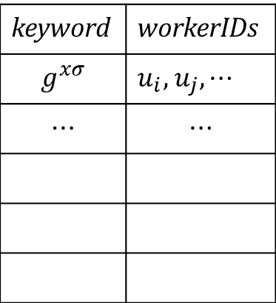
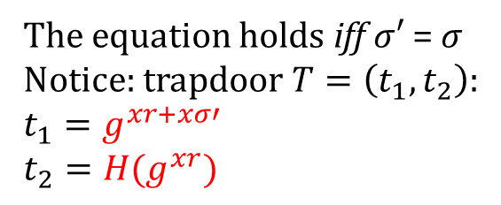

Secure Matching between Task and Workers
$\text{Match}\left(I,T\right)$
Given $T=\left(t_{1},t_{2}\right)$, broker searches keyword in index table $I$ by testing:
$$t_{2}=H(t_{1}∙{\left(keyword\right)}^{−1})$$
I (key , value)
keyword | workerIDs
$$g^{xσ}$$ | $u_{i},$ $u_{j},⋯$
$$⋯$$ | $$⋯$$
The equation holds iff $σ′$ = $σ$
Notice: trapdoor $T=\left(t_{1},t_{2}\right)$:
$$t_{1}=g^{xr+xσ′}$$
$$t_{2}=H(g^{xr})$$
Notes:
If task requirement Q = wij, the above equation satisfied…The broker selects the group of users in the table indexed by the keyword
Notice: broker performs matching without understanding anything about the task and workers!
The broker recommends this task to matched workers ->

Slide 16
Task Content Encryption and Decryption
Notes:
The worker needs to receive the task specification, payment, etc. The task spec is encrypted by task-requester…
The broker did a transformation, and passes task-spec to matched workers.
no need for interaction between the task requester and the worker at this stage

Slide 17
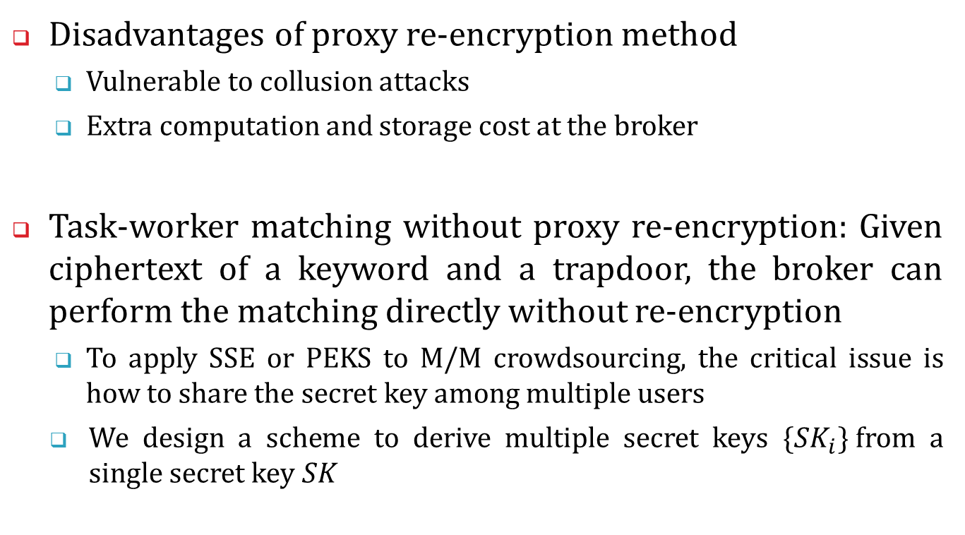
Task Recommendation without Proxy Re-encryption
Disadvantages of proxy re-encryption method
Vulnerable to collusion attacks
Extra computation and storage cost at the broker
Task-worker matching without proxy re-encryption: Given ciphertext of a keyword and a trapdoor, the broker can perform the matching directly without re-encryption
To apply SSE or PEKS to M/M crowdsourcing, the critical issue is how to share the secret key among multiple users
We design a scheme to derive multiple secret keys ${\{SK}_{i}\}$from a single secret key $SK$
Notes:
collusion attack: the master key can be easily recovered if a user colludes with the broker

Slide 18
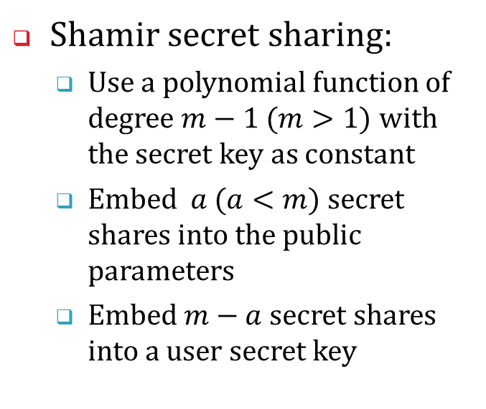
System Model and Fundamentals
The broker performs direct matching between
The ciphertext (of a keyword) encrypted by public params, and
The trapdoor generated by a user’s secret key (Sk_{i})
Shamir secret sharing:
Use a polynomial function of degree $m−1$ $(m>1)$ with the secret key as constant
Embed $a$ $(a<m)$secret shares into the public parameters
Embed $m−a$ secret shares into a user secret key
Notes:
(1) $KMS f$or user registration: $KMS$ outputs some public parameters $Params$ and generates a secret key ${SK}_{i}$for each user.
(2) Any task requester can use public parameters $Params$ to encrypt keywords and sends the keyword ciphertext $C$ to the Broker. The broker can build an index table consists of taskIDs and encrypted keywords (requirements)
(3) Any authorized worker can generate a trapdoor with his own secret key ${SK}_{i}$.
(4) With the trapdoor $T$, the broker can directly test it with each keyword ciphertext $C$.

Slide 19
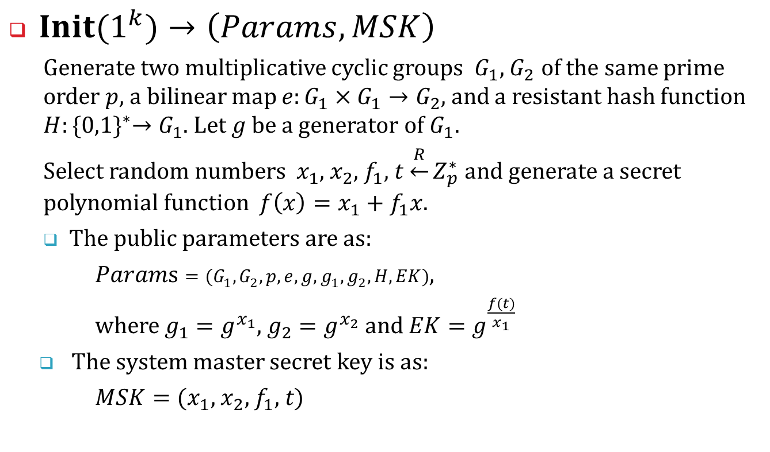
Construction Algorithms
$Init(1^{k})→\left(Params, MSK\right)$
Generate two multiplicative cyclic groups $G_{1}$, $G_{2}$ of the same prime order $p$, a bilinear map $e:G_{1}×G_{1}→G_{2}$, and a resistant hash function $H:{\{0,1\}}^{∗}→G_{1}$. Let $g$ be a generator of $G_{1}$.
Select random numbers $x_{1}$, $x_{2}$, $f_{1}$, $t$ $\underset{←}{R}Z_{p}^{∗}$ and generate a secret polynomial function $f\left(x\right)=x_{1}+f_{1}x$.
The public parameters are as:
$Params=(G_{1},G_{2},p,e,g,g_{1},g_{2},H,EK)$,
where $g_{1}=g^{x_{1}}$, $g_{2}=g^{x_{2}}$ and $EK=g^{\frac{f(t)}{x_{1}}}$
The system master secret key is as:
$MSK={(x}_{1}\text{, }x_{2}\text{, }f_{1}\text{, }t)$
Notes:
G is a group; g is a generator that generates elements in G; g1 and g2 are elements in G, generated by g (notice: g is the base)
In f(x): x1 is secret key (a constant in this function), f1 is a random number (co-efficient of x)
Notice: in Params, EK is a public key that contains f(t), a share of secret. Next slide: each user’s Ski contains f(ti), another share of secret -> with f(t) and f(ti), the secret function f(x) can be recovered

Slide 20
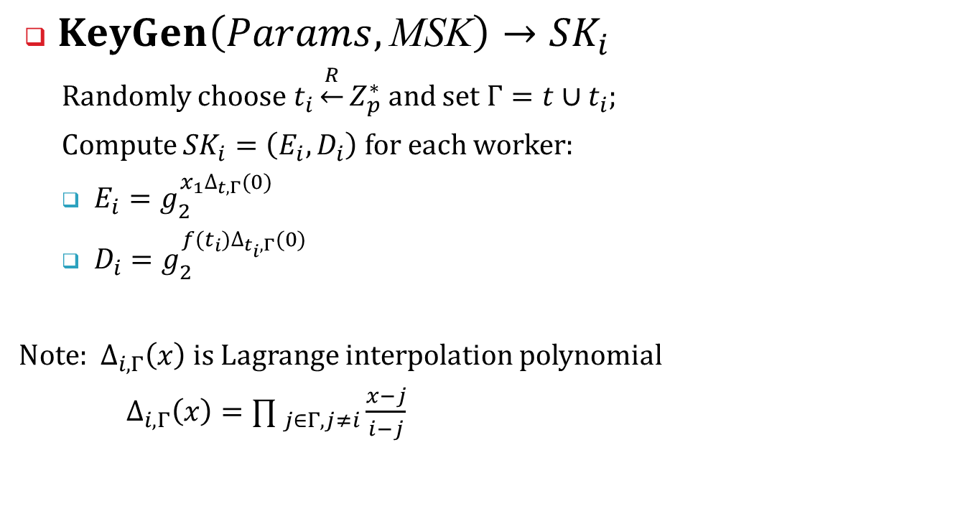
Generation of Secret Keys for Workers
$KeyGen\left(Params,\text{MSK}\right)→{SK}_{i}$
Randomly choose $t_{i}\underset{←}{R}Z_{p}^{∗}$ and set $Γ=t∪t_{i}$;
Compute ${SK}_{i}=\left(E_{i},D_{i}\right)$ for each worker:
$E_{i}=g_{2}^{x_{1}∆_{t,Γ}(0)}$
$D_{i}=g_{2}^{f(t_{i})∆_{t_{i},Γ}(0)}$
Note: $∆_{i,Γ}\left(x\right)$ is Lagrange interpolation polynomial
$∆_{i,Γ}\left(x\right)={∏ }_{j∈Γ,j≠i}\frac{x−j}{i−j}$
Notes:
No need sk for task-requesters
$Γ$ (gama) is a set with two elements: t and ti
Delta_{i, $Γ$}: i is in {t, ti}
$∆_{t,Γ}\left(0\right)$: is function $∆_{i,Γ}\left(x\right)$, where x = 0, i = t

Slide 21
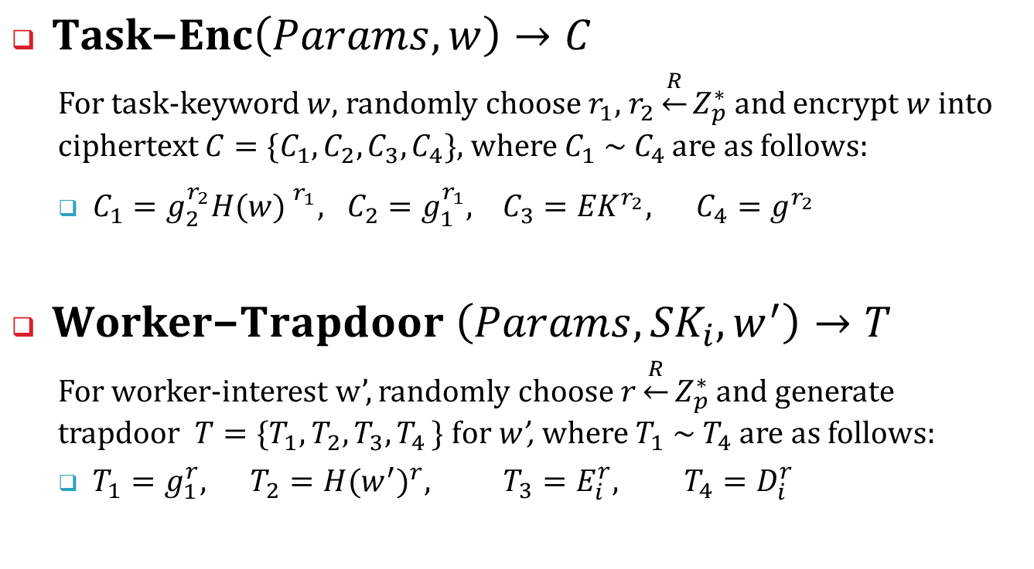
Task Encryption and Trapdoor Generation
$\text{Task}\text{−}\text{Enc}\left(Params,w\right)→C$
For task-keyword $w,$ randomly choose $r_{1}$, $r_{2}\underset{←}{R}Z_{p}^{∗}$ and encrypt $w$into ciphertext $C=\{C_{1},C_{2},C_{3},C_{4}\}$, where $C_{1} \sim C_{4}$ are as follows:
$C_{1}=g_{2}^{r_{2}}{H(w) }^{r_{1}}, C_{2}=g_{1}^{r_{1}}, C_{3}={EK}^{r_{2}}, C_{4}=g^{r_{2}}$
$\text{Worker}\text{−}Trapdoor \left(Params,{SK}_{i},w^{′}\right)→T$
For worker-interest w’, randomly choose $r\underset{←}{R}Z_{p}^{∗}$ and generate trapdoor $T=\{T_{1},T_{2},T_{3}{,T}_{4}\} \text{for} \text{w}\text{’}$, where $T_{1} \sim T_{4}$ are as follows:
$T_{1}=g_{1}^{r}, T_{2}={H(w^{′})}^{r}, T_{3}=E_{i}^{r}, T_{4}=D_{i}^{r}$
Notes:
Task requester encrypts task-requirement w by using public key, and sends C to the broker
The broker can build a task index table of (taskIDs, encrypted keywords)
Each Worker generates trapdoor (its interest w’) by its secret key AND public params
The key-point: a keyword encrypted by params and a trapdoor generated by different users Ski can match!

Slide 22

Matching between Keyword-ciphertext and Trapdoor
$Test(C,T)→1/0$
The following equation holds only if $w=w^{′}$:
$$e\left(C_{1},T_{1}\right)=e(C_{2},T_{2})⋅e(C_{3},T_{3})⋅e(C_{4},T_{4})$$
Notes:
Broker only performs matching by testing equation, it doesn’t understand ciphertext or trapdoor!
e: bi-linear pairing

Slide 23
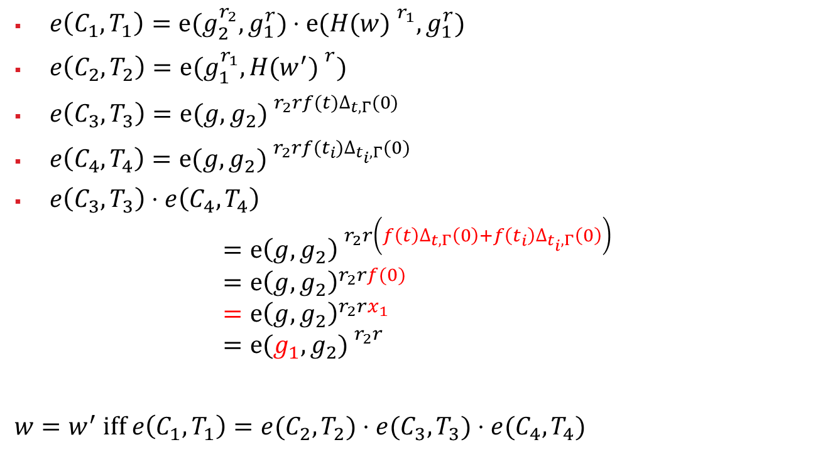
Correctness Proof
$e\left(C_{1},T_{1}\right)=e(g_{2}^{r_{2}},g_{1}^{r})⋅e({H(w) }^{r_{1}},g_{1}^{r})$
$e\left(C_{2},T_{2}\right)=e(g_{1}^{r_{1}}, {H(w^{′}) }^{r})$
$e\left(C_{3},T_{3}\right)={e(g,g_{2}) }^{r_{2}rf(t)∆_{t,Γ}(0)}$
$e\left(C_{4},T_{4}\right)={e(g,g_{2}) }^{r_{2}rf(t_{i})∆_{t_{i},Γ}(0)}$
$e\left(C_{3},T_{3}\right)⋅e\left(C_{4},T_{4}\right)$ $={e\left(g,g_{2}\right) }^{r_{2}r\left(f\left(t\right)∆_{t,Γ}\left(0\right)+f\left(t_{i}\right)∆_{t_{i},Γ}\left(0\right)\right)}$ $={e\left(g,g_{2}\right)}^{r_{2}rf(0)}$ $={e\left(g,g_{2}\right)}^{r_{2}rx_{1}}$ $={e(g_{1},g_{2}) }^{r_{2}r}$
$w=w^{′}$ iff $e\left(C_{1},T_{1}\right)=e(C_{2},T_{2})⋅e(C_{3},T_{3})⋅e(C_{4},T_{4})$
Notes:
Note: bi-linear paring function: e(g1, g2) = e(g2, g1);
e(g1, g2)^{r1r2} = e(g1^{r1}, g2^{r2}) = e(g1^{r2}, g2^{r1});

Slide 24
Worker Revocation Problem
Revocation incurs very high cost!
When a worker leaves the system, secret keys of other users and the task index table (ciphertexts) all need to be regenerated (recomputed)
Notes:
Adv: The broker doesn’t need to encrypt anything; all encryption is done by requesters and workers, but
Worker revocation problem: since in this scheme workers generate trapdoors with secret keys, and the broker simply does matching on ciphertext. The worker can always generate trapdoors and obtain matched tasks, so long as he has the key.
To disable a worker’s key, all existing users’ keys need to be regenerated and re-distributed, and task-indexes need to be re-generated.

Slide 25
Research Issues in Secure Task Recommendation
Multi-keywords of task requirements
Range requirement of tasks
Conjunctive functions of task requirements and worker interests
……
Notes:
Range: 30-40 years old workers? Cannot compare greater / less in ciphertext!

Slide 26
Summary
SSE and PEKS are the major techniques for searchable encryption
They are not suitable for secure matching between multi-requesters and multi-workers in crowdsourcing
Two privacy-preserving task recommendation schemes for crowdsourcing
Proxy re-encryption method
Server direct matching without re-encryption

Slide 27
Thank You!
Q&A

