Slide 1
Secure, Incentivized and Unlearning-enabled Data Sharing for Large Model Machine Learning
Xiaohua Jia
Dept of Computer Science
City University of Hong Kong
Notes:
Data sharing: 3 key words spell out the 3 key requirements for data sharing
Suppose you’ve a good dataset in your hand, I want let you share out your data for training a model: what are your concerns or requirement for you to share out your data

Slide 2
Increasing need for data sharing
Machine Learning relies on data, big and quality data
As training over public data is reaching its limit, it requires individuals/institutions to share their private data
Cross-domain data sharing is more important for data-driven Apps
Notes:
There is an increasing need for data sharing
ChatGPT has seen almost all cloud data -> tap the data in private owner’s hand

Slide 3


Data fragmentation and isolation
Data sharing
Data is collected and administrated by individual owners
Data is stored locally and kept in silos
Each data app only sees its data in a silo
People are reluctant to share their data out
Sharing data out is equivalent to relinquishing ownership
Once shared out, data can be copied, traded, or abused without owner’s consent
Notes:
However, the reality is: data are often fragmented and isolated…

Slide 4
Challenges
Lack of secure authorization and its compliant computation scheme
Shared data shall be only used for its authorized app, and nothing else
Lack of incentive for data sharing
Data owner shall have a fair share of the profit generated from the trained models/apps
Lack of “unlearning” scheme
Data owners shall have the right to remove their data and its influence from the trained models
Notes:
To achieve horizontal data sharing, challenges are …
Security -> data is shared for the authorized purpose of use, and nothing else (owner wishes to retain the data ownership, even sharing with you)
What we wish for -> lack of…
Incentive -> data valuation

Slide 5






Tasks
Design a secure data authorization and its compliant computation scheme
Design a fair data valuation scheme for profit sharing
Design a machine unlearning scheme that removes the influence of cancelled data from the trained model
Data owner
Data Authorization & Computation
Data
Authorization
Rewards
Model
Apps
Data valuation
ML Unlearning
Data consumer/
Apps’ owner
Data sharing platform
Notes:
Explain the figure, the red-box has three tasks

Slide 6
Task 1: Secure data authorization and computation
Data is only used for authorized applications, and nothing else
Enforcing data & app binding for computation
Privacy-preserving computation
Server can only compute over the data, but not know the data content
Notes:
Data is authorized to be used by agreed App only: Implies two requirements: …

Slide 7




Data access control schemes won’t work
Existing solution: use blockchain for authorization management and off-chain key distribution for data access
Data ciphertext
Access policy
① Access ciphertext
On-chain layer for policy recording
Ledger
③ Check policy
Off-chain layer for secure key distribution
② Request
④ Data access key
Key management committee
E. Kokoris-Kogias et al., “CALYPSO: Private Data Management for Decentralized Ledgers”, in Proc. of VLDB 2021.
Notes:
Calypso: EPFL & UCL
Utilize blockchain for access-control (authorization verification).
A key committee verifies permission via blockchain and passes key
Authorized users use the key for decryption.

Slide 8

Key issue: post sharing data control
The data would be revealed to the data consumers once authorization is given
Lose control on how the data will be used by the authorized consumers

Slide 9

Central-server checking won’t meet the requirements
Existing solution: information flow control (IFC) policy + enforcement methods, e.g., trusted server or hardware for verification
Correctness enforcement
Data (plaintext)
Result
IFC rules
App
Server
Check if the data matches the IFC rules (e.g., data & app binding)
Run app over the data
Key issues
Rely on a central trusted server
Data privacy is not fully protected (against the server)
Eslam Elnikety et al., Thoth: Comprehensive Policy Compliance in Data Retrieval Systems. In USENIX Security, 2016
Frank Wang et al., Riverbed: Enforcing User-defined Privacy Constraints in Distributed Web Services. In USENIX NSDI, 2019
Notes:
IFC: enforce the IF policies associated with variables in a program, so as to constrain how data flows through the system (i.e., enforce dataID inside the program to bind data&App), but:
1) Rely on central trusted server
2) Data leakage… how to authorize data to be used by agreed App only ->

Slide 10

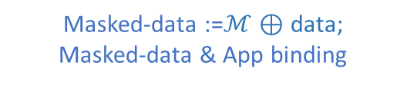
Our solution (ideally)
Data authorization with data masking and data&app binding
Plaintext-Compatible Data Masking
Computation with Data&app Binding
Masked-data :=$ℳ⊕$ data;
Masked-data & App binding
2
3
App
Model Trainer (Server)
Masked-data
Data owner
Binding
1
Authorized App
Data privacy protection via masking (a one-way function)
The server cannot recover the data content
Masked-data & app binding
Data can only be used for authorized model training, and nothing else
Ideally, the solution is non-interactive, i.e., binding is required only once
Notes:
Two requirements -> Two techniques for data&app binding and data masking
…
1) The server sends the authorized app to the owner
2) The owner mask data to protect privacy, binds the masked data with the app, and sends them to server
3) Server can compute over masked data efficiently Ideally, this solution is non-interactive. The binding’d be done only once, However, we cannot find a good “masking” method that all ML operations can be done on masked-data efficiently… ->

Slide 11


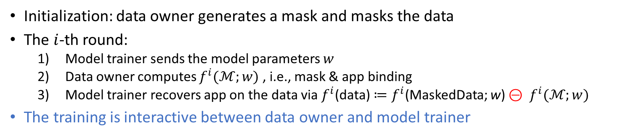
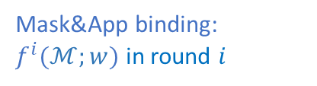






The actual solution: Training with data masking and data&app binding
In the $i$-th training round:
Initialization
Apply App on mask: $f^{i}(ℳ;w)$
3
$f^{i}$(data)$≔f^{i}$(MaskedData) $⊝ f^{i}(ℳ)$
MaskedData :=$ℳ⊕$ data
2
$$⊝$$
MaskedData
Sent to the trainer
Data owner
$f^{i}$(MaskedData)
$$f^{i}(ℳ)$$
Model Trainer
Data owner
Mask&App binding:
$f^{i}(ℳ;w)$ in round $i$
1
Model parameters w in round $i$
Initialization: data owner generates a mask and masks the data
The $i$-th round:
Model trainer sends the model parameters $w$
Data owner computes $f^{i}(ℳ;w)$ , i.e., mask & app binding
Model trainer recovers app on the data via $f^{i}$(data)$≔f^{i}$(MaskedData; w) $⊝ f^{i}(ℳ;w)$
The training is interactive between data owner and model trainer
Notes:
initialization;
Interactive in each round : a) Data user sends model parameters w to owner; b) owner computes f(M;w) and sends to user; c) the user computer f(maskedData;w) – f(M;w), obtaining f(data); note: f(M,w) cancels the noise added to the data!
Key point: a) model trainer cannot recover data; b) data&model binding,

Slide 12
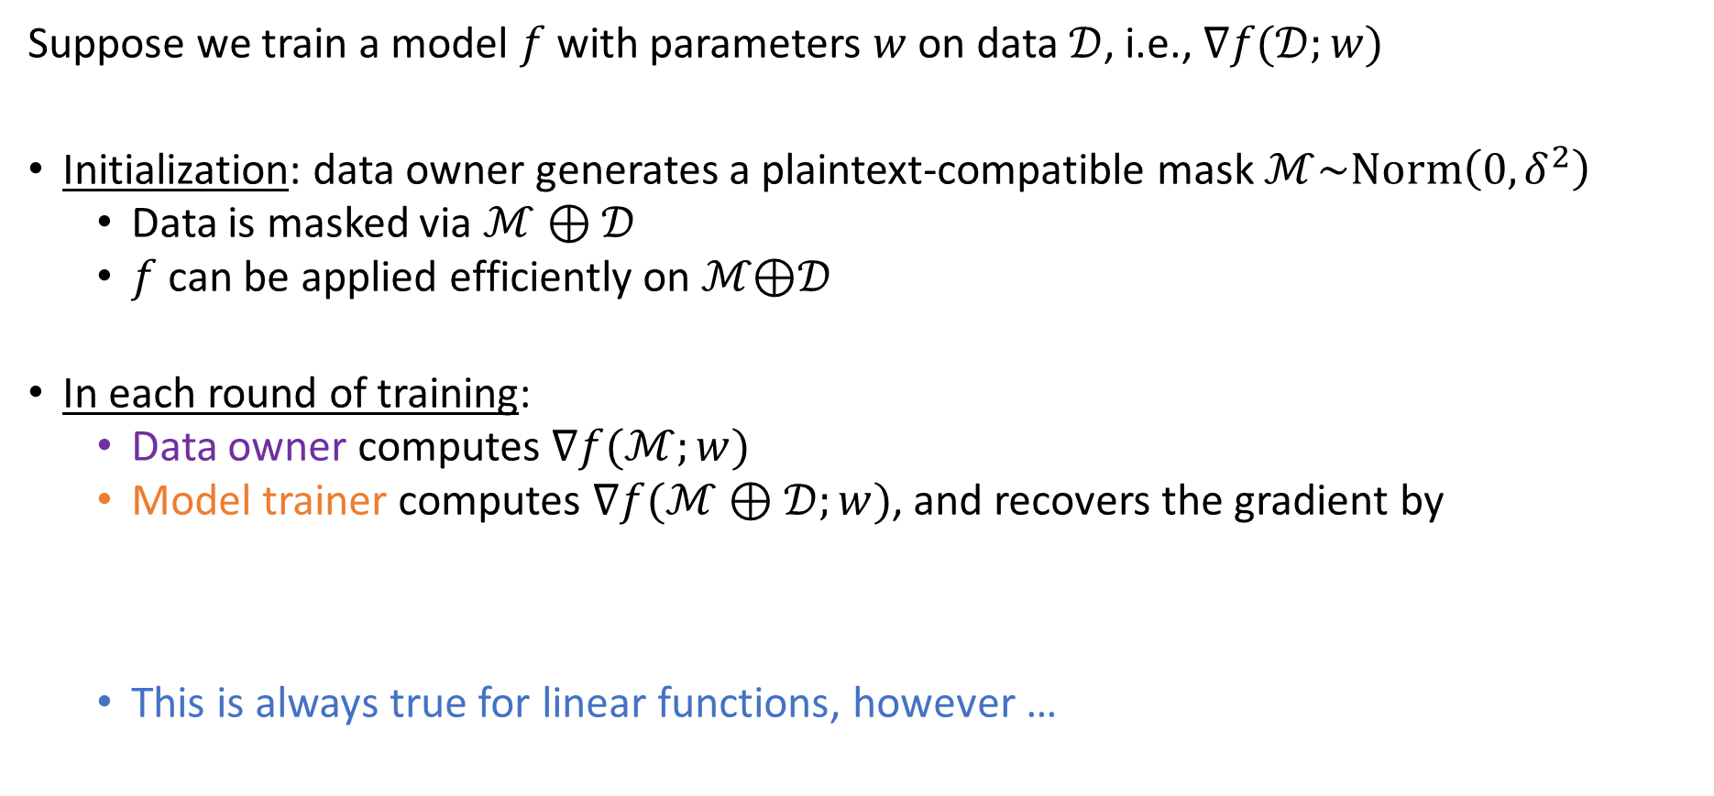
How it work: Training with data masking and data&app binding
Suppose we train a model $f$ with parameters $w$on data $𝒟$, i.e., $∇f(𝒟;w)$
Initialization: data owner generates a plaintext-compatible mask $ℳ\sim Norm\left(0, δ^{2}\right)$
Data is masked via $ℳ⊕𝒟$
$f$ can be applied efficiently on ℳ⊕𝒟
In each round of training:
Data owner computes $∇f(ℳ;w)$
Model trainer computes $∇f(ℳ⊕𝒟;w)$, and recovers the gradient by
This is always true for linear functions, however …
$$∇f\left(𝒟;w\right)=∇f\left(ℳ⊕𝒟;w\right)−∇f(ℳ;w)$$
by trainer
by owner
Notes:
In details: Training f is to compute the gradients $∇f(𝒟;w)$ in each iteration.
Initialization: M is a noise matrix following Gaussian distribution, \delta is the standard deviation.
Note: when we mask data D, we cannot mask labels y (that’s why y cannot be on server’s side in plaintext).
i-th round: interactive computation of $∇f(𝒟;w)$, note: noise M is canceled.
This is for linear function. However, for non-linear…

Slide 13
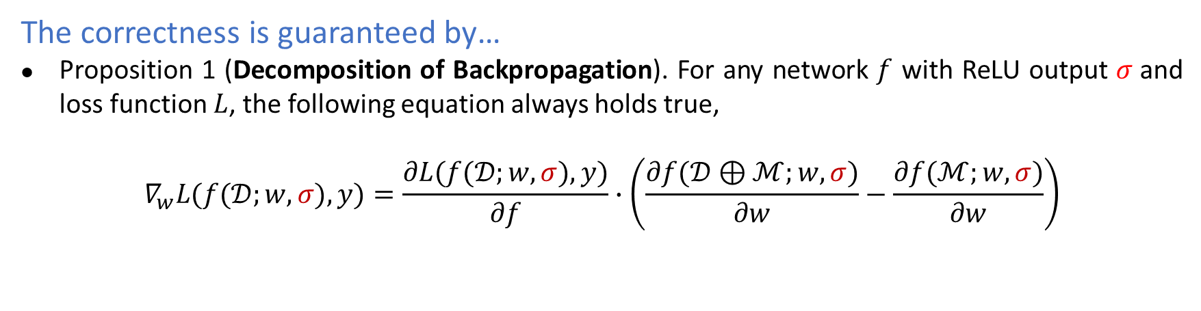
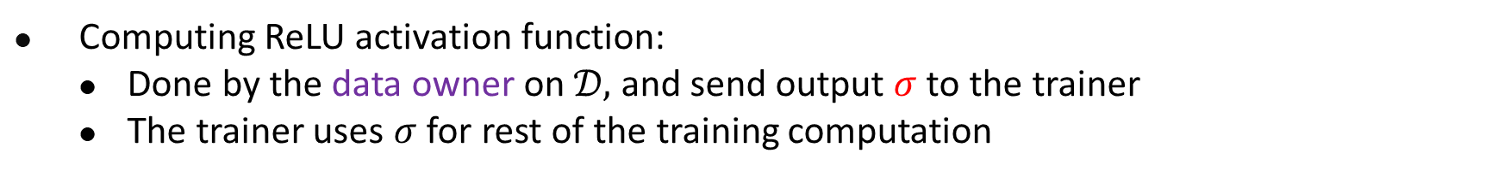
When ReLU and loss-function are non-linear
Computing ReLU activation function:
Done by the data owner on $𝒟,$ and send output $σ$to the trainer
The trainer uses $σ$ for rest of the training computation
Computing loss function $L$:
Joint computation by data owner the model trainer interactively, as below
The correctness is guaranteed by…
Proposition 1 (Decomposition of Backpropagation). For any network $f$ with ReLU output $σ$and loss function $L$, the following equation always holds true,
$$∇_{w}L(f(𝒟;w,σ),y)=\frac{∂L(f(𝒟;w,σ),y)}{∂f}∙\left(\frac{∂f(𝒟⊕ℳ;w,σ)}{∂w}−\frac{∂f(ℳ;w,σ)}{∂w}\right)$$
Loss head by owner
by trainer
by owner
Notes:
To address the issue of non-linearity and loss function, we first compute ReLU at the owner, denoted as `\sigma` to make f linear. \sigma is computed via one forward pass using data D, can be done efficiently. Then, loss-function can be done linearly as by Proposition 1, note: the loss-head and last part are done by the owner.

Slide 14
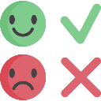




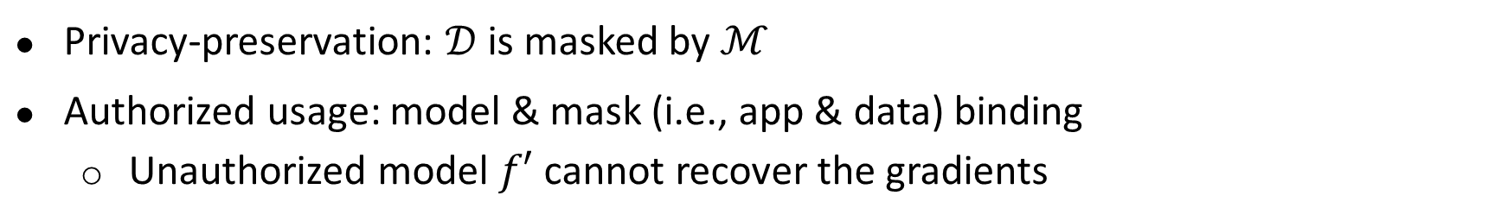
Summary: data&app binding for authorized training
Privacy-preservation: $𝒟$ is masked by $ℳ$
Authorized usage: model & mask (i.e., app & data) binding
Unauthorized model $f′$ cannot recover the gradients
$$⊝$$
Valid Gradients
$$⊝$$
Meaningless Results
Provided by the owner
App-Mask binding
Notes:
Summary: meet both requirements: data privacy and authorization
We can only do this for model-training in ML, not general secure-computation

Slide 15


Task 2: Fair data valuation for profit sharing
Attribute-based or auction-based data valuation
Contribution-based data valuation
Challenging issues
Efficient contribution-based data valuation
Minimize overhead incurred by data valuation
Notes:
If my data trained app made 1M profit, how much is my share of profit?
What is the “fair” data valuation: Traditionally, data valuation is based on data attributes (size) or through auctions, but both of them ignore the quality of the data.
Data should be valued based contribution it makes, ie., no contribution, no reward. This prevents people from using low quality or junk data for ML training.

Slide 16
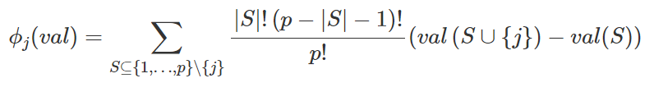
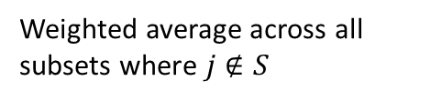


Contribution-based data valuation
Shapley value-based data valuation
Score for dataset $j$
Gain by including $j$
Weighted average across all subsets where $j∉S$
Dawn Song, Oasis project, https://www.oasislabs.com/dawn-song.
A. Ghorbani and J. Y. Zou, “Data shapley: Equitable valuation of data for machine learning,” in Proc. of ICML, 2019.
Notes:
Common method for contribution based valuation: Shapley-based valuation…
Sharpley value was introduced by Llod Shapley, who won nobel prize in 2012 because of it.
The score is calculated as the average of “all combinations” of subsets of participants (i.e., 2 participants, 3 participants, … N participants)
Dawn Song: Oasis project! But, they’re for selling data. We don’t sell!

Slide 17
Problems with Shapley-based valuation
High computation cost
The valuation of each combination of subsets of participants requires a complete training process
The computation cost is too high for datasets of multiple parties
Not applicable to dynamic data (e.g., streaming data)
Notes:
incurs high computation cost and cannot deal with dynamic data.

Slide 18
Our Solution
Gradient-based Data Valuation
Evaluate data points based on their impact on the model during Stochastic Gradient Descent (SGD) training process
Two-phase of data valuation
1) Training Phase: Store necessary information during SGD training
2) Data Valuation Phase: Calculate value score for each data point
Measures each data point's contribution towards the final model*
18

Slide 19
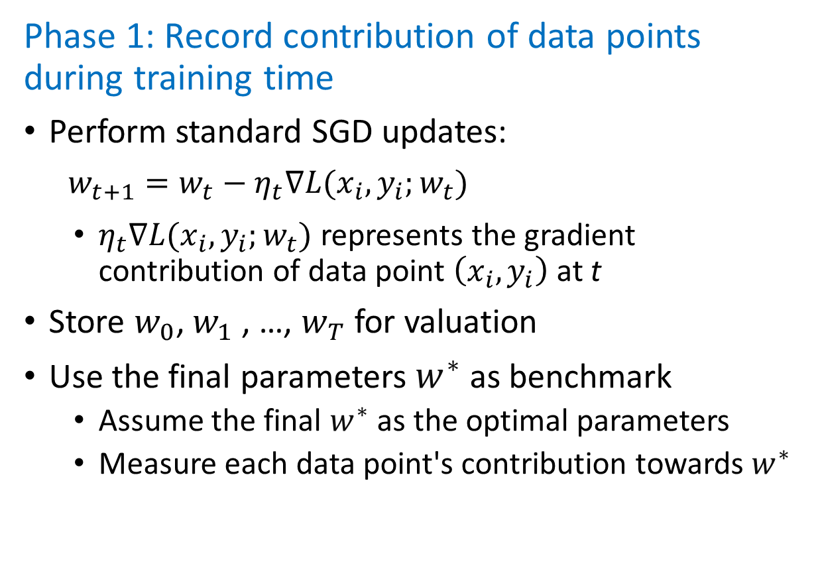




Gradient-based data valuation (1)
Phase 1: Record contribution of data points during training time
Perform standard SGD updates:
$w_{t+1}=w_{t}−η_{t}∇L(x_{i},y_{i};w_{t})$
$η_{t}∇L(x_{i},y_{i};w_{t})$ represents the gradient contribution of data point $\left(x_{i},y_{i}\right)$ at t
Store $w_{0}$, $w_{1}$, …, $w_{T}$for valuation
Use the final parameters $w^{∗}$as benchmark
Assume the final $w^{∗}$as the optimal parameters
Measure each data point's contribution towards $w^{∗}$
loss
$$w_{t}$$
$$w_{t+1}$$
$$w_{T−1}$$
$$w^{∗}$$
weight
19
Notes:
w_{t}, w_{t+1}, …, w_{T-1}, w* are model parameters at each step, w* is the final parameters (it’d be done after the completion of training when w* is known)
$η$ is the learning rate;
$∇L(x_{i},y_{i};w_{t})$: de’rivative of L (the loss-function) over w

Slide 20




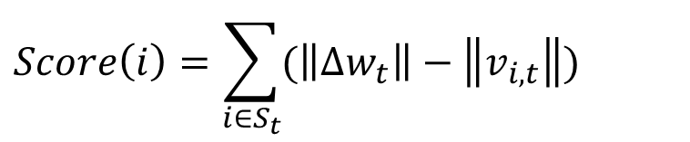




Gradient-based data valuation (2)
Phase 2: Data valuation after training process
The distance from w_{t} (current state) to $w^{∗}$ without data $i$
The distance from w_{i,t} to $w^{∗}$after using data $i$ at step t
Data i's contribution towards optimality at step t
Total contributions of data $i$over all steps
$\left\|{∆w}_{t}\right\|=$ $\left\|w^{∗}−w_{t}\right\|$
loss
$$w_{t}$$
$$\left\|v_{i,t}\right\|=\left\|w^{∗}−w_{i,t}\right\|=\left\|w^{∗}−(w_{t}−η_{t}∇L(x_{i},y_{i};w_{t}))\right\|$$
$$∆w_{t}=w^{∗}−w_{t}$$
$$η_{t}∇L(x_{i},y_{i};w_{t})$$
$$Score\left(i,t\right)=\left\|∆w_{t}\right\|−\left\|v_{i,t}\right\|$$
$$w_{i,t}$$
$$v_{i,t}$$
$$w^{∗}$$
weight
$$Score\left(i\right)=\sum_{i∈S_{t}}{(\left\|∆w_{t}\right\|−\left\|v_{i,t}\right\|)}$$
A higher score indicates greater contribution towards final parameters w*
20
Notes:
After completion of training, w* is known
||v|| Euclidian length of vector v
w_{i,t} = $(w_{t}−η_{t}∇L(x_{i},y_{i};w_{t}))$, the contribution of xi at t
||w_{t} – w*||: vector wt minus w*, the length of blue line in fig.

Slide 21
Shapley Value ​​Method vs. Gradient-Based Method
Shapley Value Method
The valuation of each combination of subsets of participants needs to go through a full training process
Too high training cost
Gradient-based Method
The valuation of a data’s contribution is done at the end of the training process
Need only one training process to complete the valuation of all data
21
Notes:
Summary: one round of training and one round of valuation!

Slide 22





Task 3: Machine Unlearning for Large ML Models
Machine Unlearning
The process of removing data points and their influence from a trained model
Original training dataset
Train
Trained Model
remaining data
forgotten data
Impractical
computational cost
time consumption
Retrain
Unlearn
As the same as possible
Retrained Model
Unlearned Model
Notes:
Definition： Machine unlearning is the process of removing data points and their influence from a trained model, meaning that the model behaves as if it had never seen the removed data during training.

Slide 23
Unlearning: Motivations and Challenges
Motivation for Machine Unlearning
Privacy concerns or legal disputes (right to be forgotten)
System security (poisoned data removing)
Adaptability (model evolution)
Challenges in Machine Unlearning
Data dependency
Overhead for both training and unlearning
Performance degradation after unlearning
Jie Xu, Zihan Wu, Cong Wang, Xiaohua Jia: Machine Unlearning: Solutions and Challenges. IEEE Trans. Emerg. Top. Comput. Intell. 8(3), 2024
Notes:
Motivation:
Privacy Concerns: ‘Right to be forgotten’ requires the ability to remove individual data points from machine learning models. System security: Remove poisoned data points to enhance system security and robustness
Adaptability: Machine unlearning allows for the removal of incorrect or outdated data from the model, helping it to adapt to changing environments and maintain its accuracy.
Challenges:
Interdependence make it difficult to remove the influence of a single data point without affecting the rest.
Technical challenges : Computational and time overhead
-> unlearning is hard

Slide 24
Scales of Large Models Training/Unlearning
Billions of parameters, large training data, and weeks of training time
Model | Parameters | Training Data | Estimated Training Time and Platform
GPT-3 (OpenAI) | 175 billion | 300B tokens (Common Crawl, Wikipedia,…) | Several weeks on a large-scale GPU cluster
GPT-4 (OpenAI) | Not publicly released | Not publicly released | Not publicly released
BERT (Google) | 340 million (BERT-Large) | Wikipedia and BooksCorpus | 4 days on 64 TPU v3 cores
T5 (Google) | 11 billion | Colossal Clean Crawled Corpus | Several days on 256 TPU v3 cores
Qwen-14B (Alibaba) | 14 billion | 3.0T tokens (public web documents, encyclopedia, books, codes, etc.) | Not publicly released
DeepSeek-V3 (DeepSeek) | 671 billion | 14.8T tokens (math, code, multilingual samples) | 2.788M H800 GPU hours (~55 days with 2048 H800 GPUs)

Slide 25
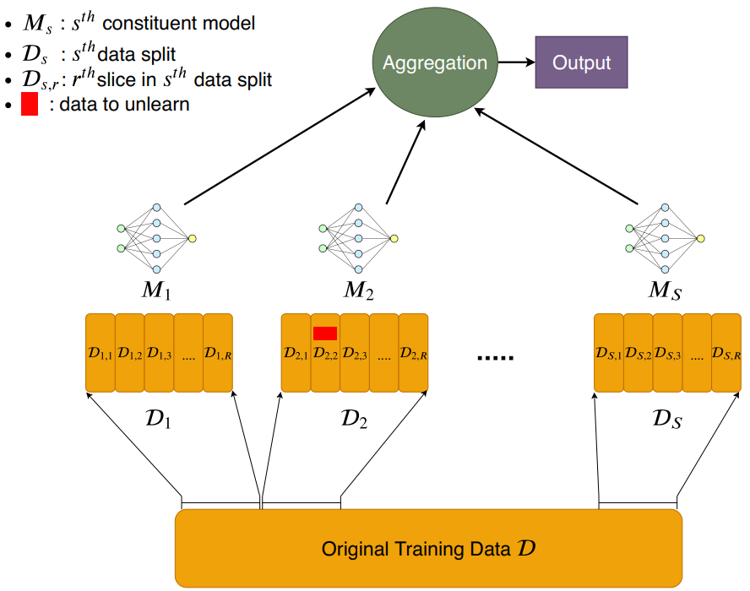
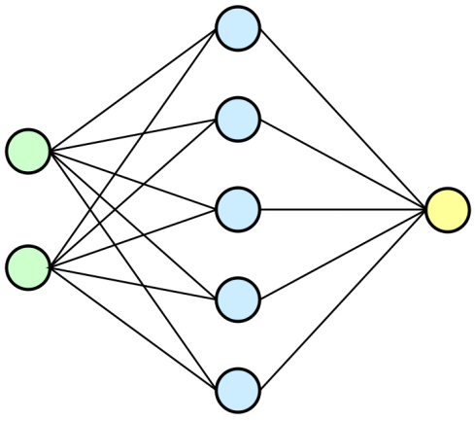
An example: sharding-based learning/unlearning
Traditional ML Architectures
Sharding-based ML Architectures
Sub-dataset
Sub-dataset
Sub-dataset
25
Notes:
Instead of training a single model on entire training data, sharding-based ML divides the data into shards, each trains a separate sub-model. The final output is an aggregate of these sub-models' results.

Slide 26
Sharding-based unlearning
Traditional Machine Unlearning
Retrain the entire model from scratch using the full training data
Sharding-based Machine Unlearning
Only retrain the affected sub-models using the affected sub-dataset
Sub-dataset
Affected
Sub-dataset
Sub-dataset
Retrain the full training data
26
Notes:
sharding-based machine unlearning only retrains affected sub-models, significantly improving efficiency.

Slide 27
Limitations of sharding-based unlearning
Sharding-based unlearning:
Need sufficient training data for each large model
to prevent overfitting and maintain generalization
Train S times larger model
Store S times larger model
Massive computational, storage, and time costs!
Billions param
Billions param
Billions param
27

Slide 28
Our solution: Separation of public/private data in ML
Principal Strategy:
Divide training data into two categories:
Public data, non-sensitive & no need for unlearning (e.g., Wikipedia, ImageNet)
Private data, sensitive & need for unlearning (e.g., medical data, financial data)
Two-phase training of large models:
Pre-train, train a backbone (base) model
Fine-tune, customize the base model for specific tasks or domains
Public data
Pre-trained model
Private data
Fine-tune
(prompt tuning)
28
Notes:
Our solution divides the data into public and private datasets.
We first pre-train the backbone of the large model using the public data (no unlearning request), and then use the private data (potential unlearning request) for prompt tuning.

Slide 29






Model parameter turning vs. Prompt tuning
Prompts are appended to the training data and then fed into the pre-trained model
Guide the pre-trained model to adapt to different tasks with optimized prompts
Pre-training
Model Parameter Tuning
Prompt Tuning
eg: GPT-3
Google T5
Task A model
(11 Billions params)
Prompt A
$$x_{A}$$
Pre-trained model
(11 Billions params)
Pre-trained model
(11 Billions params)
Prompt B
$$x$$
$$x_{B}$$
$$y$$
Task B model
(11 Billions params)
$$x$$
$$x_{C}$$
Prompt C
Task C model
(11 Billions params)
Learnable Prompts
(Around 20K params each)
B. Lester, R. Al-Rfou, and N. Constant, “The Power of Scale for Parameter-Efficient Prompt Tuning,” EMNLP 2021 - 2021 Conference on Empirical Methods in Natural Language Processing, Proceedings, pp. 3045–3059, 2021.
Notes:
We take prompt tuning approach.
Prompt tuning is a method to adapt a pre-trained model to specific tasks by changing the input prompts, rather than the model's internal parameters. It utilizes the pre-trained model and customizes it for particular tasks through the input prompts.
Prompt doesn’t change the parameters of the base-model.
x: tuning training data
Advantages:
It avoids retraining the whole model.
Efficient for unlearning: Prompt parameters are separated from base model and much smaller

Slide 30

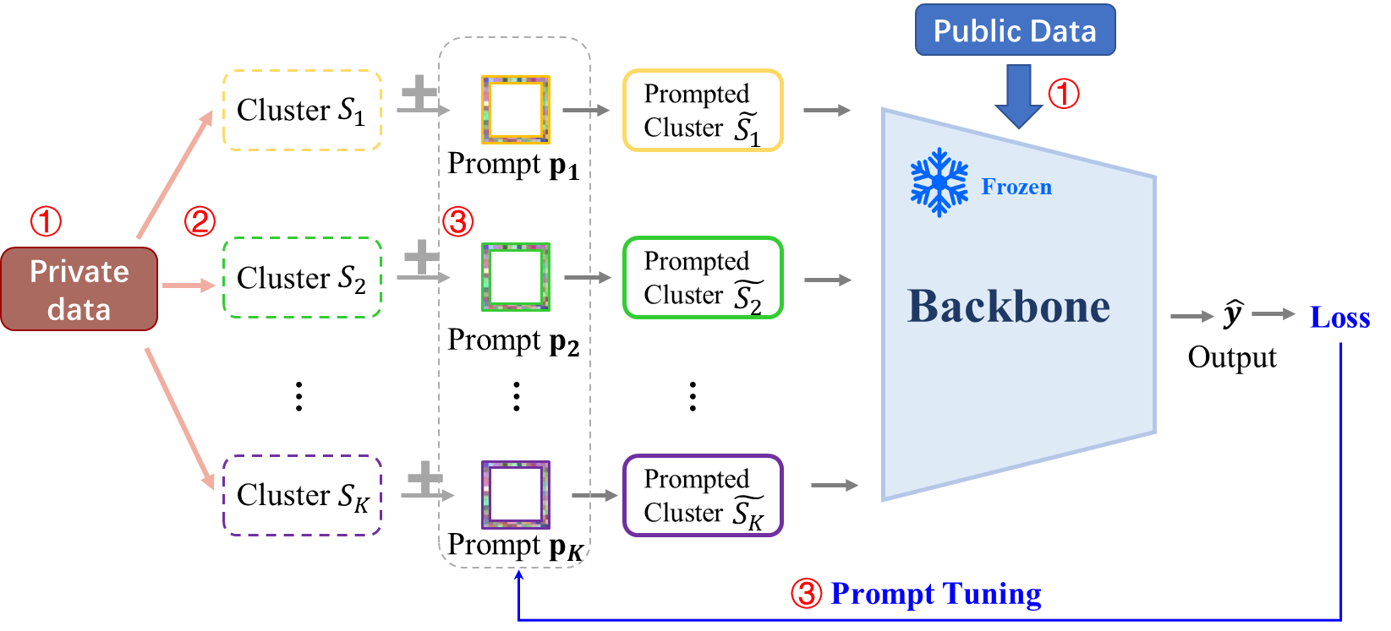

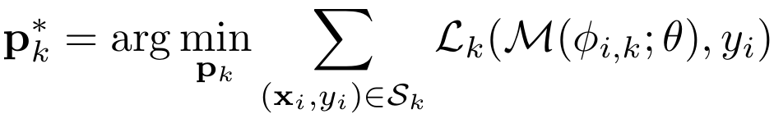


Prompt-tuning-based Machine Learning/Unlearning: Prompt tuning
Private data
$x_{i}$
Prompt
$$p_{k}$$
Prompted data
1. Data Separation and Pre-training
Separate public and private datasets
Pre-train backbone on public data
2. Private Data Clustering
Cluster private data by domains
3. Prompt Tuning for Clustered Data
For each private data point
Attach prompts to data
Fine-tune prompts
Notes:
Input: private data + prompts (to be learned)
Frozen backbone: no change of base model
Output: ${\hat{y}}_{i,k}=ℳ\left(Φ_{i,k};θ\right)$, it is the output corresponding to the input data x_i and the prompt of cluster k.

Slide 31
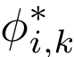
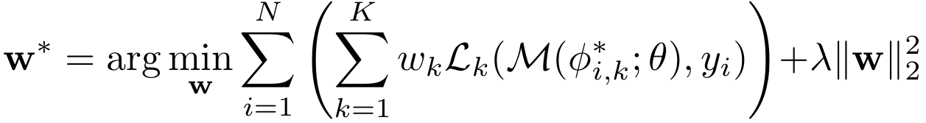
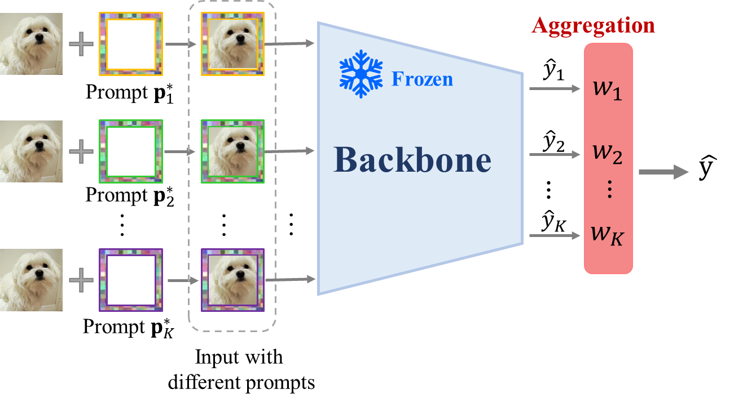
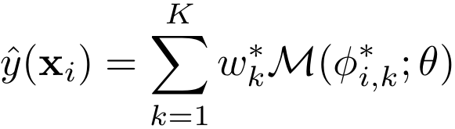



Prompt-tuning-based Machine Learning/Unlearning: Weighted aggregation
Private data
$x_{i}$
Optimal prompt $p_{k}^{∗}$
Optimal prompted
data
4. Adaptive Weighted Aggregation
④
Notes:
w=[w_1,w_2,…,w_k]
w*=[w_1*,w_2*,…,w_k*] are the optimal weights.
It is important to improve generalization and reduce overfitting when dealing with large-scale models. A single prompt may not capture all the knowledge embedded in other prompts needed for some complex images. Therefore, we design a proximity-aware adaptive weighted aggregation method that combines the predictions obtained using different prompts.
By using multiple prompts and assigning them weights based on the correlation between clusters and samples, this method not only takes complementary advantages of different prompts, reduces the risk of overfitting, but also ensures that the model remains adaptable to diverse input data, capturing the nuances that a single prompt might miss, leading to more robust and well-rounded predictions.

Slide 32
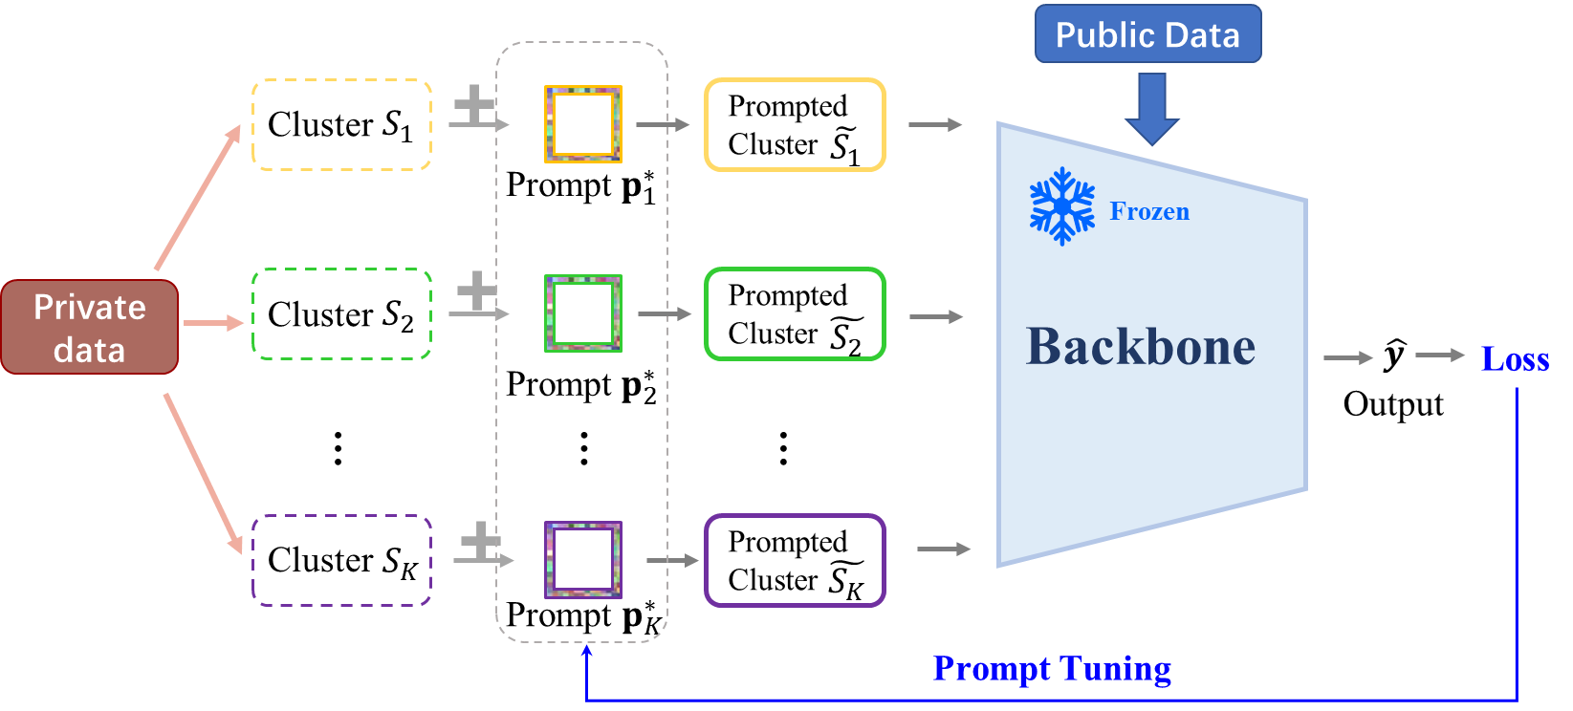



Prompt-tuning-based Machine Learning/Unlearning: Unlearning
Private data
$x_{i}$
Optimal prompt $p_{k}^{∗}$
Optimal prompted
data
5. Unlearning of Prompts
Remove the data from the cluster
Update affected prompts & weights
The backbone remains frozen!
Advantages:
Efficient unlearning
Avoid catastrophic forgetting
Jie Xu, Zihan Wu, Cong Wang, Xiaohua Jia: LMEraser: Large Model Unlearning via Adaptive Prompt Tuning. AISTATS, 2025.
Notes:
Catastrophic forgetting: since we use frozen model, it avoids catastrophic forgetting even deleting a lot of private data

Slide 33
Concluding Remarks
Three key technologies to facilitate data sharing:
Secure data authorization and its compliant computation
Contribution-based data valuation
Efficient unlearning
Notes:
summary

Slide 34
Data sharing and distributed training is
a future direction for collective intelligence
Notes:
One person’s intelligence is always limited, because he has limited data
…..

