Slide 1

CS1102 Lec10 – Computer Security
Computer Science Department
City University of Hong Kong

Slide 2
Objectives
Identify the various types of security risks/threats that can cause damages to computers or users
Recognize how a computer virus works and take the necessary steps to prevent viruses
Distinguish different malicious programs: viruses, worms, Trojan horses, spyware and cookies
Discuss techniques to prevent unauthorized computer access and use
Define encryption and explain why it is necessary
Discuss public/private key infrastructure and explain how it could be used for secure communication and authentication
Describe precautions you should take to safeguard your computer and data

Slide 3
Computer Security
Computer security is about protecting information from being attacked, while making it readily available to authorized users
Security risk/threat is any thing, event or action, that could cause a loss of or damage to computer hardware, software, data, or processing capability. The threats originate from two main sources
Human
Malicious : usually come from users who have malicious intention, like hackers
Non-malicious: usually come from careless users who are not trained on computers or are not aware of various computer security threats
Nature
Come from nature disasters such as Earthquakes, hurricanes, floods, lightening, fire and etc.

Slide 4
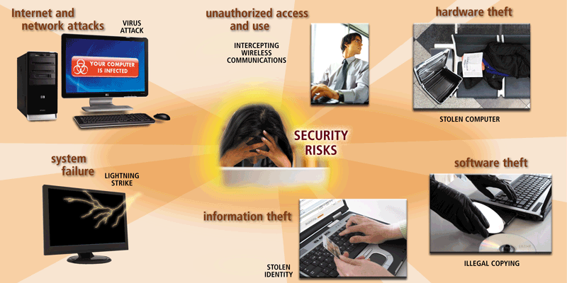
Computer Security Risks

Slide 5
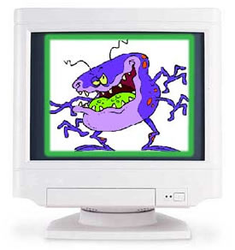

Types of Viruses Attacks
Major threats to data are malicious software (malware)
Viruses
Self-replicating programs that attach themselves to executable files
Can spread from file to file
Can damage files or hardware
Worms
Programs that use computer networks and security holes to spread themselves (no need to attach themselves to files)
Typical worms were designed only to replicate and spread, and do not attempt to change the systems they pass through
Can cause system or network disruption by generating overwhelming amount of traffic
Trojan horses
Programs that claim to perform one function while actually doing something else
Not designed to replicate themselves
Can steal passwords or open backdoors (remote access for hackers)
Notes:
Trojan horse is a technique to embed virus into a “seeming useful” program. It can do damages the same as virus.

Slide 6
Threats to Privacy
Data privacy or information privacy (or simply privacy) is the right of individuals to decide when and how much they want to share with others
Personal information is a marketable commodity, which raises many issues:
Collecting public, but personal or private information (e.g., Google’s Street View)
Spreading information without consent, leading to identity theft
Spreading inaccurate information
Threats to your privacy include
Internet cookies
Spyware and Adware
Spamming and Phishing

Slide 7
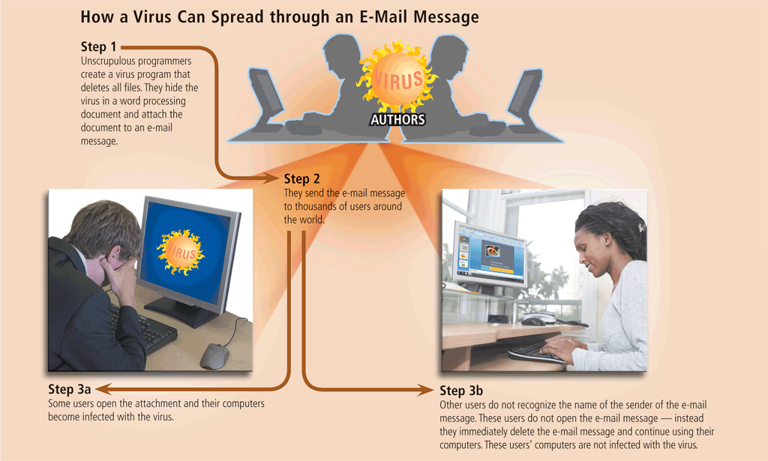
Computer Virus
A computer virus is like a biological virus, which can "infect" a program by attaching itself to it
Viruses replicate themselves on the host (infected) computer
One way is to infect executable files , such as .exe or .vbs files
When computer executes the infected program, the virus instructions will get the chance to be executed, and infect more other files
When the infected files are distributed to other machines, the virus spreads to other machines
Can be classified according
to types of files they infect:
Executable file virus
Boot sector virus
Macro virus
Email virus
Notes:
Fig. is an example of an email virus.

Slide 8
Computer Virus
An executable file virus is the virus that attaches to an application program (.exe, or .vbs)
The host program needs to be executed in order for the virus to replicate
A boot sector virus infects some system files that the computer uses every time it boots up
The boot sector of a floppy disk or hard disk contains the instructions how to load the operating system
The virus can guarantee it gets executed every time the system starts
Macro viruses infect a set of instructions called a macro that is used to automate tasks in documents and spreadsheets
When the infected document or spreadsheet is opened and you choose to enable macros, the macro virus gets executed and infects other documents
Email viruses are virus programs sent as email attachment that will cause the host machine infected if activated
When the user view the attachment, the virus code gets executed
Notes:
Virus must attach to an executable file to take effect: boot section and Macro are all executable program. The same as email attachment.

Slide 9
Symptoms of Infection
Viruses, worms, and Trojan horses spread by sharing files, USB, CD’s, web site download, email attachments
The downside of all those free stuff from the Internet are the security threats
If you have the following symptoms in your machine, you may be infected by some malicious software
See some unknown or not-making-sense Windows messages
Frequent annoying pop-up ads
Encounter problems when saving files or notice missing files
Computer runs slower than usual
Frequent or unexpected reboots or shuts down
Sending out e-mails or Internet traffic on its own
Available memory is less than expected
Increase in size of executable files
Periodic network activities when you are not accessing the network

Slide 10
Anti-Virus Software
Anti-virus software are the utility programs that monitor your computer, looking for potential viruses, worms and Trojan horses
The most common technique for antivirus software is to store virus signatures in a Database and scan your files regularly for these signatures
A virus signature is a known identifier of the virus, usually some specific pattern of virus code
Works for known viruses, BUT is not able to detect new viruses
Once a virus is found
The anti-virus program will attempt to remove the detected viruses or
Quarantine infected files in a separate area of hard disk

Slide 11
Spyware and Adware
Spyware is the software that gathers and reports information about a computer user without the user's knowledge or permission
May perform many different functions, including:
Delivery of un-requested advertising (pop-up ads in particular)
Collecting private or sensitive information by
Logging keystrokes
Recording Internet Web browsing history
Scanning documents for sensitive data
Adware refers to the software that displays advertisements or pop-up ads with or without the user's knowledge or permission
Notes:
Spyware: you may not feel its existence
Adware: some website has many ads that the owner deliberately put on…

Slide 12
Spamming and Phishing
Spamming is the act of sending unsolicited (un-welcomed) electronic messages to many recipients
The most common form of spam is email spamming
Spammer obtain email addresses by a number of means
From mailing list
From Web pages
By guessing
Phishing refers to faked websites or emails that are designed to steal your personal information especially credit card numbers, bank accounts and passwords
Common Internet phishing includes
Sending out many email messages that appear to be legitimate (legal and genuine)
Designing web sites look official but actually not
Notes:
In webpage, not give directly usable email-address to prevent people mis-use ur email-addr

Slide 13
Unauthorized Access and Use
Another kind of security threats is unauthorized access to someone’s computer (data and programs) without permission
A port probe (or port scan) uses automated software to locate computers that have open ports and are vulnerable to unauthorized access
Servers use TCP Port (a number ranges from 0 to 65535) to communication with remote clients, which leaves vulnerable points for malicious attacks
Denial of Service attack that jams servers (e.g., web server) or networks with traffic such that servers become unable to server normal requests
A back door is a piece of program that allows intruders to bypass security controls
Spoofing is a technique that intruders use to concealing the identity of the sender to make their network transmission appear legitimate
Notes:
Port probe: most of machines disable port connection except a couple of ports that they provide services.
Spoofing attack: TCP/IP spoofing: use false IP address

Slide 14
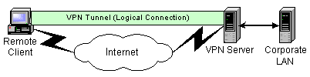
Prevent Unauthorized Access
How companies or organizations protect their computers against malicious intrusion?
Using access control that defines who can access computer and what actions they can take
Requiring user name and password for users to log in the system OR
Requiring using possessed objects such as smart cards OR
Using biometric input devices
Installing firewall system (consisting of hardware and software) to analyze network traffic, and block unwanted traffic and identify suspicious behaviors
Firewall does its job by monitoring every packet that goes in and out of your computer
Setting up virtual private network (VPN) access to secure remote connections via a public network to corporate LAN
14
Notes:
Firewall can block/allow traffics from particular IP address, open incoming traffic for some ports only.

Slide 15
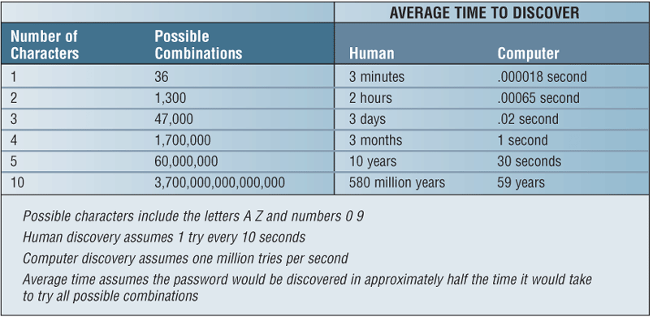
Password-based Authorization
Your choice of password can actually affect overall system security
You should choose one that is long enough and difficult for others to make guesses about what you have chosen, but at the same time easy to remember
Brute-force attack v.s. dictionary attack
Notes:
Brute force basically tries all the possible keys mentioned on the keyboard to decrypt the password or any encrypted message.
Dictionary attack only tries those possibilities that are supposed to be successful, it sort the words by the frequency of the use and then contiguously hits and tries.
Computer tries passwd very fast: to stop people using computer to guess passwd, nowadays they usually require the input of specially generated string (must be human readable but computer un-recognizable). It takes less time than that of brute force attack

Slide 16
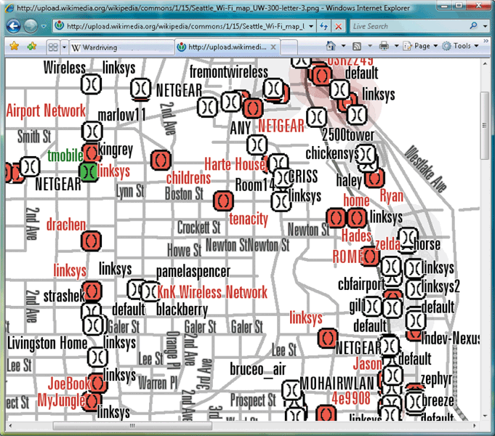
Wireless Security
Wireless access poses additional security risks
War-driving is the act of searching for Wi-Fi wireless networks by a person in a moving vehicle, using a portable computer or PDA
Connecting to the network and using its services without explicit authorization is referred to as piggybacking
In addition to using firewalls, some safeguards improve security of wireless networks
Configure WAP (wireless application protocol) so that only certain devices can access it (e.g., devices with registered IP addresses)
Use WPA (WiFi Protected Access) or WPA2 security standards for more advanced encryption techniques
Notes:
Note: 1) wireless signal is broadcast in nature; 2) the information from your mobile device to web-server may not be encrypted!
For piggybacking: Set passwd for your wifi router
WAP: a standard to provide internet access to wireless devices, WAP phone, WAP browser
WPA and WPA2 are two security protocols defined for WiFi access

Slide 17
Data Protection through Encryption

Slide 18
Encryption - Data Protection
Encryption is the process of converting readable data into unreadable characters (called cipher text) to prevent information theft
Just like encoding and decoding, to convert the cipher text back to the original data, a decryption process is needed
The encryption/decryption process usually involves a cryptographic algorithm + some cryptographic key(s)
Many encryption methods exist, for example
Name | Method | Original text | Ciphertext
Transposition | Switch the order of characters | WIRELESS | IWERELSS
Substitution | Replace characters with other characters | I LOVE YOU | V YBIR LBH
Expansion | Insert characters | MOUSE | MDODUDSDED
Compaction | Remove characters and store elsewhere | COMMUNICATION | COMUICTIN
Notes:
Easy transposition: list the text in an array in rows, and output in columns: what’s the key?
Most of the modern cryptograph are based on substitution.

Slide 19
Motivation of Encryption
Hello
Bob
Alice
Hello
Attacker (Eve) intercepts
and reads messages

Slide 20
Motivation of Encryption
Hello
Hello
@#%%^
Bob
Alice
@#%%^
Attacker (Eve) intercepts
but cannot read messages

Slide 21
Symmetric & Asymmetric Encryption
Symmetric key encryption techniques use the same key for encryption and decryption
Requires the key to be distributed before someone else can read the cipher-text
Problem: someone else can capture the key which makes it vulnerable to attack
Asymmetric key encryption also known as public key encryption
Uses a pair of different keys
A public key is a widely distributed one (could be posted on a Web page or emailed)
A private key is kept secretly
Encryption can be done by either key, with the other key for decryption
Notes:
RSA algorithm: by 3 professors from MIT
Difference between symmetric and asymmetric

Slide 22
Encryption with Asymmetric Keys
Bob’s and Alice’s public keys are publicly available
Bob’s private key is kept secretly and only can be seen by him
Alice’s private key is kept secretly and only can be seen by her
A.1. Bob uses Alice's public key to encrypt the message
A.2 Alice uses her private key to decrypt the message
Bob
Alice
*@%&
B.1. Bob uses his private key to encrypt the message
B.2 Alice uses Bob's public key to decrypt the message
/![;'4!@#%%^
@*&)@*%&@#
Which one? A1+A2 vs. B1 + B2
Notes:
Use the example you and me (I’m Bob):
Green example is to prevent people from reading the email to Alice
? What’s the use of Pink example: to prevent people from modify it: this’s the document-signature!

Slide 23
An Authentication Protocol with Asymmetric Keys
1. Bob sends Alice a secret in plain text
secret
3. Bob uses Alice's public key to decrypt, and check the secret
2. Alice uses her private key to encryption the secret
Bob
Alice
*@%&
4. Bob uses Alice's public key to encrypt the message
5. Alice gets the encrypted message and decrypts it using her private key
/![;'4!@#%%^
@*&)@*%&@#
Authentication + Encryption
Notes:
After step 3, Bob is convinced Alice is the true “Alice”
Step 4&5 is for Bob to send data to Alice in secured channel.
?how can Bob be sure that the Alice’s public key is from the genuine “Alice” (it can be a faked Alice distributed her public key) → certificate

Slide 24
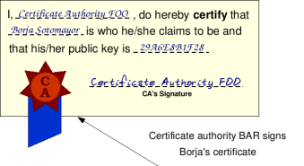
Digital Certificate
Public key approach seems good, but
Someone could provide a false public key. How to verify the public key is really Alice's ?
A Digital certificate is used
A user can apply a digital certificate from a Certificate Authority (CA). The CA issues the user a certificate and an associate private key. The user can post the certificate to public and keep the private key for himself.
A certificate is a digital document containing the user's ID information and public key, and bearing the signature of the CA.
A recipient can use the CA's public key to verify if a received certificate is a genuine one and save the sender's public key for future use.
With the sender's public key, the recipient can send an encrypted reply.
NB: CA charges fees for certificates
Notes:
Slow
Use fig to explain certificate
When you do online business you need to have a certificate, e.g., if you start a web-shop…

Slide 25
Format of a Digital Certificate
A certificate has two parts: data, and CA’s signature.
The data part contains information about the person who requests the cert:
version no. of X.509 standard, serial no. of the certificate (unique to a CA)
distinguished name of CA and the name of subject (in X.500 format)
valid period
signature algorithm used by the CA (e.g, PKCS #1 MD5 with RSA Encryption)
public key of the subject being certified
Special extensions (optional)
The signature of CA:
Signature algorithm and CA’s signature of this certificate.
N.B. Anyone receiving the certificate can use the signature algorithm and CA's PublicKey to verify it. PublicKeys of the CA is pre-loaded in outlook.
Notes:
Note: a digital certificate is a document to prove u’re the person you claimed to be!
The data part tells who you’re.
The signature of CA is used to verify if the certificate is a valid/genuine one. We all need to trust CA (which is the root of trust).

Slide 26
A Sample Certificate
This is a certificate issued by Ace CA:
Data
Version: v1 (0x0)
Serial Number: 1 (0x1)
Signature Algorithm: PKCS #1 MD5 With RSA Encryption
Issuer: OU=Ace Certificate Authority, O=Ace Ltd, C=US
Validity: Not Before: Fri Nov 15 00:24:11 1996
Not After: Sat Nov 15 00:24:11 1997
Subject: CN=Jane Doe, O=Ace Industry, C=US
Subject Public Key Info:
Algorithm: PKCS #1 RSA Encryption
Public Key: 00:d0:e5:60:7c:82:19:14:cf:38: F7:5b:f7:35:4e:14:41:2b:ec:24:
33:73:be:06:aa:3d:8b:dc:0d:06: 35:10:92:25:da:8c:c3:ba:b3:d7:
lf:1d:5a:50:6f:9a:86:53:15:f2: 53:63:54:40:88:a2:3f:53:11:ec: 68:fa:e1:f2:57
Public Exponent: 65537 (0x10001)
Signature
Algorithm: PKCS #1 MD5 With RSA Encryption
Signature: 12:f6:55:19:3a:76:d4:56:87:a6: 39:65:f2:66:f7:06:f8:10:de:cd:
1f:2d:89:33:90:3d:a7:e3:ec:27: ac:e1:c0:29:c4:5a:69:17:51:dc:
1e:0c:c6:5f:eb:dc:53:55:77:01: 83:8f:4a:ab:41:46:02:d7:c8:9a: fe:7a:91:5c
Notes:
Data & signature parts;
Data part in details;
Signature part in details.

Slide 27
Sign an Email / Read a Signed Email
A signed email ensures you the email is truly from the owner of the email-address (the sender cannot deny it):
When user click “sign” to sign an outgoing email, his private key is used to generate a signature from the email. (An email’s signature is the encrypted abstract of the email.)
The email is attached with two files: 1) the email’s signature and 2) the sender’s certificate
When the recipient receives this signed email, the mail-reader (e.g., outlook) will:
Verify the attached certificate by using the CA’s public key
Verify the attached email’s signature by using the certificate
Save the certificate in local database for future use…
Notes:
Show outlook interface: “Sign” and “Encrypt” icons on command bar! Explain them.
Sign an email: the sender cannot deny it.

Slide 28
Encrypt / Decrypt Emails
When a user clicks “encrypt” to send an email, the email will be encrypted by using the recipient’s public key (embedded in the recipient’s certificate).
The user needs to have the recipient’s certificate for encrypting the email (the certificate was already saved in local database when receiving a signed email earlier from the recipient).
When the recipient receives the encrypted email, the mail-system will use his private key to decrypt it.
An encrypted email will not be eavesdropped or tampered.
Notes:
When you encrypt a message to a recipient that you never received a signed email from him, the outlook will prompt a window, telling you that it cannot find the certificate of the recipient!
Decrypt a message also need to access the database that keeps your privateKey database (password is required).

Slide 29
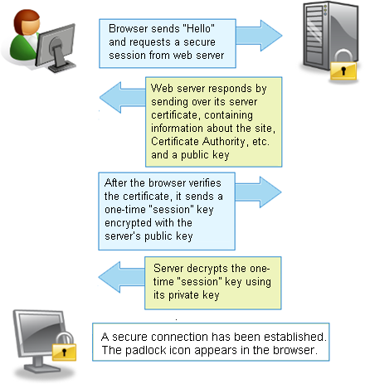
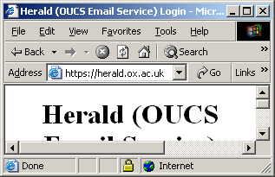
SSL - Secure Sockets Layer
SSL (Secure Sockets Layer) provides encryption of all data that passes between clients and Internet servers
You will probably see a key icon becoming whole or a padlock closing indicating the session is secure
Also notice that the http in the address bar, becomes https
Use public/private keys for authentication and symmetric session keys for data communication
Notes:
Gmail interface!
If it’s not https, the information from browser to webserver is NOT encrypted.
https: you need to supply your username and passwd. You don’t want your passwd to be eavesdropped on the way from your PC to the web-server. You need SSL!
In fig.: after step 4, both browser and webserver agree on the same session key
Step 5: the browser use the session key to encrypt username & passwd, and webserver also use the session key to encrypt reply….

Slide 30
Security Tips
Regularly backup your data
Keep your system up to date (OS patches in particular)
Better turn your computer off when you aren’t using it
Install an anti-virus software on your computer
Update your anti-virus software regularly by downloading new virus signatures
Never open an email attachment unless you are expecting it and it is from a trusted source
If the antivirus program flags an email attachment as infected, delete the attachment immediately
Install a personal firewall software
Check all downloaded programs for viruses, worms, or Trojan horses, spyware, adware

Slide 31
Security Tips (continued)
Set the macro security level at least Medium so you can enable or disable macros
Choose a good password and regularly change your password
Don't fill out registration forms unless you see policy statement saying information won't be sold
Set browser to prompt you to accept cookies or disable cookies
Install anti-spyware software
Set email-filter or spam blockers
Never respond to requests for personal information via e-mail
Visit Web sites by typing the URL into your address bar – don’t click the links in emails
Check to make sure the Web site is using encryption for personal data

Slide 32
Lesson Summary
Computer security threats may come from human (malicious or non-malicious) or nature, which could cause a loss or damage to your computer or data.
A malicious-program or malware is a program that acts without user's knowledge and deliberately changes the computer's operation or steals sensitive information. Malware include viruses, worms, Trojan horses, spyware, adware. To protect your computer from those malware, you need to install anti-virus, anti-spyware and personal firewall programs.
Guidelines to ensure secure passwords include using at least eight characters; using a combination of digits, letters and control characters; and choosing a combination that only you would know.
Internet cookies are the small files stored at your local hard disk that enable websites to be customized for your own interests.
To protect your data from authorized access, encryption could be used to convert readable data into unreadable cipher text.

Slide 33
Reference
[1] HowStuffWorks.com - Computer Virus
http://computer.howstuffworks.com/virus.htm
[2] Wikipedia - Computer Virus
http://en.wikipedia.org/wiki/Computer_virus
[3] Ronald B. Standler - Examples of malicious programs
http://www.rbs2.com/cvirus.htm
[4] UMD.edu – Choosing a good password
http://www.cs.umd.edu/faq/Passwords.shtml
[5] Answers.com - SSL/TLS
http://www.answers.com/topic/ssl
[6] Wikipedia - Public key cryptography
http://en.wikipedia.org/wiki/Public-key_cryptography

Slide 34

For you to explore after class
Lec10-Q1: why are Internet cookies seen as a kind of privacy threat to Internet users?
Lec10-Q2: what is "dictionary attack”? what kinds of passwords are vulnerable to dictionary attack? what kind of passwords are more safer?

Slide 35
Exam review
1. “fill-in” type of questions [1 mark for each]
E.g., Which of the following storage is volatile? Cache memory or flash memory?
2. conceptual questions [2-3 marks for each]
E.g., List two functions of a typical operating system.
3. BRIEF explanation (2-3 sentences) questions [4 marks for each]
E.g., Recently your friend Tom receives a lot of spam emails, and these emails present an “unsubscribe” link or button at the bottom. Because Tom doesn’t want to receive those emails any more, he wants to click the link to unsubscribe it. What is your advice to Tom?

Slide 36
Exam review
Design questions:
“fill-in” short program as in Lab work
“fill-in” flow-chart design of a program
“fill-in” Digital circuit design
……
Notes:
Some HTML contents
Lab 01 – 06 are examed.

