Slide 1

CS1102 Lec09 - Internet and WWW
Computer Science Department
City University of Hong Kong

Slide 2
Objectives
Describe the TCP/IP protocol, and how router works
Discover the relationship between IP addresses and domain names, and how DNS works
Identify today's popular Internet services
Discuss in details how browsers work and identify the components of a Web address (URL)
Explain how cookies could help with user preference or browsing interests
Describe how email and instant-messaging work

Slide 3
Who Controls the Internet?
No one controls the Internet
  It is a public, cooperative, and independent network
  Each organization is responsible only for maintaining its own network
Several organizations set some standards
  Internet Society (ISOC): a nonprofit, nongovernmental society
    Subcommittees, the Internet Architecture Board (IAB) and the Internet Engineering Task Force (IETF), establish and enforce network protocol standards.
  World Wide Web Consortium (W3C): sets standards and guidelines for Web technologies
    W3C Recommendations include: HTML, CSS, XML, PNG, SVG, …
  ICANN (Internet Corporation for Assigned Names and Numbers): oversees allocation of IP addresses and domain names, DNS root servers and Top Level Domain name management.
Notes:
Internet is different from WWW. Internet is like a highway to transport information; WWW is like super-markets that provides content. Anything that uses Web-browser belongs to WWW.
Isoc (not well know), but its subcommittee IETF is a well-known body in Internet Research community
W3C
ICANN

Slide 4
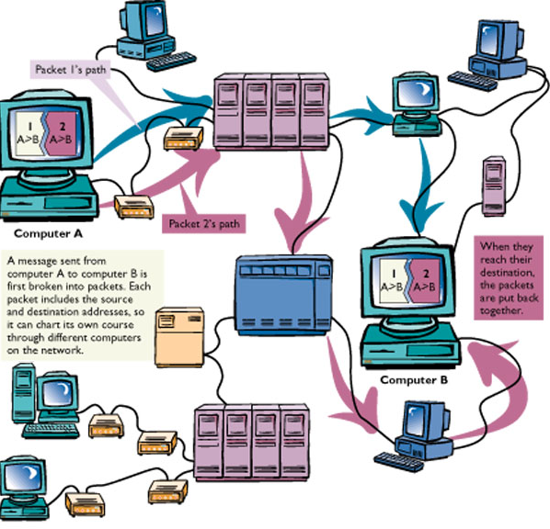
Internet Protocol - TCP/IP
Transmission Control Protocol/ Internet Protocol
  Defines how information can be transferred and how machines on the Internet can be identified with unique addresses
  Becomes the "language" of the Internet
  TCP: breaks data into packets
  IP: addresses packets
Notes:
Diagram shows: 1) two packets may take different paths (routes)
2) it’s multi-hop routing

Slide 5
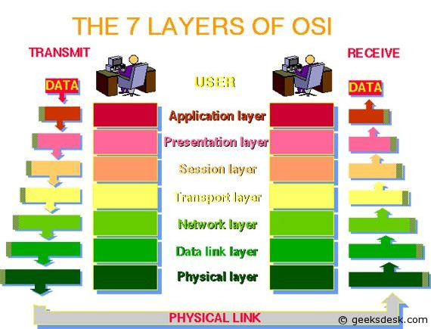
OSI 7 Layer Model of Computer Networks
Applications:
FTP, HTTP, Emails, MSN, ……
TCP
IP
EtherNet
Modem
Notes:
Internet: TCP/IP & below,
Web (HTTP) is one of the services of internet; email, skype are not web applications…

Slide 6
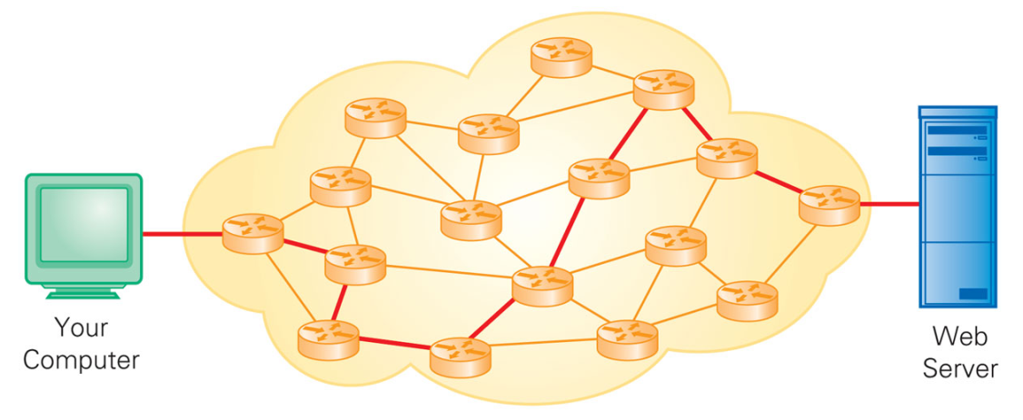
TCP/IP Protocol
TCP breaks a message into small fixed-size units called packets
  Each packet has all the information needed to travel from network to network. A typical IP packet looks like:
  Routers forwards data packets across networks toward their destinations through a process called routing
    A router communicates with other routers to maintain a routing table
    A routing table stores the best routes (e.g., shortest path) to destinations
Sour IP
Dest IP
Send Port #
Recv Port #
Seq No.
Len
Data ……
Notes:
IP header & TCP header
? Size of a routing table →

Slide 7
IPv4 Address Classes
class
A
0
network
host
1.0.0.0 to
127.255.255.255
B
10
network
host
128.0.0.0 to
191.255.255.255
C
110
network
host
192.0.0.0 to
223.255.255.255
D
1110
multicast address
224.0.0.0 to
239.255.255.255
32 bits
Notes:
IP addresses are divided into classes for the convenience of routing: given an IP addr, it tells: a) which class, b) network add.
One organization obtains a “network” address, depending on the size of its network
By using class & network ID, it reduces routing table size dramatically. Recent IP addr allocation is based on geographic locations.

Slide 8
IP Addresses
IP addresses are used to identify locations of hosts in Internet
  Each computer or device connecting to the Internet has a unique logical address, IP address
    Each device also has a physical address, _____ address?
  IPv4 address is 32-bits, represented as four 8-bits numbers, separated by periods (normally in decimal)
    E.g., 123.23.168.22
    Numbers in an octet can't exceed ________?
  Each IP address consists of two parts: network address and host address
    E.g., 144.214 correspond to CityU LAN
  Permanent vs. temporary IP addresses
    Computers such as servers or office PCs that need permanent identification on the Internet have permanent IP
    Most other computers (especially mobile devices) have dynamically assigned (temporary) IP
Notes:
Show IP address of your PC: command-prompt > IPconfig OR
Control-panel -> network connections -> …. (show setting, it could be “obtain IP / DNS dynamically” for notebooks)
? Each machines has unique MAC addr, why still needs IP address? MAC addr doesn’t tell location, it’s more like an ID.

Slide 9
Domain Names
IP addresses are not suitable for human users to remember
  Users have difficulties in remembering a 32 bit number separated by periods
  Will become harder! Since there are more and more machines connected to the Internet, IPv4 addresses (32-bits) are running out.
    The new version IPv6 (128 bits) is under deployment
The Internet servers use human-readable names called domain names
  E.g., 209.131.36.158 vs. www.yahoo.com
  A domain name is a key component of URLs and e-mail address
    www.cs.cityu.edu.hk (identifies a server machine)
    wangjy@cityu.edu.hk (identifies a mailbox)
Notes:
Email address & domain name
Domain names are hierarchical: explain domains: “cityu.edu.hk”, “.edu.hk”, “.hk”; each domain has a DNS server
Each computer has a name (for human), address (IP) and and ID (Mac addr)

Slide 10
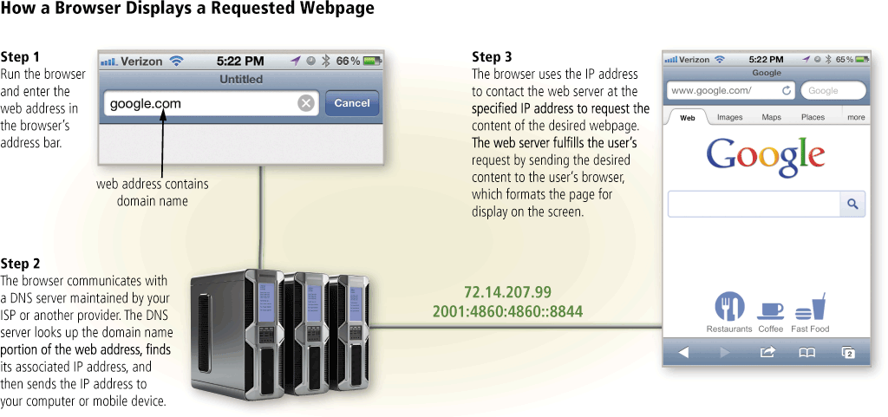
Domain Name Translation
http://www.dnsstuff.com/
Notes:
The diagram is wrong!
Task of DNS: Translate names into IP address. Quick 3 steps (next page is better)
Demo: name translation http://www.dnsstuff.com/
By supplying a domain name, www.cs.cityu.edu.hk, it generates the report: notice: 1) on top, it shows the local IP addr and location. 2) in the report, it first shows the “ns” who provides the Ipaddr; 3) at end, it shows the Ipaddr of the name.

Slide 11
Hierarchical DNS Servers
When a user in Cslab at CityU browses page http://www.cs.iit.edu, DNS servers translate name “www.cs.iit.edu” to IP address first
The browser sends an HTTP request to www.cs.iit.edu directly using its IP address
Root DNS server
2
4
5
3
DNS server of
dns.cs.cityu.edu.hk
DNS server of
dns.iit.edu
1 what is IP of www.cs.iit.edu
6 216.47.152.221
WebServer of
www.cs.iit.edu
HTTP connect to 216.47.152.221
PC in CSlab
Notes:
For all internet operations, DNS names need first to be translated to IP addresses!

Slide 12
Domain Name System
How are domain names related to IP addresses?
  The mappings between IP addresses and domain names are stored in a large distributed database called Domain Name System
  Computers that host parts of the DNS database are called domain name servers (DNS), which are responsible for translating human-readable domain names into numerical IP addresses
  DNS servers are organized in a tree structure following the layers of domain names (e.g., DNS servers for “cs.cityu.edu.hk”, “cityu.edu.hk”, …)
  There are 13 root DNS servers, denoted as “a ~ m.root-server.net.”
Where to get the domain name for your own Web site?
  You need to register your domain name with an organization called ICANN (Internet Corporation for Assigned Names and Numbers)
    It is a global organization that coordinates management of the DNS system
    Dozens of Accredited Registrars which handle domain name requests
    You need to pay an annual fee for each domain name (US$10 - US$50)
Notes:
Demo of config DNS: control panel -> network and sharing center (or “network connections” for window XP) → local area connection 2 –> properties -> choose TCP/IP (properties) -> show IP address and DNS servers
?how is name www.cs.cityu.edu.hk resolved if a user in USA browses it?
Draw on board of tree structure of DNS servers “cs.cityu.edu.hk”… root name server

Slide 13
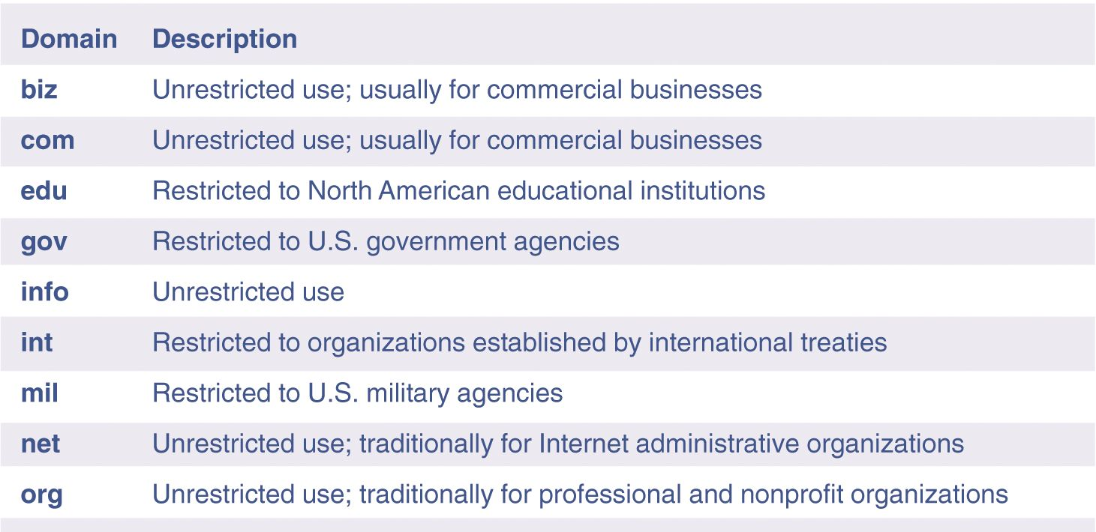
Top-level Domain Names
Top level domains appear in the last part of domain names
  A top level domain indicates the type of site, the country, etc.
Notes:
.cn, .fi, .fr, .au, .jp, .uk, .de
.tv (? Country or company): Tuvalu, population 10K, the total government budget is around 10 Million/year, but it ask for $50Mil to sale its domain name. it was brokered by a Canadian young man in 1998.

Slide 14
The Internet's Major Services
The World Wide Web (WWW)
  Developed in 1993 by Tim-Berners Lee
  Allows links among documents
  Uses browsers to display documents
Electronic mail (e-mail)
  Transmission of messages and files
News or newsgroups
  Online area where users discuss a particular topic
  Forum, Electronic Message Bulletin
Instant messaging
  Real time conversation service, as well as exchange of messages or files
Voice over IP
  Uses broadband Internet connection to make telephone calls
Peer-to-peer services
  Allows file sharing among users
  Napster and BT are examples
  Illegal to share copyrighted material
Grid computing
  Resource sharing among a group of computers in network
  E.g., SETI@home

Slide 15
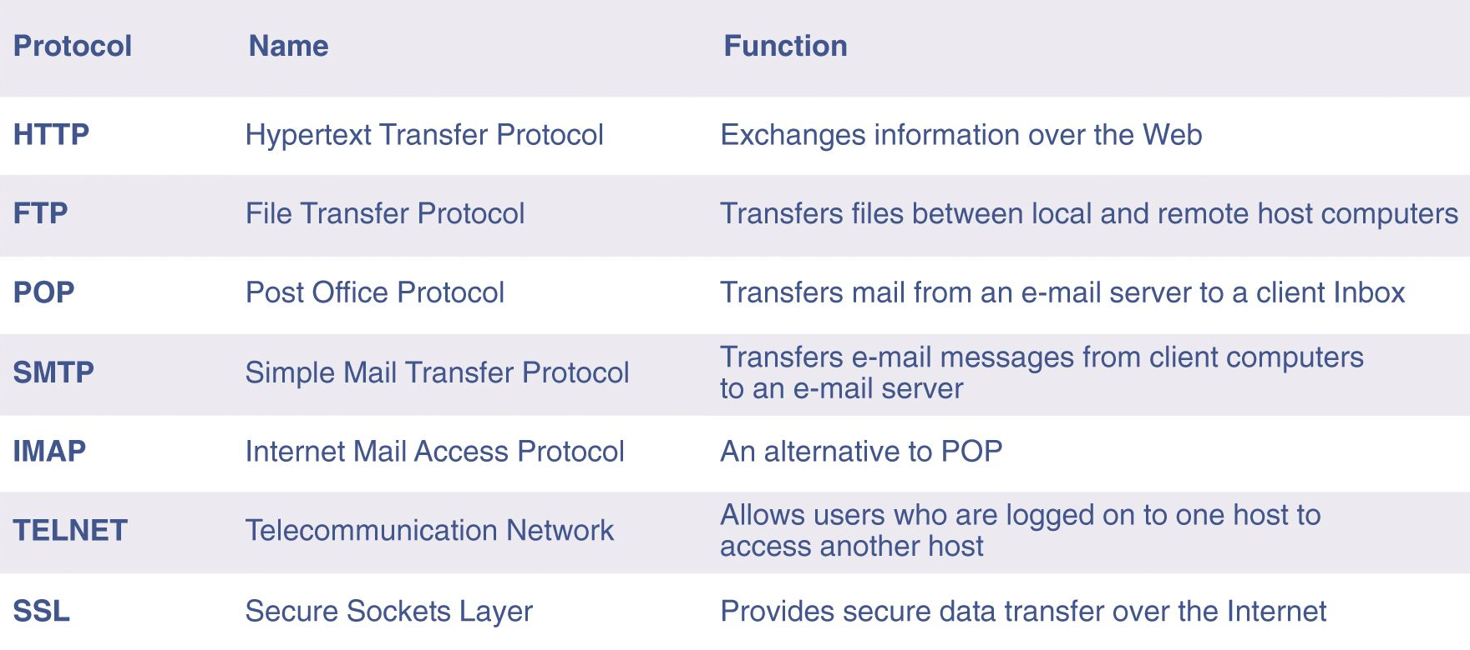
Well-known Internet Protocols
Less and Less Popular
Notes:
SSL + HTTP -> https!
telnet

Slide 16
SMTP
Short form for Simple Mail Transfer Protocol
Used for sending emails from email-client to the mail server and between mail servers to deliver emails to final destinations
SMTP commands include “HELO”, “MAIL FROM: send-addr”, “RCPT TO: recv-addr”, “DATA”, etc.
Assume emails are in plain-text format
For binary attachments (zip, exe, pictures), the email program should first convert data with MIME (Multipurpose Internet Mail Extensions)
Notes:
Demo: telnet smtp.cityu.edu.hk 25
HELO xxx // it doesn’t check xxx
MAIL FROM: president // it doesn’t check if president is a valid email address. The sender displayed in the email will be “Obama@whitehouse.org” // doesn’t check either
RCPT TO: xxx // xxx must be valid email addr for delivery
DATA
(this is a protocol!!!)

Slide 17
POP3 & IMAP
POP3 stands for Post Office Protocol version 3, and IMAP for Internet Message Access Protocol
POP3/IMAP act like mailbox, specifies where emails should be delivered to and stored until recipients coming to read
They are used by local email-client (such as outlook) to retrieve emails from the mail-server
  POP3 retrieves all emails from the server to the client whenever a user accesses his email account and all emails are stored at the client
  IMAP displays the list of emails in mailbox and retrieves only the emails user chooses to read (all emails are still and always stored at server)
IMAP is getting more popular than POP3 as people use iphone or mobile device to read emails:
  Allow partial download of big emails (e.g. skip the attachments)
  Emails are stored at server, saving client’s space (safer, more reliable ?)
Notes:
Note: web-mail (using browser to access emails) does NOT use pop3 nor IMAP. It uses HTTP to access mail-server!
POP or IMAP (internet mail access protocol) is used by a local email client (e.g. outlook) to retrieve emails from a mail-server. The port number for POP3 (version 3) is 110 (port # for POP2 is 109).
cityU mail-service has 3 servers: SMTP, POP3 and IMAP. They are different programs and can run in different machines.
The difference between POP3 and IMAP is that POP3 retrieve all mails from server to the client-side when the user reads mails, but IMAP only transmit the email-headers and retrieve actual email when the user chooses to read it. All emails are stored in server.

Slide 18
HTTP (HyperText Transfer Protocol)
Specifies the command and syntax for transfer of web pages and file. HTTP commands include: GET, POST, HEAD, etc.
Has nothing to do with the data content & HTML
  e.g. HTTP can be used to transmit non-HTML data
Allows browser to GET files from and POST information (e.g. HTML forms) back to server
Allows server to provide extra information, such as
  Last updated date of web-page (by HEAD request)
  Character set encoding (English, Chinese or Japanese)
  Cookies

Slide 19
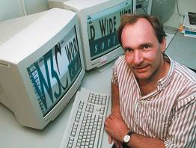
World Wide Web
Only been existence since 1991
Original idea for the WWW was attributed to one person
  Tim Berners-Lee a researcher at CERN (European Laboratory for Particle Physics) in Switzerland
  His idea was to link information together in related documents
  Originally, WWW was text based
In 1993, the first graphical browser Mosaic was released by NCSA (National Center for Supercomputers Applications)
In 1994, Marc Andreessen left NCSA and started a company Netscape focused on the Web
In 1997, Microsoft bundled the IE 4
with Windows 98
Notes:
FTP is the father of HTTP

Slide 20
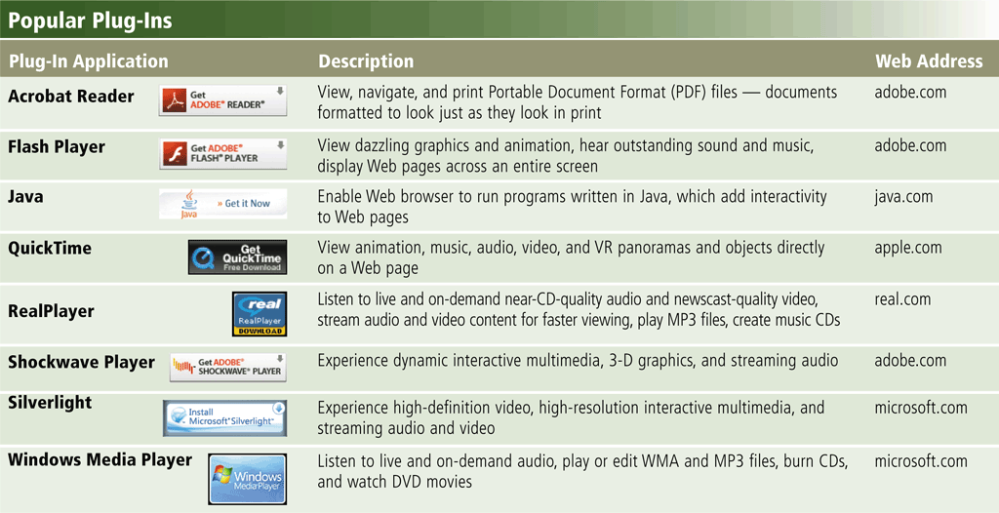
Web Browser
A Web browser is a program that allows you to view Web pages (text as well as multimedia content)
  Browsers use HTTP protocol to interact with web-servers.
  Popular browser in use today: Microsoft Internet Explorer, Mozilla Firefox, Netscape Navigator, Opera, Safari, Google Chrome
Browsers do not support all of the multimedia by default
  Need a plug-in program (or called adds-on) to view multimedia files
Notes:
Client-server model of web service.
Web Browser is the client. It is basically a text-formatting software.

Slide 21
When you type a URL in the browser, ….
Suppose you type in a Web address on the browser
  http://www.cityu.edu.hk/fse/program/academic_program.htm
  The browser breaks the URL into 4 parts
  The browser asks a DNS server to translate domain name to IP address
  The browser uses the IP address to set up a TCP connection to the web-server
  The browser sends a request in HTTP protocol to the web-server asking for the HTML file (e.g., GET /fse/program/xxx.htm)
  The server returns the corresponding HTML file to the browser
  The browser reads the file, interprets the HTML tags and displays the page
Protocol
Host Name
Domain Name
File Path
File Name
Notes:
Note: http and https are different protocols. https uses different format (encryption, public key, etc)…
Demo: telnet www.cs.cityu.edu.hk 80 //connection setup
GET /~jia/index.html HTTP/1.0

Slide 22

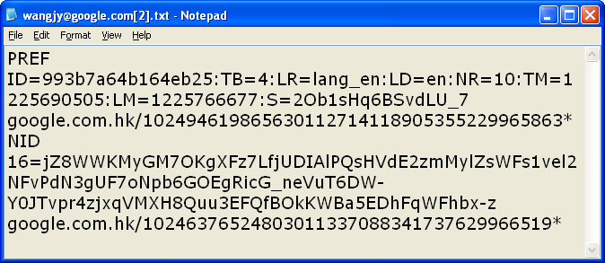
Cookies
Cookie - small piece of data generated by a Web server and stored on client’s hard disk
  Web-server is stateless
  Help Web-server track user’s browsing histories
  Relatively safe
Your computer does not have to accept cookies
Notes:
Purpose of cookies
Configure cookies: IE-Tools -> internet options -> privacy: slide the bar to set the right level of “cookie” acceptance
(optional) You can search “cookies” in C:\ drive, OR:
For Internet Explorer 8 in Windows XP, cookies are kept in
C:\Documents and Settings\<username>\Local Settings\Temporary Internet Files
For Internet Explorer 9 in Windows 7, cookies are kept in
C:\Users\<username>\AppData\Local\Microsoft\Windows\Temporary Internet Files
Make sure you turn on the option to view hidden and system files: open My Computer -> Tools -> Folder Options -> View tab, select the option to Show hidden files and folder to browse to the locations listed below.

Slide 23
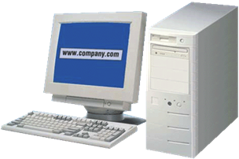
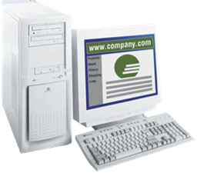
How Cookies Work?
Step 1. When you type Web address of Web site in your browser window, browser program searches your hard disk for cookies associated with Web site.
Step 2. If browser finds a cookie, it sends information in cookie file to Web server.
Unique ID
Cookies
Step 3. If Web server does not receive cookie but is expecting it, Web site creates pairs of (cookie, ID) and sends the list of cookies back to browser. Browser accepts all cookies and stores them on local disk. Web server can now receive cookies when you access the site next time.
Unique ID
Web server for
www.company.com
Request Home Page
Notes:
Delete cookies: IE-Tools –> internet options -> general: browsing histroy, click “delete”: pop up a window allowing to choose items (cookies) to delete…

Slide 24
Beyond HTML
Basic HTML does not provide much flexibility
  Users are asking for more multimedia content, greater interactivity, and improved user-friendliness
Multiple new technologies have come up to offer interesting and effective alternatives to HTML
  DHTML (Dynamic HTML)
    The combination of HTML tags, CSS, JavaScript code, Java Applet and ActiveX controls to allow the appearance of a Web page to change after it is loaded into browser
  AJAX (Asynchronous JavaScript and XML)
    A group of web development techniques used on the client-side to create asynchronous Web applications, i.e., exchanging data with the server and updating parts of a Web page without reloading the whole page.
Notes:
Cascading Style Sheets (CSS)
AJAX allows web pages to be updated asynchronously by exchanging small amounts of data with the server behind the scenes. This means that it is possible to update parts of a web page, without reloading the whole page.

Slide 25
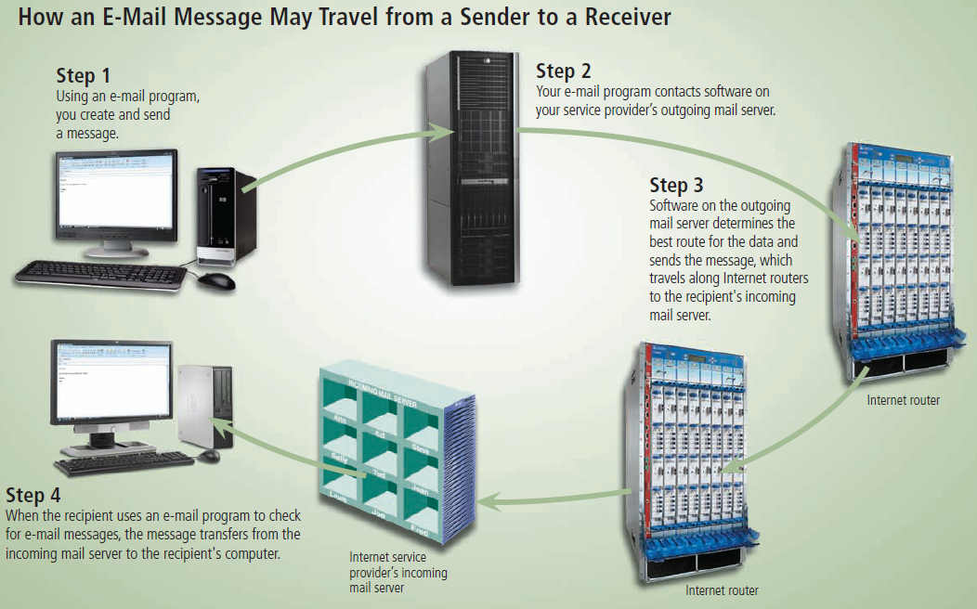
Other Internet Services
Email : server + clients
Notes:
Note: Outlook -> smtp -> pop3 -> Outlook, servers are in RED

Slide 26
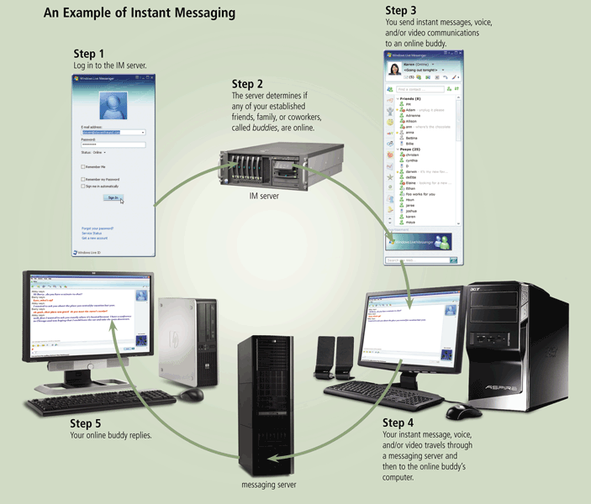
Other Internet Services
Instant messaging (IM):
server + clients

Slide 27
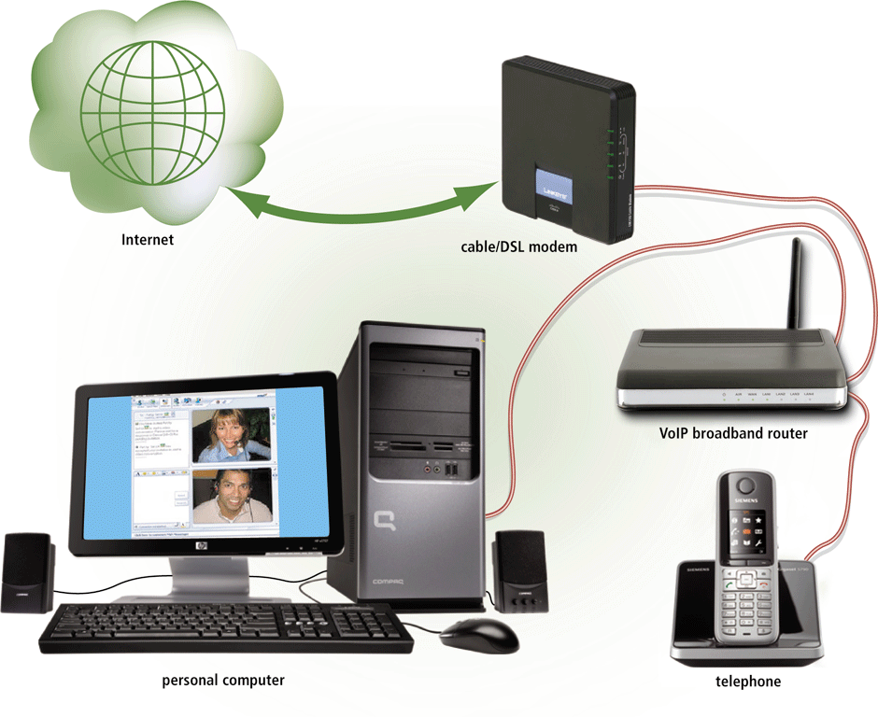
Other Internet Services
VoIP (Voice over IP) enables users to speak to other users over the Internet
  Also called Internet telephony
Notes:
Digram: use PC call phones.
Skype, QQ

Slide 28
Other Internet Services
Social Networking
  Connecting people and organizations that share a common interest or activity
    E.g., Facebook, Twitter, Weibo, LinkedIn
Blogs
  Personal news pages that are date/time-stamped and arranged with the most recent items shown first
    E.g., Techcrunch, ReadWriteWeb
Webcast and podcasts
  Live streaming audio and video broadcast on the Web or downloadable to media players
Wiki
  A specially designed Web site that allows visitors to edit the contents, supports collaborative writing
    E.g., RoboWiki

Slide 29
Other Internet Services
E-commerce: buying and selling of goods over the Internet
  Business-to-consumer (B2C)
    Online banking, online stock trading, online shopping
  Consumer-to-consumer (C2C)
    Web auction
  Business-to-business (B2B)
    Involves the sale of a product or service from one business to another, e.g. Alibaba
    Primarily a manufacturer supplier relationship
Cloud Computing
  Shifts computing activities from users’ desktops to computers on the Internet
  Frees end-users from owning, maintaining, and storing software programs and data

Slide 30
Lesson Summary
The Internet is a network of networks that connects all kinds of computers around the world and uses TCP/IP protocol to allow computers/devices to communicate
No single organization owns or controls the Internet
TCP/IP protocol is the language of the Internet, defining how information can be transferred and how machines on the network can be identified with unique addresses
Today's Internet offers users a variety of services, each of which may employ a specific kind of protocols, such as HTTP, SMTP, POP/IMAP, SSL
WWW is not equal to the Internet, which is an interlinked collection of HTML pages and multimedia content

Slide 31
Reference
[1] World Wide Web Consortium
  http://www.w3.org/
[2] Internet2 Consortium
  http://www.internet2.edu/
[3] ICANN
  http://www.icann.org/
[4] HowStuffWorks.com - Internet Infrasture
  http://www.howstuffworks.com/internet-infrastructure.htm
[5] W3C - A little history of WWW
  http://www.w3.org/History.html
[6] Wikipedia - Web 2.0
  http://en.wikipedia.org/wiki/Web_2

Slide 32

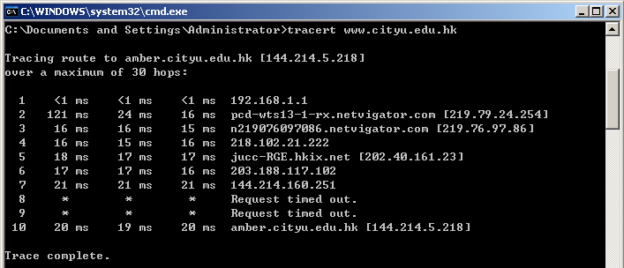
For you to explore after class
Lec09-Q1: note that when upstream speeds differ from downstream speeds, you have an asymmetric Internet connection; when upstream and downstream speeds are the same, you have a symmetric Internet connection. Most available Internet connection services, such as DSL and cable connection, are asymmetric. Why this asymmetry is okay for most Internet users?
Lec09-Q2: each node in the Internet already has a unique MAC address, why we still need to assign an IP address to it?
Lec09-Q3: note in this Tracert command execution, it displays a "Request timed out" message at hop 8 and hop 9. Does it necessarily mean that hop 8 and hop9's system have problems? Is there any other reasons causing such time-out?

