Slide 1

CS1102 Lec08 - Computer Network
Computer Science Department
City University of Hong Kong
Notes:
1session: P13

Slide 2
Objectives
Illustrate advantages of using a computer network
Discuss the purpose of the components required for successful communications
Illustrate how a stack of network protocol layers work together
Identify commonly used data transmission medium and communication devices
Differentiate between client-server and peer-to-peer networks
Name the most widely used LAN network communications standards
Draw a conceptual diagram illustrating the Internet backbone, NSP, ISP, and routers
List various options to access and connect to the Internet

Slide 3
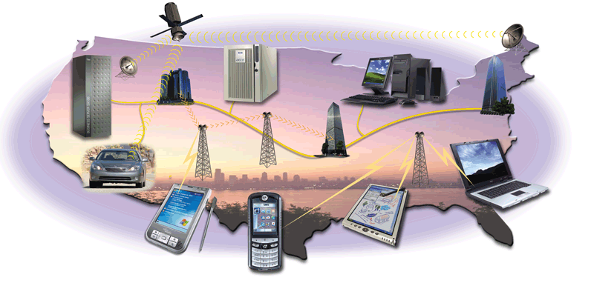
Networks and Communications
Computer network - a group of computers connected together to communicate, exchange data, and share resources in real time
  Computer communications - the process in which two or more computers or devices transfer data or instructions by way of a medium
Notes:
Computer networks was different from the telephone networks: computer networks consists of LAN, routers and WAN; while telephone lines are separated from Internet lines.
For wireless, computers use WiFi, while mobile phones use cellular networks.
But in recent years, these two networks are merging together. In many homes, one cable serves three things: telephone, internet and TV. For wireless, mobile phones can use cellular networks to connect to Internet!

Slide 4
Network Enables…
Simultaneous access to data
  Data files are shared
    Data are stored in a centralized place
    All users have access to identical, up-to-date information
  Software can also be shared
    Site licenses
Sharing of hardware resources
  Printers and faxes are commonly shared devices
  Reduces the cost per user
Collaborative work by multiple people
Personal communication
  Email
  Instant messaging
  Conferencing
    Videoconferencing
  Voice over IP
    Phone communication over network wires
Easier data backup
  Usually in business corporations
    Employers keep the data on a shared storage device
    The network manager makes regular backups of the data

Slide 5
Components in Communications
Components in a communication system
  Sending device/computer
    The device/computer initiates instructions to transmit information
  Communication device on the sending side
    The device converts the information from the sending device into signals carried by the communication channel
  Communication channel
    The media on which the information travels
  Communication device on the receiving side
    The device converts the signals from the communication channel to the data that the receiving device can recognize
  Receiving device/computer
    The device/computer accepts transmission of information
Sending device
Modem (network card)
Physical medium
Modem (network card)
Receiving device
Notes:
Example of sending a file
Modem
Codec

Slide 6


Network Protocol
All communication activities on a network are governed by protocols
  An agreed-upon format or a set of rules for transmitting data between two devices
  E.g., a human protocol and a computer network protocol
Hi
Connection
request
Hi
Connection
response
Got the time?
GET www.google.com HTTP/1.1
2:00
<file>
time
Notes:
Computers communicating with each other requires a protocol!

Slide 7
Protocol “Layers”
The job of data transmission in Internet is too complex.
It is divided into layers.
NOTE: internet is packet-switching network
GET a file
Assemble packets to file
Receive a packet in Net
Receive packet on a link
SEND a file
Divide data to packets
Route each packet in Net
Transmit packet on a link
Client side
Server side
Physical Communication Link
Notes:
Example of transport a huge machine by using a truck from HK to BJ, dismantle it into pieces that can be carried in trucks..
Each layer has correctness-checking: TCP layer, IP layer, data-link layer

Slide 8
Layers of data transmission
Data Transmission
TCP
IP
Data link
Data Transmission
TCP
IP
Data Link
Physical signal transmission
Each layer independently provides a service
  has a function separate from other layers
  rely on services provided by layer below
Notes:
This is the abstraction of layers, corresponding to the file transfer
? TCP: divide file into packets, IP: routing, Data Link: transfer link by link

Slide 9
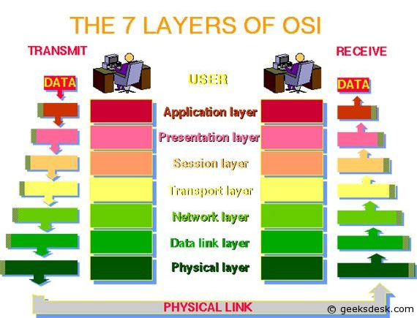
OSI 7 Layer Model of Computer Networks
Applications
TCP
IP
EtherNet
Modem
Notes:
OSI (open system interconnection)
EtherNet is on a link.
Physical layer: Modem
Usually we call session layer above “applications” – only 5 layers in practice
TCP divide data into packets, data can be file, skype, online video-stream,
Packet packaging, adding header on the way down, and remove header up (why packet getting longer in fig)
? Which layer finds the route from source to dest?
? Which layer checks if all packets are in correct order?

Slide 10
Network Protocol Stack
The network is divided into layers, each of which has a function separate from that of the other layers
  OSI Network Model
The protocol stack or protocol suite is the vertical arrangement of the layers; each layer is governed by its own set of protocols
Layers | Examples
7) Application | HTTP, FTP, Telnet
6) Presentation | ASCII
5) Session | SSL
4) Transport | TCP, UDP
3) Network | IP, IPX
2) Data Link | Ethernet, Token Ring,
1) Physical | IEEE 802.11, IEEE 802.16, ISDN

Slide 11
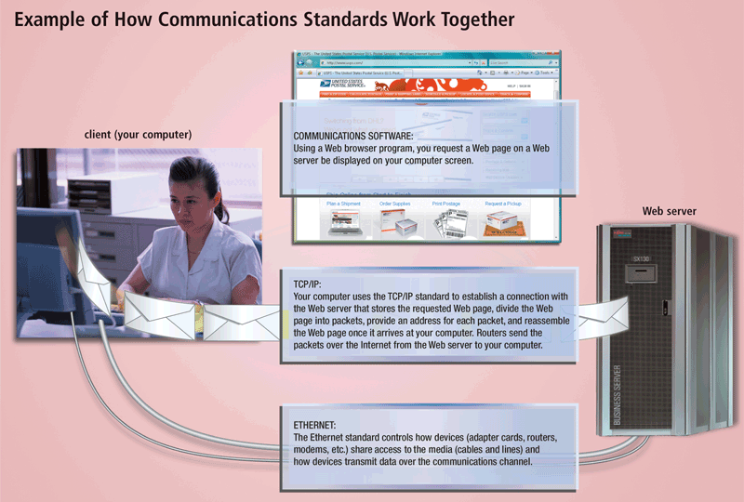
Example of How Network Protocols Work Together
Notes:
Example: retrieve a webpage: sending request, receiving data.

Slide 12
Communication Channel
Communication channel - the transmission media that are capable of carrying signals
  Analog signal : continuous
  Digital signal: discrete (either high or low)
    The speed at which signal can change from high to low is called signal frequency
  Bandwidth is the amount of data that can transmit over the channel (data transfer rate) per unit of time
    Usually measured in Kbps, Mbps or Gbps (bits per second)
      Low bandwidth is 56 Kbps
      High bandwidth is over 1.5 Mbps (also called broadband)
  Latency is the time it takes a signal to travel from one place to another
  Transmission media can be wired or wireless:
Wired (with cables) | Wireless
Twisted-pair cables | Infrared rays
Coaxial cables | Radio waves
Fiber optic cables | Microwaves
Notes:
Communication media

Slide 13
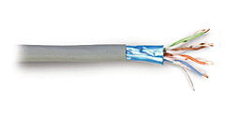
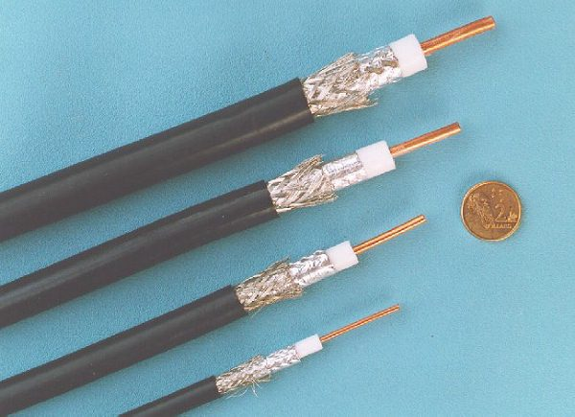
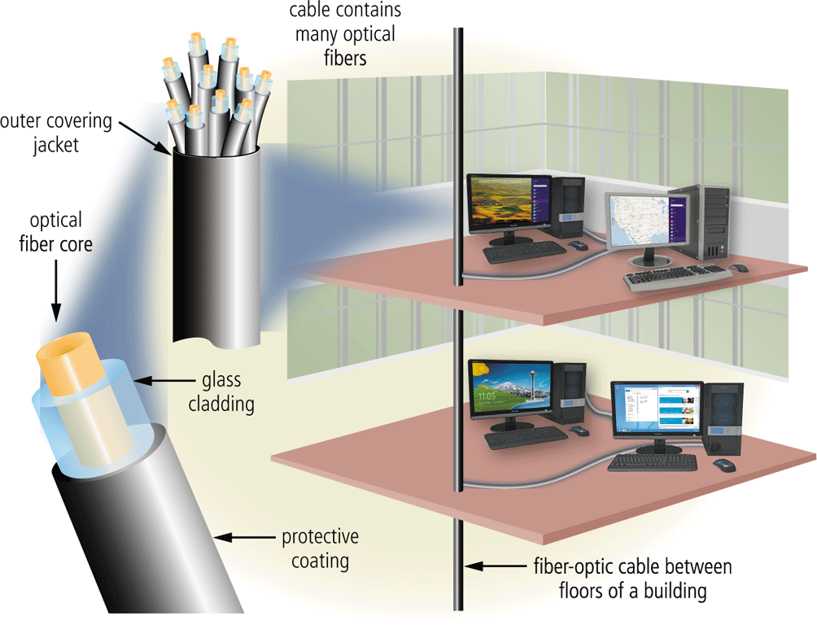
Cable Transmission Media
Twisted-pair cable
  Most common LAN cables (similar to telephone lines)
  Consisting of pairs of twisted copper wires - twisted to prevent wires from electromagnetic interference
  Transfer rate up to 100 Mbps ~ 1 Gbps
Coaxial cable
  Similar to wires used for cable TV
  Can be laid underground or underwater for both short (in office) or long distance
  Transfer rate up to 1 Gbps ~10 Gbps
Fiber-optic cable
  Bundles of hair-thin strands of glass that uses light beams to transmit signals
  Faster than coaxial and twisted-pair
  Transfer rate approaching 100Gbps
Details in reference [1]
Notes:
Twisted (ethernet cable) -> coaxial (TV cable) -> fiber
Charlse Gao – father of fiber-optic communications, 2009 Nobel prize winner

Slide 14

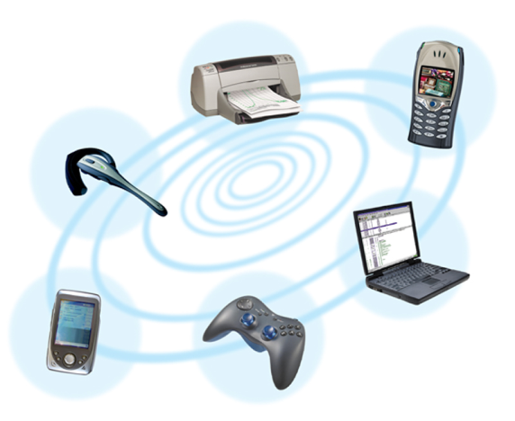
Wireless Transmission Media
Infrared Ray (IR)
  Signals carried in infrared light waves
  Travel in straight line with no obstructions
  Transmission distance up to 30 meters
  Transfer rate up to 4Mbps
Radio Frequency
  Signals carried in electromagnetic waves
  Signals broadcast in omni-directions (can reflect back & forth on obstacles)
  Bluetooth
    Transmission distance up to 10 meters
    Transfer rate up to 2Mbps
  Cellular phone radio
    Transmission distance up to 10 kilometers
    Transfer rate up to 15Mbps (4G)
  WiFi
    Transmission distance up to 180 meters outdoor
    Transfer rate up to 108Mbps
Notes:
Notebook has infra-red transmission: you can put two notebooks together and transfer data between them (not common anymore bcs people use USB)
Each cell is typically 26 square km
How to locate where your iphone is? GPS, celluar or WiFi…
Is my presenter in intrared or radio?

Slide 15
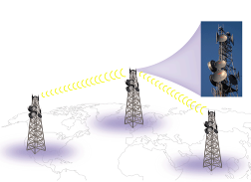
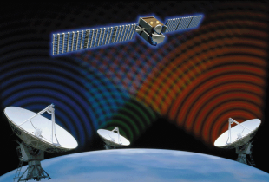
Wireless Transmission Media
Micro Waves
  Signals carried in high frequency electromagnetic waves
  Signals broadcast in omni-directions
  As the earth is round, we need many microwave stations to relay data over a long distance
    The earth-based reflective dishes are built at a distance of around every 30 miles (48 kilometers)
  Communication satellite
    Space station that receives microwave signals from earth-based stations, amplifies the signals, and broadcasts them back to other stations on earth
Notes:
WiMax: IEEE802.16, longer distance for rural areas

Slide 16
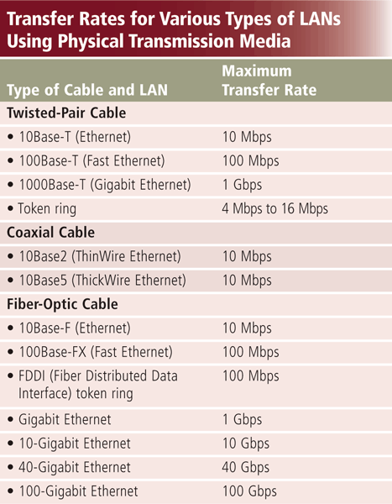
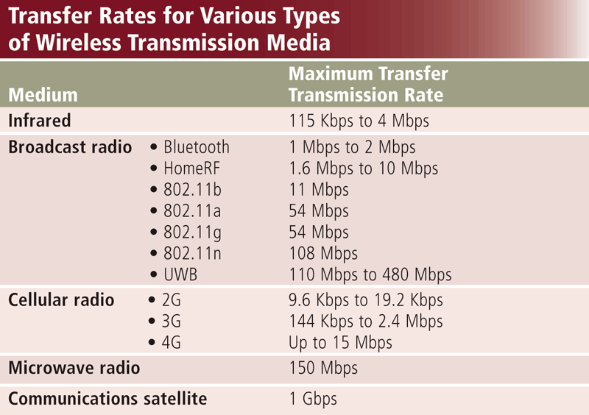
Transmission Rates
Notes:
802.11 series are WiFi vs. cellular (phone network)
Bluetooth: 802.15

Slide 17
Network Card
Network card (called Network Interface Card, NIC)
Adapter card or PC card that enables computer or device to access network
Each card has a unique address MAC (Media Access Control) address: used to identify the computer in networks
E.g. EtherNet card address is a typical example of MAC address. It is a 48-bits address in the format of:
0e: 3c: 24: 3a: 03: 06
  IEEE allocates EtherNet addresses to all manufacturers to ensure the uniqueness of addresses
Notes:
Some IP address is dynamically allocated for mobile device, but MAC address is hardwired to your notebook
IP address tells location, but MAC address doesn’t
?what’s the IP address of your notebook when it goes on Internet?

Slide 18
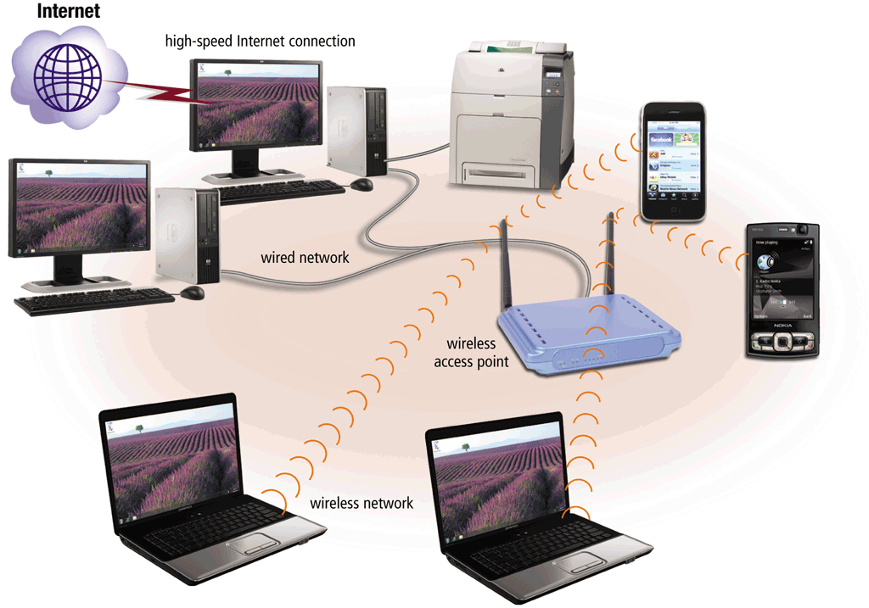
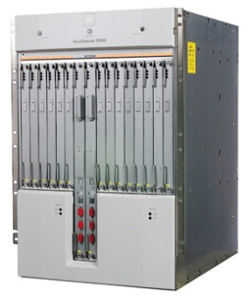
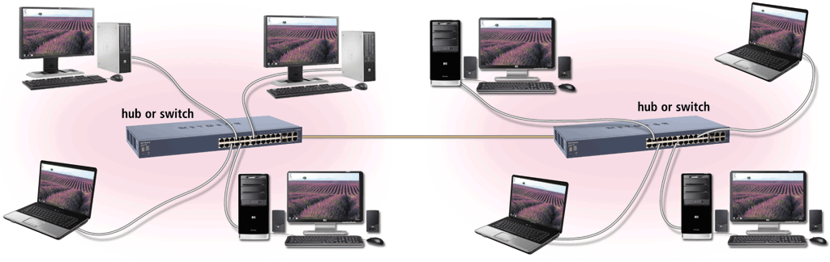
Communication Devices
  Wireless access point
    Devices that transports data wirelessly to a wired network
  Router
    Devices that connect computers or other routers to route data to their correct destinations in the network
    For smaller business and home networks, a router (or called switch or hub) allows multiple computers to share a single high-speed Internet connection through a cable modem or DSL modem
    Many are protected by a hardware firewall
Notes:
Edge-router, core-router
? How can a router route a packet out: based on destination’s IP address

Slide 19
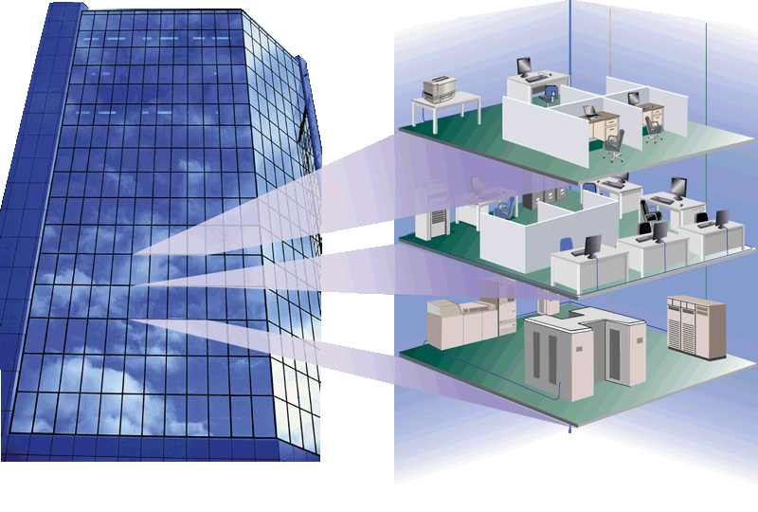
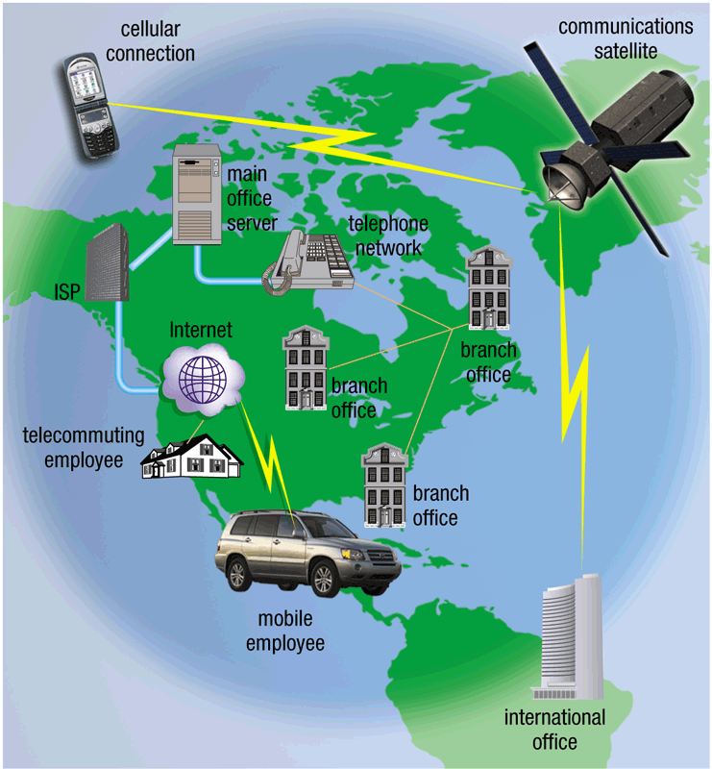
Types of Computer Networks
Common types of networks
  LAN (local area network)
    Networks that are in local geographical areas, such as homes or office buildings
    connected using cables or wireless media
    E.g., home network, CS department network in CityU
  WAN (wide area network)
    Networks that cover a wide geographic area
    Using long distance transmission media to link computers separated by a few or thousands of miles
    Internet is the world's largest WAN
Notes:
Is cityu network a LAN or WAN? Network in HK?

Slide 20
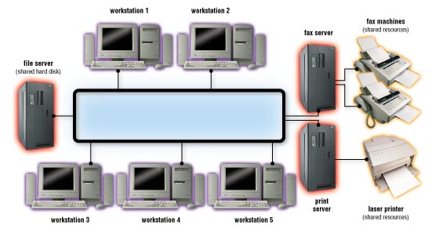
How Networks Are Architected/Structured
Client-server network
  Individual computers (called client) are connected to a central computer (called server)
  Clients request for services whereas servers provide services
  The clients can access programs or files stored on the server
    E.g., application server, file server, print server
  Server and client computers install different software
    Domain name server (DNS)
    File server
    FTP server
    Web server
    Email server
    Print server
    Database server
    Network server
Notes:
Client / server are at application layer
Most of the internet services are structured as client/server model

Slide 21
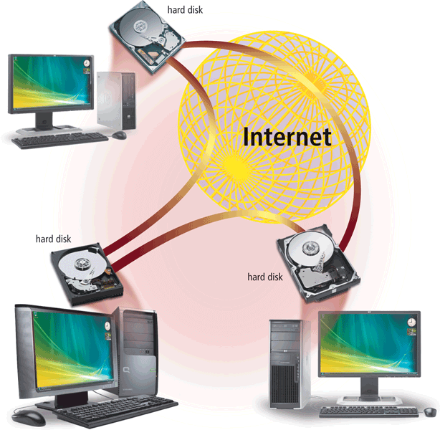
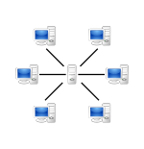
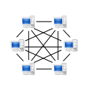
How Networks Are Architected/Structured
Peer-to-peer networks (P2P)
  Every computer, called peer, is connected directly or indirectly to other peers
  Each computer provides its own resources to other computers, and in the mean time can access resources of other computers
  All computers need to run the same P2P software (protocol). E.g., BitTorrent is one of the most commonly used P2P protocols
Details in reference [5]
Notes:
Many streaming video webservers use P2P technology, such as BitTorrent
? Have u ever used a P2P system: yes, when you download / watch movies/ videos

Slide 22
Network Classification Summary
CATEGORY | DESCRIPTION | EXAMPLES
Geographical | Area where network devices are located | LAN, WAN
Structural | Hierarchy of devices | Client/Server, P2P
Transmission Media | Technologies for cables and signals that carry data | twisted-pair, coaxial, or fiber-optic cable; radio frequency; microwaves; infrared
Bandwidth | Capacity of network | Broadband, narrowband

Slide 23
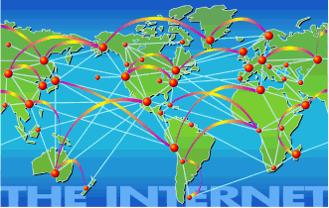
What is the Internet?
The Internet is an interconnected network of thousands of local, regional, national and international networks
Connects computers to almost every country in the world
  Growing too fast to measure its growth
  Too decentralized to quantify
  A network with no hard boundaries

Slide 24
Internet Infrastructure
Internet has the Internet backbone to interconnect all regional networks
  The Internet backbone consists of high-speed fiber-optic links connecting high-capacity routers or communication satellites
  Constructed and maintained by NSP (Network Service Providers), usually major telecommunication companies or governments
Besides the backbone, the Internet also contains regional and local communication links such as local telephone systems, cable television lines, mobile phone systems, and satellite dishes
  Constructed and maintained by ISP (Internet Service Providers), usually regional or local telecommunication companies or cable television companies
Notes:
NSP: AT&T, GTE
China: China telecom (northern), 中国联通 (southern)

Slide 25
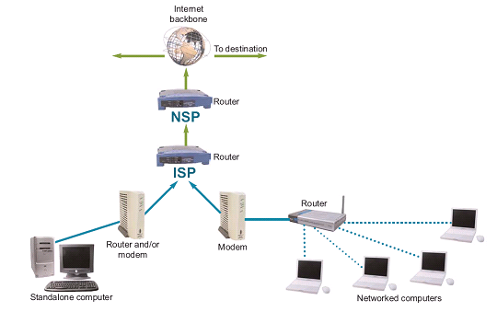
Internet Infrastructure
Large ISPs connect directly to NSP backbone routers to gain backbone access
Smaller ISPs typically connect to a larger ISP routers to gain Internet access
End users connect their computers to ISP cables to gain Internet access
home

Slide 26
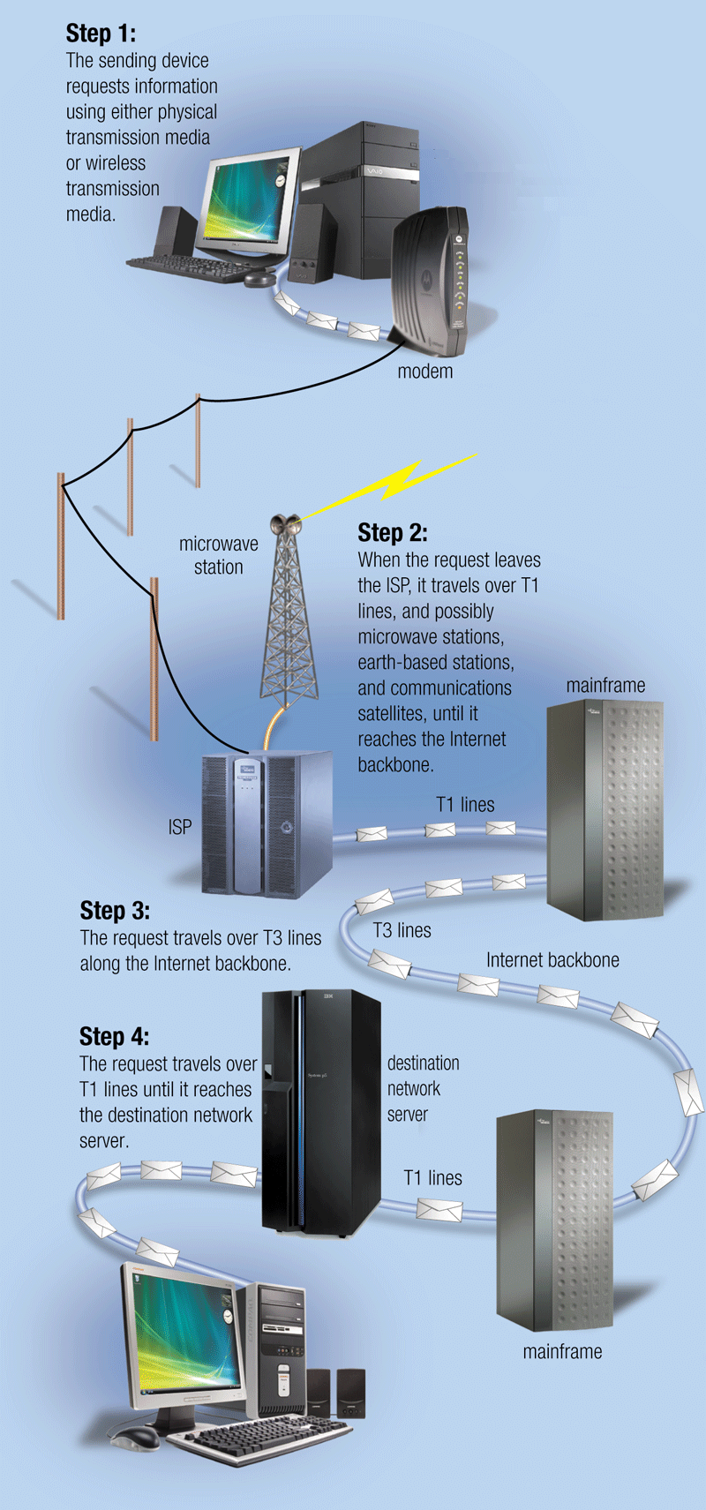
How your request is sent over the Internet
home
Step 1 - your computer requests information through either wired or wireless connection to the ISP
Step 2 - when the request leaves the ISP, it travels over T1 lines, and possibly microwave stations, earth-based stations, and communication satellites, until it reaches the Internet backbone provided by the NSP
Step 3 - the request travels over dedicated high-speed lines along the Internet backbone (T3 lines)
Step 4 - the request reaches the ISP of the destination network server
Step 5 - from the ISP, the request then travels over telephone lines or other transmission media until it reaches the destination network server
NSP
ISP
ISP
NSP
home
Notes:
Home-computer, ISP, NSP (mainframe)
Example: you browse a webpage of Stanford U: A signal from your notebook -> CityU router (ISP) -> Step3: HK gateway router (mainframe) -> Tokyo -> LA (mainframe) -> StanfordU (ISP)

Slide 27
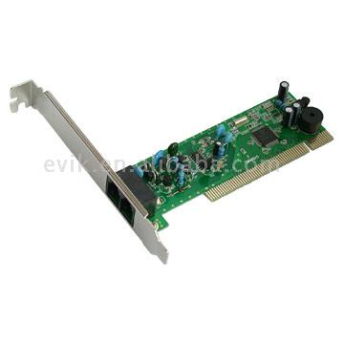


Internet Access Options
Dial-up connections
  Use standard telephone lines + a modem
  Bandwidth is up to 56 Kbps
  Converts signals between analog and digital
ISDN and DSL connections
  Use standard telephone lines + ISDN/DSL modem + a NIC card
  ISDN bandwidth is up to 128 Kbps
  DSL bandwidth is up to 1.5 Mbps
Cable connections
  Available from telephone companies, cable TV services, networking companies, or satellite service providers
  Coaxial cable line + a cable modem + a NIC card
  Bandwidth is up to 1.5 Mbps
Others include: cellular services, satellite connection services
Notes:
Dial-up (no use anymore)
ISDN (Integrated Service Digital Network ) modem (for computer use only, phrasing out), DSL (digital subscribe line)
Cable connections: combine telephone, computer and TV together (used nowadays)

Slide 28
Dial-up Connections
A dial-up connection is a fixed Internet connection that uses a voice-band modem and telephone lines to transport data between your computer and your ISP
  A voice-band modem converts the digital signals from your computer into analog signals that can travel over telephone lines
Notes:
Not use anymore (skip)

Slide 29
ISDN or DSL
High-speed, digital, always-on Internet access technology that runs over standard phone lines
Since all voice conversations take place below 4 KHz, the low-pass (LP) filters are built to block everything above 4 KHz, preventing the data signals from interfering with standard telephone calls.
Notes:
DSL: digital subscriber line. DSL is a very high-speed connection that uses the same wires as a regular telephone line.

Slide 30
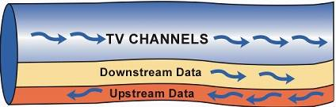
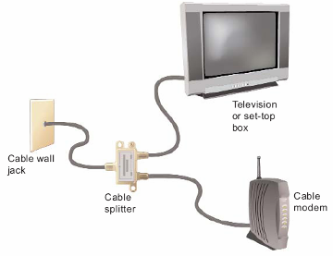
Cable Internet Service
Cable Internet service distributes broadband Internet access over the same infrastructure that offers cable television service
  The coaxial cable used to carry cable television can carry hundreds of mega-hertz of signals
  The cable modem takes up some of the un-used frequency bands to transmit Internet upstream and downstream data

Slide 31
Fixed Internet Connection Roundup
Notes:
Downstream != upstream
Wimax: 802.16. wireless. No WiFi in this table.

Slide 32
Lesson Summary
A computer network is a system of connected computers that can exchange information and share resources
The advantage of a network include: better communication, data and resource sharing, efficient backup
The separation of a network design into layers allows for modular design, and divides the responsibility of the different layers; within each layer, protocols are defined as the rules governing the format, speed, initiation and synchronization of communication.
Networks can be distinguished by the distances they cover. LAN locates within a relatively limited area. WAN spans a wide geographical area.
Two common network architecture include: client-server model and peer-to-peer model

Slide 33
Lesson Summary (continued)
Common communication channel or transmission media include: twisted-pair cables, coaxial cables, optical fiber cables, infrared rays, radio, microwaves
Communication devices include: modem (dial-up and cable), network card, wireless access point, hub, and router
You can connect to the Internet in several ways using different communication devices

Slide 34
Reference
[1] Copper and Glass: A Guide to Network Cables
  http://www.windowsnetworking.com/articles_tutorials/Copper-Glass-Guide-Network-Cables.html
[2] HowStuffWorks.com - Fiber Optics
  http://www.howstuffworks.com/fiber-optic.htm
[3] Wikipedia – Radio Spectrum
  http://en.wikipedia.org/wiki/Radio_spectrum
[4] Introduction to WiFi Standards
  http://www.crutchfield.com/S-3idETr5R3yJ/learn/learningcenter/home/wifi.html
[5] The World of Peer-to-Peer (P2P)
  http://en.wikibooks.org/wiki/The_World_of_Peer-to-Peer_(P2P)/All_Chapters
[6] Bluebooth
  http://www.makeuseof.com/tag/technology-explained-what-is-bluetooth/
[7] HowStuffWorks.com - Router
  http://computer.howstuffworks.com/router.htm

Slide 35

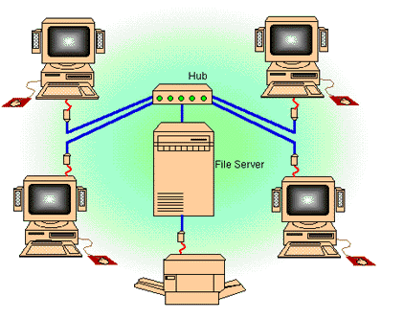
For you to explore after class
Lec08-Q1: Could this network (with one central server in the middle) be used for peer-to-peer communication and explain your reason?
Lec08-Q2: say your Internet connection's bandwidth is 1Mbps, how many seconds you need to download from the Internet a 4-minute MP3 song with 128Kbs? (assuming 1Kb=10³ bits and 1Mb=10⁶ bits)
Lec08-Q3: say you want to watch a real-time streaming video of Formula 1 Race, and this video's frame size is 320x240, frame rate is 30 fps, color depth is 24-bit, video codec compression ratio is 1:60, and audio bit-rate is 64Kbps mono, what is the minimum bandwidth you needs in order to smoothly watch this video?

