Slide 1

CS1102 Lec07
– Digital Media
Semester B, 2012-13
Computer Science Department
City University of Hong Kong
Notes:
video of Robocode for Lab:
http://www.youtube.com/watch?v=92x8dLgmrJ8&list=UUFn3O-SqDAP1B30WdG2FHbw&index=6
Finish RLE and flowchart in last lecture. RLE will be referred later.

Slide 2
Objectives
Describe the various types of digit media
Identify hardware/software that can be used to work with various types of digital media
Identify digit media files by their file extensions
Compare waveform audio and MIDI music
Compare bitmap images and vector images, and describe procedures required to convert vector graphics to into bitmaps, and convert bitmaps to vector graphics
Discover how resolution, image size, color depth and compression affect the file size of a bitmap image

Slide 3
Objectives (cont'd)
Illustrate some commonly used image compression techniques
Use storage calculation to justify the reason why compression is essential for digital video
Discover how window size, frame rate, and compression affect file size for a desktop video
Describe how video streaming works

Slide 4
Digital Media
Digital media
  Pictures, sound, video and animation stored/processed in computers in digital format (i.e., binary numbers)
Typical hardware requirements work with digital media
  A powerful microprocessor
  Large memory and storage capacity
  A high-quality monitor and a display card
  May also need some input devices
    A microphone or keyboard for audio input
    A digital camera or scanner for graphics input
    An analog video camera for video input and a video capture card to convert analog video to digital video
    Or a digital video camera

Slide 5
Lec07 - Digital Media
- Digital Sound

Slide 6
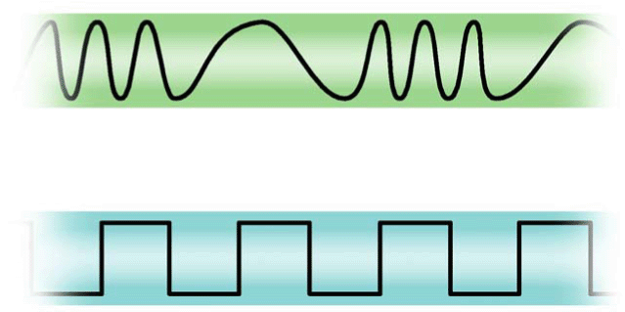
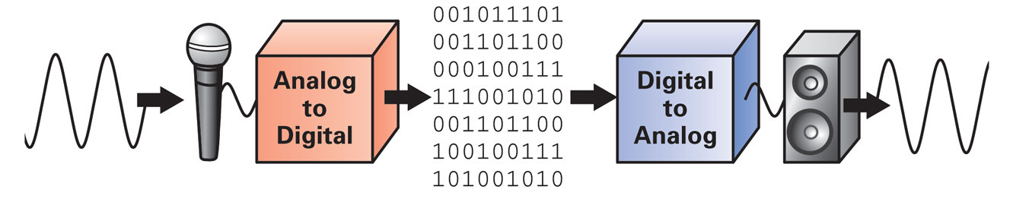
Digital Audio Basics
Audio is originally an analog waveform signal, and it must be converted into discrete digital signal in order to be stored in and processed by computers
Example converting devices
  Analog->digital : sound cards, display/video cards, scanners,
  digital cameras, video capture cards
  Digital->analog : sound cards, display card
Analog (waveform) data signal
Digital (discrete) data signal

Slide 7
Digital Audio Basics (cont'd)
Notes:
Sampling frequency

Slide 8
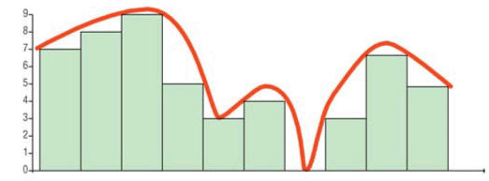
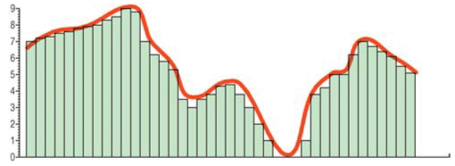
Analog to Digital
Two steps to convert analog signals to digital signals:
  Sampling - to slice the analog wave into small segments regularly at uniform intervals (called samples)
  Quantization - the height (amplitude) of each sample is converted into a binary number
  Sampling rate - the number of times per second that a sound is measured during the converting (recording) process
    Measured in hertz (Hz)
Notes:
The higher sampling rate, the more accurate to the original signal.

Slide 9
Sound Quality
Sampling – how many times per second?
  Human ear can hear sound from 20Hz-22000Hz
  Audio CD uses a sampling rate of 44100Hz
  Some very high quality (studio quality) audio uses a sampling rate of 48000Hz – 96000Hz
  For voice/speech signal, a smaller sampling rate is good enough (e.g. 11000Hz)
Quantization – how many bits are needed for a single sample?
  CD uses 16 bits per sample (65536 values, high quality)
  Lower quality music uses 8 bits (256 values) per sample
Number of channels
  Mono – only one channel
  Stereo – 2 channels (left, right)
  Surround - 5.1 channels (left, right, center, left surround, right surround, and a base enhancement channel)
Notes:
Human hear the sound wave Hz is a different thing from sampling rate Hz. The higher sampling rate (Hz) can recover the original sound wave better.

Slide 10
Audio Compression
Uncompressed audio data need a large amount of storage space
Data compression (or encoding) is the technique of reducing the number of binary digits required to represent data
  E.g., a 5-minute .mp3 file takes up less than 5MB
  An audio/video compression algorithm is typically referred to as audio/video codec (coding & decoding)
  Compressed video/audio data must be decompressed (or decoded) before being viewed/heard
Q: For a 5-minute stereo song with a sampling rate of 44100 Hz and 16 bits per sample, how many bytes are needed?
Notes:
On-board: 44100*2bytes*5*60

Slide 11
Data Compression
Data compression can be lossless or lossy
  Lossless – the compressed-then-decompressed version is 100% identical to the original one
    Often used in file compression, such as ZIP, RAR, …
  Lossy – the compressed-then-decompressed version is not identical to the original one, but the difference are almost undetectable by human
    Often used in audio, image and video compression
    Sacrifice some quality for smaller file size
In audio/video compression
  Compression ratio measures reduction in data quantity produced by a compression algorithm
    Expressed as <compressed size> : <original size>
  Bit rate measures the amount of data (no. of bits) per second video/audio
    Expressed in bps (bit per second)
Notes:
Data need store and transmission, so it should be compressed.

Slide 12
Waveform Audio File Format
Audio Format | File Extension | Advantage | Disadvantage
Wave | .wav | Good sound quality Supported in browsers without plug-in | Audio data is stored in raw, uncompressed format, so files are very large
MP3 (also called MPEG-1 Layer 3) | .mp3 | Good sound quality even though the file is compressed Can be streamed over the Web | Requires a stand-alone player or browser plug-in
RealAudio | .ra .ram .rx | High degree of compression produces small files Can be streamed over the Web | Sound quality is not up to the standards of other formats Requires a player or plug-in
WMA (Windows Media Audio) | .wma | Compressed format, very good sound quality | Requires Windows Media Player
AAC (Advanced Audio Coding) (the successor to the MP3) | .aac .m4p .mp4 | Lossy compressed format with good quality and small file size Default audio format of Apple's iPhone, iPod, iTunes | Heavily patent, may limit the usage potential
Notes:
.wav: uncompressed, big file.
Demo: a .wav and .mp3 files.
.au, .mp3 is often used (by Microsoft Media Player)

Slide 13
MIDI Music
MIDI stands for Musical Instrument Digital Interface
  specifies a standard way to record, store and play back music on digital sound synthesizers
  Unlike waveform audio files, MIDI files (.mid) do not represent sound directly, but contain instructions on how the sound should be created
    Information includes the pitch of a musical note, note-on time, note-off time, note volume, the type of the instrument
    Most sound cards are equipped to generate music from MIDI files
  Advantage
    MIDI files are very small
  Disadvantage
    Does not produce high quality “real” sound
Notes:
MIDI record the script of notes (and instruments), and plays the sound out by instruments according to the notes. Different PCs may produce sound differently from the same .mid file if their synthesizers are different (like play the notes out at piano)
It’s a good tool for composer (and instrument lovers)
See an example of .mid file

Slide 14
Lec07 - Digital Media
- Digital Graphics

Slide 15

Bitmap Image
Bitmap image (also called raster image)
  Images are digitized/sampled by a grid of dots, each dot is called a pixel
  Each pixel is assigned a binary color value
    Resolution : the number of horizontal and vertical pixels
      Bitmaps do not have a fixed physical size
      Higher monitor resolution -> smaller image size
    Color depth : the number of bits to represent the color intensity
      Determines the number of colors available for use
    Bitmaps does not scale well; resizing bitmap image will reduce quality
Notes:
Bitmaps don’t have a fixed physical image size, depending on how you scale: scale-up: poor quality; scale-down: good quality

Slide 16

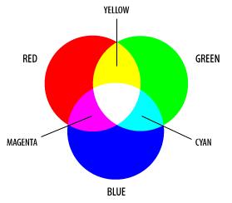
Color Depth
RGB representation
  Color is commonly represented according to the proportions of red, green and blue that constitutes the color
    True color (24-bit for RGB)
    32-bit for RGBA (A stands for Alpha, used to create transparency effect)
  The colors used in web pages are based on RGB, often written in hexadecimal values
    E.g., <body bgcolor = “#0F69F3”>
      The intensity of colors are: Red = 0F₁₆, Green = 69₁₆, Blue = F3₁₆
    #000000 is black; #ffffff is white; gray colors have equal RGB values
CMYK color printer
Notes:
Color code format:
Note: RGB NOT RYB (this’s different from painting color)
Notice: RGBA: A for transparency.
Demo in ppt: select a text and use icon “Shape Fill”-> more colors-> customized color: all 00 is black, all ff… is white, and a “Transparency” bar at left bottom!!!
CMYK color printer (K = Key = black)

Slide 17


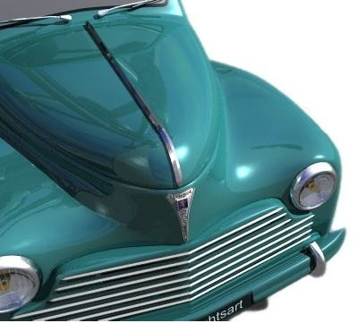


Image Compression
Similar to audio, image compression can be lossless or lossy
  Lossless – the decompressed image is 100% identical to the original one
    E.g., RLE (run-length encoding), compresses a sequence of same color pixels into a "Color + Number of Pixel" format
    E.g., use color indexes to represent color values using less number of bits
  Lossy – the decompressed image is not identical to the original one, but the minor loss of quality is acceptable
    E.g., we can reduce the color space to the most common colors in the image
Original Quality (424KB)
50% Quality (15KB)
10% Quality (5KB)

Slide 18
Vector Image
Vector images (also called object-oriented images)
  Images are represented by a collection of points, lines and other geometric objects
  Instead of storing the pixel color values, a vector graphic file contains the instructions for the computer to create the shape, size, position, and color for each object in an image
  Compared to bitmap images
    Vector images resize better; the objects change proportionally and maintain their smooth edges
    Vector images require less storage space
    It is easier to edit an object in a vector graphic
    BUT, vector images are not usually as realistic as bitmaps
  Vector images need a rasterization step for output to monitor or printer
  Tracing software is needed to convert bitmaps to vector graphics (very hard!)
Notes:
Vector image is similar to MIDI for audio.
It’s drawing out, not displaying out!

Slide 19
Graphics File Formats
File Format | Image Type | Description
BMP | Uncompressed bitmap format | A graphics format native to Microsoft Windows. BMP is widely used on PCs for icons, buttons and other controls. The BMP file format supports up to 24-bit depth color.
TIFF | Uncompressed bitmap format | TIFF is bitmap format defined in 1986 by Microsoft and Aldus (now part of Adobe) and widely used on both Macs and PCs for high-resolution scanned images and digital photos for desktop publishing
JPEG or JPG | Lossy compressed bitmap format | JPEG is bitmap format popularly used on the Web. It can compress TrueColor bitmap images with various compression ratio
GIF | Lossless compressed bitmap | GIF is also a bitmap format popularly used on the Web. GIF images can only contain 256 or fewer colors. GIF format also supports transparency and animation.
PNG | Lossless compressed bitmap | PNG is a format designed to improve the GIF format, supporting 24-bit depth color and transparency. Unlike JPEG, PNG compressed bitmap data without losing any data. PNG itself does not support animation.
WMF (Windows MetaFile) | Vector graphic format | The native vector graphics file format in Windows. They can also hold bitmaps and text. WMF files are made up of actual Windows drawing commands which results in an efficient format that renders illustrations very quickly.
SVG (Scalable Vector Graphics ) | Vector graphic format | A vector graphics format from the W3C for the Web that is expressed in XML. Introduced in 2001, SVG was designed to become the standard vector format just as GIFs and JPEGs have become the standard bitmaps for the Web.
Notes:
.bmp is NOT compressed; .gif and .png are “lossless compressed”, so their size are larger than JPG (see examples)
.gif has only 256 colors (8-bits)
.jpg has 24-bits for color and 8-bits for transparency (32 bits)
.png is an improved version for .gif
SVG graph for charts and curves: in lab

Slide 20
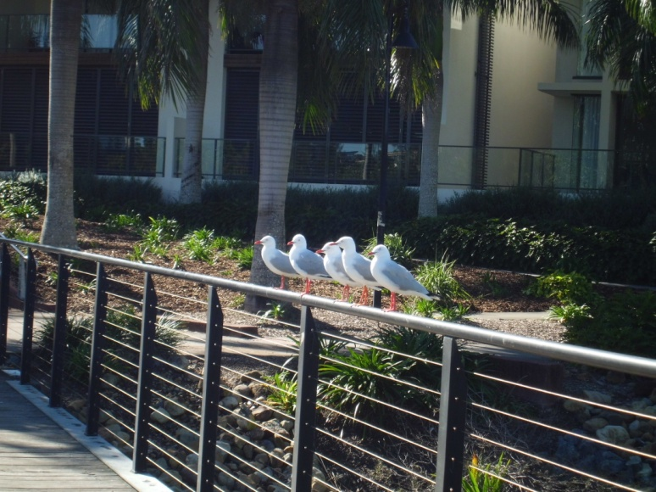
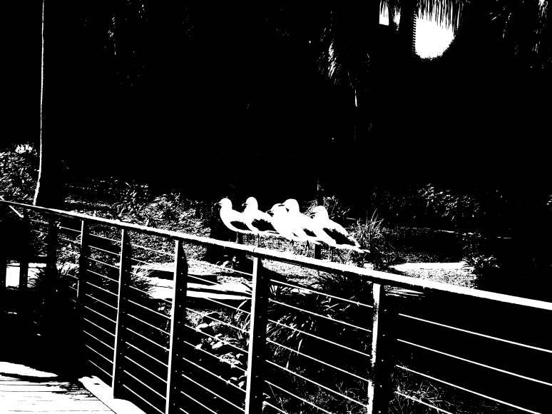
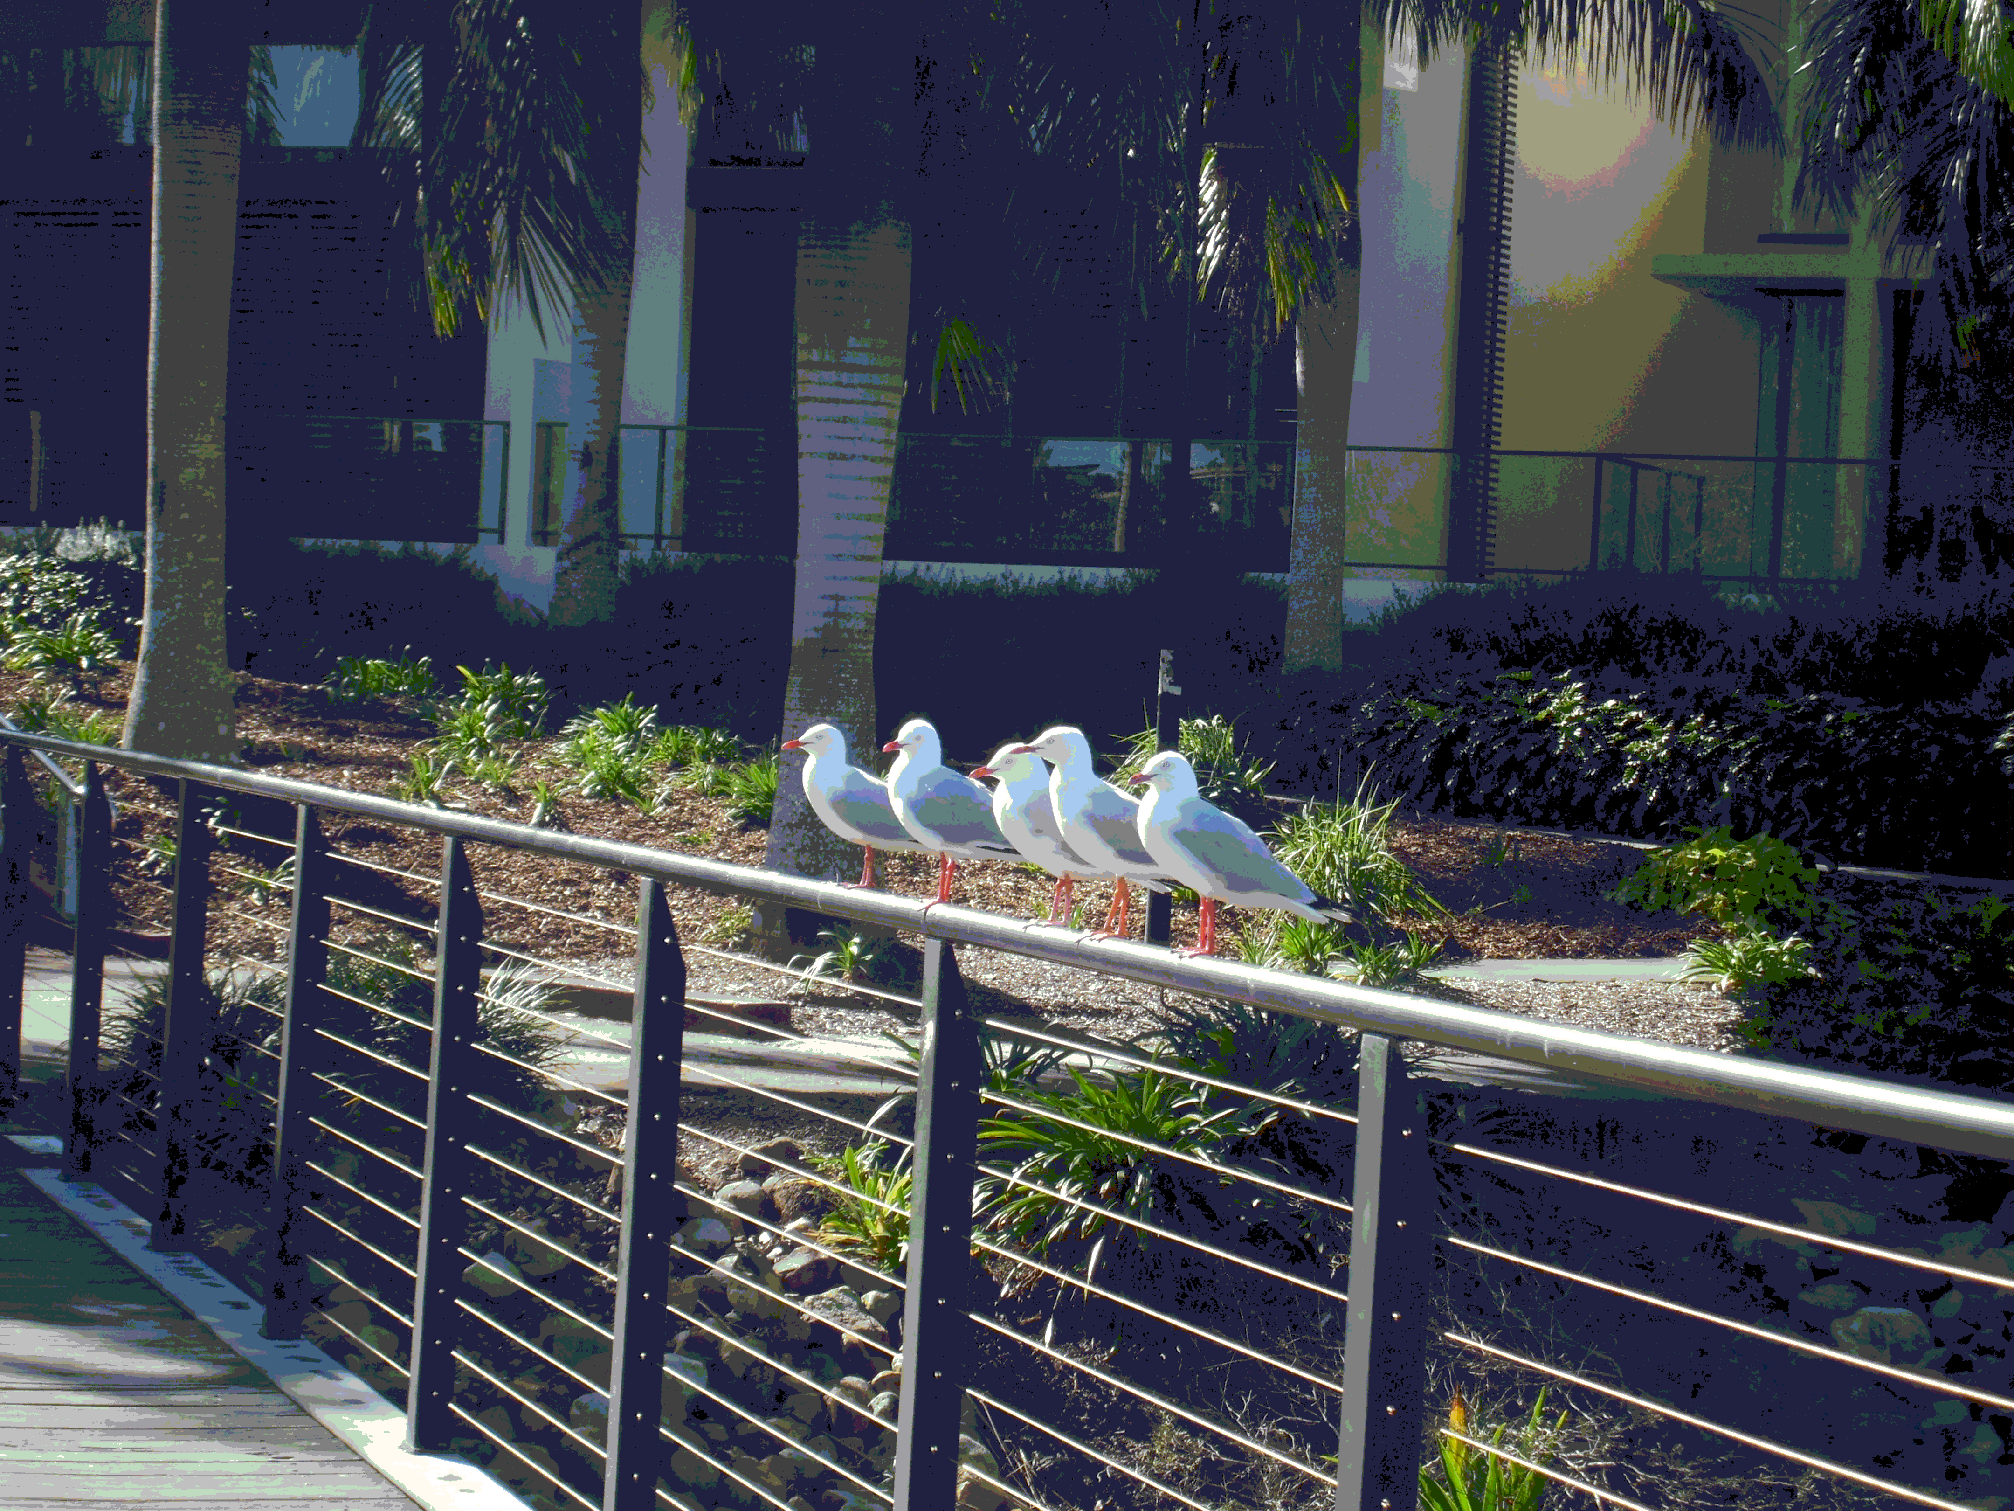
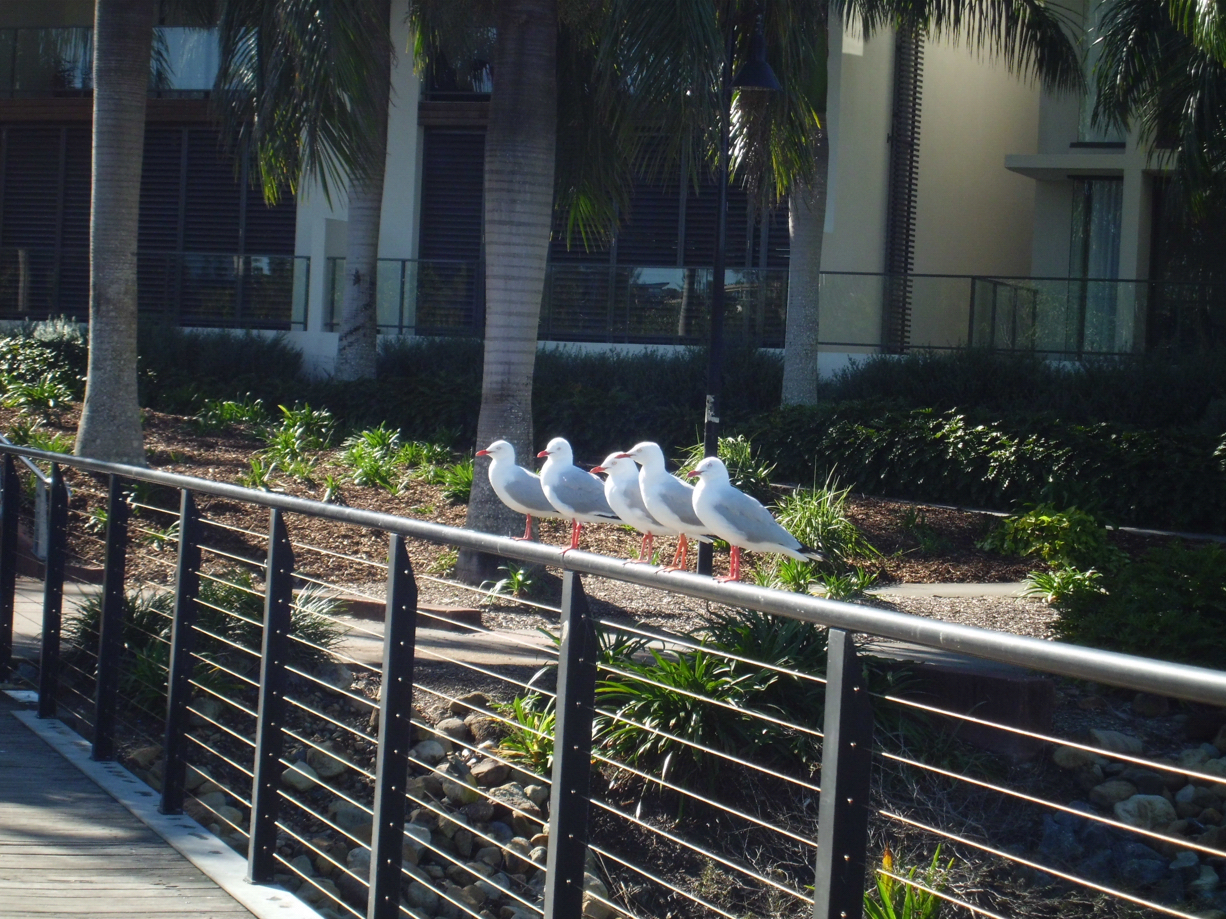

photo.jpg, 2.4M
.bmp, mono, 1.7M
.bmp, 8-bit colors, 13.7M
.tif, 35.7M
.gif, 3.7M
.png, 32-bit colors, 22.9M
Notes:
Note: for TIF file, you can open it with Adobe-photoshop (PS) to edit the file. It’s widely used s/w for editing photos
Both .bmp and .tif are uncompressed! Their sizes are big.
PNG is improved GIF with more color (larger size).
Click the original picture -> right-mouse -> save as picture -> choose image format of saving

Slide 21
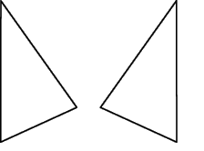
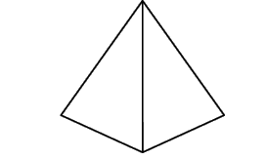
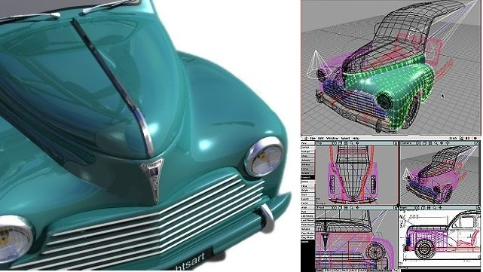
3D Graphics Basics
2D v.s. 3D pictures
Like vector graphics, 3D graphics are stored as a set of instructions for computers to create geometric objects at run-time
  A picture that has or appears to have height, width and depth is three-dimensional (or 3-D).
  A picture that has height and width but no depth is two-dimensional (or 2-D).
Image from http://www.lembrechtsart.be/nl/3d5.htm
Notes:
3D are created at run-time, it must have powerful computer.
Right-figs: wireframes to represent 3D objects

Slide 22
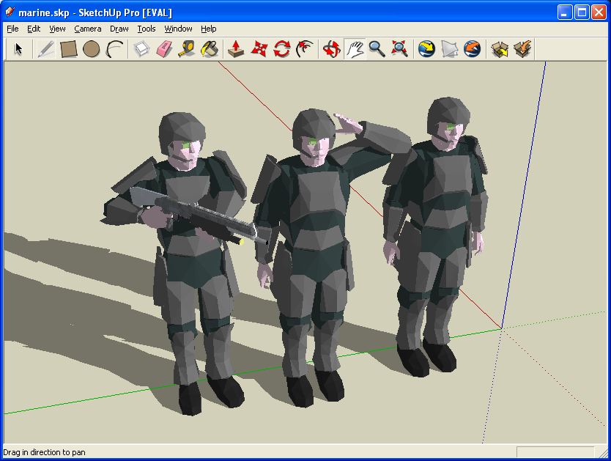
3D Graphics Basics (cont'd)
To compose a 3-D graphics, thousands or millions of small shapes are put together into a structure called a wireframe to make the images look as though they have the smooth curves
  Rendering covers a wireframe with surface color and texture
  Ray tracing adds light and shadows to a 3-D image
Notes:
Wireframe: coming from the old way people use metal wire to make 3D object.

Slide 23
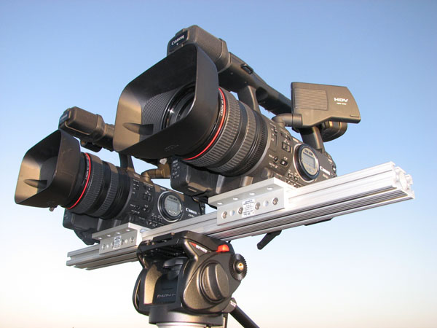
Make 3D Movies
-two synchronized video streams
Notes:
what exactly is a 3D movie? As shown on the screen, when shoot a 3D movie, simply use two cameras next two each other and make sure that they are synchronized during capturing.
For each frame, there’re two pictures, one from each camera (corresponding to our two eyes) ->

Slide 24
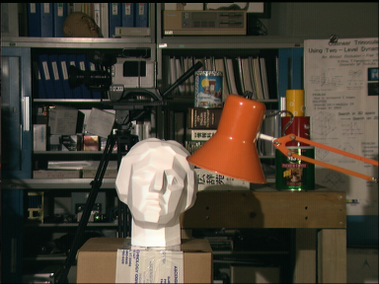
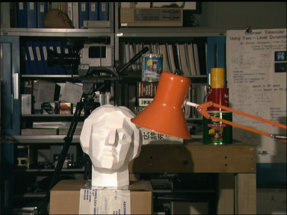
3D (stereo) images
Left image
Right image
Notes:
When play, play two synchronized video streams (frames switch in high frequency). If you use your naked eyes, you see two almost overlapping images; but if you wear special glasses for 3D, the left glass will filter away the frames for right eye and the right glass filter away left frames. So it creates the effect that your left eye see one video stream and right eye see the other video stream. See http://en.wikipedia.org/wiki/Polarized_3D_system

Slide 25


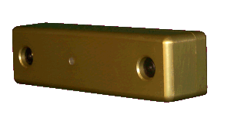
Construct 3D models: Stereo Vision
- Basic principle of 3D from stereo
Parallel cameras
A
B
Find correspondence!
Notes:
25
25
To construct a 3D object, we need to find the depth of each pixel of the object, i.e., (x, y, z) coordinates. If we want to find the depth of the red dot on the left, we then need to search for its correspondence on the right image. The search range is confined to the scanline if the camera is strictly calibrated.

Slide 26
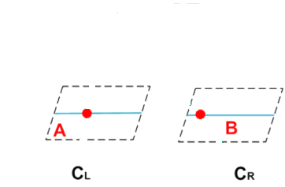

Passive: Stereo Vision
- Basic principle of 3D from stereo
$$Z(A)$$
A
B
Find correspondence
=>
Triangulation.
Problem: it is hard to find the correspondence!!
Notes:
26
26
use triangulation to compute the depth of a point (blue dot) from the two images (two red dots in A and B).
So, you know the depth of each pixel, i.e., you know the convex or concave of the surface of the object. You can use 3D model to construct the 3D object.
Details of finding depth z are in page 36.

Slide 27
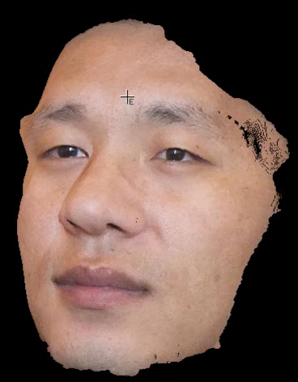
Notes:
You can make a facial model (or mask) based on the constructed 3D object.
The cutting edge technology: 3D printer. It can make the real object automatically from 3D model (images) by using plastic material (shapable)!

Slide 28
Lec07 - Digital Media
- Digital Video

Slide 29
Digital Video
A video is just a sequence of images (frames) showing one after another very quickly
Two most common video signal standards
  PAL (Phrase Alternating Line)
    25 frames per second (fps)
    Frame resolution: VCD (352x288), DVD (704x576) pixels
  NTSC (National Television System Committee)
    30 frames per second (fps)
    Frame resolution: VCD (352x240), DVD (704x480) pixels
  For VCD/DVD video, color depth typically is 24 bits
  HDTV provides even higher frame resolution:
    720p: (1280x720)
    1080p: (1920x1080) (so-called “Full High-Definition”)
    Ultra-HDTV: (7680x4320) (experimental, begin in 2015)
Notes:
PAL: Asia pacific and Europe
NTSC: north america
Notice: frame resolution for VCD, DVD, HDTV; fps are the same!
? What is the size of one hour PAL DVD movie (NO sound) if it’s NOT compressed? -> ? HDTV

Slide 30
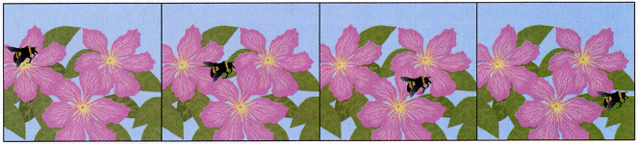
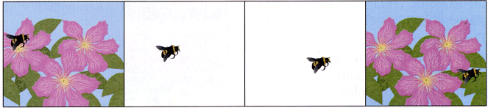
Video Compression
Video compression is similar to repeating image compression on each frame.
Additionally, video compression software (video codec) can also makes use of the similarities between frames, or reducing the frame rate
  The video compression is usually lossy
  E.g., MPEG video/audio encoding standards
Notes:
Simply transmit the position of bee, bcs all backgrounds are the same: video conferencing

Slide 31
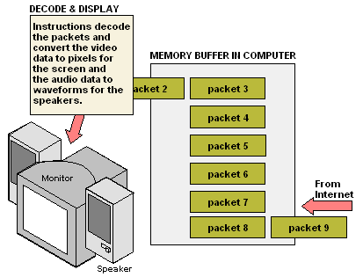
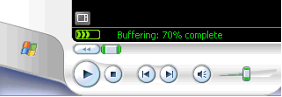
Streaming Video
Streaming is the transfer of video data in a continuous stream over the Web that allows the user to play it before the entire file is transferred
The Streaming Concept
The client side stores a few seconds of video in the memory buffer before it starts sending it to the screen and speakers. Throughout the session, it continues to receive video data ahead of time from the server.
Notes:
Web-streaming: caching a few seconds: Fig. on right

Slide 32
Video Format
Video Format | File Extension | Platform | Description
AVI (Audio Video Interleave) | .avi | PC | A common format for storing digital clips from video cameras; used for desktop video on PC platform
QuickTime Movie | .mov | PC, Mac, Unix, Linux | One of the most popular formats for desktop and streaming Web videos, requiring Apples Quicktime Movie Player
MPEG (Moving Pictures Experts Group) | .mpg or .mpeg | PC, Mac, Unix, Linux | Versions include MPEG1, MPEG2, and MPEG4; used for desktop video, PDA video, and streaming Web video
RealMedia | .rm | PC, Mac, Unix, Linux | Produced by RealNetworks company, a popular format for streaming Web videos
WMV (Windows Media Video) | .wmv | PC | Offers different compression options for high-quality videos; used for desktop video, PDA video, and streaming Web video
VOB (Video Object) | .vob | Standalone DVD player, PC, Mac, Linux | Industry-standard format for standalone DVD players
Flash Video | .flv or .swf | PC. Mac | Popular for Web-based video; requires Adobe Flash Player
Notes:
.mov produced by camera
.mpg movies on PC

Slide 33
Lesson Summary
Music, voice and sound effects can all be recorded and digitally stored as waveform audio, where the amplitude of the sound waves are sampled at small intervals and stored as binary numbers. Popular waveform audio file formats include WAV, MP3, RA, WMA and AAC
Unlike waveform digital audio, MIDI music is artificially created and contains information about how the sound should be created. MIDI files usually has an extension of .mid.
A bitmap image is composed of a grid of pixels, and the color of each pixel is stored as binary number. Popular bitmap file formats include BMP, TIFF, GIF, JPEG and PNG
A vector image consists of a set of instructions for creating the picture. Popular vector file formats include WMF, and SVG

Slide 34
Lesson Summary (continued)
Like vector images, 3D graphics are also stored as a set of instructions
A video is composed of a series of still images, each of which is called a frame. Popular video file formats include AVI, MOV, MPEG, RM, WMA, VOB, FLV and SWF.
Videos can be transferred and played on the Web using streaming technique. The idea is to transfer the first segment of a video, begin to play it and then continue to transfer additional segments.
Data compression is the general term used to describe the process of compacting original data so that it requires less storage space.
  Compression algorithms are design to compress text files, audio, image, and video
  To measure the data reduction produced by a compression algorithm, compress ratio and bit rate are used.
  Compression can be either lossless or lossy

Slide 35
Reference
[1] Wikipedia – Audio data compression
  http://en.wikipedia.org/wiki/Audio_data_compression
[2] HowStuffWorks – How MP3 Files Work?
  http://computer.howstuffworks.com/mp3.htm
[3] Wikipedia – Windows bitmap
  http://en.wikipedia.org/wiki/Windows_bitmap
[4] Understanding image file formats – by Bryan Chamberlain
  http://amath.colorado.edu/computing/graphics/understand_fmts.html
[5] W3C - SVG Talk
  http://www.w3.org/2002/Talks/SVG-HongKong-IH/3.html
[6] Wikipedia - Digital video
  http://en.wikipedia.org/wiki/Digital_video

Slide 36

For you to explore after class
Lec07-Q1: what is the compression ratio when compressing a stereo CD song into the MP3 format with 128 kbit/s bit rate? (assuming 1k=10³)
Lec07-Q2: similar to audio, uncompressed video data need a large amount of storage space. For a 30 seconds clip in PAL DVD format with stereo sound in a sample rate of 48 kHz, how many bytes are needed? (assuming 1k=10³)
Lec07-Q3: similar to audio, video compression can also be described in bit rate - the number of data bits per second. If we know that MPEG-2 codec in a DVD player has a bit rate up to 9.8 Mb/s (assuming 1M = 10⁶), what is the compression ratio if the clip in above question is compressed in MPEG-2?
Notes:
Q1: CD sampling rate: 44100, each sample is represented by 16bits
Q2: DVD picture quality, frames/s, audio data….

Slide 37
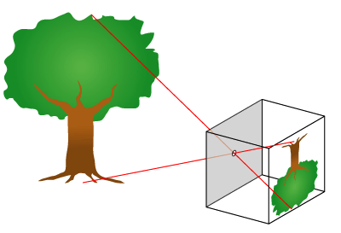

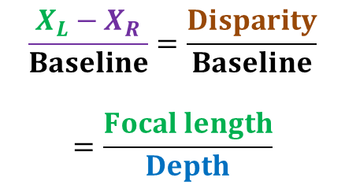


Baseline
Depth (in z direction)
$$\frac{X_{L}−X_{R}}{Baseline}=\frac{Disparity}{Baseline}$$
$$=\frac{Focal length}{Depth}$$
$X_{L}−X_{R}$=Disparity.
$$X_{L}$$
$$X_{R}$$
Focal length
Baseline
Notes:
Use triangles to find z!

