Slide 1

CS1102 Lec05 - Software
Computer Science Department
City University of Hong Kong
Notes:
1.5 week
1st hour: P.12 (slow demo)
2nd hour: upto P.30 (leave rest for next week)

Slide 2
Objectives
Describe two fundamental types of software and their relationship
Describe the role and main functions of the operating system in a computer
Describe the term user interface
Explain the purpose of the following utilities: backup, system restore, disk defragmenter, uninstaller and screen saver
Identify various operating systems
Identify the categories of application software and give examples on each category

Slide 3
Software
Software - series of instructions that tell a computer what to do and how to do it
  Also called a program
    A key feature of computer programs is that they can be run or executed
  Software is "soft"
    Hardware is physically there, can be touched
A software usually consists of one or more executable files and some supporting data files
  The extension of a file usually tells what kind of file it is, for example, .ext, .dll, .dat, .doc, .txt
Notes:
Such as iphone s/w managing “contacts”: program + data

Slide 4
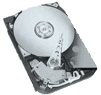



Running Software
HDD
RAM
Operating system program
Operating system interface
1. When your computer has been booted up, operating system program is loaded into RAM
Word processing program
Word processing program window
2. When you start a word processing to edit a document, both the program and the document are loaded into RAM from the hard disk
Document is saved
into the hard disk
You make changes in
the document in RAM
3. When you edit the docu, the docu is only changed in RAM; When you click save button, the document is copied from RAM to hard disk
Instructions and data
Are removed From RAM
You quit the program
4. When you quit the word processing task, the memory for program and document is claimed back by OS for future use.
Notes:
Draw memory image on board, OS (at bottom), MS-word s/w, docu, stack; when it quits, the memory is claim back for future use
When run a s/w, it must be brought to RAM.
OS is always in RAM whenever the computer system is on, it’s running all the time!

Slide 5
Types of Software
System software
  Programs that control or maintain the operations of the computer and its devices
Application software
  The purpose of application software is to make users more productive and/or help with personal task
  E.g., word processing, game playing, e-mail, web browsing …
Notes:
System s/w: OS and programs as extension of OS, such as device driver, utilities (window browser), they’re NOT application-specific
Anti-virus: system s/w or application?

Slide 6
Lec05
Software - Operating System

Slide 7
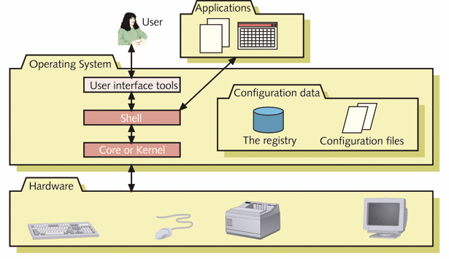
Operating System
Operating system
  OS acts as the master controller for all activities that take place within a computer system
  Hardware + OS sometimes called platform, providing the infrastructure for application software
OS acts as an interface between the hardware and the application software
Notes:
OS is in between h/w and applications: upper interface to support applications, low interface interact with h/w to provide a virtual machine.
What’s OS: programs that manage h/w, resources and applications
Notice “user” and “applications” in diagram, they interact with OS through different interface:
OS interface to users: window interface or text interface (command lines), explain later page 21.
OS interface to applications: API (not “shell”)
OS support different H/W; an application can only run on one type of OS (platform).
Imagine a computer without OS: The early computers, no OS.

Slide 8
Which following lines use OS functions ?
//Scan and show the factors of x
function computeResults() {
var x=Number(document.getElementById("x").value);
var h=""; var count=0; var i;
for (i=1;i<=x;i++) {//check through 1, 2, 3, 4, .. x for factors
if (x%i==0) {
h=h+i+" "; count++; }
}
document.getElementById("factor_list").innerHTML=h;
document.getElementById("factor_count").innerHTML=count;
}
Notes:
Input from window /output to screen

Slide 9
OS Functions
Process management
  Manages tasks that CPU works on
Memory management
  Memory allocation /claim back for tasks, virtual memory management
File system
  How to store and retrieve files on disk
Device management
  allows application software communicate with peripheral hardware component
Application interface (user-interface and APIs)
  provides a interface for software applications to access the OS functions, such as file access, I/O, etc.
Notes:
4 functions (interface is not part of OS)

Slide 10
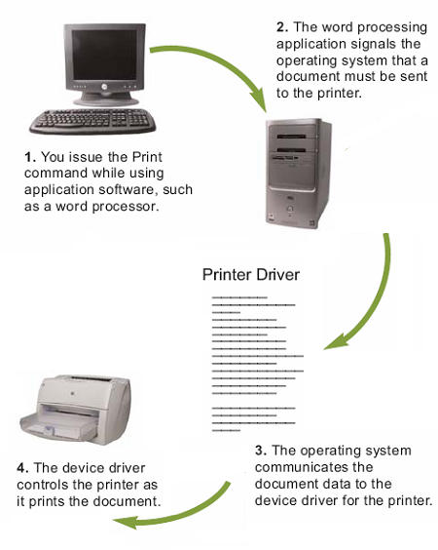
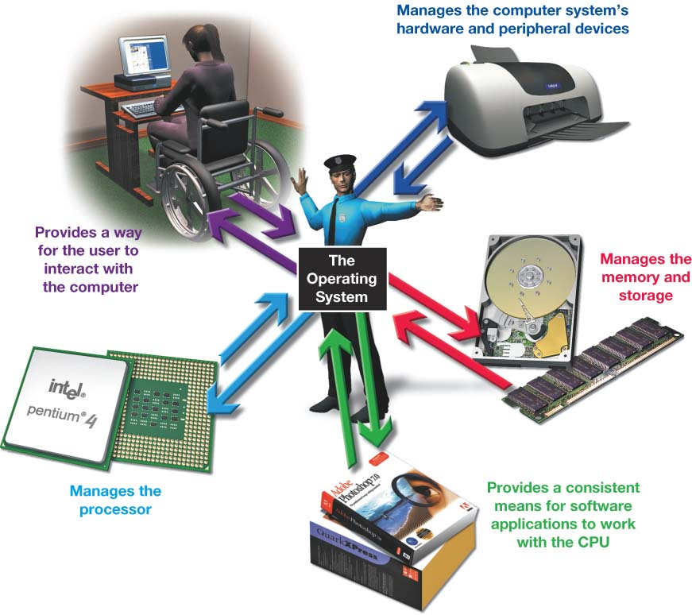
Operating System Functions
Notes:
Righ-hand side Fig. first: manage devices and provide an user-friendly interface
Left-hand side: is an example of how a “print” cmd is executed by OS.

Slide 11
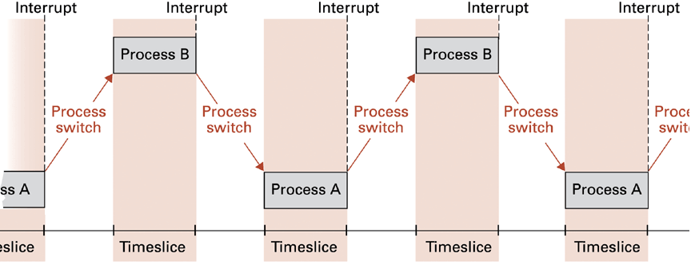
Process Management
Today's computers are multi-tasking which allows a single user to work on two or more programs at a time, so the processor(s) must be shared among all the programs
  OS ensures that each program (more precisely, a process) receives enough of the CPU time to function properly
  The switching between processes are so fast that it looks like several programs are running concurrently
Notes:
A process is a task: when a program is executed, it becomes a task (process)!
Show task management to see tasks running situation. MS-DOS cmd: tasklist
If u want to disable/change to manual-start of task: go to control panel / systems and security (for window 7 only) / administrative tools/ services, you’ll see a list of service tasks. Double-click one, you can change setting of “auto start”, manual start, disable, etc.
Interrupt and process switching: remember the current state: ? What is the most important state: instruction count register!

Slide 12
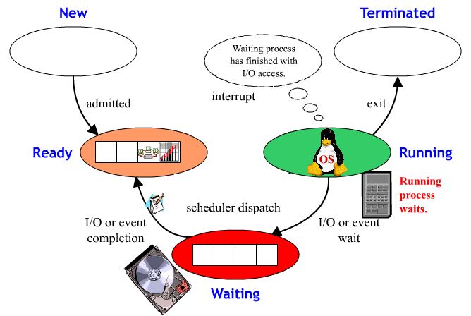
Process Management (II)
Process can have one of the following five states at a time
State & Description
New The process is being created.
Ready The ready process is waiting to be assigned to a processor to run.
Running Process that is currently being executed.
Waiting The process is waiting for some event to occur, such as the completion of an I/O.
Terminated The process has finished execution.
Notes:
New and terminated: you don’t see them
What is the state of the processes in task-list?
What is the process currently running?

Slide 13
Process Management (III)
The operation of selecting the next process to be executed is known as scheduling. Scheduling algorithms include
  First Come First Serve (non-preemptive)
    When the current running process finishes, the oldest process in the ready queue is selected to run next.
  Shortest Job First (non-preemptive)
    When the current running process finishes, the process in the ready queue with the shortest expected execution time is selected to run next
  Round Robin (preemptive)
    A clock interrupt is generated at periodic intervals. When the interrupt occurs, the current process is preempted, and the oldest one is selected to run next.
Nowadays many computers include multi-core processors. The operating system also supports a division of labor among all the cores.
Head
Tail
Notes:
Note: in non-preemptive scheduling, a process won’t come from head to the tail. NOT commonly used.
Round robin is the most commonly used! It creates an illusion that the CPU is dedicated for each task

Slide 14
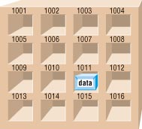
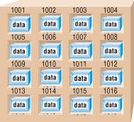
Memory Management
Memory management
  When a user initiates an application, the OS decides where to place it in memory and may allocate additional memory to the application if necessary
  Each program gets its own portion of memory, and OS needs to keep programs from interfering with each other's memory portion
RAM
Notes:
See memory on board linear configuration: low memory part: OS, user processes, for example of editing a word doc, then another process editing a powerpoint, … then run a browser … (too many processes and run out memory)
? If there’s NO sufficient RAM for process anymore, what to do ->

Slide 15
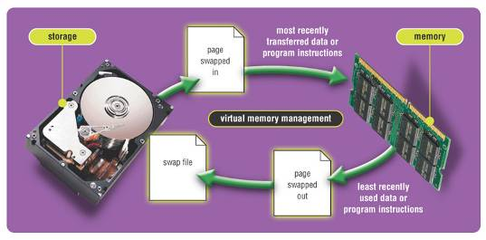
Virtual Memory
Memory management becomes more complex when the total memory space required exceeds the actual physical memory space
  Virtual Memory: borrowing some space from the hard disk functioning as additional RAM
  Paging technique to swap programs and data back and forth between the actual RAM and the virtual RAM
Notes:
Page in: most recent used;
Page out: least recently used

Slide 16
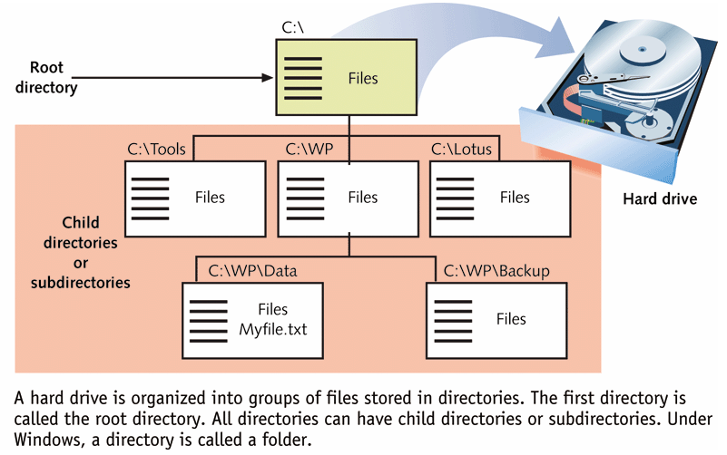
Files and Directories
Computer file - a named collection of data that is stored on a storage medium
Files can be organized into folders (directories)
Notes:
Demo: search-program for “command prompt” to show . And .. Of directories
Explain relative pathname: . and ..

Slide 17
File Extension
File extension is the part of file name that is separated from the main file name by a period, and it may provide a clue to the file's contents
  E.g., .exe, .jpg, .htm
MS Windows uses a file association list to link a file extension to its corresponding application software
Although a file extension is a good indicator of a file’s format, it does not really define the format
  A file header is a section of data at the beginning of a file that contains information about a file
Notes:
A link from a file name to the s/w that opens it. So when u click the data file, the s/w is auto-started to open it.

Slide 18
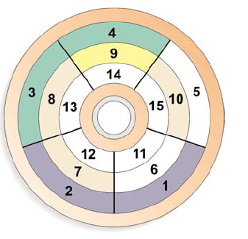
File System
The smallest allocation unit, consisting of one or multiple sectors
File system keeps track of the names and locations of files in Master-File-Table (one for each directory) containing:
  File (or directory) name
  Cluster IDs allocated
  to the file
Fragmented files are stored
in noncontiguous areas and may
decrease performance
Defragmentation utilities help re-arrange
files so that they are stored in contiguous areas
Notes:
File system: store files on disk, and locate them on disk when for access…not a easy job! Based on Master-File-Table…
Cluster = block in UNIX: one or multiple sectors.
Explain master-file-table…
?If I want to access file “Bio.txt”, how do I search the table?
? if there are thousands/millions of files in a PC, or multiple Bio.txt in different directories? : use directory, sub-directory, …
?cluster # -> track # and sector #?: data are stored in certain order and cluster # follows the sequential order
Importance of defragmentation: user reads file sequentially, but file clusters are scattered all over disk
If master-file-table is corrupted, data cannot be accessed, although data are still on disk;
Similarly, when delete a file, the table-entry of the file is deleted, not erase disk data…

Slide 19
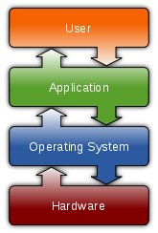
Device Management
The communication between OS and peripheral hardware is through the device driver
  Driver works as a translator translating the specialized commands of the device to commands that the OS can understand, and vice versa.
  It is often OS-specific (and hardware-specific, of course), and provided by the device manufacturer
  Today, most devices supports Plug and Play (PnP)
    Automatically recognizes new devices as you plug them into the ports
Device Driver
Notes:
See layers of Fig.
Device drivers nowadays can be independently installed. It’s provided by the device manufacturer when you buy it (e.g., print driver)
OS simply search the driver for the corresponding device.

Slide 20
Application Interface
Operating systems today are designed and developed for a specific CPU or “family of CPUs”
  Macintosh OS: Motorola CPU, IBM PowerPC CPUs, Intel CPUs
  Windows: Intel and AMD CPUs
  Linux: Intel CPUs
  Unix: Sun Sparc CPUs, Intel CPUs
For application programs to work the hardware, OS must contain codes that perform some common tasks, such as I/O, file access, etc.
  How? OS provides blocks of code for application developers to refer to or request services from
  Application programming interface (API)
Application software can be OS dependent or developed as cross-platform applications (such as Java applications)
Notes:
PC OS / workstation or server OS (unix)
OS APIs are standard

Slide 21
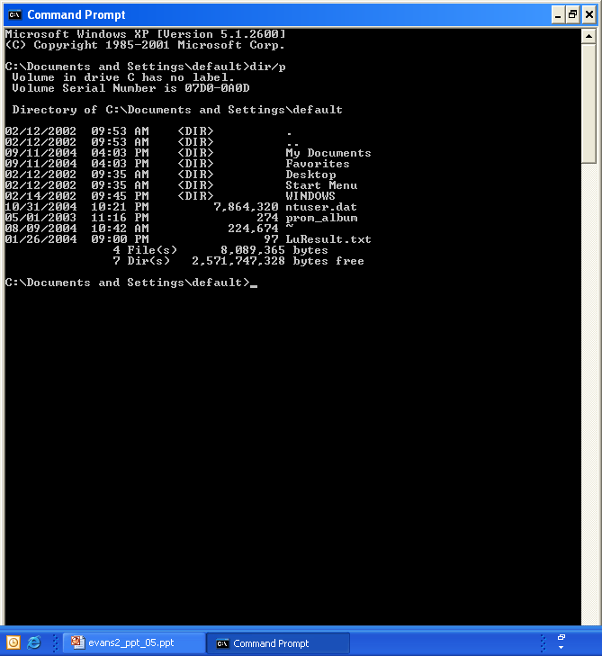
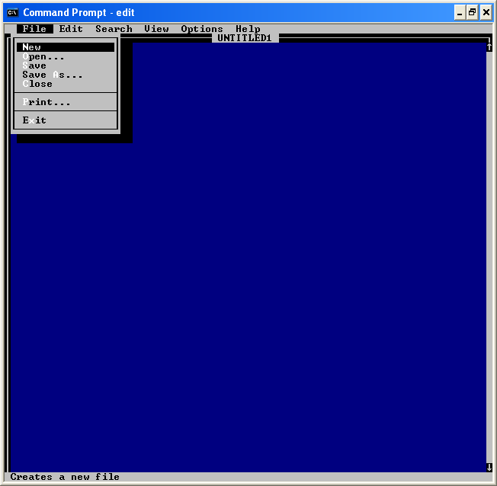
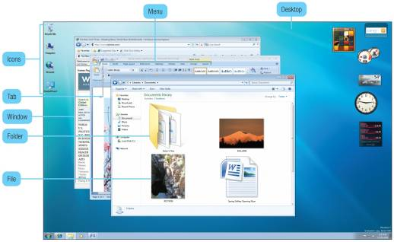
User Interface
User interface controls how users enter commands and how information is displayed on the screen
Basic types include
  Command line interface
    Keyboard input only
    Example includes DOS, Unix
    Users must remember the commands to type
  Menu-driven interface
  Graphical user interface (GUI)
Notes:
Note: differences of API and user interface (users = human!)
Demo dos prompt window (command lines)
Menu-driven interface: for specific application systems (embedded systems)
GUI = window systems

Slide 22
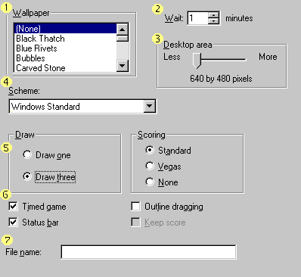
Elements of GUI
List box
Spin Control Box
Slide bar
Drop-down List
Radio Button
Check Box
Text Box

Slide 23
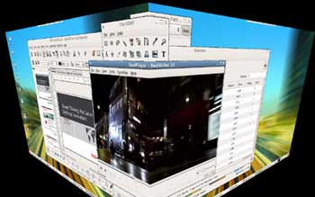
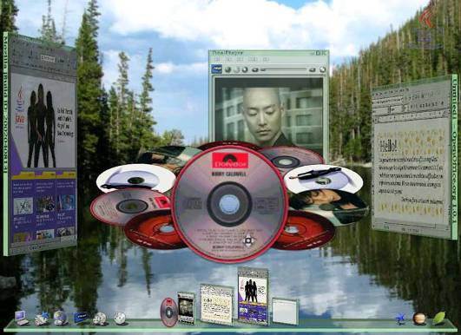
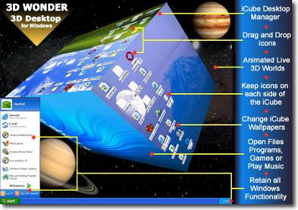
Future: 3D GUI
http://www.3dwonder.com/
http://www.sun.com/software/looking_glass/

Slide 24
Types of Operating Systems
Types of operating systems
  Standalone OS (Desktop OS)
    OS works on a desktop or notebook computer (single-user, multi-tasking)
    Example includes: DOS, Windows 9x, Windows 2000, Windows XP, Windows Vista, Windows 7, Mac OS, OS/2, Unix, Linux
  Network OS
    OS runs on servers (multi-user, multi-tasking), providing communication and routing services which coordinates communication between the other computers
    Example includes: Novell Netware, Windows NT server, Windows 2000 server, Windows 2003 server, Windows 2008 server, Unix, Linux, Sun Solaris, MVS and VM for IBM mainframes
  Embedded OS
    OS runs on mobile devices such as PDAs and cell phones (single user, multi-tasking)
    Example includes: Windows CE, Palm OS, Windows Phone 7, iPhone OS, BlackBerry OS, Google Android, Embedded Linux, Symbian OS
Notes:
NetworkOS: network is the computer (by John Gage 1984) -> Netcomputer (Netbook)
What’s difference between OS for network computer and OS for PC: no much difference, but no need of powful CPU, large RAM (computing is on remote), large DISK (storage is remote)
Embedded OS for embedded systems: camera, fridge, lift, everywhere. OS for iphones (iphone is a mini PC!)

Slide 25
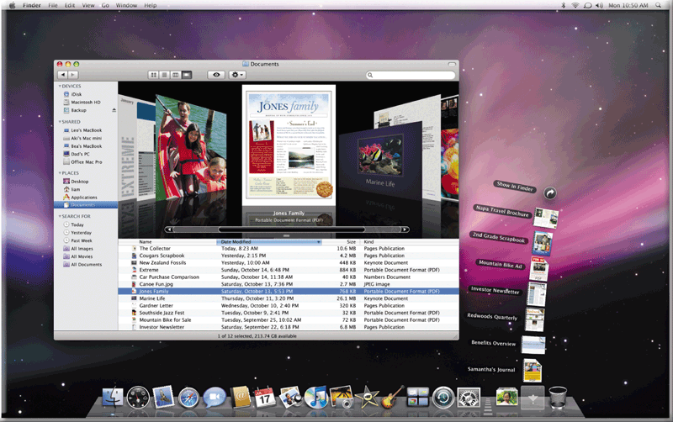
Mac OS
Mac OS Runs on Apple computers
Popular for its photo-quality icons and easy-to-use menus
Latest version is Mac OS X
Notes:
Window system was started by Mac
IBM PC was a competitor, but was losing to Mac. Microsoft had a law suit with Apple on window system…

Slide 26

Unix and Linux
The Unix OS was developed in 1969 at AT&T's Bell labs
  Gained a good reputation for its robustness and reliability in multi-user environments
  Popular choice for servers, mainframes and supercomputers
The Linux OS (version of UNIX) was developed by a young Finnish student named Linus Torvalds in 1991
  Encouraging programmers to develop utilities, enhancement and share with others
    Open source
    No propriety
  Google Chrome OS based on Linux
Notes:
Login to Cslab gateway, use cmd: “uname –a” to see the version of UNIX (5.10, h/w info….)
Linux: open source. It become very popular for small systems (embedded systems)
Its command set is almost the same as UNIX

Slide 27
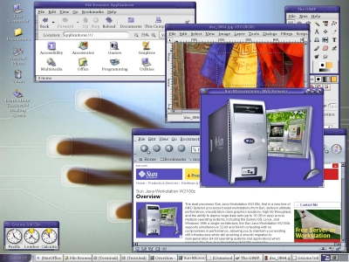
Unix and Linux
Unix/Linux users can choose from several graphical interfaces
Notes:
The above are all Linux windows. UNIX is not a window system.

Slide 28
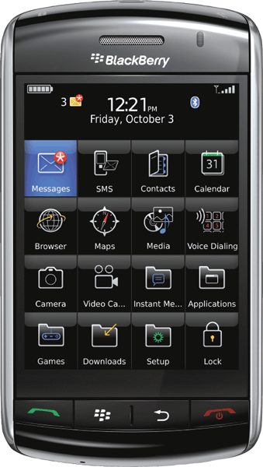
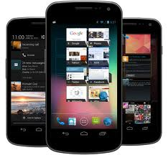
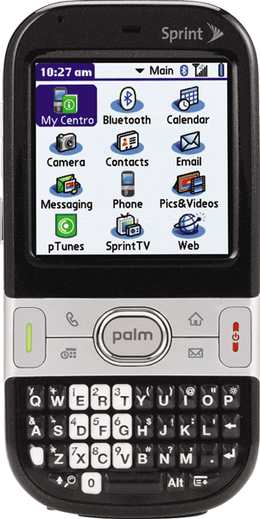
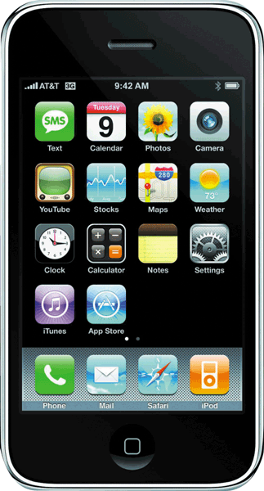
Embedded Operating Systems
An embedded operating system resides on a ROM chip on a mobile device or consumer electronic device
Notes:
Linux is a popular one, RT-Linux
Android, Palm OS, iOS, etc.

Slide 29
Lec05
System Software -
Utilities

Slide 30
Utility Programs to Enhancing an OS
A utility program is a kind of system software that provides extensions of operating system capabilities.
Utility programs often performs tasks related with system maintenance, for example
  Backup utility
    Copies selected files or entire hard disk onto another disk or tape (often compressed to save storage space)
  System restore utility
    Rewinds your PC back to an early time (called a restore point)
  Disk defragmenter
    Re-organizes files and unused space on hard disk so programs run faster
  Security utilities
    Detects and protects a computer from malicious software or unauthorized intrusions
  Other utilities include software uninstaller, screen saver, performance monitor, troubleshooting, personal firewall, and …
Notes:
Backup setting: control-panel -> backup and restore (then, you can change setting)
Restore is together with “backup” (see above).

Slide 31
Lec05
Software -
Application Software

Slide 32
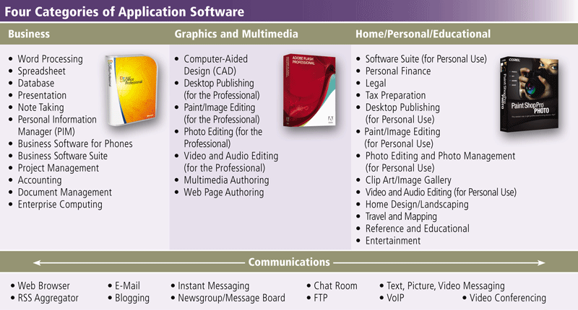
Application Software
Application Software
  Differing from system software, applications help you personally to accomplish some specific tasks
Notes:
4 categories: …. and communications.

Slide 33
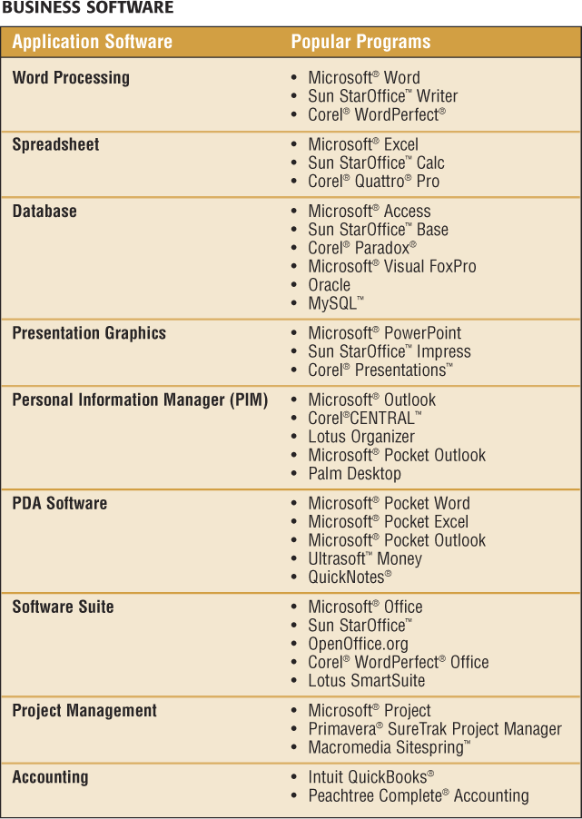
Business Software
To assist people with business activities
  Word processing - allows user to create and manipulate text and graphics
  Common features in word processing software
    Spelling check
    Grammar check
    AutoCorrect
    Search and replace
    Speech input
    Thesaurus
    Tracking changes
    Mail merge
    …

Slide 34
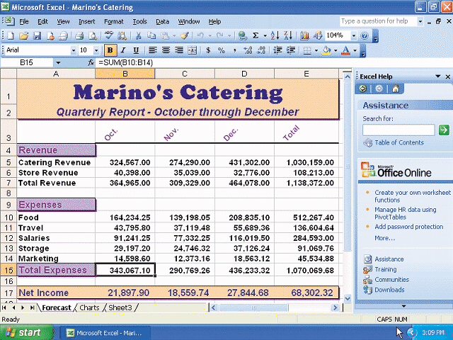
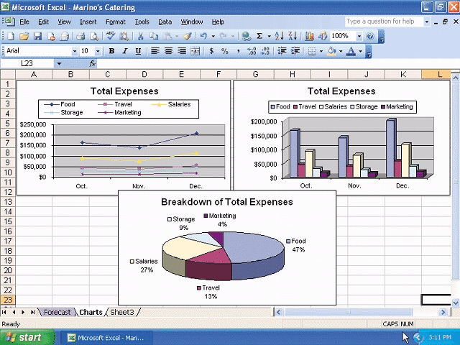
Business Software - Spreadsheet
A spreadsheet uses rows and columns of numbers to
  Organize data
  Perform calculations by built-in or user-defined formulas
  Turn the numbers into graphic reports and charts
Notes:
Microsoft Excel

Slide 35
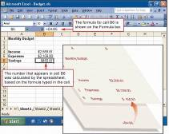
Spreadsheet Software (cont'd)
In spreadsheet, a formula tells the computer how to use the contents of cells in calculations
  E.g., =D4 - D5 + (D8 * 1.1)
  A formula can contain
    Cell references
    Mathematical operators
    Functions (e.g., SUM, AVG, MIN, MAX, IF ….)
Charting depicts data in a spreadsheet in a graphical form
Microsoft Office also provides macro coding feature
  allowing users to write small programs to automate repetitive tasks in Office applications
  MS macros are in VBA code (Visual Basic Application)
Notes:
Example in DataFile/L6.xls. Explain:
Create a new cell of sum of expense “=SUM(E2:E22) “
Create a new cell of Average (of expense) and use function AVG “=AVG(E2:E22)”
Create a new column of Balance and use function “=(D24 – E24)”
Insert a pie chart for income
Insert a bar chart for expense (move the chart away, so it won’t overlap the pie chart)!

Slide 36
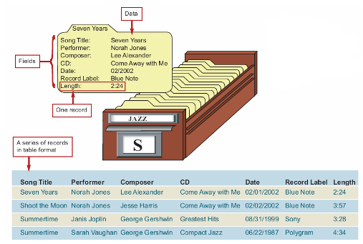
Business Software - Database
A database is simply a collection of data organized in a manner that allows access, retrieval, and use of that data
Data software allows you to
  To enter, find, organize, update and retrieve information stored in a database
  Database software stores data as a collection of records composed of fields that hold data
    A record holds data for a single entity such as a person, place, thing or event
    A field holds a specific piece of information within a record
    Records are arranged in a grid of rows and columns (table)
Notes:
Database allows you to find a particular record efficiently: imagine cityu has over 50,000 students. This is different from “spreadsheet” (the data on a sheet ☺

Slide 37
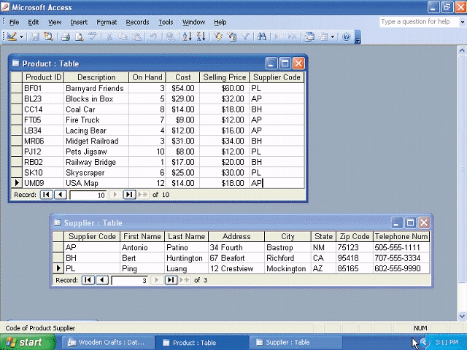
Database Software (cont'd)
A query language such as SQL (Structured Query Language) provides a set of commands for locating and manipulating data
  Example:
  SELECT Name
  FROM Student
  WHERE Grade = 'F'
Popular database systems
  MS Access, MySQL, MS SQL server, Oracle database
Notes:
Relational database: holding all related information of an object together, such as personal info, payroll system, student registration, etc (different from excel files).
Example:
mysql -hhostname -uusername -ppasswd
e.g.
% mysql -hjserv -ujdemo -papple1
(jserv is the host name of DBMS, jdemo the user name and apple1 the password.)
> use db_jdemo; // set database to db_jdemo. Need to do this first!!!
> show tables;
> select * from COFFEES;
> select COF_NAME, PRICE from COFFEES;
> select COF_NAME, PRICE from COFFEES where PRICE < 8;
> exit;

Slide 38
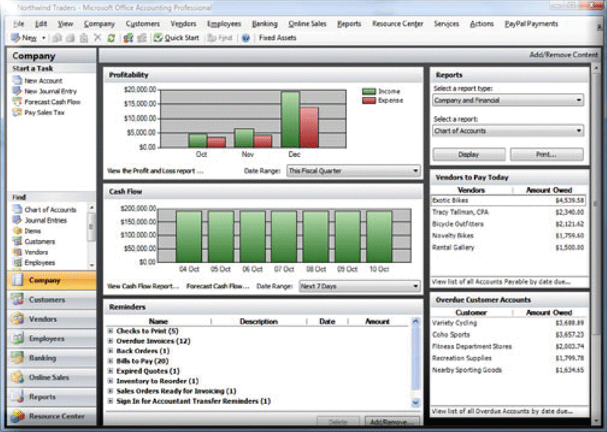
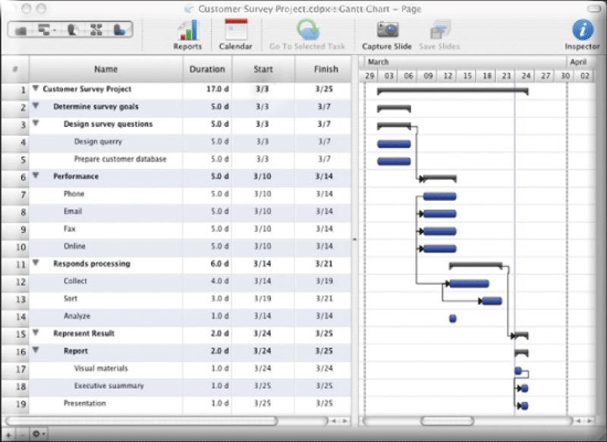
Other Business Software
Presentation graphics software
  Used to create visual aids for presentations (or slide shows)
Personal information manager (PIM)
  Includes a calendar, address book, a task-to-do list
  Most PDAs and many smart phones include PIM functionality, and can be synchronized with desktop computers
Project management software
  Allows you to plan, schedule, track, and analyze the events, resources, and costs of a project
Accounting software
  Helps companies record and report their financial transactions
Notes:
Left: project schedule; right: company accounting

Slide 39
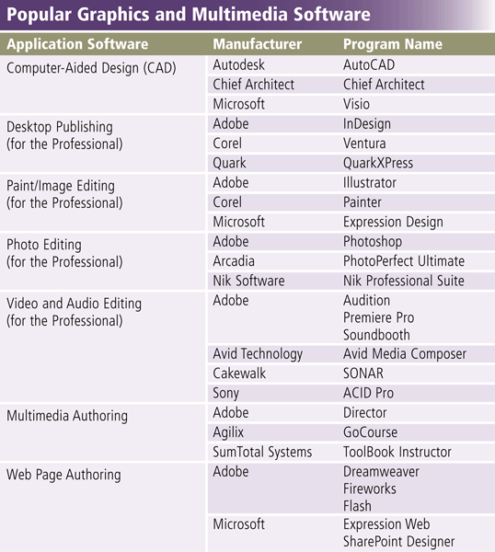
Graphics and Multimedia Software
Popular graphics
and multimedia
software products

Slide 40
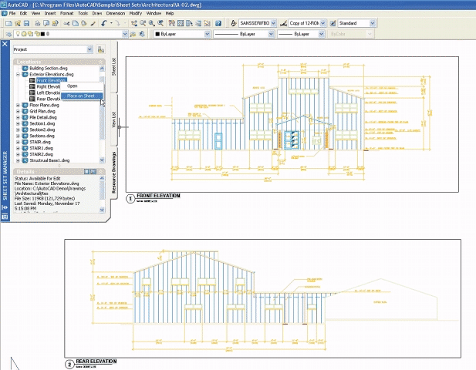
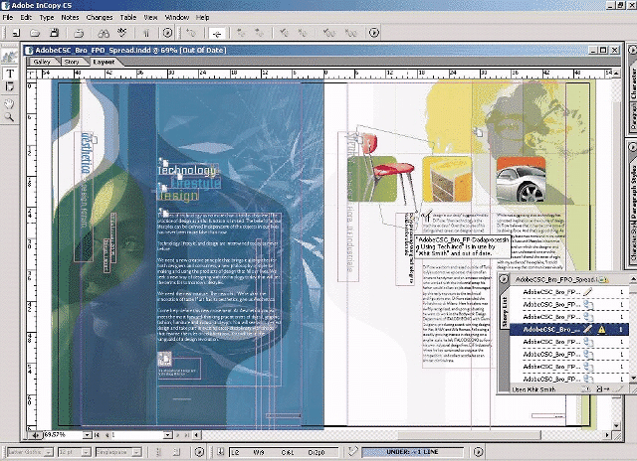
Graphics and Multimedia Software
Computer-aided design (CAD) software
  Allows you to create engineering, architectural, and scientific designs
Desktop publishing software
  Enables you to design and produce sophisticated documents that contain text, graphics, and many colors

Slide 41
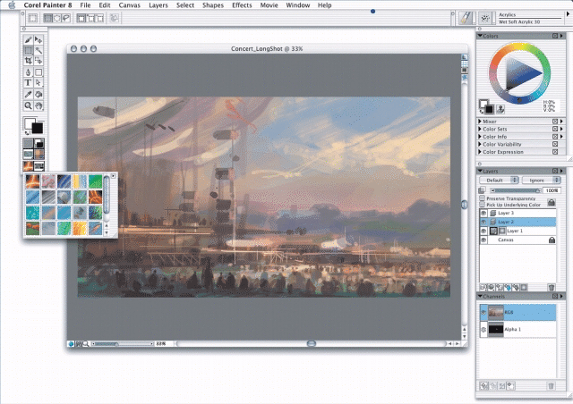
Graphics and Multimedia Software
Paint/Image editing software
  Used to create and
  modify graphical images
Audio editing software
  Allows you to make your own digital voice and music recordings
    Audio editing software
    CD ripper software
    Audio encoding software
    Computer-aided music software
    MIDI sequencing software
Notes:
MIDI (music instrument digital interface)

Slide 42
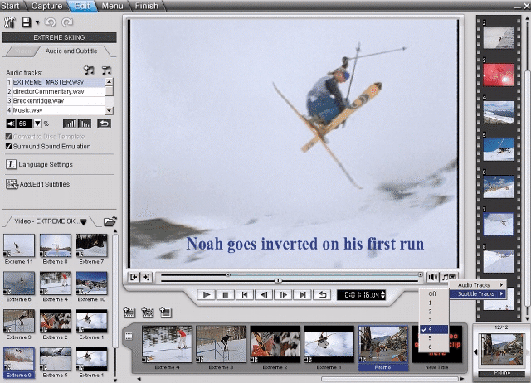
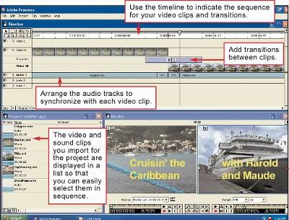
Graphics and Multimedia Software
Video /Audio editing software
  Video editing software allows you to modify a segment of a video, called a clip
  Audio editing software allows you to
    Transferring video footage from a camcorder to a computer
    Clipping out unwanted footage
    Assembling video segments
    Adding special visual effects
    Adding a sound track

Slide 43
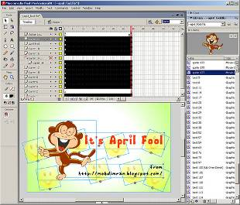
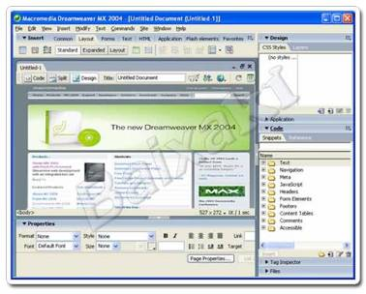
Graphics and Multimedia Software
Multimedia authoring software
  Allows you to combine text, graphics, audio, video, and animation into an interactive
  presentation
Web page authoring software
  Allows users of all skill levels to create Web pages

Slide 44
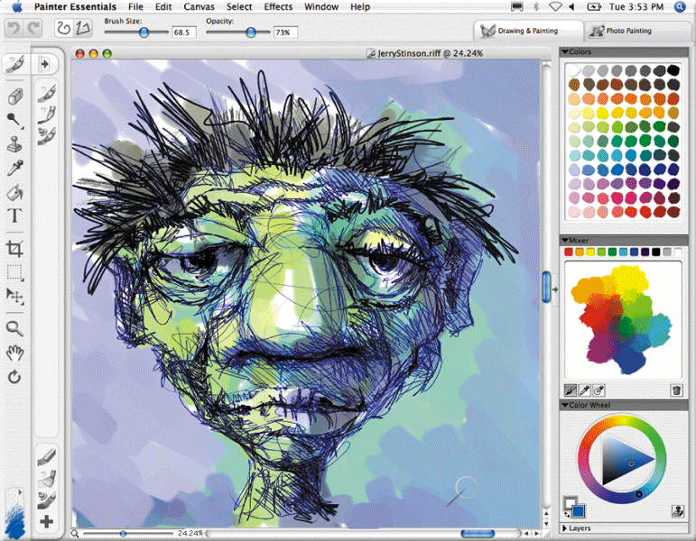

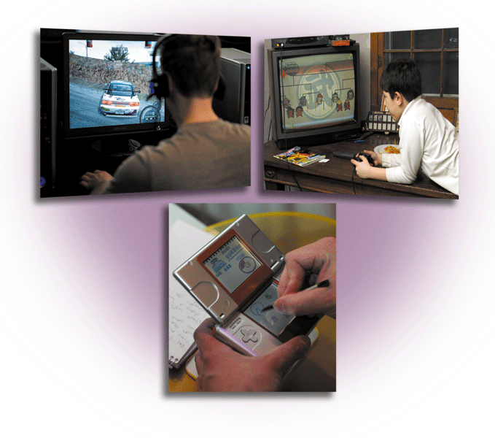
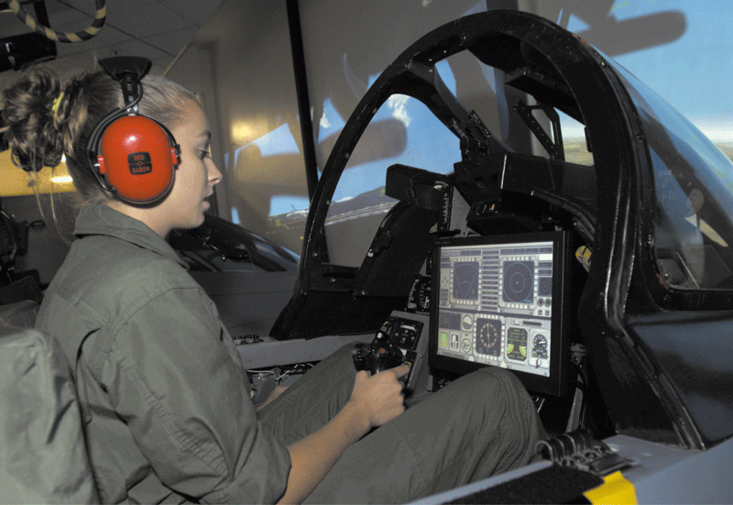
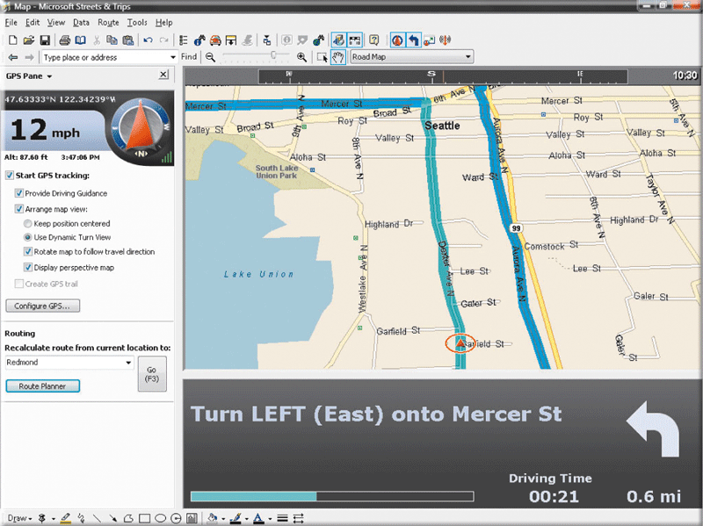
Software for Home, Personal, and Educational Use
Personal finance software
Tax preparation software
Travel and mapping software
Home design software
Educational software
Entertainment software
  Media players
  Computer games

Slide 45
Application Software for Communications
Communication software facilitates communication and data sharing between people
  Email
  Web browser
    Web application is a software program which the user accesses over a network with a web browser
  Instant messaging
  RSS Aggregator
  Blogging
  Video conferencing
  FTP
  VoIP
  Peer to peer file sharing

Slide 46
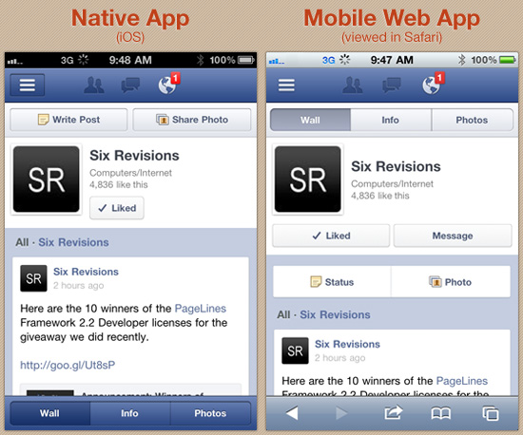
Desktop Applications vs. Web Apps vs. Mobile Apps
Desktop apps
  Application software running on desktop/notebook computers
  Could be developed separately for each operating system or developed as cross-platform applications
  Need installation
Mobile native apps
  Applications specially designed to run on a device’s OS, and typically needs to be adapted for different devices
  Need installation
Web apps (desktop or mobile)
  Front-end clients specifically designed for running in browsers
  Need Internet connection to back-end servers
  NO need installation
Good ? Bad?
Users? Developers?
Notes:
Slow……..

Slide 47
Software License
Commercial software is copyrighted so it cannot be legally duplicated for distribution to others
  A copyright is a form of legal protection that grants the author of an original “work” exclusive rights to copy, distribute, sell and modify that work
Software License
  A legal contract that defines the ways in which you may use a computer program
    Single-user license, multiple-user license, site license
  Where is the license exactly
    EULA (End-User License Agreement): Agree or Not Agree
Software piracy is used to describe the unauthorized copying and selling of software

Slide 48
Software License
Different levels of permission for software use, copying and distribution
  Commercial software
    You only buy the right to use it
  Shareware
    Distributed free for trial period; after trial period, you need to pay
  Freeware
    Copyrighted software at no cost
    You can make copies, distribute it but cannot change it or sell it
  Open source software
    Copyrighted software distributed together with its source code
    You can use, modify, and redistribute it
  Public-domain software
    No copyright restrictions
    You can freely copy, distribute, and even sell it; but you are not allowed to apply for a copyright on it
Notes:
All forms of s/w has copyright except public-domain s/w (but you still cannot apply copyright over it)

Slide 49
Lesson Summary
A computer's software is like the chain of command in an army
  Application software tells the operating systems how to do
  The operating system tells the device drivers
  The device drivers tell the hardware
  The hardware actually does the work
Software copyright is a form of legal protection that grants the software author an exclusive right to copy, distribute, sell, and modify that software
Software license is a legal contract that defines the ways in which you may use a software
  Commercial, shareware, freeware, open source, and public domain software

Slide 50
Lesson Summary (continued)
OS functions include
  Interacting with computer hardware to manage a computer's resources, which include the CPU, main memory and other peripheral devices
  Providing the user interface
  Providing the interface for application software
Application software helps user accomplish some specific tasks, and it includes four basic kinds
  Business
  Graphic and multimedia
  Education, home and personal use
  Communication

Slide 51
Reference
[1] Wikipedia - Operating System
  http://en.wikipedia.org/wiki/Operating_system
[2] HowStuffWorks.com - Operating System
  http://computer.howstuffworks.com/operating-system.htm
[3] CPU Process Switching Animation
  http://courses.cs.vt.edu/~csonline/OS/Lessons/Processes/index.html
[4] Wikipedia - History of Microsoft Windows
  http://en.wikipedia.org/wiki/History_of_Microsoft_Windows
[5] Wikipedia - Linux
  http://en.wikipedia.org/wiki/Linux
[6] Wikipedia - Spreadsheet
  http://en.wikipedia.org/wiki/Spreadsheet

Slide 52

For you to explore after class
Lec05-Q1: explain why Windows can support PnP, i.e., the addition of a new device without requiring reconfiguration or manual installation of device drivers?
Lec05-Q2: depending on the file system and disk volume, a cluster ranges in size from one sector to several sectors. State how using large-sized clusters would affect disk utilization ratio and the system performance, comparing to using small-sized clusters.
Lec05-Q3: make a list of 6 file extensions you find in a computer that you use most often. Explain each of the extensions are for what type of files
  E.g., .exe - for executable files
Notes:
Cluster-size: block - size

