Slide 1

CS1102 Lec04b
Hardware – Input, Output & Ports
Semester A, 2013-14
Computer Science Department
City University of Hong Kong
Notes:
Finish all slides + storage part left by last week

Slide 2
Objectives
Define computer input and discuss input devices commonly used today and explain how and when they are used
Define computer output and discuss output devices commonly used today
  Discuss the factors that affect the image quality on an LCD monitor
  Compare different types of printers available today
  Identify the features to be considered when choosing a printer
Differentiate between a port and a connector
Recognize ports that are typically built into a PC and for what devices

Slide 3
CS1102 Lec04
Hardware – Input
Notes:
I/O are peripheral devices, NOT in the box of system unit

Slide 4
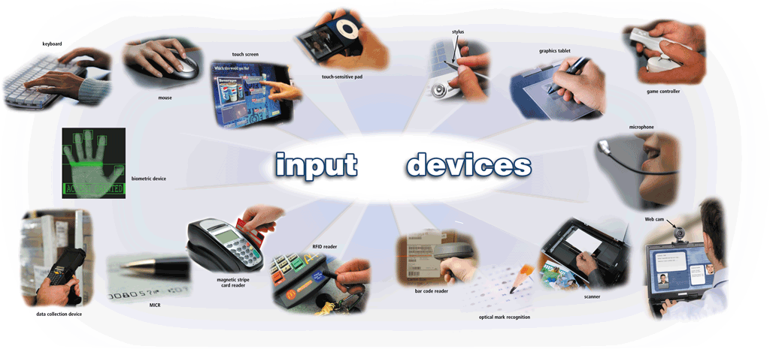
What is input?
What is input?

Slide 5
Input: From Person to Processor
Input – data or instructions entered into the computers
  Data include characters, numbers, images, audio and video
  Instructions can be in the form of programs, commands, user responses
    A program is a series of related instructions that tells a computer what tasks to perform and how to perform them
    A command is an instruction that is issued by a user and triggers the execution of a program
    A user response is an instruction that a user issues by replying to a question displayed by a program
Notes:
Program
Interaction between program and user (commands / response): ATM machine: commands & user input

Slide 6
Input Devices
An input device is any hardware component that allows users to enter data and instructions into a computer. Three major types of input devices:
  Keyboard type devices – converts user typed characters into computer readable form
  Pointing devices – control the position of cursor or pointer on the screen
  Digitizing devices – converts other forms of data into computer readable form (binary digits)
Notes:
Pointing device - mouse

Slide 7
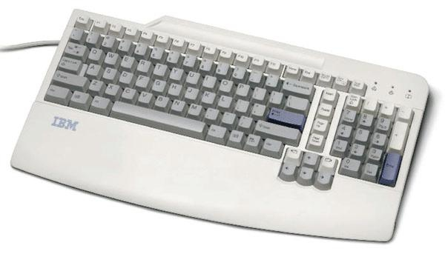
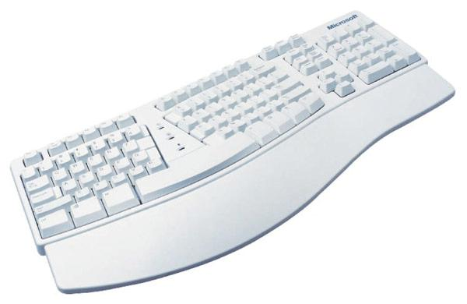
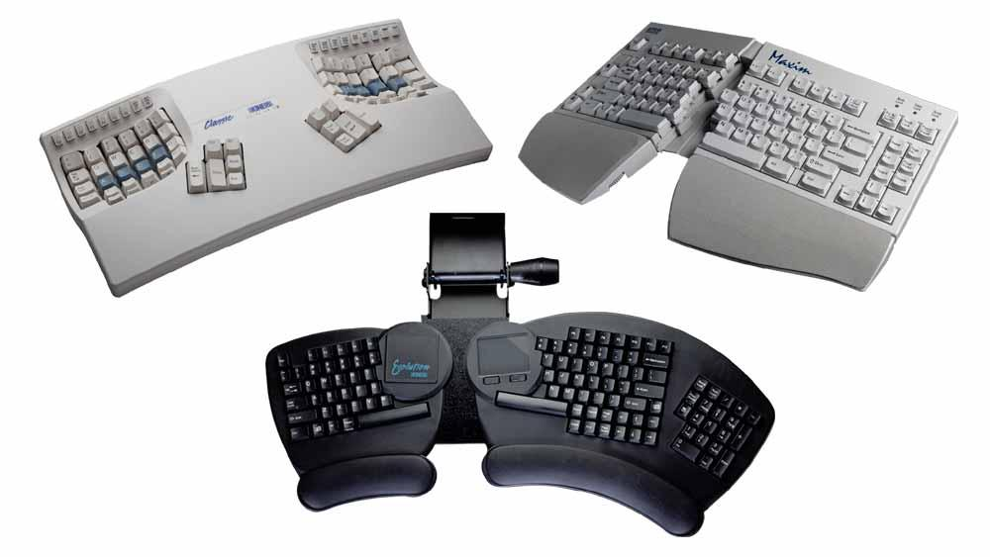
Keyboards
Keyboards
  Used to enter letters, numbers and special characters
Types of keyboards
  Standard keyboards
    Based on the typewriter’s QWERTY layout
  Ergonomic keyboards
    To address possible medical problems
Notes:
Keyboard is the most primary input device. Many OS makes kbd standard input.

Slide 8
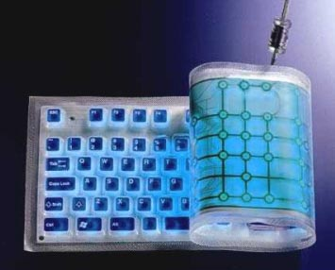
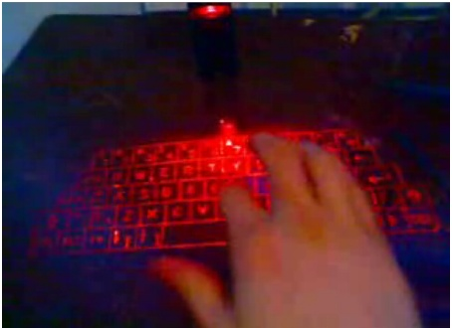
Keyboards (continued)
Types of keyboards
  Wireless/cordless keyboard
    Communicate with a receiver attached to a port on the system unit through infrared (IR), radio frequency (RF) or Bluetooth connections
  Folding keyboard
    Used with handheld devices
  Visual keyboard
    Laser projection
Notes:
Laser projection: new generation of iphone can generate projection keyboard

Slide 9
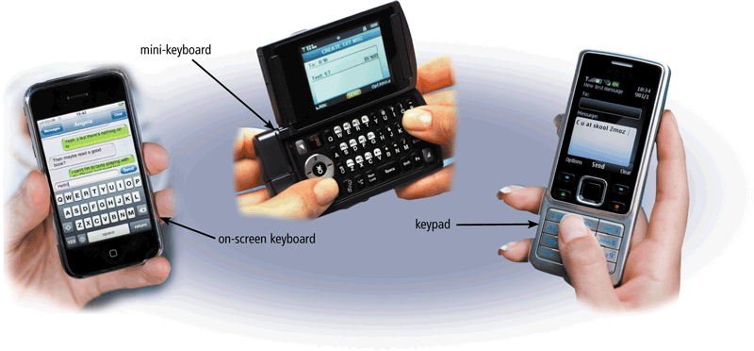
Keyboards for Mobile Devices
Keyboards on mobile devices typically are smaller and/or have fewer keys
Some phones have predictive text input, which saves time when entering text using the phone’s keypad
Notes:
Kbd for mobile devices: small & less keys, touch screen..

Slide 10
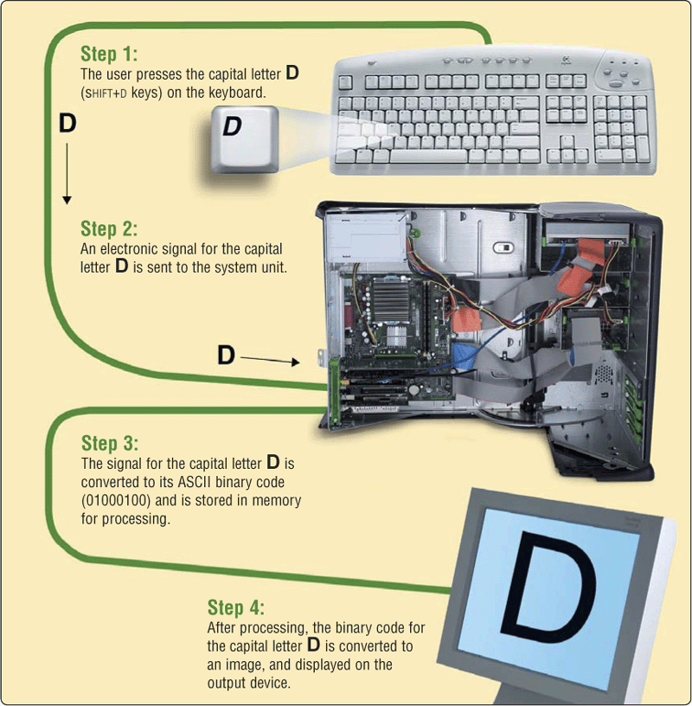
How Keyboards Work?
Notes:
Each key has a code (keycode, NOT ASCII code yet)
When you press a key, device generates a h/w interrupt signal. OS interrupt handler will be called to process this interrupt. The interrupt handler get the key-code from the certain register, interpret it…

Slide 11
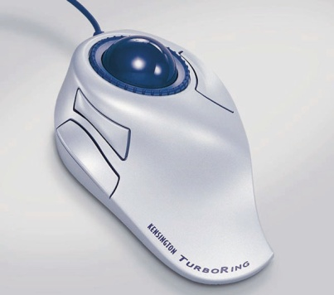
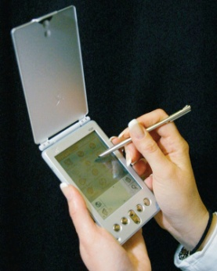
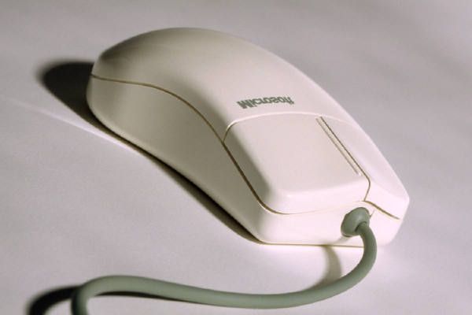
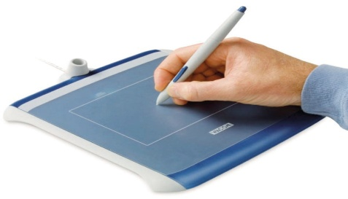
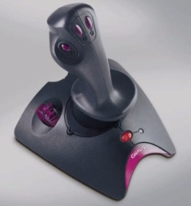

Pointing Devices
A pointing device is an input device allows a user to control a pointer (a small symbol) on the screen
  Mouse
  Touchpad
  Pointing stick
  Trackball
  Graphics tablet
  Handwriting pad
  Touch screen
  Joystick and wheel
Notes:
Mouse interrupt: always report the mouse position. Each icon on screen has a location.
Other devices are similar to mouse

Slide 12

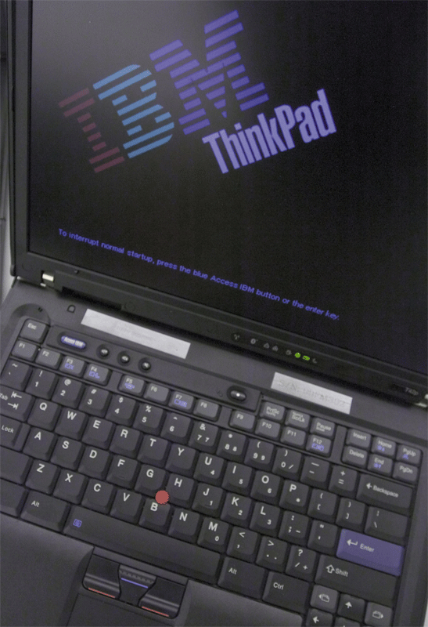
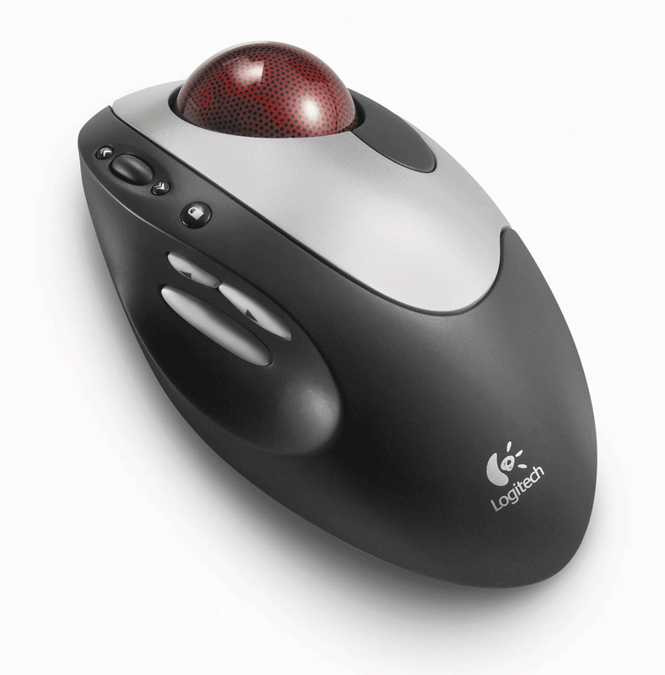
Other Pointing Devices
Touchpad is small, flat, rectangular pointing device sensitive to pressure and motion
Pointing stick is pointing device shaped like pencil eraser positioned between keys on keyboard
Trackball is pointing device with a ball on its top or side
  To move pointer, rotate the ball with thumb, fingers, or palm of hand

Slide 13
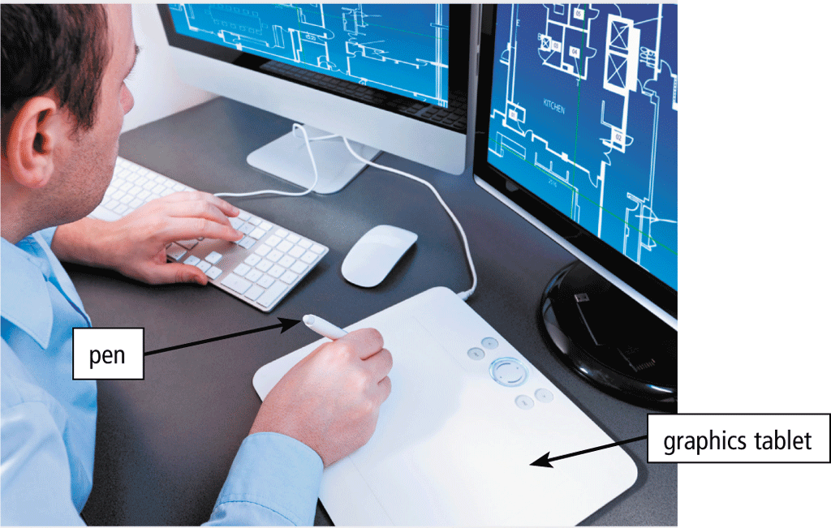
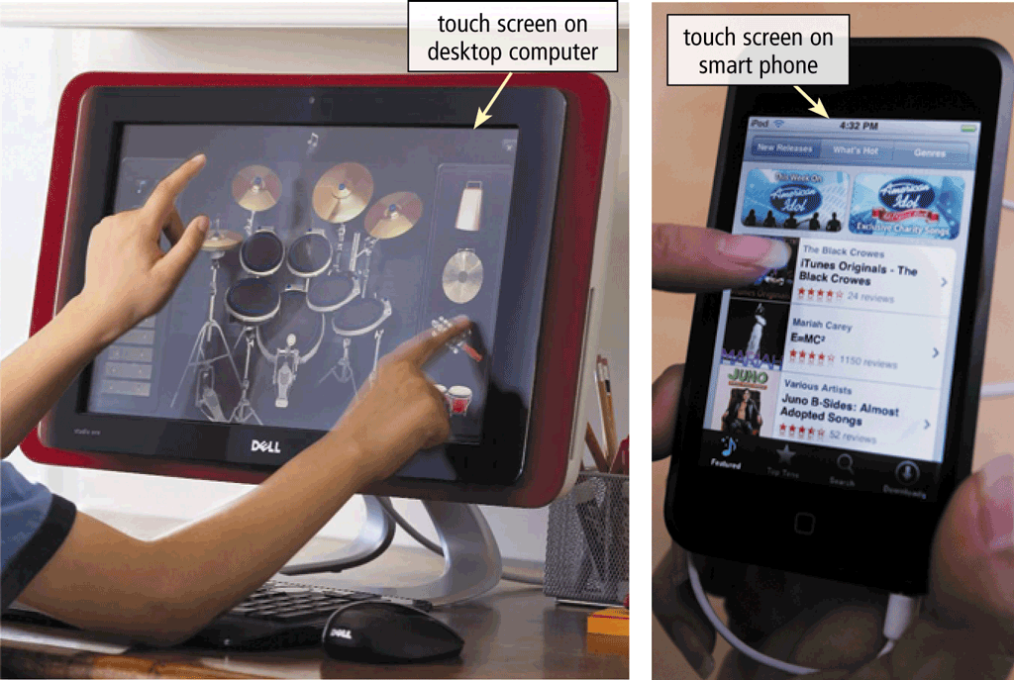
Other Pointing Devices
A graphics tablet detects and converts movements of a style or digital pen into signals that are sent to the computer
    Handwriting recognition with artificial intelligence technology
Touch screen is a monitor screen that can detect and respond to the touch of a finger or stylus
Notes:
Touch screen: the screen is a sensing board: it can response to ur touch and touch location. It’s a both Input and output device!

Slide 14
Digitizing Devices
Data is entered directly from the source and translated into digital format
  Digital camera
  Audio input
  Video input
  Game controllers
  Scanner
  Optical reader
  Bar-code reader
  Magnetic stripe card reader
  Radio frequency card reader
  Biometric input (e.g. fingerprint)

Slide 15
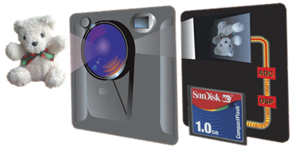
Digital Cameras
Digital cameras capture snapshots of the real world in digital images
  The amount of detail that the camera can capture is called the resolution, and it is measured in pixels.
Step 4. Digital signal processor (DSP) compresses the bytes and usually stores digital image on mobile storage media in the camera.
Step 3. Analog signal is converted to digital signal (binary bytes) by analog-to-digital converter (ADC).
Step 1. Light passes into the lens of the camera, and is separated into the three primary colors.
Step 2. A charge-coupled device (CCD) generates analog signals that represents the image based on the lights.
Notes:
Digital camera needs a fast CPU, particularly 16 shots / second: to convert signal to digit and save it.

Slide 16
Digital Cameras (cont’d)
Two factors affect the quality of digital camera photos:
  Resolution
    Resolution is the number of horizontal and vertical pixels in a display device
    A pixel is the smallest element in an electronic display
  Number of bits stored in each pixel (color depth)
    Each pixel consists of one or more bits of data
    The more bits used to represent a pixel, the more colors and shades of gray that can be represented
Notes:
JPEG: 24bits

Slide 17
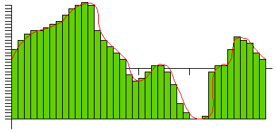
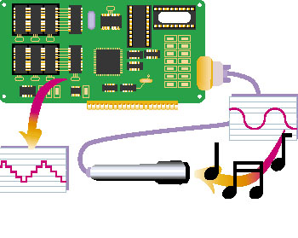
Audio Input
Audio digitizers
  Convert analog sound signals into digital signals
Step 1. A microphone transmit the sound to the sound card.
Step 2. An analog-to-digital converter (ADC) samples the sound wave, and stores the sound levels as binary bytes.
Step 3. A digital-to-analog converter (DAC) helps play the recording back to human hearable sound
Voice input
  Speech recognition - converts voice data into words or into commands
See reference [2] for details
Notes:
Speech recognition…

Slide 18
Video Input
Video input is the process of entering full-motion images into computer
  Video is sequence of images displayed at constant rate
  Frame rate is the number of frames or images that are projected or displayed per second
Devices
  Video capture card is an adapter card that converts analog video signals into digital signals
  Digital video (DV) camera records video as digital signals
  PC camera is a DV camera used to capture video, and to make video calls on Internet
  Web cam is a type of digital camera that enables users to
    Add live images /video to instant messages
    Broadcast live images / video over the Internet
    Make video telephone calls

Slide 19
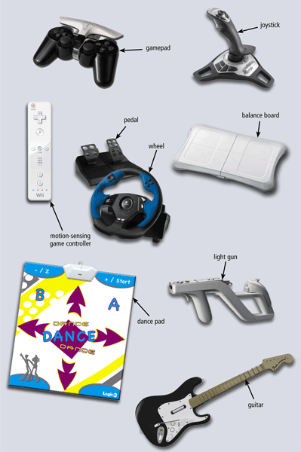
Game Controllers
Video games and computer games use a game controller as the input device that directs movements and actions of on-screen objects
  Gamepads
  Joysticks and Wheels
  Light guns
  Dance pads
  Motion-sensing controllers
  Gloves
Notes:
Any devices that computer can sense

Slide 20

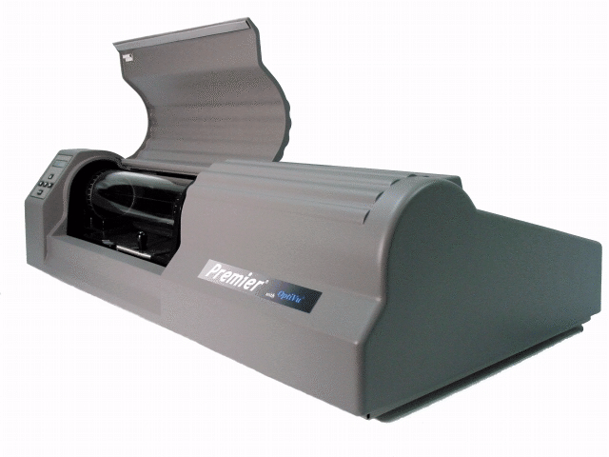
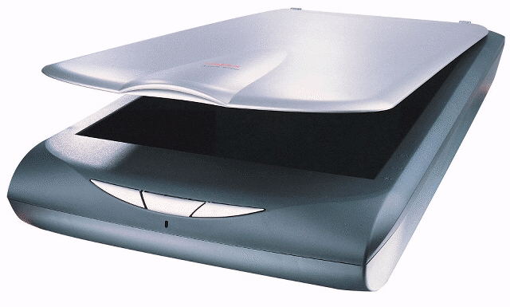
Scanners
A scanner is a light-sensing device that reads printed text and graphics
  Used for image processing, converting paper documents into digital images (bit patterns that can be stored and manipulated in a computer's memory)
See reference [3] for details

Slide 21
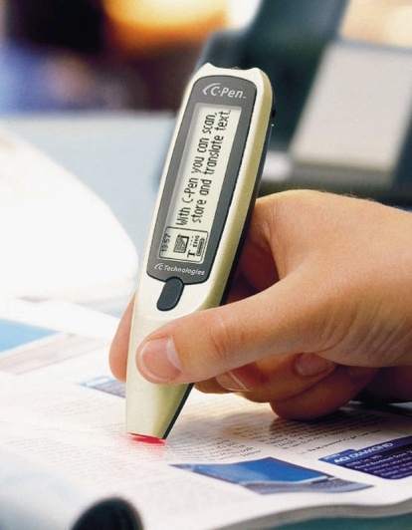

Other Input Devices
OCR (Optical Character Recognition) readers
  Device that uses light source to read characters, marks, and codes and then converts them into digital data
Bar code reader
  Uses laser beams to read bar codes
  Bar code - identification code that consists of a set of vertical lines and spaces of different widths
Magnetic stripe card reader
  Reads the magnetic stripe on the back of a credit card
  Exposure to a magnetic field can erase the contents of a card’s magnetic stripe
Notes:
OCR: similar to bar code reader / mag stripe card reader

Slide 22
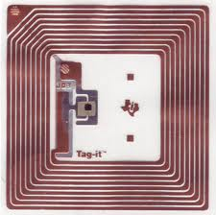
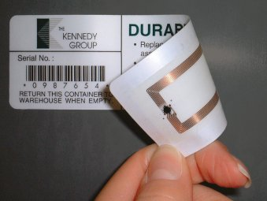
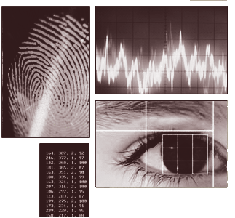
Other Input Devices
RFID (radio frequency identification) technology
  A RFID tag placed in or attached to an object which ) has been electronically programmed with unique information
  A RFID reader emits radio signals to activate the tag and to read and write data to it, in ranges of anywhere from one inch to 100 feet or more
  E.g., contact smart card, contactless smart card
Biometric input
  Authenticates person’s identity by verifying personal characteristic
    Iris scan (a.k.a. retinal scan) captures and analyze images of the human retina
    Voice verification system compares live speech with stored voice pattern
    Signature verification system recognizes shape of signature
Image from http://www.cacsecurity.com/biometrics.asp
Notes:
Internet of Things: use RFID to identify physical things. RFID is very useful for item tracking: UPS parcel tracking & delivery

Slide 23
CS1102 Lec04
Hardware – Output

Slide 24
Output: From Pulses to People
Output is data coming out of a computer that has been processed into a useful form
Output devices
  Devices that translate information processed by computer into human readable form
Two types of output devices
  To produce softcopy
    Display on screen, voice output, sound output, video output, mechanical output
  To produce hardcopy
    In a printed form

Slide 25
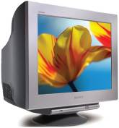
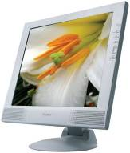

Screen Display - Monitor
CRT monitor - Cathode-ray tube
  Obsolete
LCD monitor – Liquid Crystal Display
  Light shine through a layer of liquid crystal cells to make an image
  Used in all kinds of computers
    PC, notebook, Tablets, smart phones, digital cameras
  Thin, light, Low power consumption
  Lower radiation emission
Other monitors
  E-Book readers
  Digital/interactive whiteboards
  High-definition television (HDTV)
Notes:
Screen: standard output

Slide 26
Monitor Measurements
Screen size
  Diagonal length of the screen measured in inch
  Common sizes are 15, 17, 19, 21, and 22 inches
Resolution
  A measure of the total number of pixels displayed on the whole screen
  Determines the fineness of display details
  The higher the resolution, the closer together the dots, the finer the image
Dot pitch ( or pixel pitch)
  The distance between sub-pixels of the same
  color, measured in millimeters (mm)
  The smaller the dot pitch, the finer the image
Short form for "picture element" - basic units that compose a picture
Standard | Resolution
SVGA | 800 x 600
XGA | 1024 x 768
WXGA | 1280 x 800
SXGA | 1280 x 1024
UXGA | 1600 x 1200
QXGA | 2048x1536
See [4] for more standards
Notes:
Dot pitch is the distance between the pixels on the display. The size of the display equals the number of pixels times the dot pitch.

Slide 27
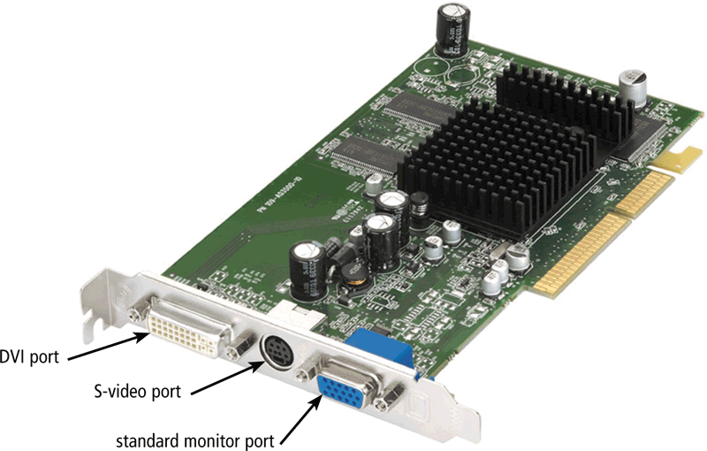
Graphics Card
Besides a display device, a computer display system also requires a graphics card that generates the signals for displaying an image on the screen
A graphics card typically contains
  Graphics processing unit (GPU)
    A dedicated graphics microprocessor optimized for calculations which are fundamental to 3D graphics rendering
  Special video memory
    A special kind of RAM dedicated to holding the display data
  Special graphics accelerator technology
Notes:
In the old days PC, no graphics card. The display is very slow: it all relies on the CPU to process.

Slide 28
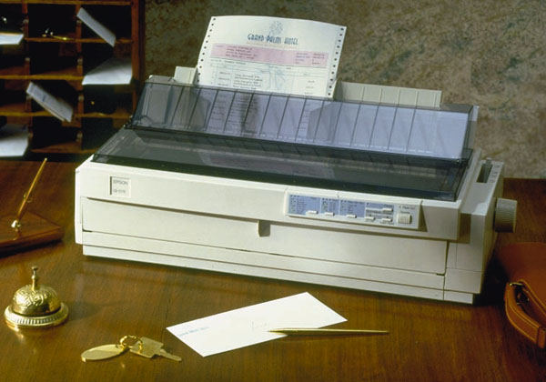
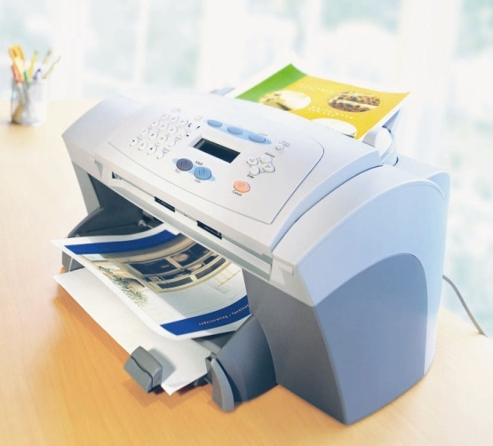
Printers
A printer produces text and graphics on a physical medium
  Printed information is called a hard copy, or printout
  Landscape or portrait orientation
Two basic groups of printers:
  Impact printers
    Make direct physical contact with the paper
    E.g., line printers, dot-matrix printers
  Non-impact printers
    Form characters and graphics without striking the paper
    E.g., inkjet printers, photo printers, laser printers
Notes:
Impact printer: old, slow.

Slide 29

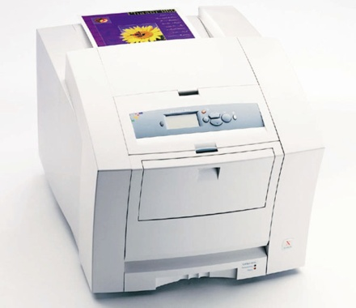
Laser Printer and Inkjet Printer
Non-impact printers
  Without direct physical contact the paper
  Faster and quieter than impact printer
  Inkjet printers
    Spray tiny drops of liquid ink onto paper
    Prints fewer pages/minute than laser printers
    High-quality color
    Costing less than laser printers
    Photo printer is a special kind of inkjet printer
  Laser printers
    Have a laser beam to charge the paper, which attracts fine powder (toner)
    High-resolution output
    Fast printing speed
See reference [5] & [6]

Slide 30
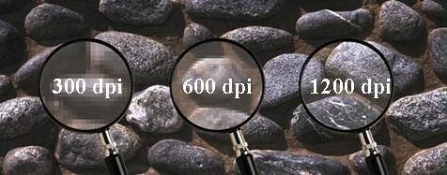
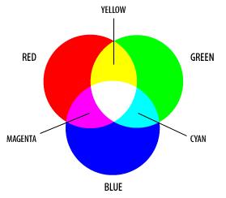
Printer Measurements
Color or B&W
  CMYK is 4 color inks used in color
  inkjet/laser printers
Duplex capability
  Can print on both sides
Resolution
  Measured in dots per inch (dpi)
Print speed
  Measured in characters per second (cps) or
  pages per minute (ppm)
Duty cycle
  An estimate of how many pages per month a printer is designed to handle before it fails or requires maintenance
Notes:
CMYK ink: four color mode printing. It uses 4 color inks: Cyan (sai-an), Magenta (mer-genta), Yellow and Key (black): CMYK

Slide 31
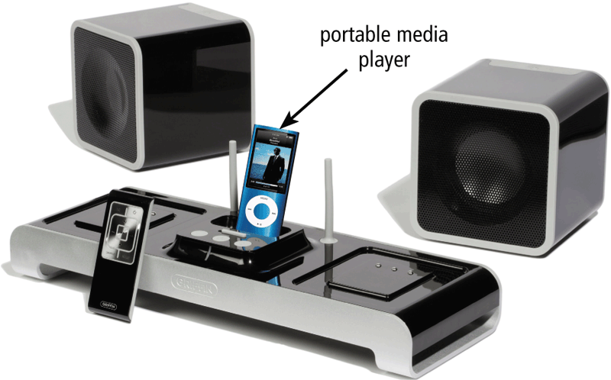
Audio Output
Audio output devices produces music, speech or other sounds that people can hear
  Speakers, headphones, earbuds (also called earphones)
  Some speakers are specifically designed to play audio from a portable media player
  Text to speech system converts normal language text into speech
Notes:
Text to speech – reverse of speech recognition

Slide 32
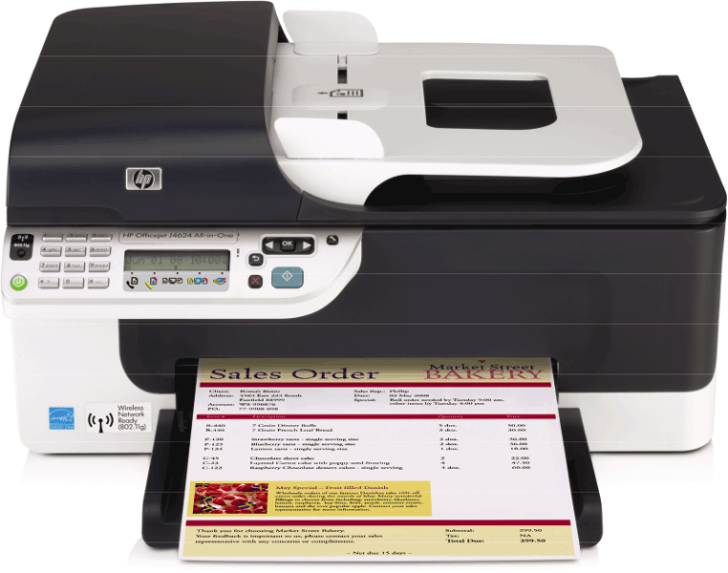
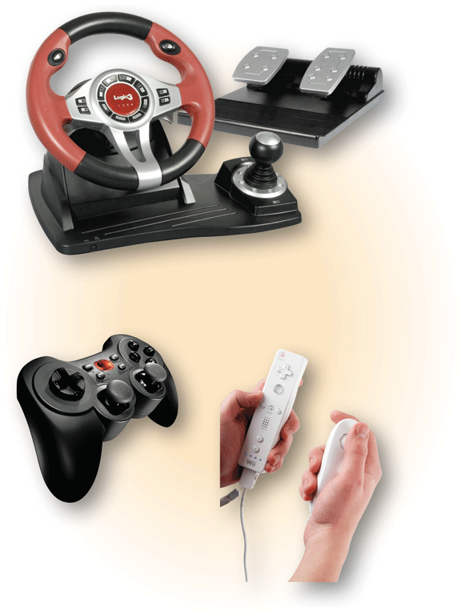
Combining Input and Output
Some devices are both input and output devices
  MFP (Multi Function Product/ Printer/ Peripheral), multifunctional, or all-in-one (AIO)
  Touch screens
  Fax machines
  Internet telephones (a.k.a., IP phones)
  Force-feedback game controllers

Slide 33
CS1101 Lec04
Hardware – Ports

Slide 34
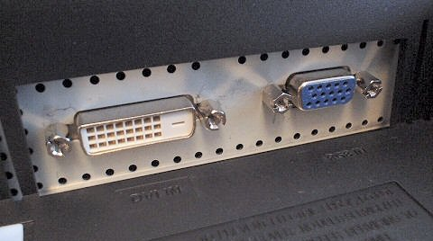
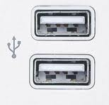
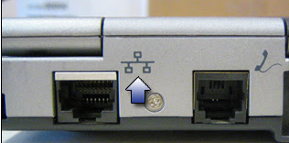
Ports and Connectors
The system or motherboard includes several standard ports to connect peripheral devices; a connector is a physical “plug” at the end of a cable that joins a peripheral to a port
Most common ports today
  Monitor port for connecting monitors
    E.g., VGA ports sends analog signals
    E.g., DVI ports sends digital signals
  USB ports (Universal Serial Bus)
    Connects up to 127 devices chained together and
    supports hot plugging
    Most popular ports today
  Network port for Local Area Networks (LAN)
    Also called Ethernet port, RJ-45
Notes:
Ports: connect device to cards or motherboard.

Slide 35

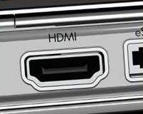

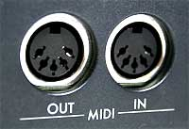
Ports and Connectors (continued)
Ports for multimedia
  Video ports for media hardware such as DVD
  players, televisions and projectors
  Audio ports for speakers and microphones
  HDMI for high definition video and audio
  MIDI for musical instruments
Legacy ports
  Firewire (IEEE 1394) for digital cameras
  Modem port for connecting telephone lines
  Serial port for attaching devices that send/receive
  messages one bit at a time
    E.g., PS/2 ports for keyboard and mouse
  Parallel port for attaching devices that send/receive bits in groups
    E.g., DB-25 parallel port for printers
  IrDA for short-range data exchange over infrared light
See [7] for pictures and guide
Notes:
Legacy ports are rarely used nowadays

Slide 36
Mid-term quiz
Section I: True/False questions
Example:
Nonvolatile memory loses its contents when the power is removed from a computer.

Slide 37
Mid-term quiz
Section II: Matching question
Given A list of Key words:
  Hardware
  Software
  Input device
  Output device
  Internet
  Peripheral device
  …………..
Example:
Displays, prints, or transmits results

Slide 38
Mid-term quiz
Section III: Multiple-choices questions
Example:
Where is data saved permanently?
  Memory
  CPU
  Storage
  Printer

Slide 39
Lesson Summary
Peripherals allow computer to communicate with the outside world or store information for later use
The most common input devices today are the keyboards and some types of pointing devices
  A mouse is a standard pointing device with most desktop PCs; its alternatives include touchpad, pointing-stick, and trackballs
For output, most computers include a display device
  A CRT monitor produces an image by firing electrons toward the screen
  LCD technology produces an image by manipulating light within a layers of liquid crystal cells
  Image quality for a display device is a factor of screen size, resolution, dot pitch, color depth, etc.

Slide 40
Lesson Summary (continued)
Printers fall into two general kinds: non-impact and impact
  When evaluating printers for purchase, several criteria need to be considered: image quality, print speed, duty cycle and etc.
External devices, such as those used for input and output, are connected to the system by ports on the back or front of the computer
  Different ports have different sizes measured in different number of pins or holes

Slide 41
Reference
[1] HowStuffWorks.com – How Computer Mice Work
  http://computer.howstuffworks.com/mouse.htm
[2] HowStuffWorks.com – How Sound Card Works
  http://computer.howstuffworks.com/sound-card.htm
[3] HowStuffWorks.com – How Scanners Work
  http://computer.howstuffworks.com/scanner.htm
[4]Wikipedia - Computer display standards
  http://en.wikipedia.org/wiki/Computer_display_standard
[5] HowStuffWorks.com – How Laser Printers Work
  http://computer.howstuffworks.com/laser-printer.htm
[6] HowStuffWorks.com – How Inkjet Printers Work
  http://computer.howstuffworks.com/inkjet-printer.htm
[7] HP – Guide to cables, connections, and ports
  http://h71036.www7.hp.com/hho/cache/315100-0-0-225-121.html

Slide 42

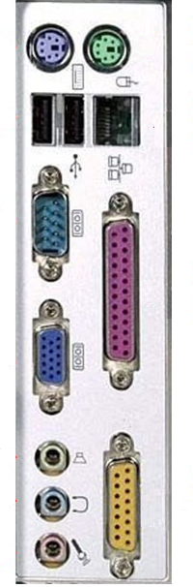
For you to explore after class
Lec04b-Q1: for a SXGA display with True Color setting, how much display memory is needed for one screen's display?
Lec04b-Q2: list 4 other names for graphic card
Lec04b-Q3: what hardware devices are connected by those circled ports?
1
2
3
5
4

