Slide 1

CS1102 Lec04
Hardware
– Inside the Box
Computer Science Department
City University of Hong Kong
Notes:
This is for 1.5 weeks
1st hour finishes p.13
2nd hour (whole week) finishes p.24

Slide 2
Objectives
Identify the basic functions and hardware components of a computer
Identify motherboard, CPU, RAM, adapter cards, and other components inside the system unit
Describe the components of a processor and how they complete a machine cycle
Explain how RAM works for CPU
Differentiate among the various types of memory
Describe why buses are needed in a computer
Describe why expansion slots and adapter cards are needed in a computer

Slide 3
Objectives (cont'd)
Differentiate between storage devices and storage media
Describe the quality characteristics of an hard disk including capacity, revolution per minute, transfer rate and access time
Differentiate among CD-ROMs, recordable CDs, rewritable CDs, DVD-ROMs, recordable DVDs, and rewritable DVDs
Identify the uses of magnetic tape and flash memory
Explain the advantages of solid state storage over magnetic hard disks
Briefly describe a PC's system booting-up sequence, and discover how ROM, CMOS, RAM and hard disk take part in the booting-up sequence

Slide 4
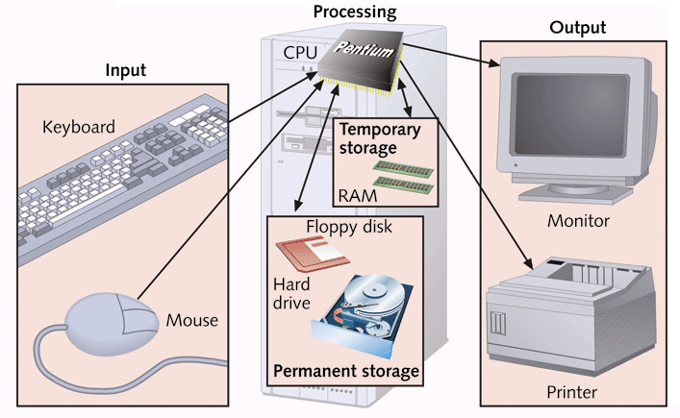
What Computers Do
Basic functions of a computer (IPOS)
  Input: accept information from the outside world
  Process: perform arithmetic or logical (decision-making) operations on information
  Output: communicate information to the outside world
  Store: retrieve and store information in storage medium
Basic hardware components of a computer
Notes:
If storage is regarded as I/O, a computer basically input, process, output

Slide 5
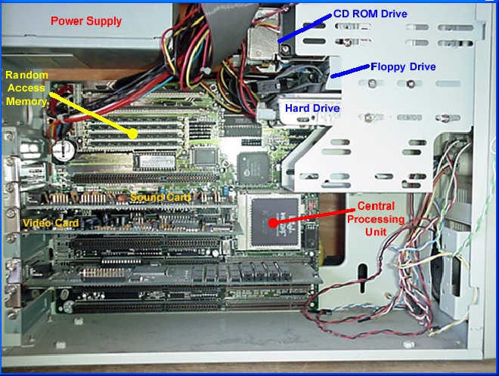
The System Unit
System unit – the case that contains electronic components of the computer used to process data
Notes:
CPU, RAM, Hard-disk, sound card and video card

Slide 6
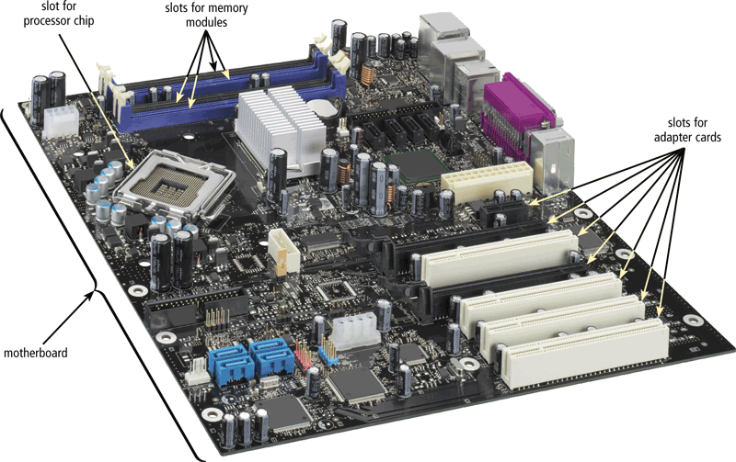
Motherboard
Motherboard – the primary circuit board in system unit
  Also known as system board
  Other components and peripherals are resided on or plugged into the motherboard
    Chips, sockets, slots, bus lines
  The job of mother-
  board is to transmit power,
  data, and instructions
  among all the components
  See a YouTube Video
  http://www.youtube.com/watch?v=NSNz6VVpWI8
Notes:
Motherboard contains all communication highways to interconnect all components.
See Video – Part One: from 1min – 4min.

Slide 7
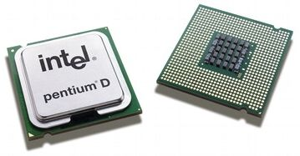
CPU (Central Processing Unit)
CPU (Central Processing Unit)
  Also known as processor or microprocessor
  It is a complex integrated circuit designed to interpret and execute instructions
  CPU has two components: control unit and ALU.
What does CPU do?
  The CPU executes the instructions of programs
Notes:
CPU also has registers and some small size cache

Slide 8
How CPU Works ?
CPU works by repeatedly executing instructions
  Instructions are just codes telling the CPU to perform a specific action
  Q: Inside computers, instructions are represented by ?
Components inside CPU
  Control Unit
    Interpret (decode) instructions and execute them
  Arithmetic/Logic Unit
    Performs the mathematical and logical operations
  Registers
    High-speed circuits inside CPU to hold instructions or data
    There are control registers (PC, instruction reg,) and data registers
    All operations, add, shift, etc, are done in registers
    Data are moved in or out between memory and registers
Notes:
Typically a machine has 32 or 64 registers.
Registers: data registers (e.g., 32 full-adders)
Control registers: program counter (PC), instruction register, program status word (psw).

Slide 9
Programming Language, Assembly, and Machine Code (binary)
Program in C Language | Offset | Machine Code | Assembly Code
int sum = 0; for (int i=1; i<100; i++) sum += i; | 0027455E | C7 45 F8 00 00 00 00 | mov dword ptr [sum],0
 | 00274565 | C7 45 EC 01 00 00 00 | mov dword ptr [i],1
 | 0027456C | EB 09 | jmp short +09h (00274577)
 | 0027456E | 8B 45 EC | mov eax,dword ptr [i]
 | 00274571 | 83 C0 01 | add eax,1
 | 00274574 | 89 45 EC | mov dword ptr [i],eax
 | 00274577 | 83 7D EC 64 | cmp dword ptr [i],64h
 | 0027457B | 7D 0B (NOTE:jump out) | jge short +0Bh (00274588)
 | 0027457D | 8B 45 F8 | mov eax,dword ptr [sum]
 | 00274580 | 03 45 EC | add eax,dword ptr [i]
 | 00274583 | 89 45 F8 | mov dword ptr [sum],eax
 | 00274586 | EB E6 (NOTE:100h-1Ah=E6h) | jmp short -1Ah (0027456E)
Notes:
Draw a CPU-box (Decode and ALU units, IR and PC registers) and Memory-box
Points: how is a program compiled, loaded into memory and executed!
C program at left, compiled into Machine code. Assembly is a human readable form of machine code.
Note: mov reg dword addr and move addr reg; “eax” is a register; “ptr [var]” is addr of var; “dword” == 32bits value.
In Intel x86 assembly, EAX is a 32bits registers; other 32bits registers are EBX, ECX and EDX.
Briefly explain “instruction execution cycle” ->
When you run Javascript, you didn’t compile it and you never see the machine code?: there’s an java-script interpret inside every browser and this interpreter execute script-code line by line.

Slide 10
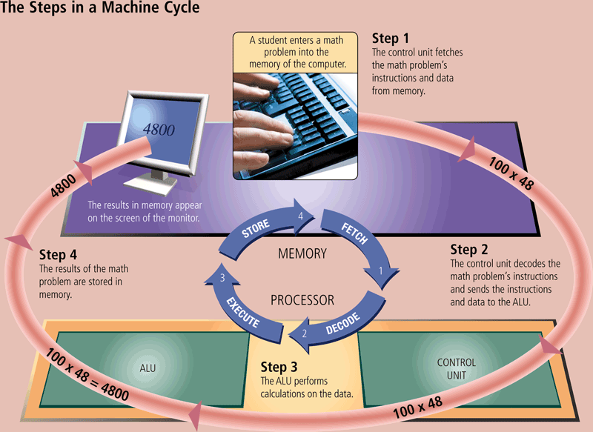
Machine Cycle
For every instruction, a processor repeats a set of four basic operations, which comprise a machine cycle
Fetch program instructions stored in the main memory
Decode what the instruction means and direct the necessary data to be moved from the memory
Perform the actual operation (execute) on the data
Store the result of the operation back to memory
See tutorial:
http://courses.cs.vt.edu/~csonline/MachineArchitecture/Lessons/CPU/index.html
Notes:
?Fetch instruction into where: the instruction-register in control unit;
? Move data from memory to where: registers. (2) is done by control unit.
All operations are done in registers. (3) is done in ALU
Store result in register back to memory
See the tutorial (animation for last two programs)

Slide 11
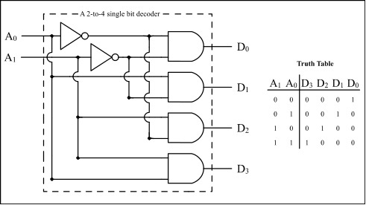
Circuits inside CPU - Decoder (I)
Decoder circuit
  A circuit that has N input lines (A) numbered 0, 1, 2, …, N-1 and 2^{N} output lines (D) numbered 0, 1, 2, …, 2^{N} -1
  Its job is to determine the value represented on its N input lines and then send a signal (i.e., a value 1) on the single output line that has the identification number
  E.g.,
Notes:
Suppose there are 2bits for operation-code!

Slide 12
Circuits inside CPU - Decoder (II)
An example of using a decoder in CPU control unit
  Suppose we use 2-digits of one instruction (in binary) to represent the operation
  A decoder interprets the operation code and sends out a signal on the correct output line
  The output signal is used to select the proper arithmetic circuit and cause it to perform the desired operation
Input lines
Output lines
Operation code:
00₂ = add
01₂ = subtract
10₂ = multiply
11₂ = divide
00₂ (0)
Add circuit
Decoder Circuit
01₂ (1)
Subtract circuit
10₂ (2)
Multiply circuit
11₂ (3)
Divide circuit

Slide 13
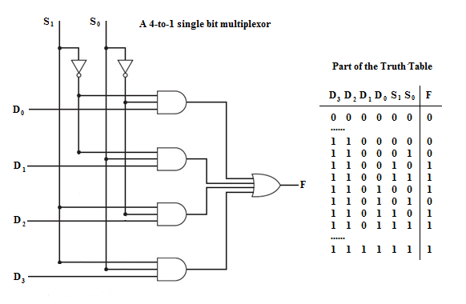


Circuits inside CPU – Multiplexor (I)
Multiplexor circuit
  A circuit that has 2^{N} input lines (D) numbered 0, 1, 2, …, 2^{N} -1, N selector lines (S) representing binary values from 00...0₂ to 11…1₂ and 1 output line (F)
  Its job is to select exactly one of its 2^{N} inputs according to the N selector lines (can be interpreted as the identification number of the input line) and copy that input line value onto the output
  E.g.,
Those multi-input AND gates and OR gates can be easily made from the standard two-input gates.
Notes:
This is for data input to ALU for operations (see animation on p10)

Slide 14
Circuits inside CPU – Multiplexor (II)
An example of using a multiplexor in CPU control unit
  Suppose we have 4 registers in CPU having data values stored inside
  A multiplexor is used to select the correct register according to the input identification number in the selection lines, and send its content out
R0
Output line
ALU circuits
R1
Multiplexor Circuit
R2
(data value from the selected register)
R3
Registers
Selection lines (input 00₂, 01₂, 10₂, or 11₂)
Notes:
Select which register value comes through to ALU

Slide 15
How to Measure CPU's Quality
Clock speed of the processor
  System clock generates regular electronic pulses for synchronizing the operating pace of components of system unit; i.e., controls timing of all computer operations
  The clock speed is measured in units called Gigahertz (GHz)
  Processor speed can also be measured in millions of instructions per second (MIPS)
Word size of the processor
  The number of bits a CPU can process at one time
  Today’s PCs typically have 32-bit or 64-bit processors
Cache
The speed of a computer also depends on the number of processors, architecture of processors, and …
See reference [4] for "evolution of processors"
Notes:
CPU speed also depends on some other parameters…
The execution of an instruction is divided into several mini-steps, such as, decode instruction, mov data from mem to regi, arithmetic operation,
These mini-steps must be perfectly synchronized.
Computer speed depends on how small slice clock can be synchronized…
CPU speed is sometimes measured as 3.2GHz. This’s NOT exactly CPU speed (a 3GHz Intel chip may have different CPU speed from a 3GHz ARM chip). MIPS is more reflecting CPU speed.

Slide 16
Multi-Core Processors
Most processor chip manufacturers now offer multi-core processors
  A core contains the circuitry necessary to execute instructions independent of the other(s)
  A multi-core processor is a single chip with two or more separate processor cores
    The most common ones today are dual-core (2), quad-core (4), and hexa-core (6)
    Each core generally runs at a slower clock speed than a single-core processor, but multi-core processors typically increases overall performance
    But the amount of performance gained by the use of a multi-core processor depends very much on the software
Notes:
Difficulty: load distribution on multi-cores
Since the H/W cost is too low, chip manufactors simply makes multi-core chips. But many OS don’t really make use of all the cores…

Slide 17
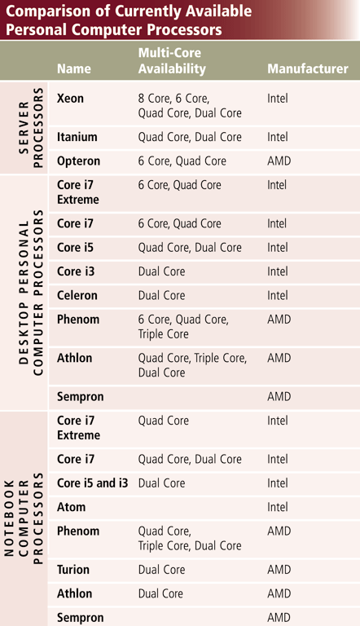
Currently Available CPU for PCs
The leading manufacturers of personal computer processor chips are Intel and AMD
Other manufacturers for server/mainframes include:
  IBM, DEC, HP, Sun Microsystems, etc
Notes:
AMD (advanced Micro Devices) has launched several law suits against Intel for unfair competition or monopoly of markets
Intel 80% and AMD 20% market share
See web a dell notebook “Notebook and Netbooks” click in an expensive one: specifications….

Slide 18
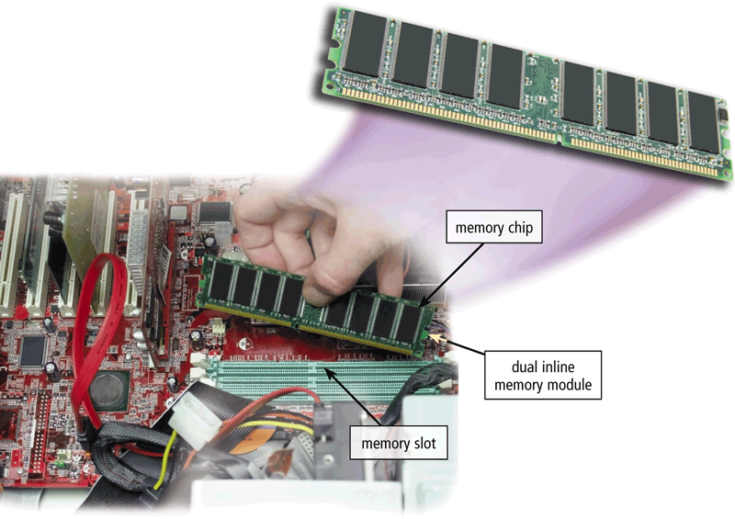
The Computer’s Memory
RAM (random access memory) - memory chips that can be read and written by the processors
  Also called main memory or primary storage
  Used to temporarily store programs that are currently running or data under processing
  Quickly accessed by CPU
  When power goes off, everything in RAM is lost (volatile)
Notes:
Main memory
10G is a good size nowadays.

Slide 19
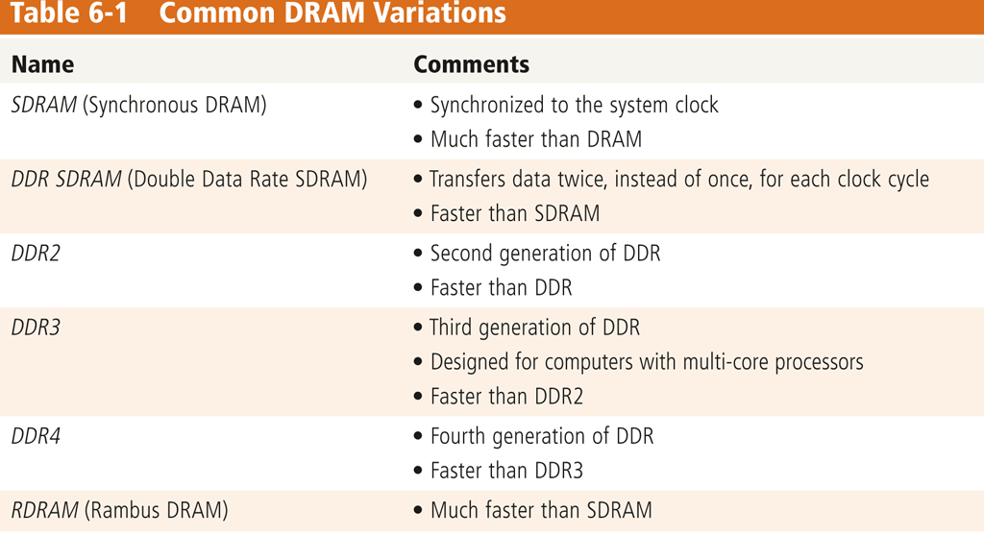
RAM - Primary Memory
Two common types of RAM chips exist
  Dynamic RAM (DRAM) : needs to be refreshed periodically
    slower, more power hungry, but cheaper
    Often used in main memory
  Static RAM (SRAM): does not need to be refreshed
    faster, consumes less power, but more expensive
    often used in
    cache memory
Notes:
DDR (double data rate)-SDRAM (synchronous dynamic RAM), DDR 2 SDRAM (DDR is always combined with SDRAM)
RDRAM (Rambus Dynamic) RAM is an alternative of SDRAM, but more expensive, less popular.

Slide 20
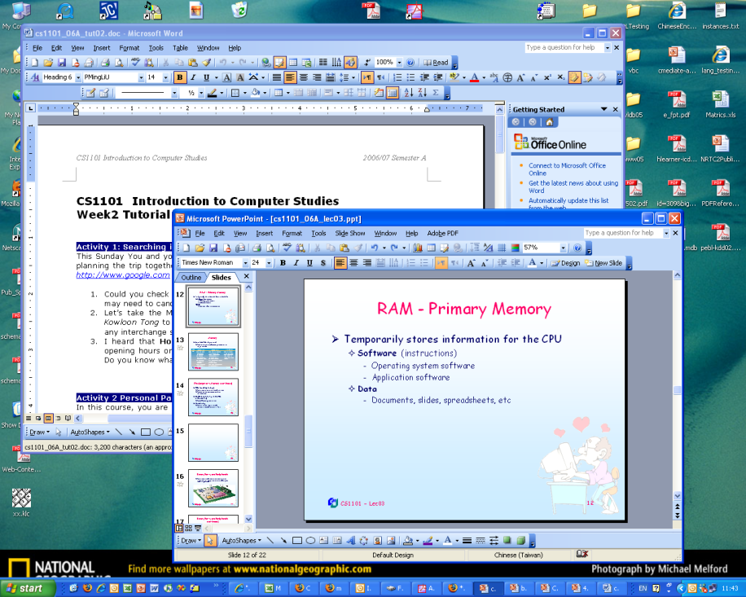
RAM - Primary Memory
Temporarily stores information for the CPU
  Software (instructions)
    Operating system
    Application software
  Data under processing
    Documents, slides,
    spreadsheets, etc
RAM capacity
  Measured in MB or GB
  Common capacity:
256MB, 512MB, 1G, 2G, 4G, 8G, …
Notes:
?when are files brought to memory? E.g., this ppt file is stored on disk, when I edit it or display it: two files are in memory: ppt s/w and this ppt file
?Why do you need large size of memory for your notebook: to store more files, or larger movies?
Why memory size affect your computer speed?

Slide 21
How RAM Works ?
The location in memory for each instruction and each piece of data is identified by an address
  Each location in memory has a unique address number
Address
Memory
salary = rate * hours
8000
instruction
CPU
8004
data
rate: 80
8008
hours: 4
800C
salary: 0
8010
320
result
Notes:
Note: data and instructions are stored together in the same format

Slide 22
Memory Access Time
It takes 1/10 of a second to blink your eye !
Access time - amount of time it takes
processor to read data from memory
  Measured in nanoseconds (ns), one billionth of a second
    RAM access times range from 0.5 ns to about 10 ns
  Also measured in millions of cycles per second (MHz)
    Today's memory normally has clock speed ranging from 133MHz to 1600MHz
  Much faster than hard-disk access, which is in range of milliseconds (ms)
    Hard disk access times range from 3 ms to about 15 ms
  Slower compared with CPU speed
    E.g.,
    Intel Core 2 Extreme QX9770 - 59,455 MIPS at 3.2 GHz
Notes:
ONY ELECTRONICS INC. - VAIO T Series Ultrabook 15.5" Touch-Screen Laptop - 8GB Memory
Model: SVT15112CX
Specifications
Specs:Details:Description:
Processor BrandIntel®ProcessorIntel® 3rd Generation Core™ i5(Also known as the CPU). The part of the computer that interprets and executes instructions. Think of it as the brain of the computer. Processor Speed1.8GHz (with Turbo Boost up to 2.7GHz)
How fast a computer processor carries out instructions. In general, faster is better, but processor speeds across brands may not be equivalent (i.e., a 3.0GHz AMD processor may not be the same speed as a 3.0GHz Intel processor).
Display TypeHigh-definition LED-backlit capacitive touch screen (1920 x 1080)Technology used to display text and images on the screen.
Cache Memory3M BA small segment of memory that stores frequently used information for fast access by the processor, improving response time.
System Memory (RAM)8GB The memory a computer uses to run its operating system, applications and active data files. Greater amounts of RAM improve speed and enable more applications to run at once.
Computer Hard Drive Size774GBCapacity for storing programs, photos, video, music and other electronic information.
Built-in WebcamYesModemNoneDevice that allows a computer to send and receive information over telephone or cable lines.
NetworkingBuilt-in 10Base-T/100Base-TX/1000Base-T Gigabit Ethernet LANAbility to connect to other devices on a network using Ethernet, Wi-Fi (wireless; 802.11), Bluetooth, etc.
…

Slide 23
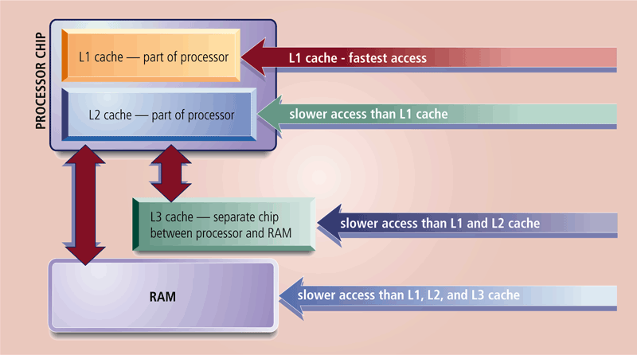
Cache Memory
Cache memory
  A very small amount of memory located either inside or very close to CPU
  Supplies the CPU with the frequently used instructions and data
  Faster than RAM but more expensive
Notes:
Usually size of MB (2M, 4M, 8M).
See 3 levels of cache
See Fig: CPU chip contains: control unit + ALU + registers + Cache!
Access speed: cache – memory - disk

Slide 24
ROM & CMOS Memory
ROM (read-only memory)
  Information is stored “permanently” by the manufacturer
  Contains the computer’s startup routine
  Data is not lost when computer’s power is off (nonvolatile)
  On a PC, ROM contains the BIOS (Basic Input/Output System)
CMOS (complementary metal oxide semiconductor memory)
  Special low-energy kind of RAM; uses battery power to retain information when other power is turned off
  Stores computer configuration settings, such as date and time, hard disk and memory capacity, and keyboard and display type
Notes:
CMOS: store configuration. It’s changeable! (but ROM is NOT changeable), NOT hard-disk either.

Slide 25
Virtual Memory
Virtual memory
  Virtual memory is created by Operating System to expand the size of main memory by swapping out memory content to hard disk when it is not in use and swapping it in when it is in use.
  Virtual memory allows CPU to run a much larger size of software than its physical memory size.
  Good – no longer get “insufficient memory” error
  Bad - performance is very slow when accessing VM
Notes:
? Can your PC run a program that is larger than its memory: Yes
….

Slide 26
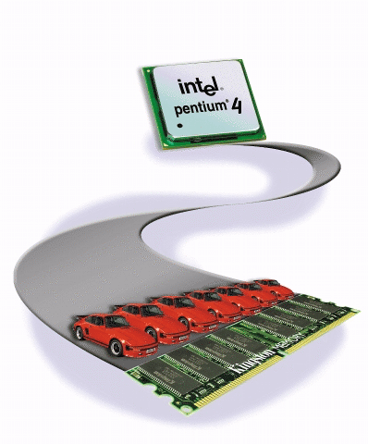
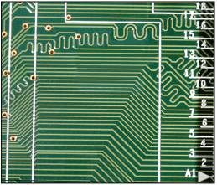
Buses
A bus - a group of wires that support communication among the various electronic components
  Bus width is number of bits transmitted at one time
    The wider, the faster
Example
  Front side bus: connect CPU with memory
  Back side bus: connect CPU with cache
  Expansion buses: connect expansion slots to CPU and memory
Notes:
Buses are embedded in motherboard, connecting all components.
Bus width is very important to computer speed.

Slide 27
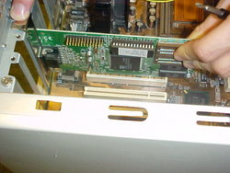
Expansion Slots and Adapter Cards
An adapter card
  Enhances system unit OR provides connections to peripheral devices
  Also called an expansion card
An expansion slot is
  An opening, or socket, on the motherboard that can hold
  an adapter card
    ISA, PCI, PCI-E, AGP
  With Plug and Play, the computer automatically configures cards and other devices as you install them

Slide 28
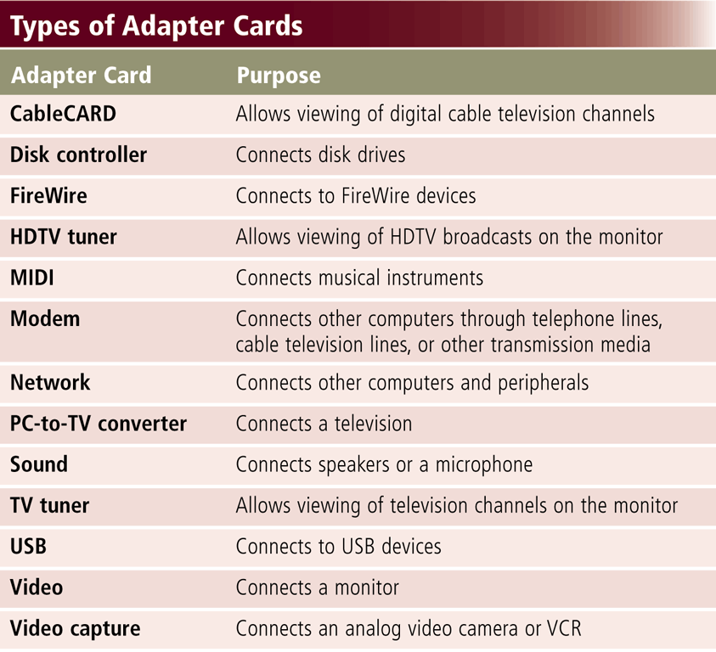
Expansion Slots and Adapter Cards
Notes:
Disk controller / network card / sound card /video card are all pre-installed in your PC
Wireless card..

Slide 29
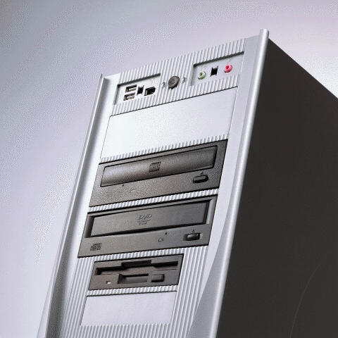
Bays
A bay - an open area inside system unit used to install additional equipment
Drive bays typically hold disk drives

Slide 30
Storage Medium & Devices
Storage - holds data, programs, and information for future use, even when the computer is turned off
  Storage medium is the physical material on which data is stored
    E.g., flash memory, floppy disks, hard disks, CDs, DVDs
    Nonvolatile - contents retained when power is off
  Storage devices are the hardware that write data to, and read data from the storage medium
    E.g., floppy disk drive, hard disk drive, USB key drive
    Writing data from memory to storage medium
    Reading data from storage medium to memory
Notes:
Medium: magnet, electronic, optical

Slide 31
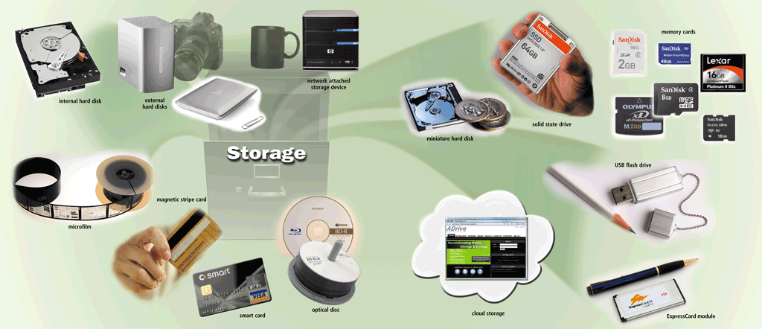
Storage Examples

Slide 32
Basic Types
Basic storage technologies
  Magnetic storage
    Magnetic storage media use disks or tapes that are coated with magnetically sensitive materials
  Optical storage
    Optical disks have chemical coatings that can be changed to create a varying surface
  Solid state storage
    Relies on integrated circuits (memory chips) to hold data
    Store data electronically

Slide 33
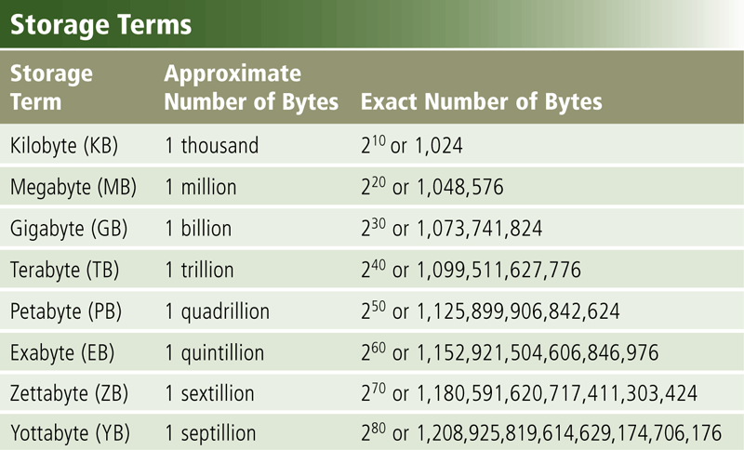
Capacity
Capacity is the number of bytes a storage medium can hold
Notes:
Large data: petabytes

Slide 34
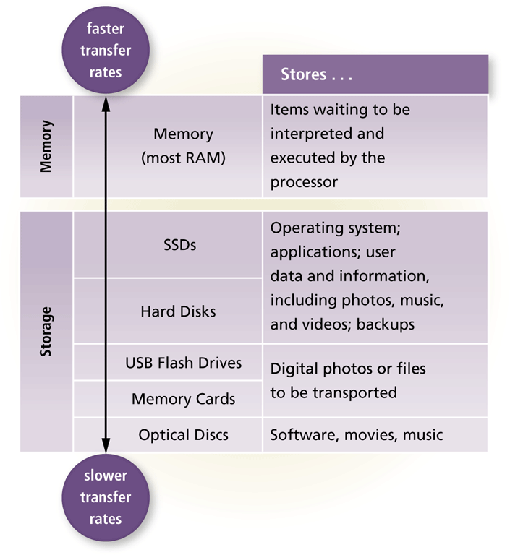
Access Time
Access time refers to the time the storage device takes to locate an item on the storage medium

Slide 35
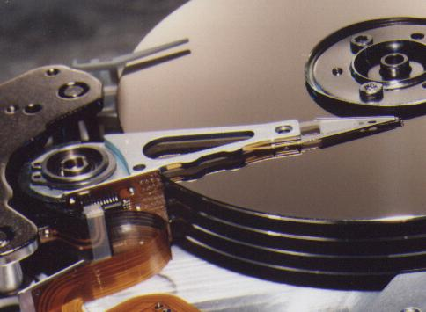
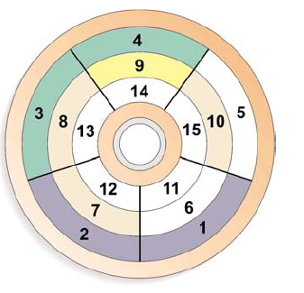
Magnetic Disks - Hard Disk
Hard disk drive or HDD
  High-capacity storage
  Consists of several rotating disks, called platters
    Stacked vertically
  Components sealed in an airtight case for protection
  Common capacity
    200G, 250G, 320G, 750G, 1T, 2T, …
Notes:
Tracks, sectors, disk r/w head, spin, seek ->
? If I want to read sector 7, 1) disk-arm moves to the right track; 2) waiting for the right sector rotating to the position under the disk-arm
Magnetic disks: keep it away from strong magnets, change bits and correct file systems

Slide 36
How data is stored on magnetic media?
Magnetic storage stores data by magnetizing iron particles on the surface
1. Before data is stored, particles on the surface are scattered in random patterns.
2. When storing data, the drive's read/write head magnetizes the particles, and lead them in a positive or negative direction ( 0 or 1).

Slide 37
Hard Disk Measurements
What are characteristics of a hard disk?
Sample Hard Disk Characteristics
Capacity 120 GB
Physical size 3.5’’ for desktop,
2.5’’ for notebook
1.8’’ for mp3 player
Revolutions per minute 7,200 rpm
Transfer rate 120 to 300 MB/s
Seek time 5ms to 15ms
Cache 2 to 16 MB
actual
disk
capacity
Notes:
revolutions per minute: find right sector
Seek time: find right track

Slide 38
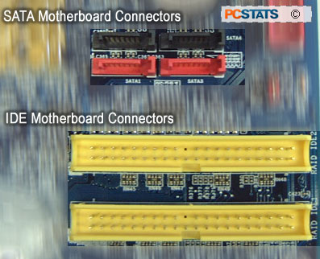
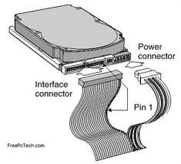
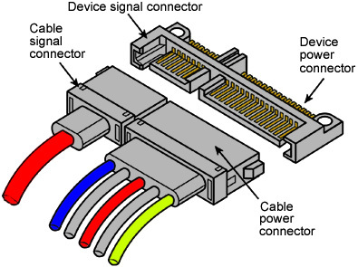
Hard Disk Interface
Hard disk interfaces (HDI)
  Through which hard disks connect to the motherboard, also for other storage devices like floppy, CD/DVD drives
  The most common ones are
    IDE / ATA controller
    SATA controller
older
newer
Notes:
SATA: serial ATA (Advanced Technology Attachment)
IDE (Integrated Drive Electronics, IBM’s term) == ATA

Slide 39
Optical Storage Media
Optical storage media
  Use focused laser beams to read/write microscopic patterns of data on plastic disks
  Not as fast as magnetic hard disks
  Types of optical media
    CD-ROM, CD-RW, DVD-ROM, DVD-RW , Blu-Ray (Hi-Def)
Two types of optical storage drives
  Read only
  Read and write
Notes:
Change the laser reflection angle… (burn a disc)
Large capacity but Much cheaper than hard-disk
If the surface dirty, it cannot be read.

Slide 40
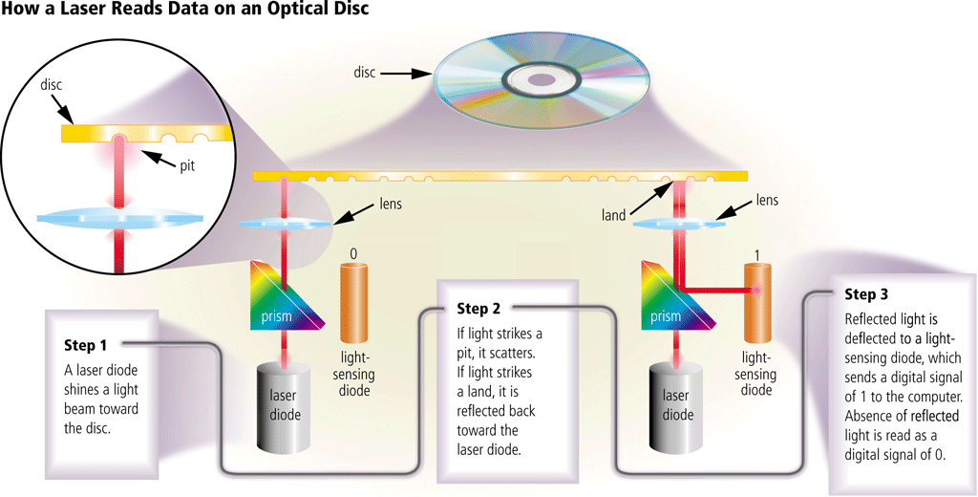
Optical Discs

Slide 41
CD Technology
CD-ROM (Compact Disc Read-Only Memory)
  Cannot erase or modify contents
  Typically holds 650 MB to 1 GB
CD-ROM drive speed
  The first generation of “single speed” (1X) of CD-ROM drives is 150 KBps
  Today, the drive speed is expressed as a multiple of the original speed
  Current CD-ROM drives transfer data at speeds of 48X to 75X
CD-R
  Compact Disk Recordable
  CD-R’s allow you to write the disk once
  Once the disk is written, it can’t be erased
CD-RW
  Compact Disk ReWritable
  CD-RW can be erased and written multiple times
Notes:
Used to distribute s/w or music, but not anymore due to the Internet downloading and USB
48X

Slide 42
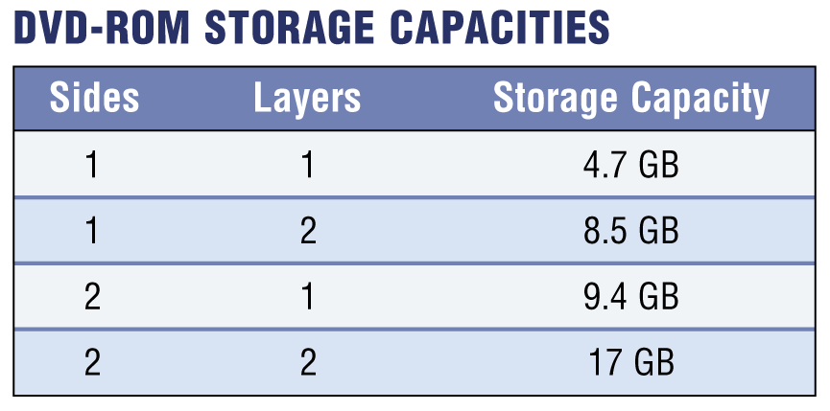
DVD Technology
DVD (Digital Versatile Disc or Digital Video Disc)
  High capacity optical disk capable of storing 4.7 GB to 17 GB
  Single speed (1X) is 1.32 MBps, and recent models are at 18X or 20X
  Many types of recordable and rewritable DVDs are available
    Read-Only (ROM)
    Recordable (+R, -R)
    Rewritable (+RW, -RW, RAM)
Blu-ray Disc (BDs)
  100 GB storage capacity
  For high-definition (high-def) video
See reference [9] for details
Notes:
DVD higher capacity

Slide 43
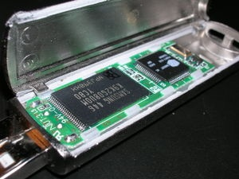
Solid State Storage
Solid-state storage is a nonvolatile, removable storage medium that employs integrated circuits (memory chips) rather than magnetic or optical media
A solid state storage device contains no mechanical parts (as Disk, CD) and store data electronically
  Advantages
    Fast speed, small, lightweight
    Portable and reliable, last longer
    Generate less heat and consume
    less power
  Disadvantage
    Small capacity compared to
    traditional storage devices
Notes:
Flash memory is an example: store data in millions of micro-transistors.

Slide 44
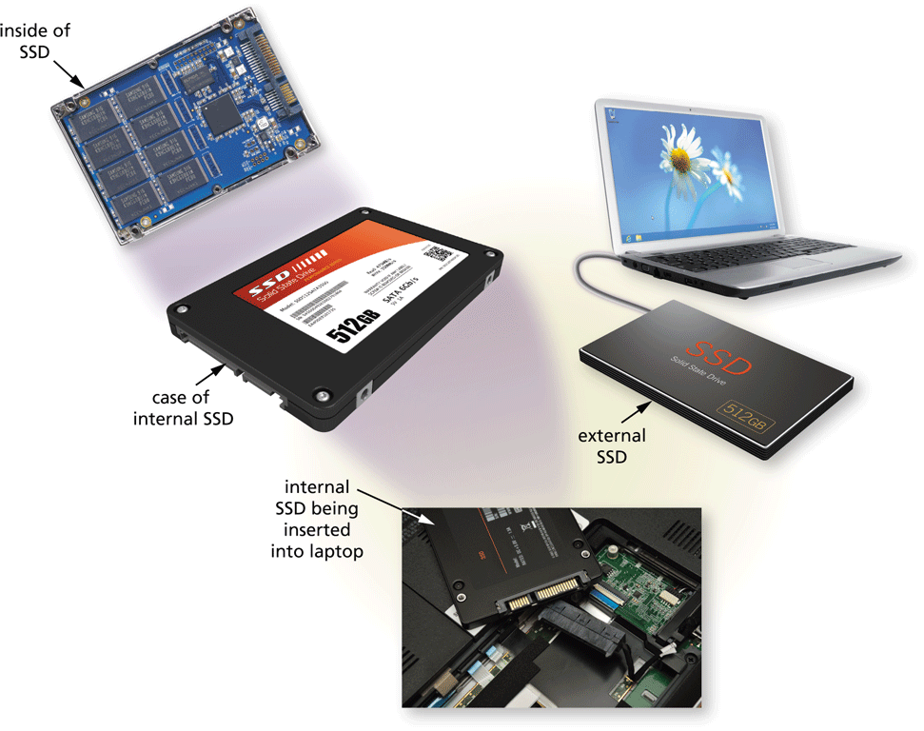
Solid State Drive (SSD)

Slide 45
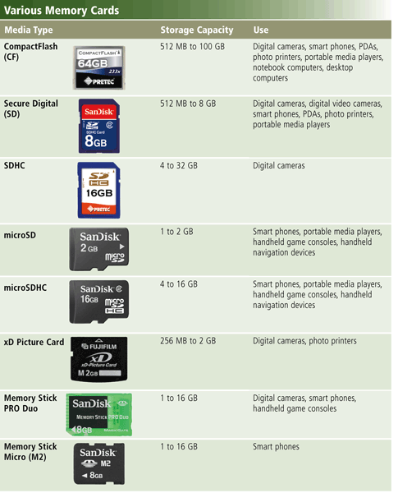

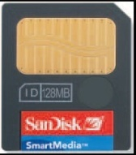
Flash Memory Cards
Flash memory – erasable memory chip
  Portable digital devices such as PDA, MP3 players, cameras and smart phones use flash memory cards
    Those devices are too small for any type of hard drives
  Available sizes vary from 128 MB up to 64 GB
  Likely to replace disk and tape storage
Notes:
Flash memory : Nonvolatile memory that can be erased electronically and rewritten
Used for phones, pagers, portable computers, handheld computers, PDAs
It has the tendency to replace hard disk.

Slide 46
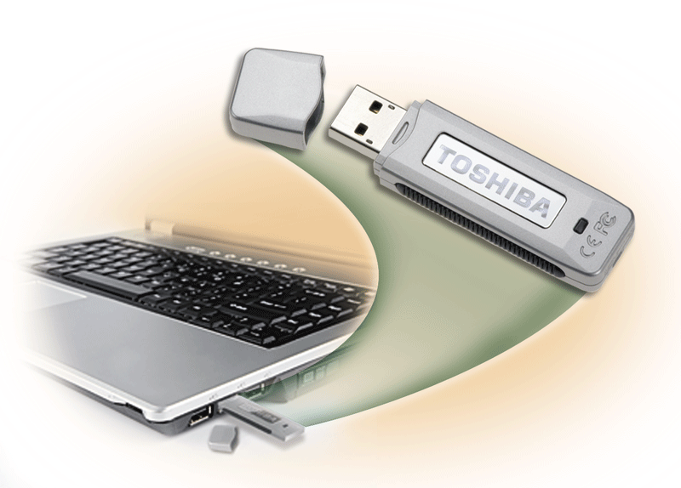
USB Flash Drive
What is a USB Flash Drive?
  Also known as, USB key, USB finger, USB thumb, USB drive
  Plugs in a USB port on a computer or mobile device
  Common storage capacities: 4GB, 8GB, 16GB, 32GB, up to 256GB
  Have eventually made the floppy disk obsolete
Notes:
USB drive: interface that r/w contents in USB

Slide 47
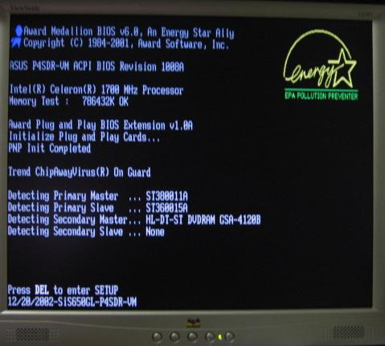
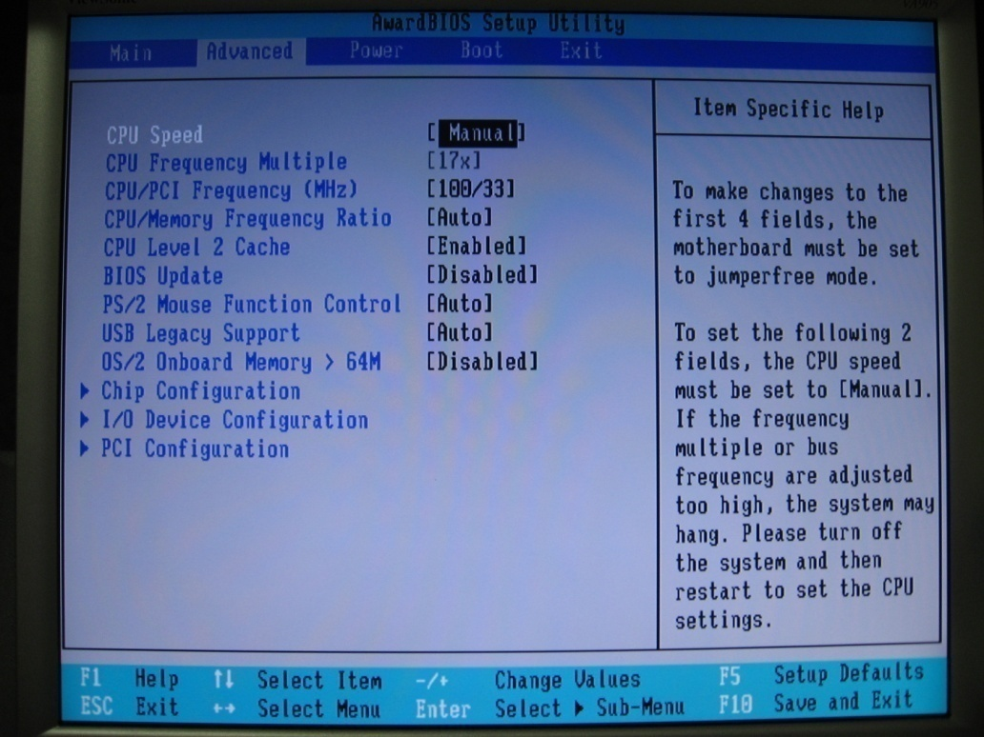
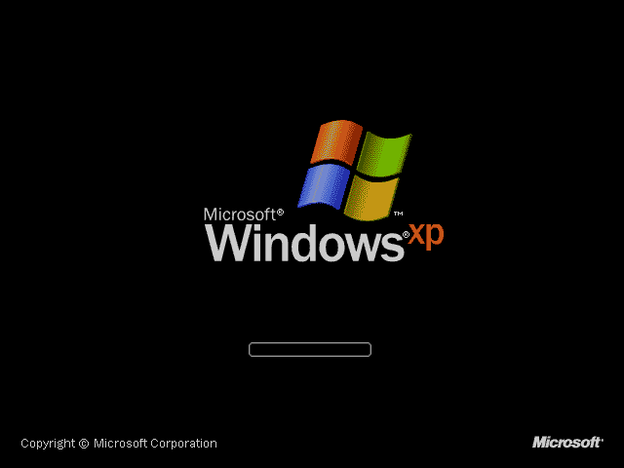
Booting up the Computer
Booting up the computer = starting the computer
  Most important job is to load the operating system
Notes:
4 steps of boot up: 1) load BIOS, 2) run-BIOS to check device setting, 3) load windows (OS), 4) run OS (then, u see user interface)

Slide 48
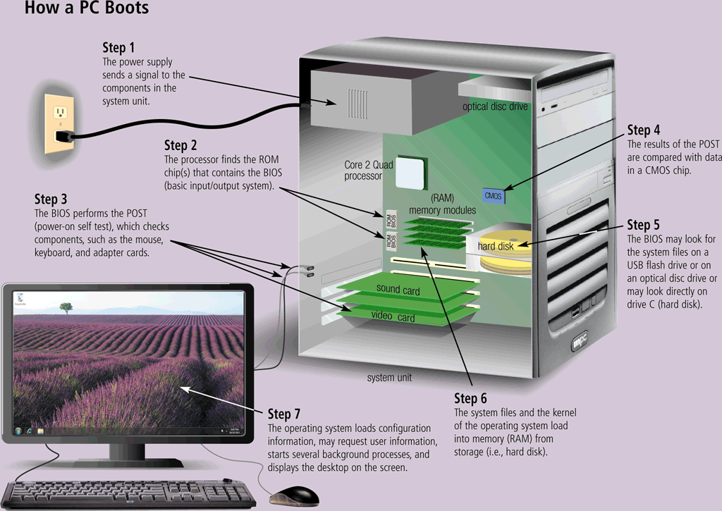
Booting up the Computer
Notes:
Bootstrap: Load BIOS (store in ROM) and check all the devices, then load OS into memory and starts run it.

Slide 49
Shut Down Options
An operating system may include various shut down options
  Shut down cuts off the power and RAM is wiped clean
  Restart re-boots your computer, meaning it saves your information to the hard drive, turns off the computer for a moment, then turns it back on again
  Sleep mode saves any open documents and programs to RAM, turns off all unneeded functions, and then places the computer in a low-power state
Notes:
Sleep mode: programs, tmp data are all in RAM (so it can wakeup immediately).

Slide 50
Lesson Summary
The basic functions of a computer is to input, process, output and store information
Inside the system unit, the motherboard hosts the CPU, main memory and other hardware components
The CPU executes software instructions to perform the calculations and logical manipulations that transform input data into output
There are four basic steps (fetch-decode-execute-store) when a computer executes an instruction
CPU’s performance, to a certain extent, depends on its clock speed and word size

Slide 51
Lesson Summary (cont'd)
The CPU uses:
  RAM (random access memory), which serves as a temporary storage area – a waiting room – to store software instructions and data for CPU
  ROM (read-only memory), which contains unchangeable information that store startup instructions for the CPU to boot up and initialize the computer
  Cache memory to store frequently used instructions and data to balance the speed difference between CPU and RAM
A bus is a data path that consists of parallel wires and connects the CPU, memory and other devices. The bus determines how much and how fast data can move within the computer

Slide 52
Lesson Summary (cont'd)
Storage devices are capable of two-way communication with the computer (i.e., read and write). Common secondary storage devices use magnetic, optical and solid-state medium
  The most common magnetic storage media are hard disks and magnetic tape.
  The primary types of optical storage are CD and DVD
  Solid-state storage devices store data on memory circuits electronically. Examples of such devices include flash memory cards and USB flash drives
When a computer boots up, CPU first performs start-up instructions from ROM to perform a self-testing. The test result will be compared with previously saved data in CMOS to verify certain hardware are operational. Then instructions in ROM direct CPU to load OS instructions from hard disk to RAM.

Slide 53
Reference
[1] Build up your own PC – step by step
  http://www.youtube.com/watch?v=QQQ30QoF_-8
[2] Buying a New Computer That is Right for You
  http://www.onlinecomputertips.com/tutorials/new_computer.html
[3] Vic Fay-Wolfe - How Computers Work: The CPU and Memory
  http://homepage.cs.uri.edu/faculty/wolfe/book/Readings/Reading04.htm
[4] Wikipedia - Instructions per second
  http://en.wikipedia.org/wiki/Million_instructions_per_second
[5] PCGuide.com – System Boot Sequence
  http://www.pcguide.com/ref/mbsys/bios/bootSequence-c.html
[6] StorageReview.com – Hard Disk Drives
  http://www.storagereview.com/guide2000/ref/hdd/index.html

Slide 54
Reference (cont'd)
[7] HowStuffWorks – Hard Disk
  http://computer.howstuffworks.com/hard-disk.htm
[8] HowStuffWorks - CD
  http://computer.howstuffworks.com/cd.htm
[9] Videohelp - DVD
  http://www.videohelp.com/dvd
[10] Steve’s DigiCams – Flash Memory Cards
  http://www.steves-digicams.com/flash_memory.html

Slide 55

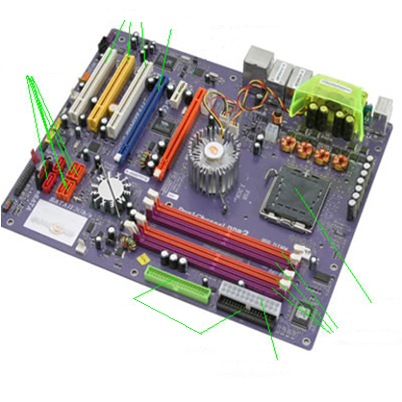
For you to explore after class
Lec04a-Q1: Those slots in the
motherboard are used to
connect WHICH hardware
components?
Lec04a-Q2: computers already
have RAM and ROM, why
they need to have CMOS too?
Lec04a-Q3: identify 5 hardware
features that may affect a
computer's running speed
5
6
4
1
3
2

Slide 56
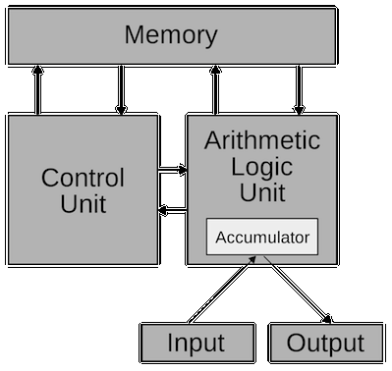
Von Neumman Architecture
Von Neumman Architecture consists of three major points:
A computer (CPU) consists of three components: ALU, Control Unit and Memory
Instructions and data are stored in memory in the same format
The control unit fetches the instructions and execute them in sequential order
Notes:
Von Neumman developed his idea about computer in 1945. Called Von Neumman architecture.
Three points….
Even nowadays, computers still follows this architecture. People may argue 3rd point “sequential execution”, bcs we’ve parallel machines. But in parallel architecture, if you look at each individual processor, it’s still sequential execution.
Von Neumman’s architecture was actually inspired by another great man’s work: Allan Turing, who designed Turing machine in 1936.

