Slide 1

CS1102 Lec03 - Programming I
Semester A, 2013-14
Computer Science Department
City University of Hong Kong

Slide 2
Objectives
Explain what is a computer program
Understand the techniques covered in CS1102 Lab01-06
Functions, Variables and Data Types
Assignment Statements
Built-in Functions
User-defined Functions

Slide 3
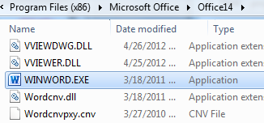
Computer Programs and Programming Languages
A computer program is a series of instructions that directs a computer to perform tasks. It is created by programmers using programming languages
Programming languages are either compiled or interpreted (language statements can be directly executed)
JavaScript is interpreted by a web browser and all you need to do to make them “do stuff” is to put them inside an HTML file
Many other programming languages need to be translated (compiled) in an extra step to become executable
Common programming languages: C, C++, C#, Java, Visual Basic, PHP (Server side language which produces HTML and JavaScript code!!)
Notes:
1st high level programming language: FORTran, 1953. before that, assembly
Why need compile: 1) more efficient in executing compiled programs (at least 10 times faster than the interpreted languages); 2. security. When you sell a s/w system, no source code is revealed. Intellective property protected.
Fig. .EXE file is compiled file

Slide 4
Coding vs. Scripting vs. Programming [in computer science]
These terms are often used interchangeably. But they are different:
Coding is to write computer code: a string that a computer would recognize.
Programming is issuing commands (program code) and seeing that they get executed.
Scripting is writing script: program code that doesn’t need pre-processing (e.g. compiling) before being run. Such pre-processing / compilation is needed for conventional ones like: C, C++, Java, C.
Coding is more general among the 3 terms . It is okay to say "CSS code", "HTML code", "JavaScript code", and "Program code".
[ The above is given as Follow-up Reading Activity for Lab 02 ]

Slide 5
Coding vs. Scripting vs. Programming [in computer science]
HTML and CSS are NOT programming languages (and therefore, not for scripting). HTML and CSS are about content and layout. They do not tell the computer any execution logic or action (command).
JavaScript is a Scripting Language for Programming. For JavaScript, many programmers prefer to use the term Scripting Language (rather than Programming Language) to distinguish it from the conventional compiled programming languages.
[ The above is given as Follow-up Reading Activity for Lab 02 ]
Notes:
HTML and CSS (cascading style sheets) are two languages for building webpages, but not programming languages.
? As a programming language, you must have control statement to control compute executions or take actions, but HTML only specifies formats…
CSS are used to specify page layout, color, font, etc. It’s used inside HTML file.

Slide 6
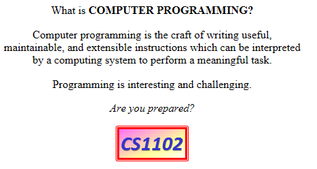
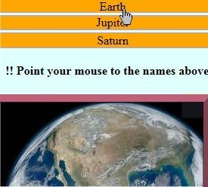
Review and Preview our Programming Labs
Lab 01 – Dynamic change of HTML contents according to mouse events.
Notes:
Prepare for assignment statement

Slide 7
Review and Preview our Programming Labs
Lab 01 – Dynamic change of HTML contents according to mouse events.
<img
src="CS1102.gif“
onmouseover =
"document.getElementById('Msg').innerHTML='<strong>Have fun!</strong>'; "
onmouseout=
"document.getElementById('Msg').innerHTML='<em>Are you prepared?</em>';"
/>
Observation:
Use of Assignment Statement
x = y; (change x’s value as y)
Notes:
“=“ is assignment.
Note: nested assignment in onmouseover = ….

Slide 8
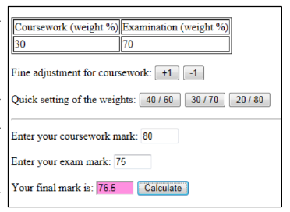
Review and Preview our Programming Labs
Lab 02 – Calculation
Notes:
Explain “Calculate” ? How to do the calculation ->

Slide 9
Review and Preview our Programming Labs
Observation:
calculateFinalMark is a function
Use of variable
Conversion from string to number
Lab 02 – Calculation
function calculateFinalMark()
{
var result; // set up a variable named result
result =
Number(document.getElementById("cw_mark").value)*
Number(document.getElementById("cw_weight").innerHTML)/100
+
Number(document.getElementById("exam_mark").value)*
Number(document.getElementById("exam_weight").innerHTML)/100;
document.getElementById('final_mark').value = result.toFixed(1);
// 1 decimal place
}
Notes:
Java script is a very simple language. It’s used to enhance web-display. It’s NOT suitable for complex computation.
It doesn’t have type of variables. Everything, char, int, string, floating-point, is var.
note: toFixed(1) is to convert a number…

Slide 10
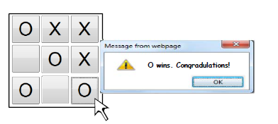
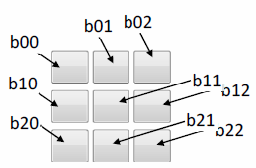
Review and Preview our Programming Labs
Lab 03 – Making Decisions (Branching in execution - if-statement)
Notes:
Demo: to check if a player wins… “if” statement.

Slide 11
Review and Preview our Programming Labs
Lab 03 – Making Decisions (Branching in execution – using the if-statement)
If (document.getElementById("b00").innerHTML==whoseTurn &&
document.getElementById("b01").innerHTML==whoseTurn &&
document.getElementById("b02").innerHTML==whoseTurn)
alert ("You win. Congradulations!");
………..
if-statement is the simplest control structure, it is provided by most programming languages.
Notes:
Note: &&, you may use ||

Slide 12
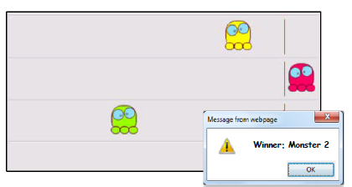
Review and Preview our Programming Labs
Lab 04 – Animation (Timed execution of instructions)
Notes:
Most of the time, function is called in response to user’s input, mouse-click, move, keyboard type, etc. sometimes, a function is triggered by a timer: very often used in animation! setInterval is such a function.
In this lab session, the interval is fixed.
It uses random number to generate speeds for 3 monsters. The step-length of monsters in each interval are different

Slide 13
Review and Preview our Programming Labs
Lab 04 – Animation (Timed execution of instructions – using the built-in setInterval function)
// Schedule the animation - call move_a_step() repeatedly every 100 millisecond
setInterval('move_a_step()', 100);
* A built-in function is a function provided by the programming language itself. Examples of JavaScript built-in functions: alert(), Number(), setInterval()
Notes:
See a demo: animation.html: setInterval to change speed in program…

Slide 14
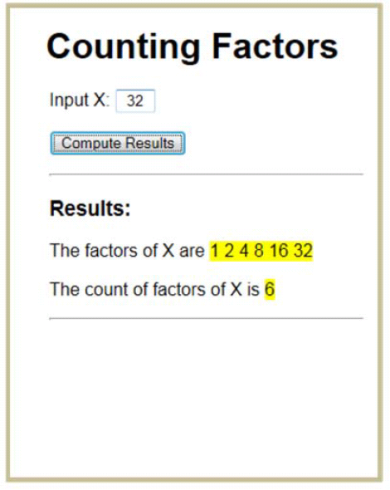
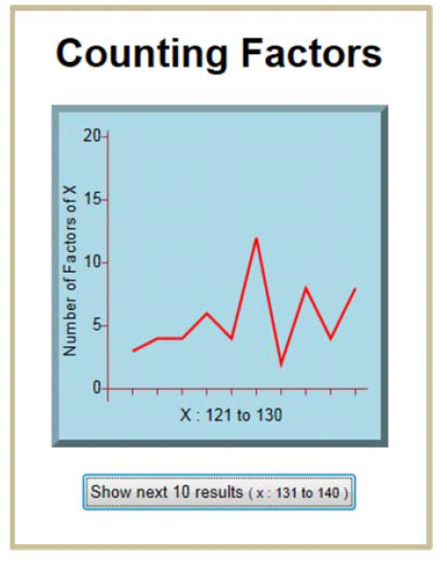
Review and Preview our Programming Labs
Lab 05 – Write a loop of statements to repeat doing something; SVG^{Scaler Vector Graphics}
Can 1 divide 32?
Can 2 divide 32?
Can 3 divide 32?
..
Notes:
Loop is one of the most important statement in any language. Computer is good at computing. Most of the computing is done by “loops”: loops to process large amount of data, loops to calculate a solution of an equation (iterative to produce more accurate result)….
Any programming language includes 1) computing operations; 2) if – statement; 3) loop – statement. You learn them, you can write programs!

Slide 15
Review and Preview our Programming Labs
Lab 05 – Write a loop of statements to repeat doing something;
var count = 0;
for (i=1; i<=x; i++) //check through 1, 2, 3, 4, .. x for factors
{
if (x%i==0) // x%i means the remainder of x/i
count++;
}
// What is value of i when exit from “for-statement”???
Notes:
? How to find the factors of an integer x?
to explain for-loop
Notice difference “=“ and “==“.

Slide 16
Review and Preview our Programming Labs
Lab 05 – Write a loop of statements to repeat doing something; SVG^{Scaler Vector Graphics}
/* Refer to the SVG polyline element with id "p", we set its "points" attribute to pairs of coordinates. */
document.getElementById("p").setAttribute("points", "10,10, 20,40, ...");
<svg>
<polyline id="p" points=""></polyline>
</svg>
Notes:
NOTE: SVG works in Chrome, not in old version of IE.
.setAttribute(“point”, “(1, 20), (2, 13), …., (10, 5)”), it sets a group of (x,y) points to draw the curve.
var pts=""; //initially empty
for (var i=0; i<=9; i++) // use for-loop to set value of a list of points
pts = pts + (60+i*20) + "," + (220-countFactors(start+i)*10)+" "; // pts contains 10 “x,y” points for drawning.
document.getElementById("p").setAttribute("points", pts);

Slide 17
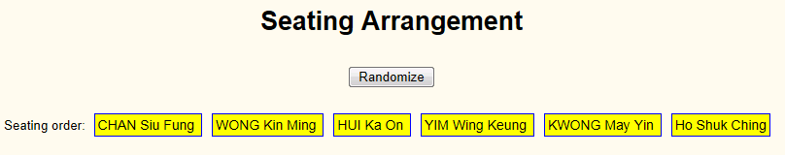
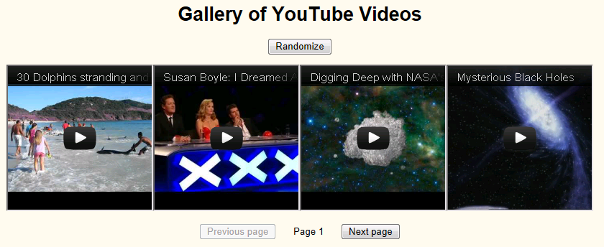
Review and Preview our Programming Labs
Lab 06 – manipulating values in an array (a collection of values)
Notes:
Array is an important data structure, often used together with for-loop.
Demo Lab6: see source code from IE: Explain array declaration, array index, for-loops, etc.

Slide 18
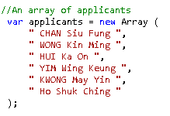
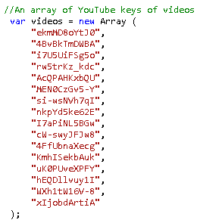
Review and Preview our Programming Labs
Lab 06 – manipulating values in an array (a collection of values)
Notes:
One dimensional array.

Slide 19
How to Avoid Bugs and How to Debug
In general:
For beginners, debugging often takes longer time than the designing and coding. Don't feel upset about this.
You can learn very quickly from each chance of debugging: Get a clear idea of the error and the correction (Need help? Ask!!). Then your skill will improve rapidly. Solving problems becomes easy and fun.
Solve errors: NOT by trial-and-error. Be systematic and calm. Be clear about the code you are writing.
[ The above is given as Follow-up Reading Activity for Lab 03 ]

Slide 20
How to Avoid Bugs and How to Debug
Good Habits During Coding:
Divide into steps and test frequently. Do not pile up errors. If the code gets confusing, you may need to rewind some steps.
Be patient to well manage the variables and functions (naming and usage; each function should have one well defined goal); and keep good clarity of logic. Patience save your debugging time and reduce effort for further modification.
If needed, add comments to remind yourself about tricky logic.
[ The above is given as Follow-up Reading Activity for Lab 03 ]

Slide 21
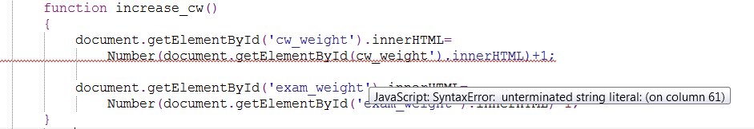

How to Avoid Bugs and How to Debug
How to Debug:
Add alert(..) to investigate the variable values at different stages of execution and show computation results.
The Editor often knows more
If a red curly underline shows, move your cursor to the line to show an error tip.
The browser may also know more
If problem happens and you use IE, double click left-bottom corner of the status bar to show its hints.
Look into the simplest unsuccessful test case first.
[ The above is given as Follow-up Reading Activity for Lab 03 ]

