Slide 1

CS1102 Lec02 - Binary Number System & Boolean Logic
Computer Science Department
City University of Hong Kong
Notes:
1st session ends page 11
2nd session ends page 17 (2’s complement)

Slide 2
Objectives
Describe the difference between analog signal and digital signal
Introduce the binary number system and binary arithmetic
Discuss how to convert between binary and decimal
Explain how various data (positive integers, characters, colors) are represented in computers
Reproduce the truth tables for the AND, OR, NOT, and XOR Boolean operations and logic gates
Trace the logic of the adder circuits composed of a few simple gates: half-adder, full-adder, multiple-bit adder
Analyze and do some simple design of logic circuits

Slide 3
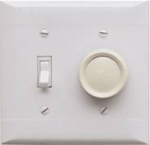
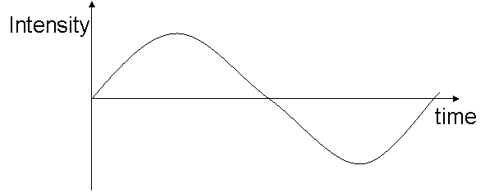
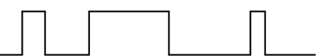
Data Representation
Data representation refers to the form in which data is stored, processed, and transmitted
Digital devices work with discrete data
Analog devices work with continuous data
Analog signal: continuous electrical
signals that vary in time
Digital signal: discrete electrical
signals

Slide 4
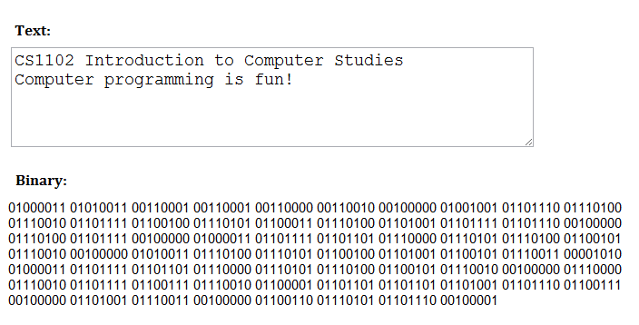
Binary System in a Digital Computer
Computers are made up of millions of switches
Each switch has two states, “on” or “off”
Thus, binary system is a nature and easiest way for a computer to represent information and implement operations
Notes:
Why people uses decimal numbers (10 as base)?
1 char is represented by 8bits – 1byte. This’s ASCII code.

Slide 5
Number Systems
Number system
  Any system of representing numbers. Also called numeral system
  The base of any number system is the number of digits in the system
The number systems most commonly used in are:
  Decimal - 10 digits 0, 1, 2, 3, 4, 5, 6, 7, 8, 9
  Binary - 2 digits 0, 1
  Octal - 8 digits 0, 1, 2, 3, 4, 5, 6, 7
  Hexadecimal - 16 digits 0, 1, 2, 3, 4, 5, 6, 7, 8, 9, A, B, C, D, E, F
Notes:
Number system has a base: decimal, binary, octal, hexal (the last 3 are in the same category)

Slide 6
Bit & Byte
Computers operate on binary numbers
  Bit (Shortening for “Binary digIT”)
    The smallest unit of information
    Either 1 or 0
    Representing numbers, text characters, images, sounds, instructions and others
  Byte : a collection of 8 bits
    Kilobytes (KB): 2¹⁰ = 1,024 bytes
    Megabytes (MB): 2²⁰ = 1,024 KB = 1,048,576 bytes
    Gigabytes (GB): 2³⁰ = 1,024 MB = 1,073,741,824 bytes
    Terabytes (TB): 2⁴⁰ = 1,024 GB = 1,099,511,627,776 bytes
    Petabytes (PB): 2⁵⁰ = 1,024 TB = 1,125,899,906,842,624 bytes
Least Significant Bit
Most Significant Bit
1 | 0 | 1 | 0 | 0 | 0 | 1 | 1
Notes:
Byte: smallest meaningful object, such as a char.
2^10 = 10^3

Slide 7
Decimal: base-10 number system
Hundreds Tens Ones Tenths Hundredths
  10² 10¹ 10⁰ 10⁻¹ 10⁻²
3 7 5 . 1 5
3*10² = 3*100 = 300.
7*10¹ = 7*10 = 70.
5*10⁰ = 5*1 = 5.
1*10⁻¹ = 1*.1 = 0.1
5*10⁻² = 5*.01 = + 0.05
375.15
Formula: ∑DIGIT * BASE ^{POSITION #}
Notes:
375.15 to explain each digit
Note: after “.” it’s actually divided by 10 (base)…
This format of calculation gives us a guideline for converting any base number to decimals
Formula: position# starts from 0; the same formula holds for binary →

Slide 8
Binary: base-2 number system
Formula: ∑DIGIT * 2 ^{POSITION #}
  2⁴ 2³ 2² 2¹ 2⁰ 2⁻¹ 2⁻²
1 1 1 0 1. 0 1
16 + 8 + 4 + 0 + 1 + 0 + 0.25 = 29.25
Octal and Hexadecimal
  Octal - base 8 number system
  Hexadecimal - base 16 number system
  E.g., (for example)
    26₁₀ = 11010₂ = 32₈ = 1A₁₆
Binary | Octal | Decimal | Hexa-decimal
0000 | 0 | 0 | 0
0001 | 1 | 1 | 1
0010 | 2 | 2 | 2
0011 | 3 | 3 | 3
0100 | 4 | 4 | 4
0101 | 5 | 5 | 5
0110 | 6 | 6 | 6
0111 | 7 | 7 | 7
1000 | 10 | 8 | 8
1001 | 11 | 9 | 9
1010 | 12 | 10 | A
1011 | 13 | 11 | B
1100 | 14 | 12 | C
1101 | 15 | 13 | D
1110 | 16 | 14 | E
1111 | 17 | 15 | F
Notes:
!On board before class: (be used all time): 2^4 2^3 …2^0. 2^-12^-2
Binary to decimal: 11101.01B -> 29.25, easy, remember the above formula!
Octal and Hexa are in the same category of binary: Octal digit has 3 bits, Hexa digit has 4 bits. This help us easily convert between binary to Octal / Hexa:
Binary -> Octal / Hexa: divide binary into 3 (or 4) bit-group (from right) and convert each group into Octal (hexal): example on slide
Octal/Hexa -> Binary: easy! Extend each digit into 3 (or 4) bits-group. (table on slide for easy reference)
On-board example: 7A(Hex) -> ?? 76(Oct) -> ??
Remember the table: 10, 100, 1000, then you can work out all binary in 4-digits.
Decimal -> binary:
On-board Example: 26D -> 11010B:
26/2 = 13 …0
13/2 = 6…1
6/2 = 3…0
3/2 = 1…1
……………
Summary: binary -> decimal. Now decimal -> binary -→

Slide 9
Decimal Integer to Binary
Convert a positive decimal integer to binary using repeated division
  Step 1 - divide the value by two and record the remainder
  Step 2 - continue to divide the quotient by two and record the remainder, until the newest quotient becomes zero
  Step 3 - the binary representation is the remainders listed from bottom to top in the order they were recorded
E.g., what's the binary for integer 13?
13 ÷ 2 = 6 ··· 1
6 ÷ 2 = 3 ··· 0
3 ÷ 2 = 1 ··· 1
1 ÷ 2 = 0 ··· 1
Dividend
Divisor
Reminder
Quotient
Answer: 1 1 0 1
Notes:
Binary representations: integers, floating-point, signed numbers
Starting from easy one: integer…
Write on board: 13/2 = ….1 (explain: u work out from lowest digit, this is a reverse operation of binary -> Dec)
6
…..
easy to verify binary -> decimal by: 2^3, 2^2, 2^1, 2^0

Slide 10
Decimal Fraction to Binary
Convert a positive decimal fraction to binary using repeated multiplication
  Step 1 - multiply the fraction by two and record the integer digit of the result
  Step 2 - disregard the integer part, and continue to multiply the fraction part by two, until the newest fraction part becomes point zero or there is a repeated digit pattern
  Step3 - the binary representation is the integer digits listed from top to bottom in the order they were recorded
Like decimal fractions, some binary fractions are periodic where a sequence of digits behind the decimal point (the period) is endlessly repeated
  E.g., 0.6₁₀ = 0.10011001₂ ...
E.g., what's the binary for integer 0.375?
0.375 x 2 = 0.75
0.75 x 2 = 1.5
0.5 x 2 = 1.0
Answer: 0. 0 1 1
Notes:
For fraction number: starting from the 1st bit after the point (left -> right): refer to row of 2 base on board
On board: It’s easy to verify 0.011B -> 0.375D by .2^(-1) 2^(-2) 2^(-3)
The binary number may be endless
On board example:
0.6x2 1.2
0.2x2 0.4
0.4x2 0.8
0.8x2 1.6
0.6………………….
Summary decimal to fraction: integer part, and fraction part.
Now consider to represent any real-number →

Slide 11
Exercise: Real Numbers to Binary
A real number is a number that has a decimal point (called floating point number in computing languages)
Convert decimal 13.375 to binary:
  13 = 1101
  0.375 = 0.011
  13.375 = 1101.011
More examples:
  133.3 = ?
  - 1345.57 =?
Standardize the representation of real numbers
Unfortunately, floating is not represented like this in computer
Notes:
computer cannot understand the fraction “.” among digits (every bit is either 0 or 1)!!! We must standardize representation of real-numbers →

Slide 12

Standardize Real Number Representation
Normalized representation of real numbers:
    20,000 → 2.0 x 10⁴; -0.0034 → -3.4 x 10⁻³
    101.01 → 1.0101x2²; -0.00101 → - 1.01x2⁻³
The integer part of a standard floating point number is always “1”, it is omitted in the representation
Each real number has 3 parts: sign, exponent, fraction
IEEE 754 (reference [4]): IEEE Standard for Floating-Point Representation of Normalized Binary Numbers
-3.4 is mantissa
-3 is exponent
Notes:
Good tute: http://www3.ntu.edu.sg/home/ehchua/programming/java/DataRepresentation.html
!!on board: 0.15625 → 0.00101 → 1.01x2^(-3): ??? What is sign (0), exponent (127-3=124=01111100B), fraction (01B)?
Explain: sign-bit, exponent, fraction (mantissa)

Slide 13
IEEE Floating Point Standard
    0.15625 = 1.01x2⁻³
Let s = +1 (positive numbers) when the sign bit is 0
s = −1 (negative numbers) when the sign bit is 1
Let e = exponent - 127
Let m = 1.mantissa in binary
The number's value v is: v = s × 2e × m
1101.011 -> 1.101011x2³ -> 010000010101011000……
  More details see reference [4]
Notes:
exponent needs to represent range -127 to +128 (255-127) using 8bits, but 0 <= 8bits <=255, so shift numbers -127,
i.e., on-board:
“-127” → “0”
-126 → 1
0 → ???
……
“128” → “255” in 8bits;
so -127 <= exp <= 128;
That’s why the actual e = exponent – 127.
??? If exp = 0, what is the real exp?
Example in the box: 0.15625 = 1.01*2^(-3) , e = 124 – 127 = -3; fraction is 1.01;
2) Since the digit before the fraction-point is always 1 in binary normalized number, so in mantissa part, it only represents the numbers after fraction-point.
Example: to represent 1101.011, -> 1.101011 * 2^(3): exponent: 3+127 -> 10000010; Mantissa: 1010110000000000….
Summary…

Slide 14
Binary Arithmetic
Rules of Binary Addition
  0 + 0 = 0
  0 + 1 = 1
  1 + 0 = 1
  1 + 1 = 0, and carry 1 to the next more significant bit
  E.g.,
  0 0 0 1 1 0 1 0 = 26₁₀
  + 0 0 0 0 1 1 0 0 = 12₁₀
  0 0 1 0 0 1 1 0 = 38₁₀
Rules of Binary Subtraction
  0 - 0 = 0
  0 - 1 = 1, and borrow 1 from the next more significant bit
  1 - 0 = 1
  1 - 1 = 0
  E.g.,
  0 0 1 1 0 0 1 1 = 51₁₀
  - 0 0 0 1 0 1 1 0 = 22₁₀
  0 0 0 1 1 1 0 1 = 29₁₀
Notes:
Subtraction is done by + 2’s complements (later)

Slide 15
Binary Arithmetic
Rules of Binary Multiplication
  0 x 0 = 0
  0 x 1 = 0
  1 x 0 = 0
  1 x 1 = 1, and no carry or borrow bits
  E.g.,
  0 0 1 0 1 0 0 1 (41₁₀)
  x 0 0 0 0 0 1 1 0 (6₁₀ )
  0 0 0 0 0 0 0 0
  0 0 1 0 1 0 0 1
0 0 1 0 1 0 0 1
0 0 1 1 1 1 0 1 1 0 (246₁₀)
Binary Division: repeated process of subtraction
  E.g.,
  1 1 0 1 1 (27₁₀ )
  1 0 1 ) 1 0 0 0 0 1 1 1 (135₁₀)
  (5₁₀) - 1 0 1
  1 1 0
  - 1 0 1
  0 1 1
  - 0
  1 1 1
  - 1 0 1
  1 0 1
  - 1 0 1
  0
function divide(N, D)
R := N
while R ≥ D do
Q := Q + 1
R := R - D end
return (Q, R) end
Notes:
Multiply is done by a loop of shift and plus operations
N/D = (Q, R), N-numerator (divisor), D-denominator (dividend), Q-quotient, R-remainder
Division is also done by loop: each time shift the “divisor” one-bit to the right-hand side and “minus” with the dividend until the “remainder” is less than the “divider”: See algorithm in the box

Slide 16
Bytes Representing Signed Integers
2's Complement representation for signed integers
  Designed to simplify the binary arithmetic, allowing the computer to perform all arithmetic operations using only addition
  Based on the idea: y - x = y + (-x)
Convert an negative integer to 2's complement :
  Convert the number to binary
  Negate each bit ( 0 →1, 1 → 0)
  Add 1 to the binary
E.g.. Convert -5₁₀ to 2's complement using 4-bits ?
0101 (+5)
1010
1011 (-5)
Notes:
1’s complement: negate each bit of a number. x’s 2’s complement is to negate x plus 1.
? Why 2’s complement of X is “-X”: On board to verify:
X 1010…11
!X 0101…00
X+!X 1111…11,
X+!X+1 0000…00; so (!X+1) = 2’s complement of X = -X

Slide 17
Subtraction with 2's Complement
Subtracting x from y ("y - x") with an n-bit 2's complement representation
  Represent x in 2's complement
  Add y and (-x)
  Discard any bits greater than n
  E.g., compute: “7 – 1” using 2's complement?
    0 1 1 1 (+7₁₀)
    + 1 1 1 1 (-1₁₀ )
    1 0 1 1 0 (+6₁₀ )
Binary | Decimal
0111 | +7
0110 | +6
0101 | +5
0100 | +4
0011 | +3
0010 | +2
0001 | +1
0000 | +0
1111 | -1
1110 | -2
1101 | -3
1100 | -4
1011 | -5
1010 | -6
1001 | -7
1000 | -8
Discard this overflow bit
Notes:
2’s complement is easy to do (negate all bits + 1)
Note: throw away the highest carry-in bit when to 2’s complementary +
See table: example -1 and -8
Note (2013): students are confused with 2’s complement of “-8” (1000) and integer 8 (1000): answer: the 4bits number in fact only use 3 bits for number and the top bit is for “sign”, so with 3bits, it can only represent positive integer upto 7. Think about 32 bits register: 9 - 6
9 = 000…001001; 6 = 000…000110; -6 = 111…111010; 9 – 6 = 000…00011

Slide 18
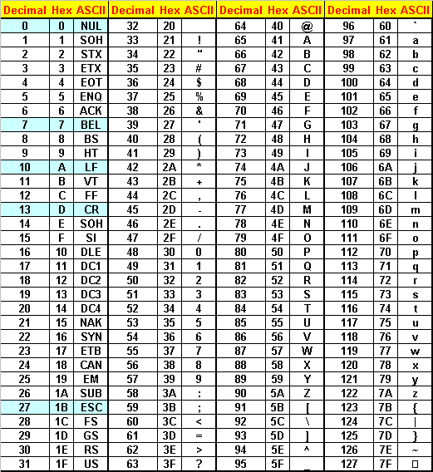
Bytes Representing Text
Each character (letter, punctuation, etc.) is assigned a unique binary number
  ASCII - American Standard
  Code for Information Exchange (primarily for English)
  Unicode: represent the major symbols used in languages world side
  E.g.,
    Text: H e l l o !
  ASCII: 48 56 6C 6C 6F 21
Notes:
How many chars can one-byte represent?
ASCII code has 128 characters, 33 control-chars (not printable) from 0-32 and 95 printable chars starting from 33 (see table)
Note: 0-9, A-Z are all consecutive numbers. It’s very useful for programming!
Unicode: include ASCII codes (the 1st 128 chars are ASCII codes), but contains many many more chars

Slide 19
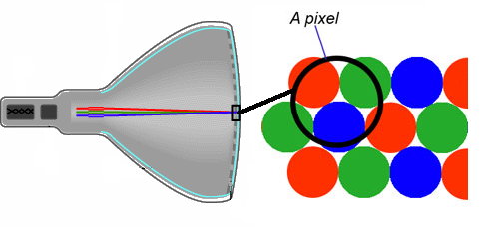
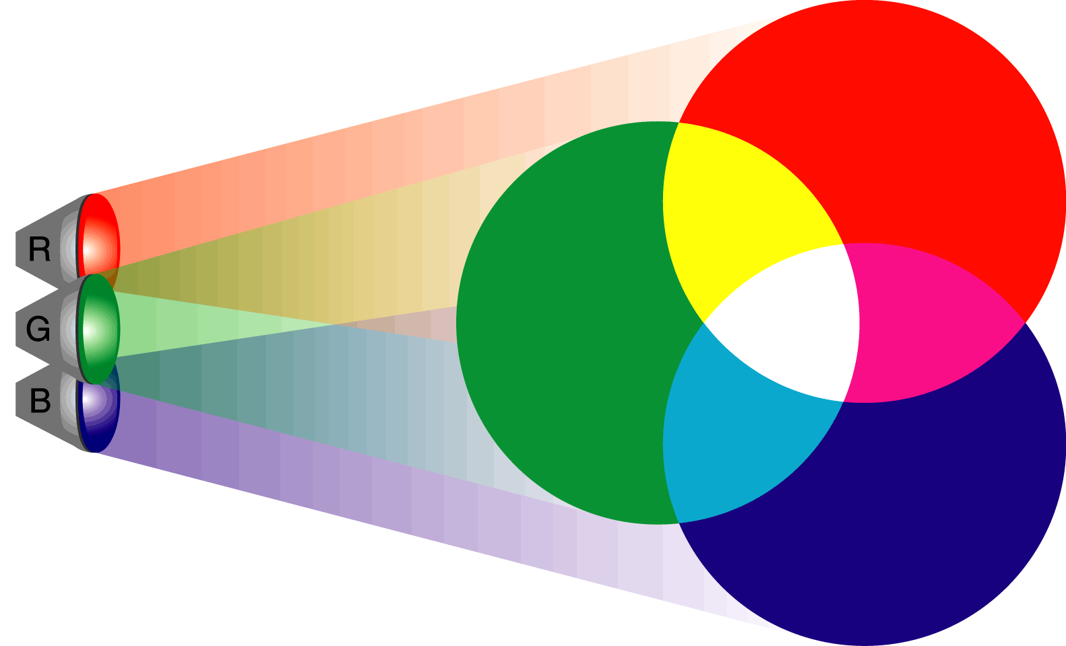
Byte Representing Colors
A monitors screen is divided into a grid of small unit called pixels
The more pixels per inch, the better the resolution, the sharper the image
All colors on the screen are a combination of red, green and blue (RGB), just at various intensities
“True color” systems require 3 bytes or 24 bits per pixel
  There are also 4-bit and 8-bit color systems
Notes:
Note: RGB, not RYB
Two well-known standard: Jpeg uses 24bits for color representation. It’s rich in color scheme. It’s used for photos;
While gif/tiff uses 8bits for colors, they’re used for computer generated images.
? What’s the size for a 3000*3000 JPEG with no compression = 3*3*3M bytes

Slide 20
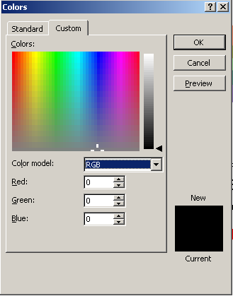
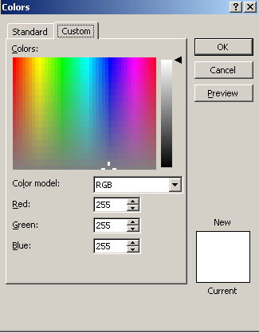
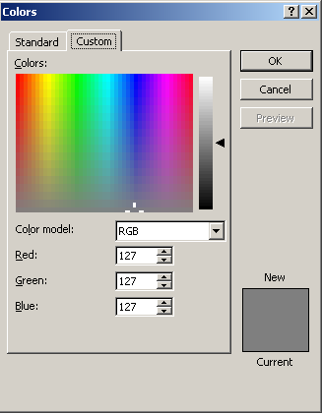
Each color intensity of red, green and blue represented as a number from 0 through 255
Black has no intensity or no color and has the value (0, 0, 0)
White is full intensity and has the value (255, 255, 255)
Between the two extremes is a whole range of colors and intensities
Grey is somewhere in between (127, 127, 127)
Notes:
Demo: in ppt left-click in “font color” -> more colors -> custom: move the target around to see color change of the right-bottom box

Slide 21
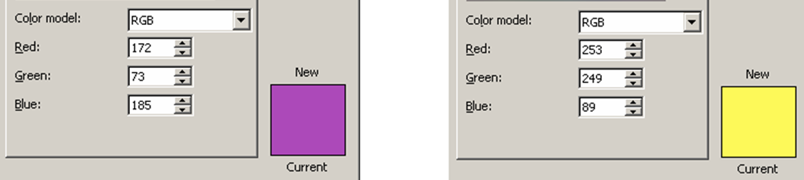
Byte Representing Colors
Let’s convert these colors from Decimal to Hexadecimal
  Red Green Blue
  Purple: 172 73 185 #AC49B9
  Yellow: 253 249 88 #FDF958
Note: in HTML, sometimes text or background color is defined in hexadecimal notation.
Notes:
Color code: two hexal digits for each color from left to right of RGB

Slide 22
Byte Representing Sound
Notes:
Sound wave: Amplitude (sound) and frequency

Slide 23
CS1102 Lec02 - Boolean Logic

Slide 24
Boolean Operations
Boolean operation: an operation that manipulates one or more true/false values
  True = 1, False = 0
  Specific operations: AND, OR, NOT, XOR (exclusive or), NAND, NOR, XNOR (exclusive nor)
Gate: a tiny electronic device that computes a Boolean operation
  Often implemented as (small) electronic circuits
  Provide the building blocks from which computers are constructed
Notes:
AND, OR, NOT, XOR are most fundamental, they cannot be implemented by other gates. They are the minimal set of primitive operations.

Slide 25


Logic Gates
AND gate
Input |  | Output
A | B | A AND B
0 | 0 | 0 | False AND False is False
0 | 1 | 0 | False AND True is False
1 | 0 | 0 | True AND False is False
1 | 1 | 1 | True AND True is True
The output is True when both inputs are True; otherwise, the output is False.
OR gate
Input |  | Output
A | B | A OR B
0 | 0 | 0 | False OR False is False
0 | 1 | 1 | False OR True is True
1 | 0 | 1 | True OR False is True
1 | 1 | 1 | True OR True is True
The output is False if both inputs are False; otherwise, the output is True.
Notes:
Notice the symbol of gates. They’re internationally standard.
See written format.

Slide 26


Logic Gates
NOT gate or inverter
Input | Output
A | NOT A
1 | 0 | NOT True is False
0 | 1 | NOT False is True
XOR gate
Input |  | Output
A | B | A XOR B
0 | 0 | 0
0 | 1 | 1
1 | 0 | 1
1 | 1 | 0
The output is True if either, but not both, of the inputs are True.
Notes:
Symbol of XOR is from OR. XOR is very important for binary “add” operation.
The above 4 operations are minimum set of essential building blocks. They cannot be implemented.

Slide 27



Logic Gates
NAND gate
Combination of an AND gate with a NOT gate
NOR gate
Combination of an OR gate with a NOT gate
XNOR gate
Combination of an XOR gate with a NOT gate.
The output is True if both of the inputs are True or both of the inputs are False.

Slide 28
Review of gates
Input |  | Output
A | B
0 | 0 | 0
0 | 1 | 1
1 | 0 | 1
1 | 1 | 1
Input |  | Output
A | B
0 | 0 | 0
0 | 1 | 1
1 | 0 | 1
1 | 1 | 0
Input |  | Output
A | B
0 | 0 | 0
0 | 1 | 0
1 | 0 | 0
1 | 1 | 1
Input |  | Output
A | B
0 | 0 | 1
0 | 1 | 1
1 | 0 | 1
1 | 1 | 0

Slide 29
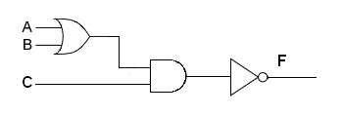
From Logic Gates to Logic Circuit
What does the following circuit compute?
Input |  |  | Output
A | B | C | F
0 | 0 | 0 | 1
0 | 0 | 1 | 1
0 | 1 | 0 | 1
0 | 1 | 1 | 0
1 | 0 | 0 | 1
1 | 0 | 1 | 0
1 | 1 | 0 | 1
1 | 1 | 1 | 0
Notes:
Explain circuit, use the table to verify circuit: it’s easy.
? What’s the written form of above circuit? F = NOT((A OR B) AND C)
But circuit design is to have this table of input and corresponding output -> find the circuit design: it’s hard, a lot harder…

Slide 30
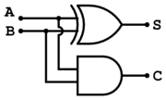
Single-Bit Adder (1)
Half-adder
  A circuit that performs an addition operation on two binary digits
  Produces a sum and a carry value which are both binary digits
Logic combinations of single-bit sum
  0 0 1 1
  +0 +1 +0 +1
  0 1 1 10
  Sum = A XOR B
  Carry-out = A AND B
Input |  | Output
A | B | Sum | Carry-out
0 | 0 | 0 | 0
0 | 1 | 1 | 0
1 | 0 | 1 | 0
1 | 1 | 0 | 1
A half-adder
Carry-out
Image extracted from reference [6]
Notes:
What’s the gate of sum? See the gate, written as A XOR B (operant, operation)
What’s the gate of “carry-out”….

Slide 31
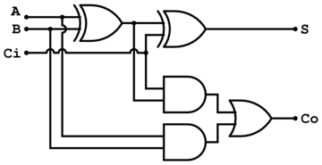
Single-Bit Adder (2)
Input |  |  | Output
A | B | Cin | Sum | Cout
0 | 0 | 0 | 0 | 0
0 | 1 | 0 | 1 | 0
1 | 0 | 0 | 1 | 0
1 | 1 | 0 | 0 | 1
0 | 0 | 1 | 1 | 0
0 | 1 | 1 | 0 | 1
1 | 0 | 1 | 0 | 1
1 | 1 | 1 | 1 | 1
Full-adder
  A logic circuit that performs an addition A + B + C_{in}
  Produces a sum and a carry out
  Note: A + B + C_{in} = (A + B) + C_{in}
Sum = (A XOR B) XOR Cin
Cout = (A AND B) OR (Cin AND (A XOR B))
A full-adder
Image extracted from reference [6]
Notes:
Full-adder: 3 inputs. Break 3 digits to two levels of adder: A + B + C_{in} = (A + B) + C_{in}
For “carry-out”, A+B -> Co’, then C_{in}+S’ -> Co’’, finally Co’+Co’’ -> Co
? Why not use “XOR”, Note: Co’ and Co’’ cannot be both 1.
Notice the written format: once you can write done the formula, you’re done with the design. In your homework or exam, you’ll be often asked to write down the formula, NO need to draw the circuit.

Slide 32
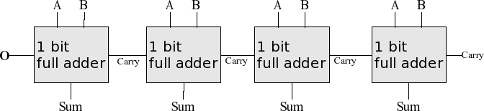
Multiple-Bit Adder
Using several full adders to add multiple-bit numbers
  Each full adder inputs a Cin, which is the Cout of the previous adder
  This kind of adder is a ripple-carry adder, since each carry bit "ripples" to the next full adder.
Image extracted from reference [6]
Notes:
A1+B1, A2+B2, ….,
32bits register: you need 32 adders
for substraction: A – B = A + NOT(B) + 1; the carry-in at the most left-hand side is set to 1.

Slide 33
Summary
Binary number system is the language which the computer can only understand
Conversion between the binary "language" and the language we already understand: the decimal system
Various data (signed or unsigned integers, real numbers, text, multimedia or even instructions) are represented as binary inside computers
Computers are built on a set of strict logic (Boolean logic); complex circuits that perform particular functions are constructed using the basic logic gates

Slide 34
Reference
[1] Howstuffworks.com - How Bits and Bytes Work
  http://computer.howstuffworks.com/bytes.htm
[2] Wikipedia - Computer numbering formats
  http://en.wikipedia.org/wiki/Computer_numbering_formats
[3] Virginia Tech - Number Systems
  http://courses.cs.vt.edu/~csonline/NumberSystems/Lessons/index.html
[4] Wikipedia - IEEE floating-point standard
  http://en.wikipedia.org/wiki/IEEE_Floating_Point_Standard
[5] Howstuffworks.com - How Boolean Logic Works
  http://computer.howstuffworks.com/boolean.htm
[6] Virginia Tech - Machine Architecture - Gates
  http://courses.cs.vt.edu/~csonline/MachineArchitecture/Lessons/Gates/index.html
[7] Wikipedia - Adder
  http://en.wikipedia.org/wiki/Adder_%28electronics%29

Slide 35

For you to explore after class
Lec02-Q1: which one is better and why, digital signal or analog signal? (give your answer within 50 words)
Lec02-Q2: given a decimal real number 22.8125₁₀, convert it into binary real number
Lec02-Q3: one hexadecimal digit can be converted to how many binary bits? Given a hexadecimal number 9AF₁₆, convert it into binary number (think of a quick way to do it other than converting the hex into a decimal and then converting the decimal into a binary)

