Slide 1

CS1102 - Introduction to Computer Studies
Computer Science Department
City University of Hong Kong
Notes:
NOTE (2013): this notes have no difference from Jean’s
1session ends by “supercomputer”
2session ends by security (didn’t have time to explain the last page of slides).

Slide 2
Course General Info (1)
Teaching Team
  Lecture: Dr. Helena WONG (Coordinator), Prof. Xiaohua Jia, Dr. Jianping Wang
  Labs: Prof. Xiaohua JIA, Dr. Jianping WANG, Dr. Helena WONG
  Dr. Jean WANG, Dr. Kenneth LEE
  Contact info on Blackboard
Reference Book
  Discovering Computers 2014 (1st Edition), by Misty E. Vermaat, Cengage Learning Ltd.
Blackboard-based course
  It is your own responsibility to check Blackboard and University e-mail account regularly for announcements and updates
Notes:
For instructor’s material, ppt, figures, answers, etc:
http://www.cengage.com/cgi-wadsworth/course_products_wp.pl?fid=M20bI&product_isbn_issn=9781285161761
For the book (already registered my own account):
www.cengage.com/login

Slide 3
Course General Info (2)
Online Resources
  Textbook CourseMate (access code will be given when purchasing the book)
    access.cengage.com
  Textbook companion site (free)
    http://www.cengagebrain.com/cgi-wadsworth/course_products_wp.pl?fid=M20b&product_isbn_issn=9781285161761&token=
  Howstuffworks.com
    http://computer.howstuffworks.com/
  Wikipedia
    http://en.wikipedia.org/wiki/Main_Page (English)
    http://zh.wikipedia.org/wiki/Main_Page (Chinese)
  Always use search engines to find out more
Notes:
Howstuffworks.com -> scroll down to see videos, show “Ultimate Computer Hardware Videos”

Slide 4
Course General Info (3)
Teaching pattern
  Lectures (2 hours per week)
    Explain the terminologies, concepts, methodologies…
  Labs (2 hour per week)
    Hands-on programming activities and discovery exercises
Assessment
  Course work (40%)
    Weekly homework (10%)
      Answer questions on Blackboard after lectures (deadline announced on Blackboard)
      Attempt programming exercises within labs
    Midterm quiz (20%)
    Group presentation (10%)
  Examination (60%)
Notes:
Labs are NOT directly link with the lecture content.
Assessment: course work: 3 components
Weekly homework: you’ve two chances to try and the higher mark will be counted.
Presentations: 3-4 students / group, and 15min presentation
Exam: 1) at least 30% of final exam to grant you a pass
2) > 80 of exam questions from lecture contents; labs < 15%

Slide 5
You Are Expected To …
University Guide
  1 credit unit = 40 to 50 hours (including lecture, tutorial, self study)
  3 credit units ~ 120 to 150 hours per semester
  ~ 10 hours per week
    ~ 6 hours self-study and practice
You are expected to take ownership of your learning
  Be prepared to the class (try to read the materials before hand)
  Attend and participate in all classes (lec & lab)
  Submit assignments on time
  Don't be afraid of asking questions (inside or outside classroom)
  Use online resources as much as possible
  No academic dishonesty

Slide 6
Course Intended Learning Outcomes
Describe the basic principles of computer systems, networks, Internet and information security;
Inquire and evaluate the social, ethical, and safety issues of emerging technologies and innovations;
Demonstrate the use of software tools and the ability to write simple programs using a scripting language;
Apply basic programming concepts and trace the execution of simple computer programs.
* For other details, check out the course syllabus in Blackboard
Notes:
1 & 3

Slide 7
Objectives for Today
Identify the basic parts of a computer and how they work together
Describe what are hardware and software using examples, and explain the relationship between them
Describe the major types of computers in use today and their principal uses
Discuss how World Wide Web and emails work
List common computer security risks and ways of protection
Notes:
Basics of computer, internet, WWW

Slide 8
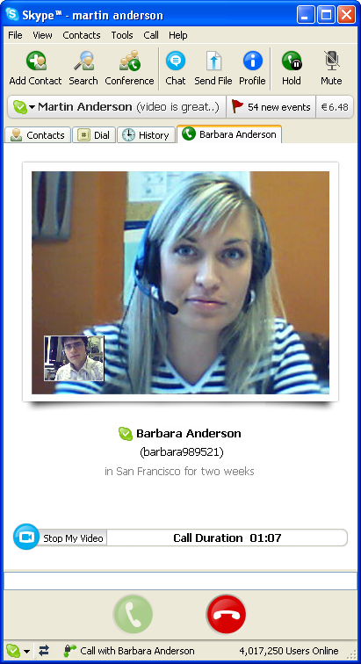

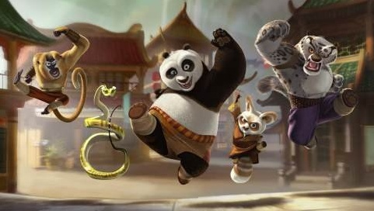
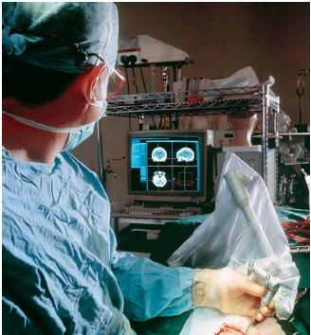
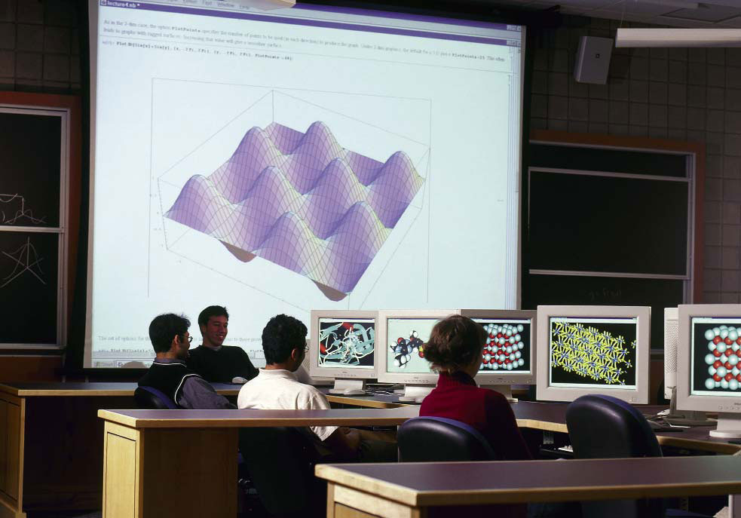
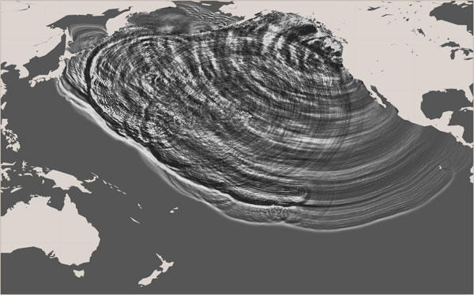
Computers Change Our Life
8

Slide 9
What Is a Computer?
"An automatic electronic device for performing mathematical or logical operations" - from Oxford English Dictionary
"A device that receives, processes, and presents information." - from Science and Technology Encyclopedia
"A computer is a machine designed for manipulating data according to a list of instructions known as a program." - from Wikipedia
"Programmable machine that can store, retrieve, and process data." - from Encyclopædia Britannica (大英百科全书)
Notes:
Different definitions from different perspectives
Is iphone a computer?

Slide 10
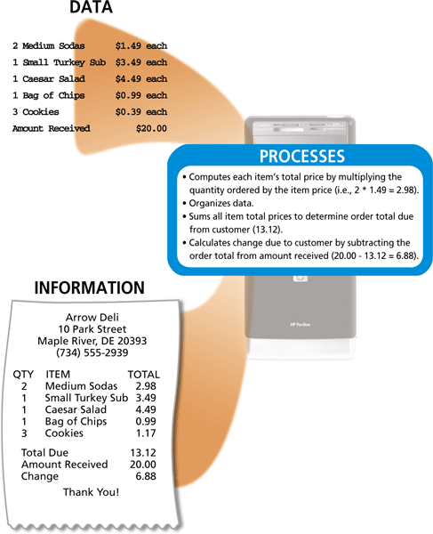
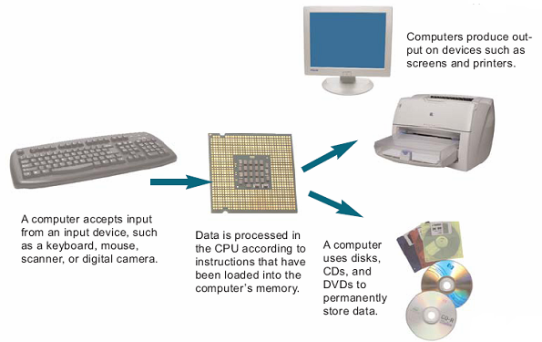
What Is a Computer?
Speed + Stupidity
A computer is a multipurpose device that takes input, processes data, stores data, and produces output, according to a series of stored instructions
Notes:
Stored instructions: program

Slide 11
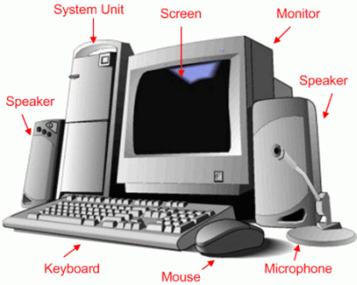
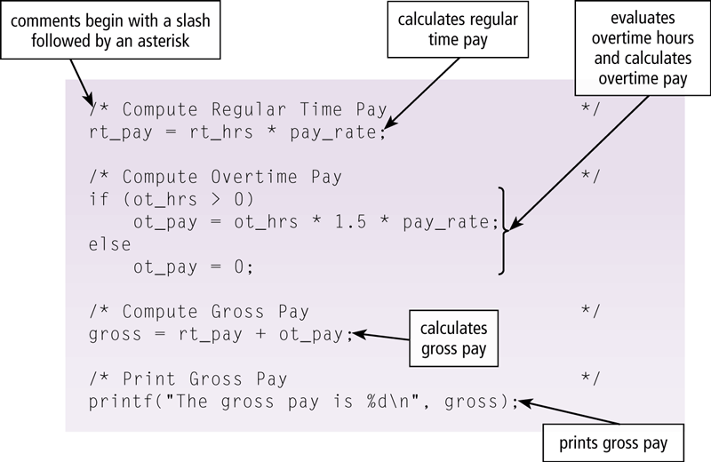
Components of a Computer
Hardware - the physical components of a computer
Software - a set of instructions that tells the computer what to do (program)
  System unit
  Peripherals
  Input
  Processing
  Storage
  Output
  Communication
Notes:
A computer consists of hardware and software

Slide 12
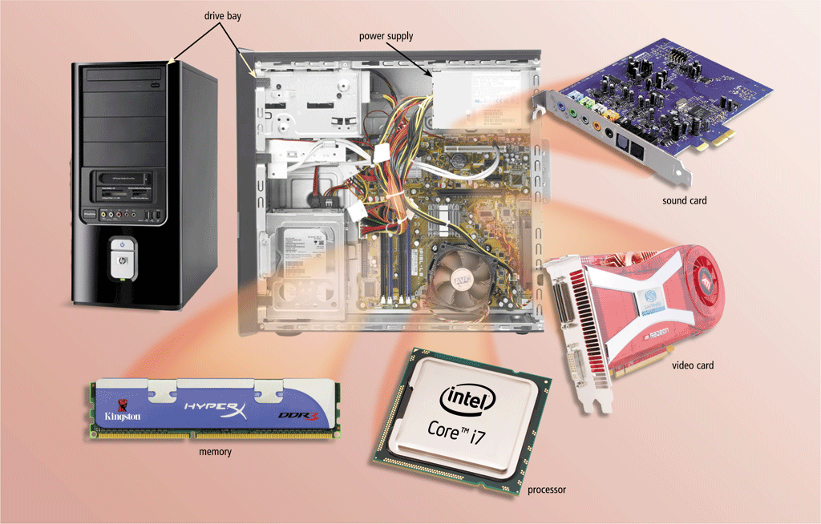
System Unit (1)
Notes:
Click the “howstuffworks” link of 2nd page, “ultimate hardware video” -> “CPU” (3 min)

Slide 13
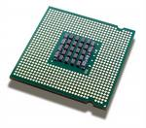
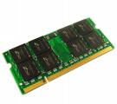
System Unit (2)
System unit - the case containing electronic components used to process data
  Central processing unit (CPU or processor)
    "The brain of the computer"
    Carry out the instructions that operate the computer
  Memory
    Temporarily stores instructions waiting to be executed and data needed by those instructions
    CPU uses memory for instant access to information
  Hard Disk
    Stores a large volume of information
    Serves as a longer-term storage device
  Motherboard, CD-ROM/DVD drive, adapter cards, ports …
Notes:
Why CPU cannot access disk directly & execute instructions?

Slide 14
Peripherals (I)
A peripheral device is any piece of hardware attached to a computer (external device)
  Input devices - hardware used to enter data and instructions
    E.g.,
  Output devices - hardware that conveys information to users
    E.g.,
  Storage devices - hardware holds data and instructions for future use
    E.g.,
  Communication devices - hardware enable a computer to send and receive information from other computers/devices
    E.g.,
Notes:
E.g. ?

Slide 15
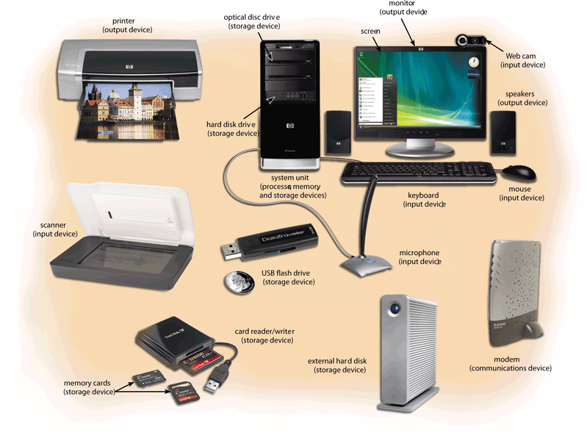
Peripherals (II)
15
Notes:
15

Slide 16
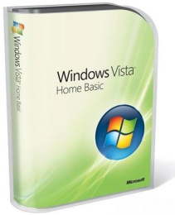

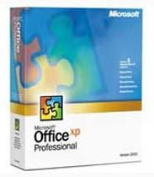
Software
CPU is controlled by software - instructions that tell it what to do
System software
  Programs that control or maintain the operations of the computer and its devices
    Including the operating system (OS), which is a set of programs that coordinates all activities among computer hardware devices and allows uses to run other software
Application software
  Programs that perform specific tasks for users, including
    Word processing, Web browser, media player, games, …
Notes:
OS: a computer without OS is just a piece of metal, cannot be used. It is the OS that presents the user interface. Basically, when u turn-on the power until u see the interface, it’s all done by OS; after that, u use applications.
Almost all the icons on your desktop are application s/w.

Slide 17
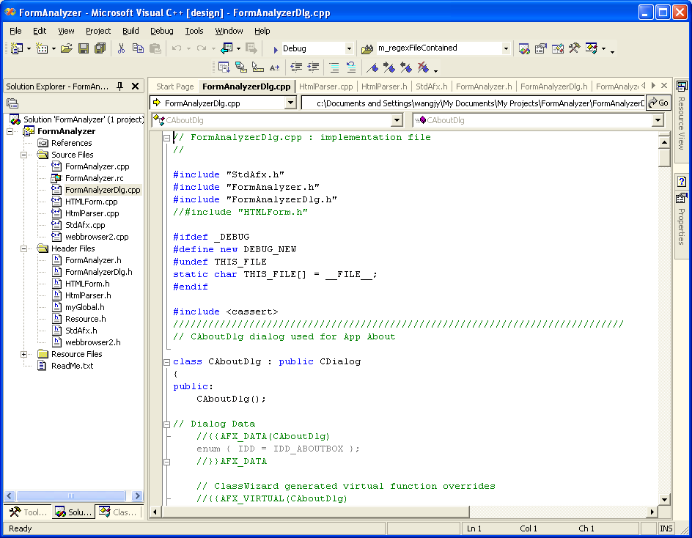
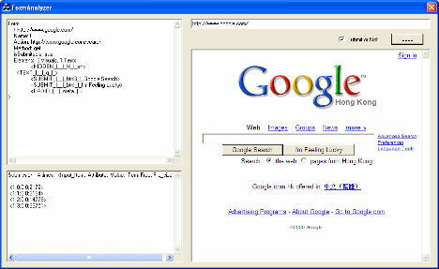
Computer Programming
What is computer programming?
  Process of creating software (writing instructions to direct computers process data)
Programming in C++
Running Application

Slide 18
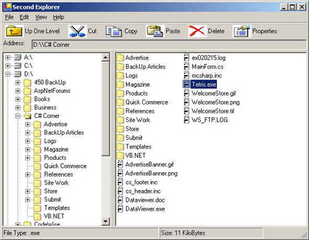
Documents and Files
Files have two types: Applications (called program files) and Documents (called data files)
  Applications contain instructions that can be executed by the computer
    Sometimes called executable files
  Documents contain passive data rather than instructions
    Sometimes called data files

Slide 19
File Management In PCs
In Windows, a file is represented by a name and an icon
  Extension - a string of (usually) three characters
    Follows a period (.) at the end of file name
    Gives more information about the file's origin or use
  Files can be organized into collections using folders (directories)
    The operating system (OS) allows you to do:
      Create folders
      Give them meaningful names
      and store files inside them
    Folders can be organized hierarchically - a folder can contain other folders
Notes:
A major part of OS is file management (OS is for resource management, resources are CPU, memory, disk).
Show “windows explorer” about tree-structure of folders /sub-folders / files in window

Slide 20
File Path
A path is the general form of a file or directory name, giving a file's name and its unique location in a computer system
  A full path or absolute path is a path that points to the same location on one file system regardless of the working directory. It is usually written in reference to a root directory
    E.g., C:\WP\Data\Myfile.txt
  A relative path is a path relative to the current working directory, so the full absolute path may not need to be given
    Files in the same working directory are listed without any preceding slashes
    A single dot (“.”) refers to the current directory
    Double dots (“..”) refer to the parent directory
    To refer to a location which is more than one directory level up, use a combination of double dots
Drive letter
Subfolder
Extension
Folder
Filename
20
Notes:
20
OS has two interfaces: text and graphical (also called Window)
Show pc console: start-all programs-accessories-Command Prompt (or in startup prompt, search “Command Prompt”), it’s DOS environment: dir, cd: Have a window folders at side to compare with DOS dir!!!
ipconfig
Some more commands: ping www.cityu.edu.hk (to see if your pc is still connecting to www.cityu)
> route print (show the local routing table)
Use Command-Prompt to show directory files in text, and at same time, use window explorer to show files (graphic interface)

Slide 21
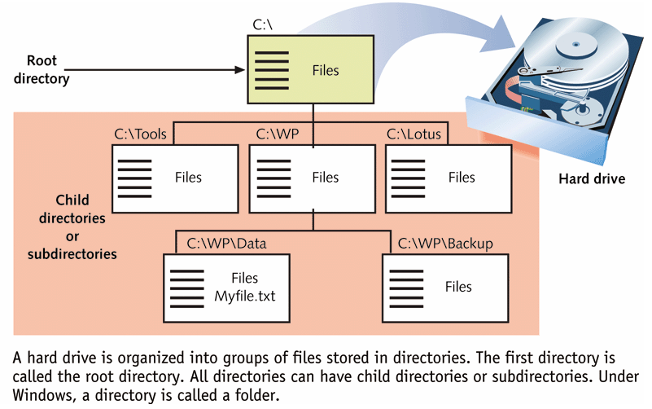
File Path Example
Question:
1) what is the absolute path of Myfile.txt file?
2) Suppose you are now in C:\WP\Backup (i.e., it is your working directory), what is the relative path of Myfile.txt file?
Notes:
See Fig.
Answer two questions

Slide 22
Categories of Computers
What are the categories of computers nowadays?
  Super-computers
  Mainframes
  Servers
  Personal computers
  Mobile computers and mobile devices
  Embedded computers
Notes:
?what is the first computer in the history
1946: ENIAC (Electronic Numerical Integrator And Computer), ENIAC was designed to calculate artillery firing tables for the United States Army's Research Laboratory.

Slide 23
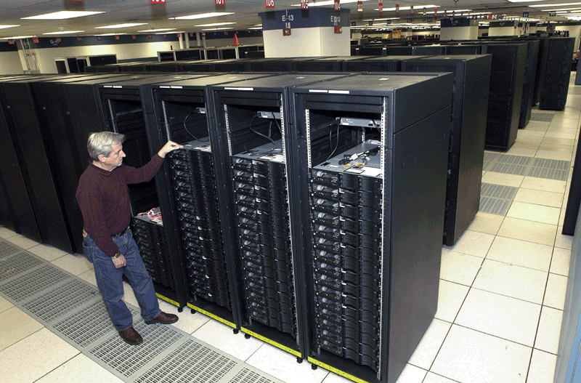
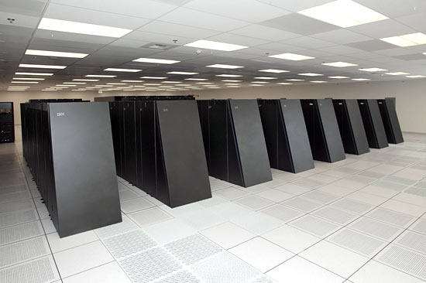
Supercomputers
Supercomputers
  The fastest, most powerful, most expensive computers at the time of its construction
  Used for specialized application that require huge amounts of mathematical calculations such as weather maps, construction of atom bombs, finding oil, earthquake prediction, etc.
  Example:
    http://www.top500.org/
    http://www.graph500.org/
Notes:
Serve one user and intensively compute one giant-task, to finish it as fast as possible.
See top 500: http://www.top500.org/, list-scroll down, top10, China tianhe-2; note: chips are Intel, so what’s the deal? interconnections and architectures!
Graph500 are more practical, benchmark for solving real problems; note: the gap between the top2 and rest
Super-computers are mostly used by defense dept, government research institutes, etc, but for business use →

Slide 24
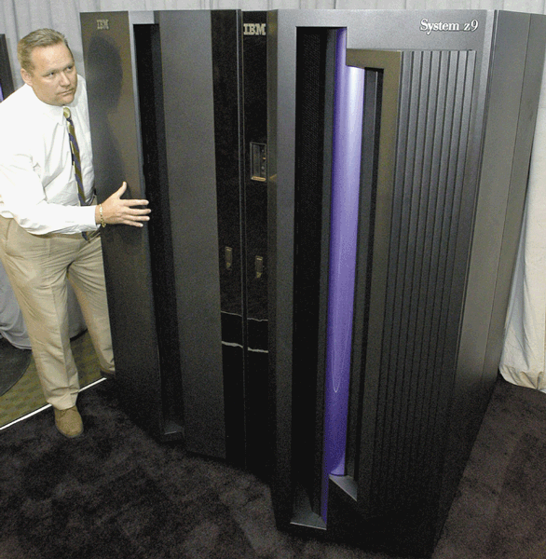
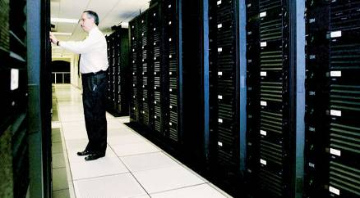
Mainframes
Mainframes
  Very large and expensive computers capable of supporting thousands users at the same time
  Used by large organizations, such as banks and airlines, for big computing jobs
24
Notes:
For timesharing use: server multi-tasks for multi-users
1952: the first general commercial use computer: International Business Machines (IBM) 701 EDPM Computer
1953: The first high level programming language: FORTRAN (The IBM Mathematical Formula Translating System) by IBM. Fortran is probably the oldest programming language, which is still widely used. The latest version is Fortran08.

Slide 25
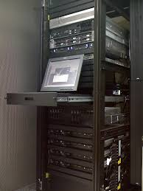
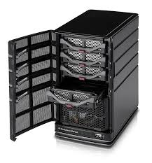
Servers
A server controls access to the hardware, software, and other resources on a network
  Provides a centralized storage area for programs, data, and information
  Some servers are mainframes

Slide 26
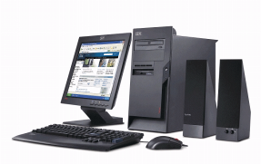
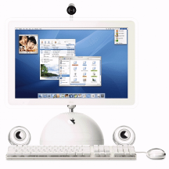
Personal Computers
PC (IBM) and compatibles use the Microsoft Windows OS
Personal computers (PCs)
  A type of computers whose price, size, and capabilities make it suitable for personal usage
  Two most popular kinds
    PC-compatible or simply PC which often use a Windows operating system
    Apple (Macintosh) use Apple iOS operating system
Apple Macintosh uses iOS
Notes:
Mainframe machines are too expensive, too big to move. In 1970s, people in silicon valley started to think how to low down the cost of computers so that small business, shops, even home can use them. It comes to the development of microprocessors.
The real boom of PCs attributed to two young college students in silicon valley in early 1980s (1983), Steve Jobs and Steve Woz. They started to build their first PC in their garage, named Apple!
Soon IBM also stepped into PC business, made IBM PCs, its OS -> DOS (same command set as command-prompt).
MicrosoftWindows OS is later story (Bill Gates developed window systems for IBM).
??? What’s the next?

Slide 27
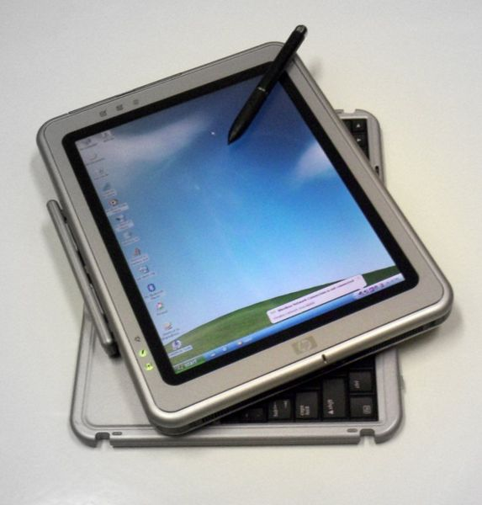
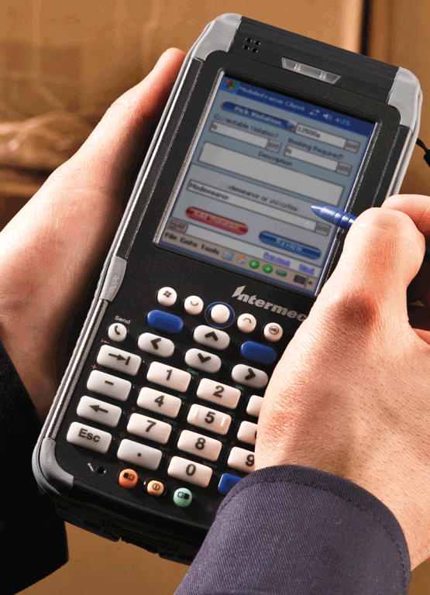
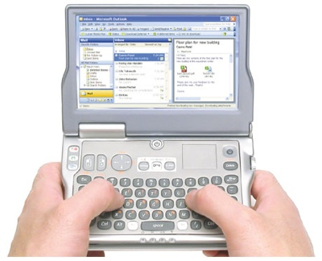
Portable Computers and Mobile Devices
Mobile computers
  Personal computer that you can carry
  from place to place
  Portable, small enough to fit on your lap (laptop)
  Examples include notebook computers, laptop computers, netbooks, and tablets
Mobile devices
  Small enough to hold in your hand
  Examples include smart phones, e-book readers, handheld computers and PDAs
Notes:
Smart phones are quickly taking over PCs as the No.1 devices for internet access.

Slide 28
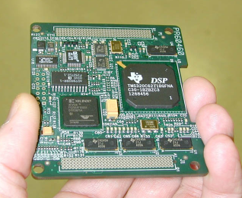
Embedded Computers
Embedded computers
  A special-purpose computer that functions as a component in a larger product
  The computer is completely encapsulated by the device it controls
  Examples of embedded systems
    Automatic Teller Machines (ATMs)
    Airplanes, automobiles
    Printers, copy machines, fax machines
    Microwave ovens, washing machines
    Videogame consoles, DVD players, mp3 players
    …
Notes:
Robots, Cameras, lift, etc.

Slide 29
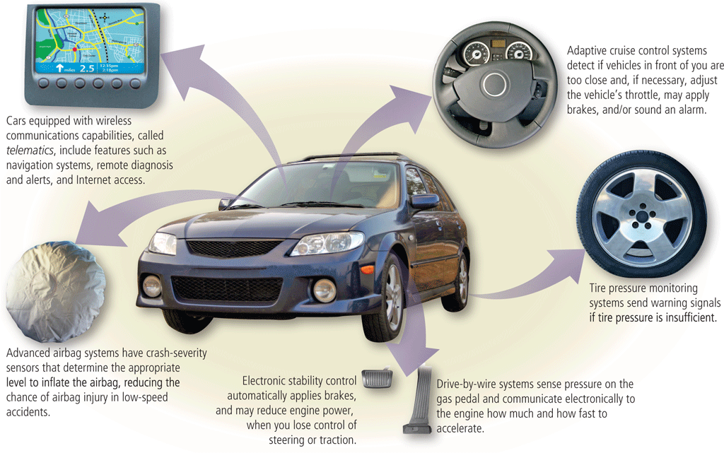
Embedded Computers

Slide 30
Computer Networks
Computer communications are
  The process by which two or more computers or devices
  transfer data, instructions, and information
Computers can be connected to a network
  A collection of computers and devices connected via
  communications devices and transmission media
  Devices include modem, network card, wireless card, …
  Transmission media include cables, telephone lines, wireless
  radio, satellites
Network can be connected to other networks
The Internet - worldwide collection of interconnected networks
  United yet autonomous: each organization on the Internet is responsible only for maintaining its own network
Notes:
In old days, computers are standalone. Purpose of communication at that time: transfer data, emails
Internet was developed in 1960s, initiated by Darpa (Defense Advance Research Project Agency).
It was first put into use in 1969, it’s called ARPANET.

Slide 31
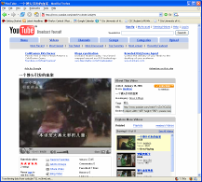
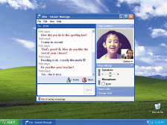
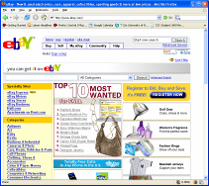
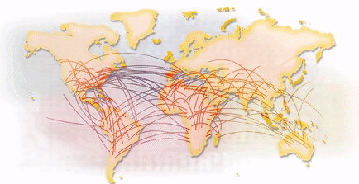
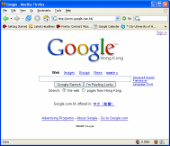
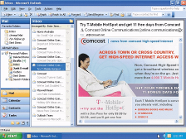
The Internet
Using the Internet, you can:
List Internet services you use. How often do you use them? Can you recall when you first used each service?
Notes:
?Answer questions?

Slide 32
World Wide Web
World Wide Web (WWW) is a most popular service on the Internet
  Made up of millions of interlinked documents called hypertexts or Web pages
  Web pages are usually written in HTML (hypertext markup language)
  Web pages are viewed via a simple point-and-click program called Web browser
  Using a Web browser, you can jump from one Web page to another by clicking hyperlinks (often called just links)
  A collection of related pages and graphics stored on the same computer is called a Web site; the server program that runs on the web-site to serve web-requests is called a Web server
  Each Web page has a unique address
    Referred to as a URL (Uniform Resource Locator)
Notes:
Before www, internet was far less popular as nowadays. The internet was used mainly for email / file-transfer (FTP).
1989: the 1st web system was developed by a group of researchers in physics at CERN (European Nuclear Research Center) in 89. The birth year of WWW is 1989.
1993: the 1st graphical web browser Mosaic was released in Feb 1993 (by NCSA). This’s more like the IE/Chrome nowadays.
Show my webpage, view source, explain hypertext/html/hyperlinks/website/webserver….

Slide 33
What is a URL ?
URL is the unique address for a Web page
http://www.cityu.edu.hk/cityu/student/index.htm
Protocol for Web pages
Domain Name
Path
Page File
Notes:
Domain-name -> machine name, notice this… there’re many phishing websites…

Slide 34
How WWW Works ?
The Web works as a client-server system
  Your computer is the client
  The remote computers that store the Web pages are the servers
1. Your browser connects to a server and requests a page (HTTP cmd)
2. The server sends back the requested page
Your machine running a Web browser
Server machine running a Web server host program
Question: is server a type of computers like mainframes and PC?
Notes:
HTTP protocol: two commands: GET / POST
? See question? Web server could be a giant cloud, or a small PC
(can you make your iphone as a web-server? Possibly not, bcs it doesn’t have an fixed IP addr)

Slide 35
E-mail Basics (I)
Short for "electronic-mail", one of the original services on the Internet
When you sign up for an e-mail account, you receive:
  A user name (sometimes called a login name or alias)
  A storage area for messages (usually called a mailbox)
An Email address is in the format of
  UserName@DomainName
  e.g., jia@cs.cityu.edu.hk
  jia@cityu.edu.hk
  jia@gmail.com

Slide 36
E-mail Basics (II)
Any user can send a mail message to anyone, regardless of whether the recipient is currently logged in — connected to the network
  The message will be waiting in the recipient’s inbox the next time he or she launches his or her e-mail program and logs in
  An e-mail message can be addressed to one person or hundreds of people
  Messages can consist of simple text or can contain attachments, such as documents, graphics, or audio/video clips
Notes:
SMTP/POP servers

Slide 37
How Emails Work ?
Emails work also in a client-server system
To: bob@b.org
From: alice@a.org
Subject: Meeting
Dear Bob, …
To: bob@b.org
From: alice@a.org
Subject: Meeting
Dear Bob, …
Alice's PC runs an email client, e.g., outlooks
Bob's machine running an email client program
1. Client A sends the email to server A by SMTP
3. Client B fetches the email from server B by POP
2. Server A sends the email to server B (SMTP)
A organization's server machine running an email server program
B organization's server machine running an Email server program
Notes:
SMTP/POP/IMAP (Post Office Protocol). SMTP is for send/receive emails, but POP is like a mailbox, which specifies where mails should be delivered to and where it stays until the recipient comes to read them. POP or IMAP (internet mail access protocol) is used by a local email client (e.g. outlook) to retrieve emails from a mail-server. The port number for POP3 (version 3) is 110 (port # for POP2 is 109).
cityU mail-service has 3 servers: SMTP, POP3 and IMAP. They are different programs and can run in one of different machines.
The difference between POP3 and IMAP is that POP3 retrieve all mails from server to the client-side when the user reads mails, but IMAP only transmit the email-headers and retrieve actual email when the user chooses to read it. All emails are stored in server. IMAP is getting more popular as cloud email systems and client using mobile (iphone) to read emails.

Slide 38
Internet Security Basics
The Internet can be a dangerous place. Once you connect a computer to the Internet, you have risk that your system will be damaged in some way
What risks are you facing ?
  Virus
  Phishing website
How can you protect yourself?
  For virus, a) no open “.exe” files attached to emails; b) no download S/W from untrusted website; c) keep anti-virus S/W upto date
  For phishing websites: a) check domain name in URL; b) no use of untrusted URL links
Notes:
Risks: virus attached to 1) email, 2) downloaded files,
Solutions: 1) not open exe files; 2) don’t download untrusted s/w; 3) use anti-virus software and keep it upto date (why keep it upto date?);
Phishing sites: check DNS (a demo of a phishing email).

Slide 39
Lesson Summary
Computers come in a variety of shapes and sizes, but they’re all made up of two things—the physical parts of the computer, called hardware, and the software instructions that tell the hardware what to do
A computer’s operating system software takes care of details of the computer’s operation; application software provides specific tools for computer users
Computers can be networked to other computers using cables, wireless radio, or other means
The Internet is a global network of computer networks used for education, commerce, and communication

Slide 40
Lesson Summary
The most popular Internet activities are exploring the World Wide Web and communicating with electronic mail
The Web World Wide works as a client-server system, and hyperlinks "glue" the whole Web together
Electronic mails also work in a client-server system
Access to the Internet is not without risks; Internet users must be prepared to deal with unsolicited e-mail, computer viruses, identity theft, and other risks. Ways to protect computer security include restricting access, encrypting data, installing firewall and anti-virus programs and regularly upgrading the system and backing-up data.

Slide 41
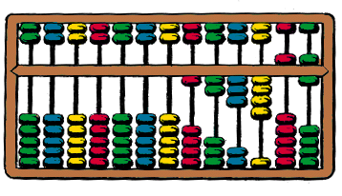
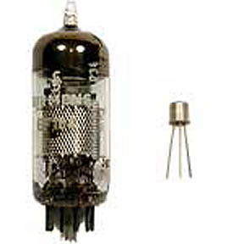

Machine Evolution
Manual calculator: before 16th century
  E.g., abacus, slide rule
Mechanical calculator: 16th to 18th century
  E.g., difference engine by Charles Babbage
First generation of computers: 1930s to mid-1950s
  Vacuum tubes
Second generation: mid to late-1950s
  Transistors
Third generation: late-1950s to early-1970s
  Integrated circuits
Fourth generation: early-1970s to present
  Microprocessor
Fifth generation ?

Slide 42
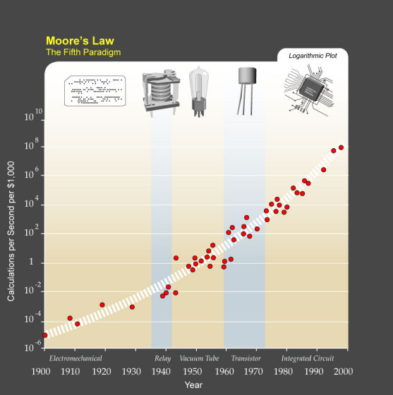
Moore's Law
Empirical observation made by Gordon Moore in 1965
  Original prediction: the number of transistors on an integrated circuit for minimum component cost doubles every 24 months
  Now it is widely associated with the claim that computing power at fixed cost is doubling every 18 months

