Slide 1
Empirical Study of Redo and Undo Logging in Persistent Memory
Hu Wan¹ Youyou Lu² Yuanchao Xu^{1,3} Jiwu Shu²
¹Capital Normal University, China
²Tsinghua University, China
³Institute of Computing Technology, CAS, China
The 5th Non-Volatile Memory Systems and Applications Symposium (NVMSA 2016)

Slide 2
Outline
Background and Motivation
Experimental Methodology
Experimental Results and Analysis
Conclusion

Slide 3

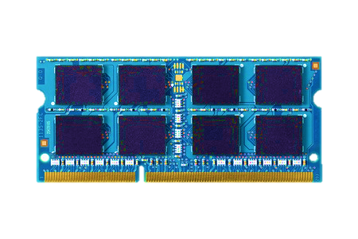
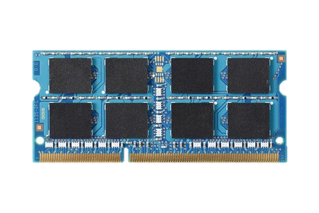


Persistent memory
CPU
Volatile
Volatile
MEMORY
Load/Store
Persistent
DRAM
Load/Store
File I/O
NVM
STORAGE
Persistent
Provides DRAM-like performance and disk-like persistency.
Can replace both DRAM and disk to build a single level system
  Byte addressable (load/store) rather than block addressable (read/write)

Slide 4

Power failure
Application's data is not consistent after random failures

Slide 5
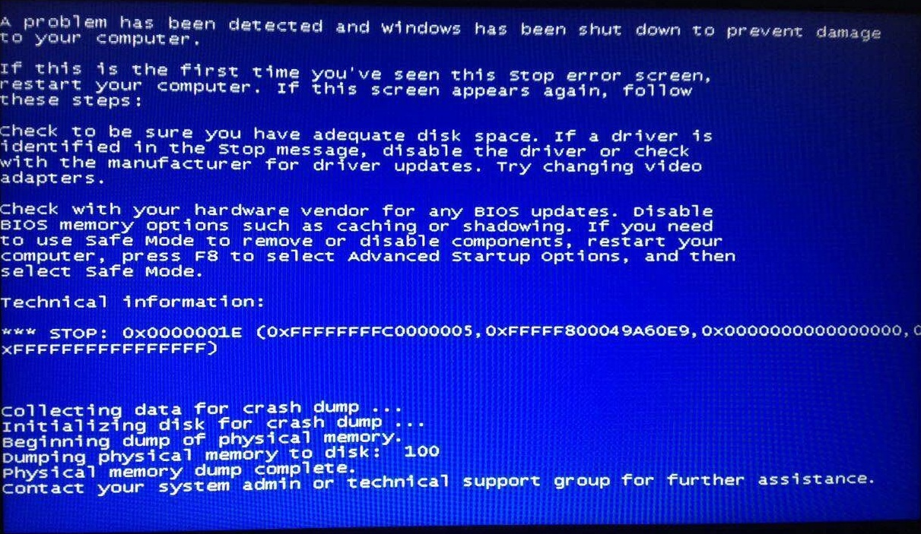
System crash
Application's data is not consistent after random failures

Slide 6

Challenges
Ensuring application data can be correctly recovered in the event of a sudden power loss or system crash.
Crash Consistency
CPU
Volatile
V
Challenges:
persistent ordering constraints
Only data in NVM survives
Transient data does not survive
Write-back caching reorders writes to NVM→Reordering breaks recovery
Cache flush instruction is too slow for flushing multiple cachelines.
D₁
D₀
PM
Load/Store
NVM
D₁
D₀
Persistent
V
STORE data[0] = 0xFOOD
STORE data[1] = 0xBEEF
STORE valid = 1

Slide 7
Persistent programming models
Transaction: provide a construct that atomically updates PM
atomic{
R.value=0xC0F;
R.Valid = 1;
}
begin_transaction(); stm_store(&R.value, 0xC0F); stm_store(&R.valid, 1); commit_transaction();
CPU Cache
C'
B'
A'
A
B
C
A'
B'
C'
Persistent Memory
A
B
C
A'
B'
C'
Data
Log
Source: Youyou Lu, Jiwu Shu, and Long Sun. "Blurred persistence in transactional persistent memory." MSST, 2015.

Slide 8
Persistent programming models
Transaction: provide a construct that atomically updates PM
atomic{
R.value=0xC0F;
R.Valid = 1;
}
begin_transaction(); stm_store(&R.value, 0xC0F); stm_store(&R.valid, 1); commit_transaction();
CPU Cache
3
2
C'
B'
A'
A
B
C
A'
B'
C'
5
1
6
4
Persistent Memory
A
B
C
A'
B'
C'
Data
Log
Source: Youyou Lu, Jiwu Shu, and Long Sun. "Blurred persistence in transactional persistent memory." MSST, 2015.

Slide 9
Undo Logging
A
B
C
store flush & fence persistent pending released
Time
A
A₀
A₁
A₁
DATA
B
B₀
B₁
B₁
C
C₀
C₁
C₁
LOG
A’₀
A’₀
A₀
B’₀
B’₀
B₀
C’₀
C’₀
C₀

Slide 10
Redo Logging
A
B
C
store flush & fence persistent pending released
Time
A
A₀
A₁
A₁
DATA
B
B₀
B₁
B₁
C
C₀
C₁
C₁
LOG
A’₁
A’₁
A₁
B’₁
B’₁
B₁
C’₁
C’₁
C₁

Slide 11
Related Works
Logging Methods | Redo Logging | Undo Logging
Ordering constraints on writes | ☺ [1, 2, 3, 5] | ☹ [1, 2, 3]
Overhead for read operations in a transaction | ☹ [1, 3, 6] | ☺ [1, 4, 6]
Commit/abort costs | ☹ / ☺ | ☺ / ☹
[1] S. R. Dulloor, S. Kumar, A. Keshavamurthy, P. Lantz, D. Reddy, R. Sankaran, and J. Jackson, “System software for persistent memory,” in EuroSys'14.
[2] H. Volos, A. J. Tack, and M. M. Swift, “Mnemosyne: Lightweight persistent memory,” in ASPLOS'11.
[3] D. Narayanan and O. Hodson, “Whole-system persistence,” in ASPLOS'12.
[4] A. Kolli, S. Pelley, A. Saidi, P. M. Chen, and T. F. Wenisch, “Highperformance transactions for persistent memories,” in ASPLOS'16.
[5] W.-H. Kim, J. Kim, W. Baek, B. Nam, and Y. Won, “NVWAL: Exploiting NVRAM in write-ahead logging,” in ASPLOS'16.
[6] S. Kannan, M. Qureshi, A. Gavriloska, and K. Schwan, “Energy aware persistence: Reducing the energy overheads of persistent memory,” Computer Architecture Letters.

Slide 12
Motivation
We are motivated to conduct empirical performance study and revisit the performance of redo and undo logging methods in the context of persistent memory.

Slide 13
Outline
Background and Motivation
Experimental Methodology
Experimental Results and Analysis
Conclusion

Slide 14
Experimental setup
Application
Intel Xeon® E5-2637 v3 processors
32GB DDR4 DRAM
32GB SMARTTM DDR4 NVDIMM
PM-aware FS: EXT4 w/ DAX
NVML v0.4*
Transactional object store system: libpmemobj & libpmem libraries
File I/O
Load/Store
PM Library (NVML)
User space
Kernel space
VFS
PM-aware FS
MMU mappings
Persistent Memory (NVDIMM)
* Available at https://github.com/pmem/nvml.

Slide 15
Redo & Undo Logging Implementation
Undo log transaction: original implementation in libpmemobj.
Redo log transaction: based on libpmemobj with sync and async log truncation similar to Mnemosyne [Volos et al., ASPLOS’11].
UNDO
REDO

Slide 16
Workloads
single-obj: Each transaction allocates one persistent object, and adds the same object to undo/redo log many times.
multi-obj: Each transaction allocates many persistent objects, and adds all the objects to undo/redo log.
Read/(Read+Write): 10%, 30%, 50%
Workload | Log/map entry size (byte) | # of operations
single-obj | 128::2::16384 | 1000
multi-obj | 128::2::16384 | 1000

Slide 17
Outline
Background and Motivation
Experimental Methodology
Experimental Results and Analysis
Conclusion

Slide 18
Findings
Redo logging significantly outperforms undo logging for workloads in which a transaction updates large number of different objects, while it underperforms undo logging for workloads with intensive read operations.
Observation 1
Undo logging is more sensitive to the read-to-write ratios, compared to redo logging.
Observation 2
Enabling asynchronous log truncation significantly boosts transaction performance, especially for log-heavy transactions.
Observation 3

Slide 19
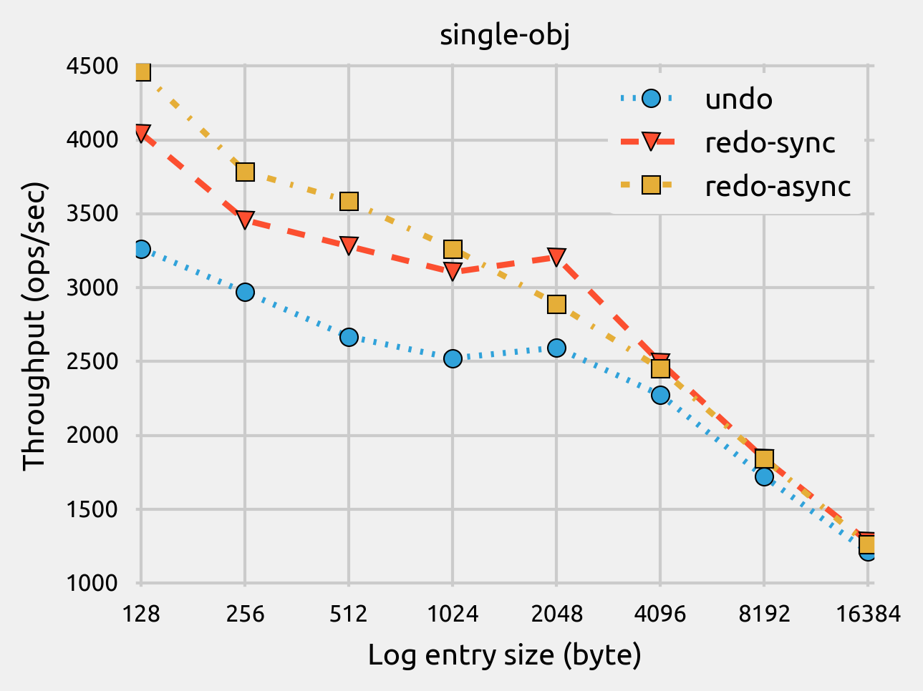
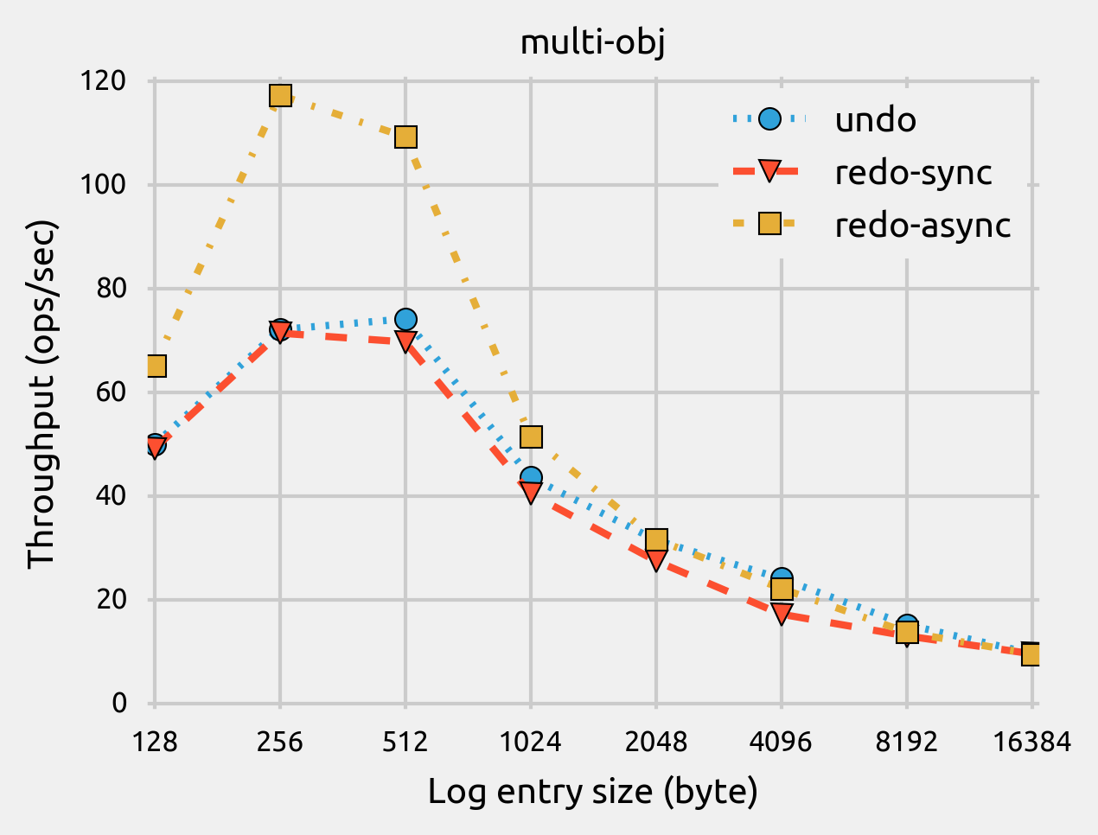
Findings
Redo logging significantly outperforms undo logging for workloads in which a transaction updates large number of different objects, while it underperforms undo logging for workloads with intensive read operations.
Observation 1
37%
17%/20%
24%
▲Throughput of single-obj and multi-obj workloads with varied log entry sizes.

Slide 20
Findings
Redo logging significantly outperforms undo logging for workloads in which a transaction updates large number of different objects, while it underperforms undo logging for workloads with intensive read operations.
Observation 1
37%
17%/20%
63%
24%
▲Throughput of single-obj and multi-obj workloads with varied log entry sizes.

Slide 21
Findings
Redo logging significantly outperforms undo logging for workloads in which a transaction updates large number of different objects, while it underperforms undo logging for workloads with intensive read operations.
Observation 1
37%
17%/20%
63%
24%
▲Throughput of single-obj and multi-obj workloads with varied log entry sizes.

Slide 22
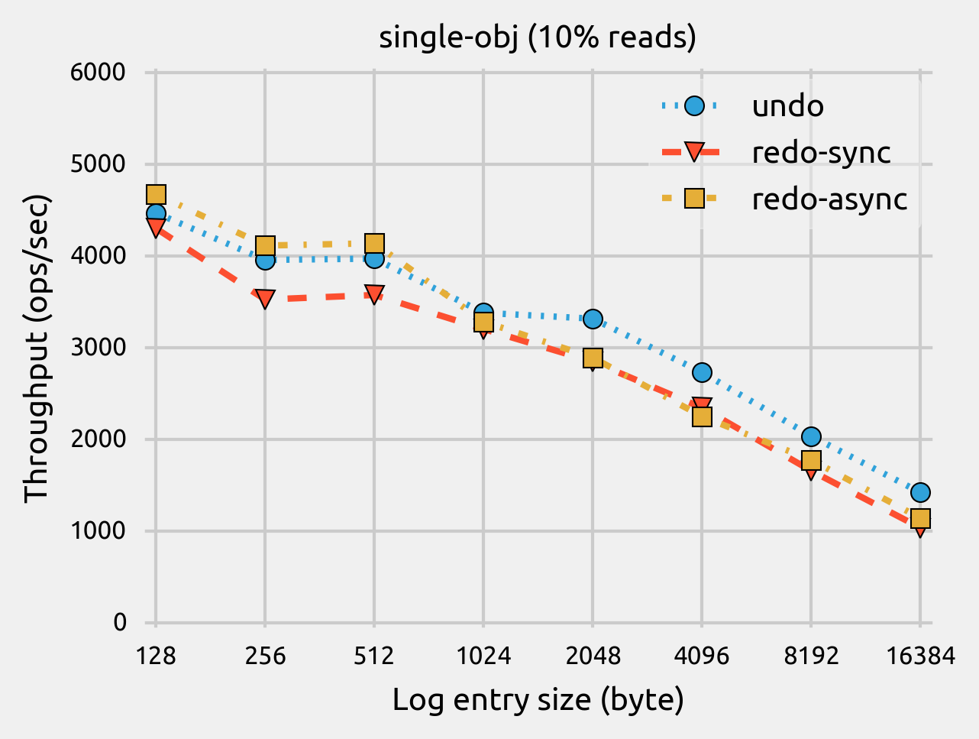
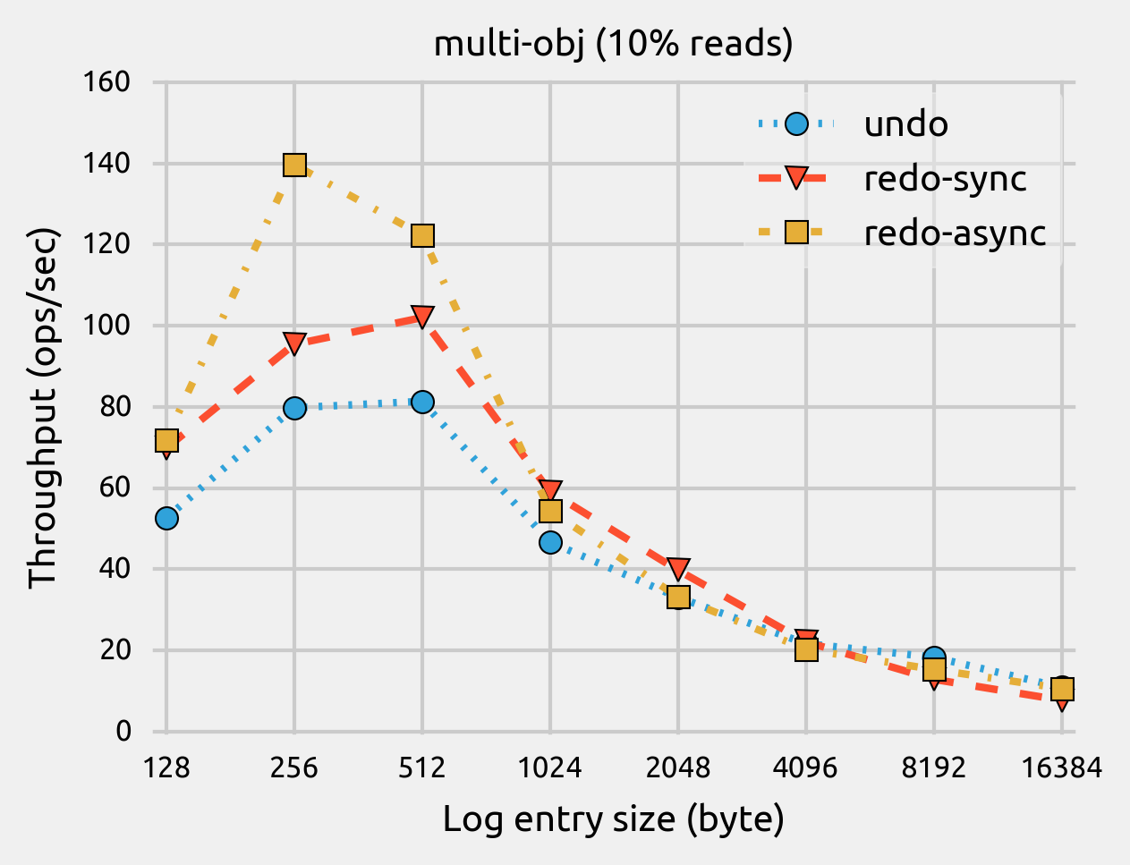
Findings
Redo logging significantly outperforms undo logging for workloads in which a transaction updates large number of different objects, while it underperforms undo logging for workloads with intensive read operations.
Observation 1
▲Throughput of single-obj workload with varied log entry sizes and 10% reads.
▲Throughput of multi-obj workload with varied log entry sizes and 10% reads.

Slide 23
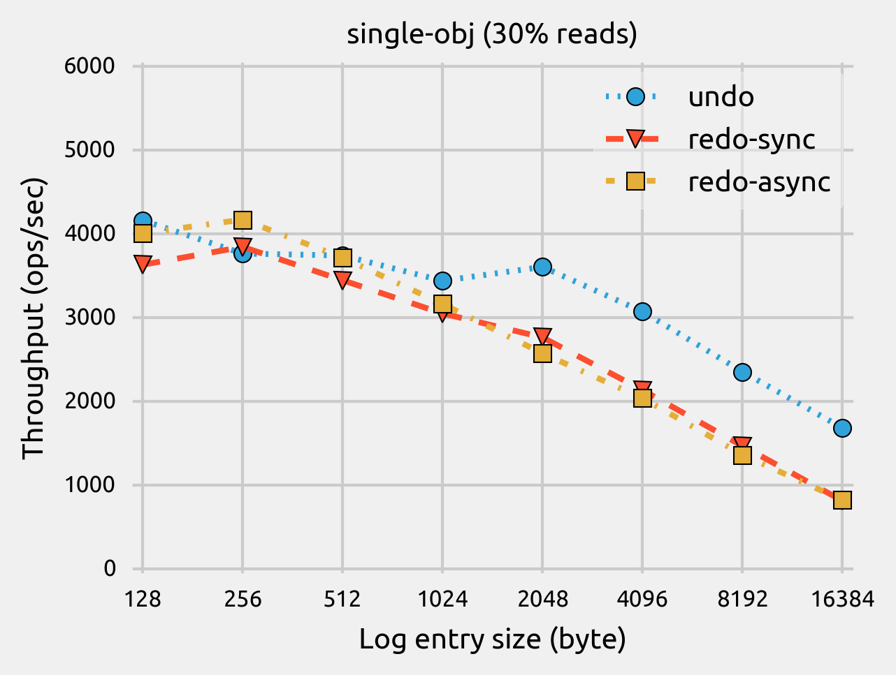
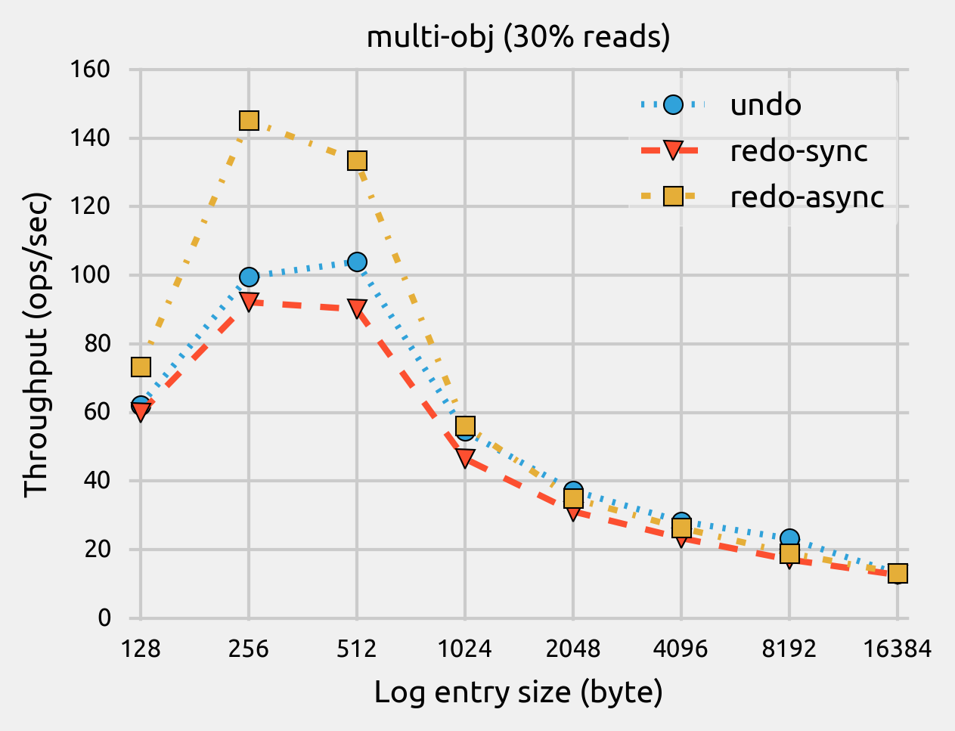
Findings
Redo logging significantly outperforms undo logging for workloads in which a transaction updates large number of different objects, while it underperforms undo logging for workloads with intensive read operations.
Observation 1
▲Throughput of single-obj workload with varied log entry sizes and 30% reads.
▲Throughput of multi-obj workload with varied log entry sizes and 30% reads.

Slide 24
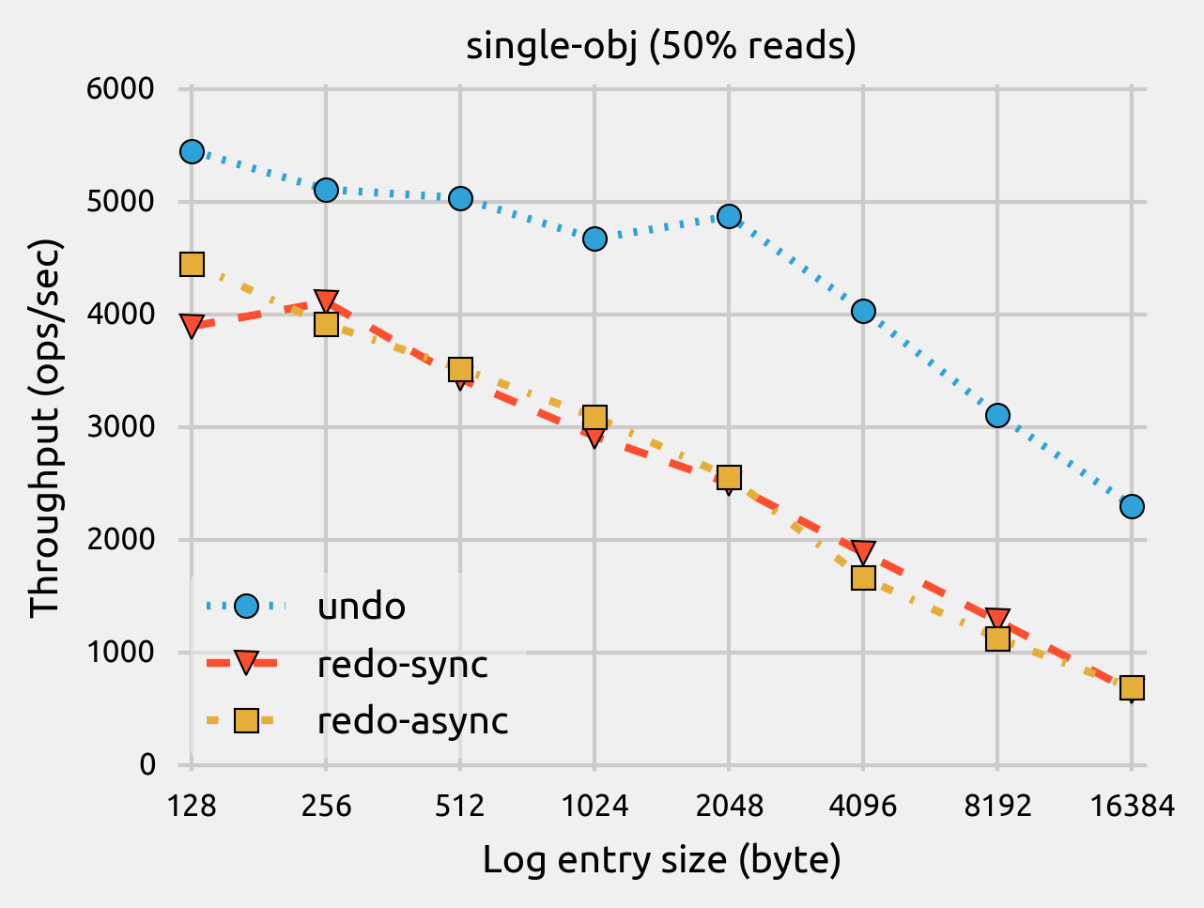
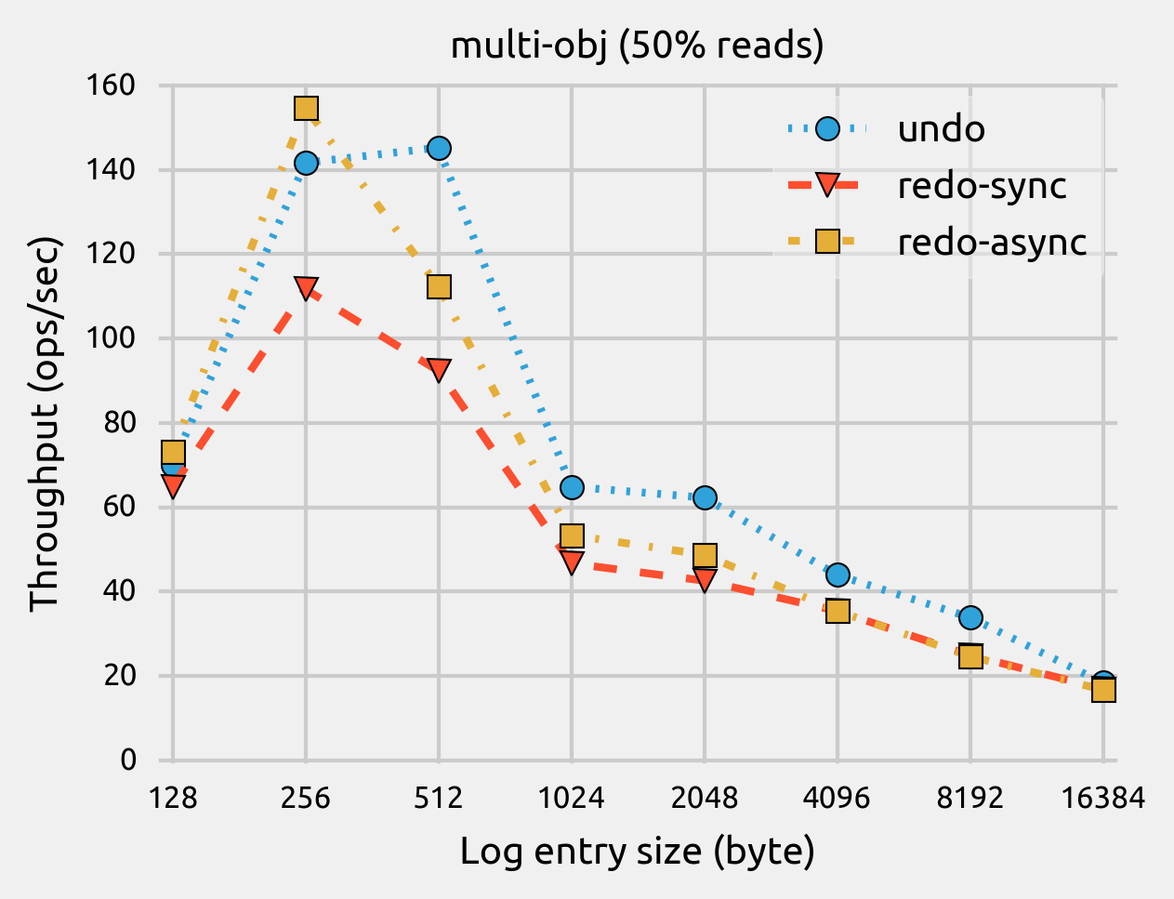
Findings
Redo logging significantly outperforms undo logging for workloads in which a transaction updates large number of different objects, while it underperforms undo logging for workloads with intensive read operations.
Observation 1
20%-252%
▲Throughput of single-obj workload with varied log entry sizes and 50% reads.
▲Throughput of multi-obj workload with varied log entry sizes and 50% reads.

Slide 25
Findings
Redo logging significantly outperforms undo logging for workloads in which a transaction updates large number of different objects, while it underperforms undo logging for workloads with intensive read operations.
Observation 1
20%-252%
▲Throughput of single-obj workload with varied log entry sizes and 50% reads.
▲Throughput of multi-obj workload with varied log entry sizes and 50% reads.

Slide 26
Findings
Redo logging significantly outperforms undo logging for workloads in which a transaction updates large number of different objects, while it underperforms undo logging for workloads with intensive read operations.
Observation 1
20%-252%
▲Throughput of single-obj workload with varied log entry sizes and 50% reads.
▲Throughput of multi-obj workload with varied log entry sizes and 50% reads.

Slide 27
Findings
Undo logging is more sensitive to the read-to-write ratios, compared to redo logging.
Observation 2
40%
▲Throughput of single-obj workload with varied log entry sizes and read-to-write ratios.
▲Throughput of multi-obj workload with varied log entry sizes and read-to-write ratios.

Slide 28
Findings
Undo logging is more sensitive to the read-to-write ratios, compared to redo logging.
Observation 2
26%/17%
▲Throughput of single-obj workload with varied log entry sizes and read-to-write ratios.
▲Throughput of multi-obj workload with varied log entry sizes and read-to-write ratios.

Slide 29
Findings
Undo logging is more sensitive to the read-to-write ratios, compared to redo logging.
Observation 2
▲Throughput of single-obj workload with varied log entry sizes and read-to-write ratios.
72%
33%/30%
▲Throughput of multi-obj workload with varied log entry sizes and read-to-write ratios.

Slide 30
Findings
Enabling asynchronous log truncation significantly boosts transaction performance, especially for log-heavy transactions.
Observation 3
38%↑
25%↑
24%↑
20%↑

Slide 31
Findings
Enabling asynchronous log truncation significantly boosts transaction performance, especially for log-heavy transactions.
Observation 3
Log entry size < 256 bytes:
  persistent memory allocator used in our study can get more performance benefits as the allocation size increases;
Log entry size > 256 bytes:
  larger allocations for new log entries make the persist overheads become relatively higher than the benefits it gains.

Slide 32
Outline
Background and Motivation
Experimental Methodology
Experimental Results and Analysis
Conclusion

Slide 33
Conclusion
Redo or undo logging are widely used mechanisms in persistent memory transaction.
Whether to use redo or undo logging in persistent memory is still in hot debate.
We empirically evaluate redo and undo in the open source NVML library.
Our study suggest “one does not fit all”.
  Redo logging significantly outperforms undo logging for workloads in which a transaction updates large number of different objects, while it underperforms undo logging for workloads with intensive read operations.
  Undo logging is more sensitive to the read-to-write ratios, while redo logging is less sensitive.
  Asynchronous log truncation is much helpful in redo logging for log-heavy transactions.

Slide 34
Empirical Study of Redo and Undo Logging in Persistent Memory
Thanks!
Hu Wan, Youyou Lu, Yuanchao Xu, and Jiwu Shu
wanhu@cnu.edu.cn

