Slide 1



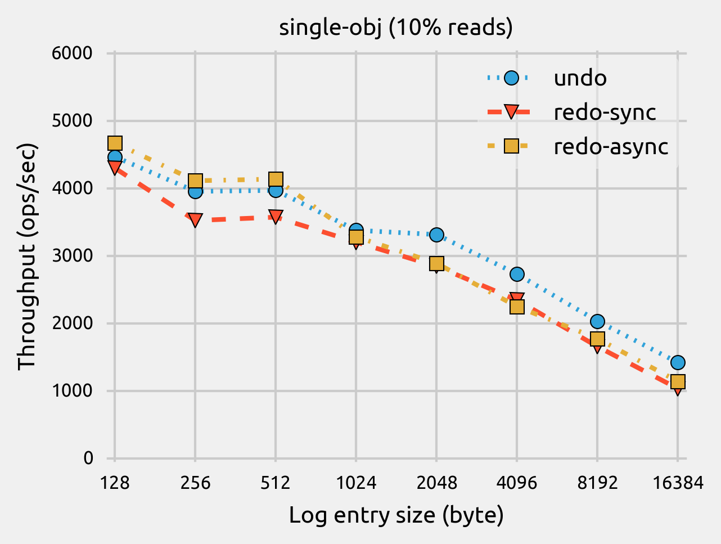
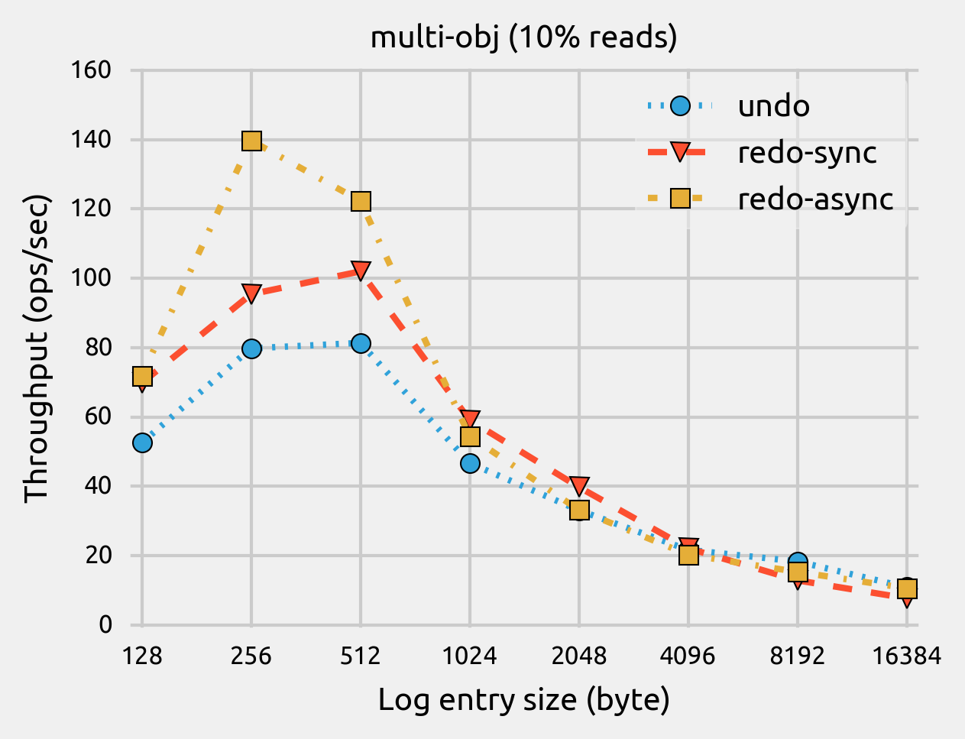
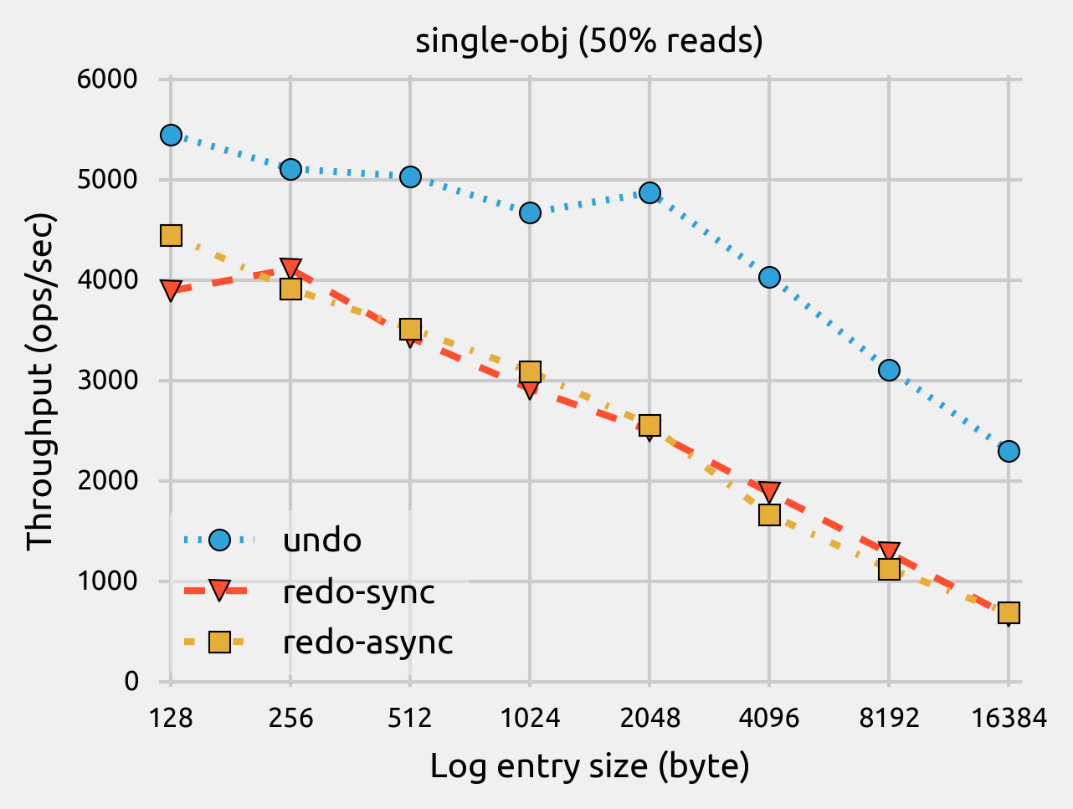
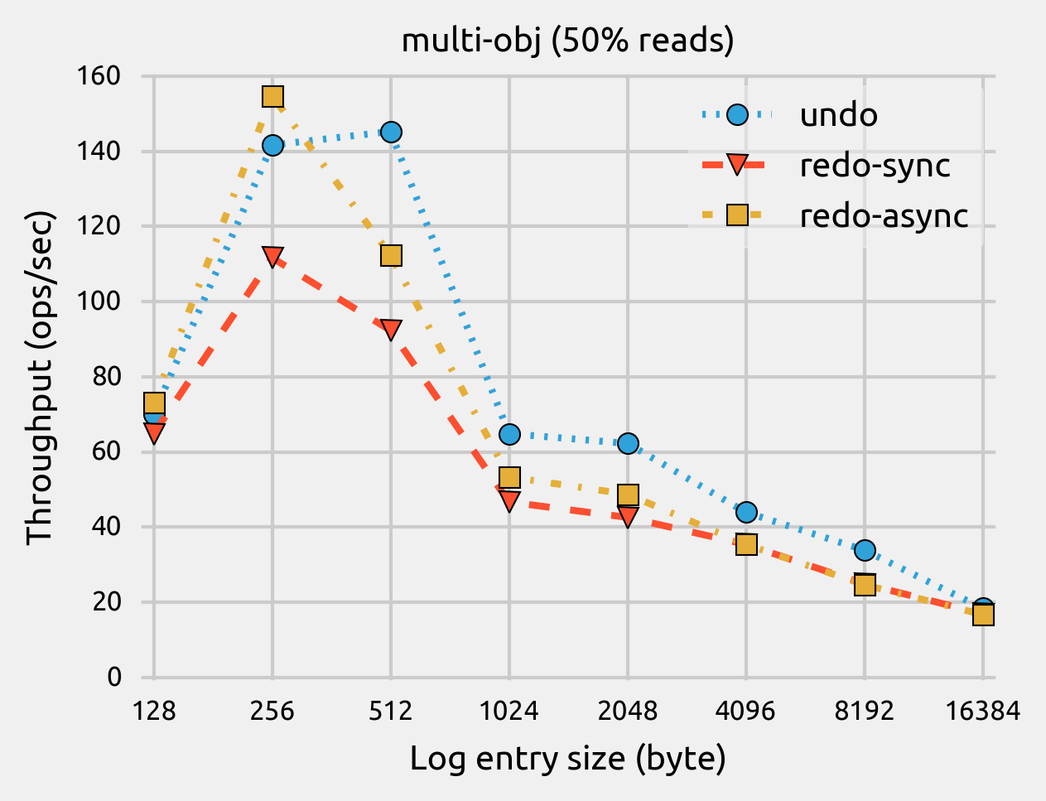
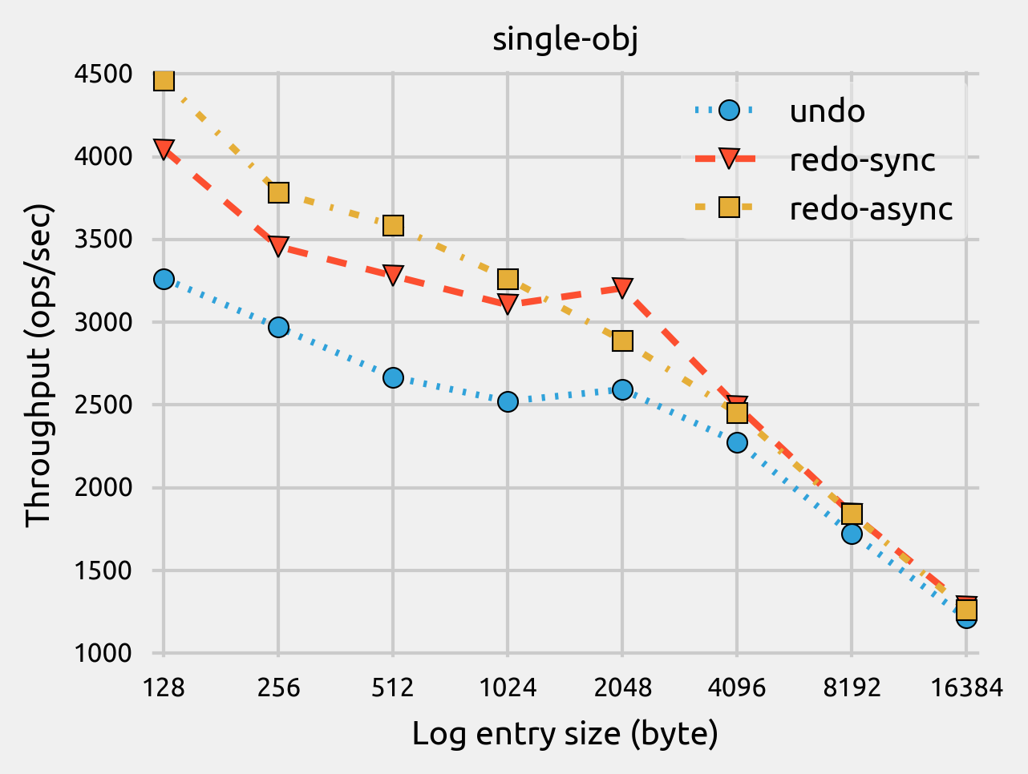
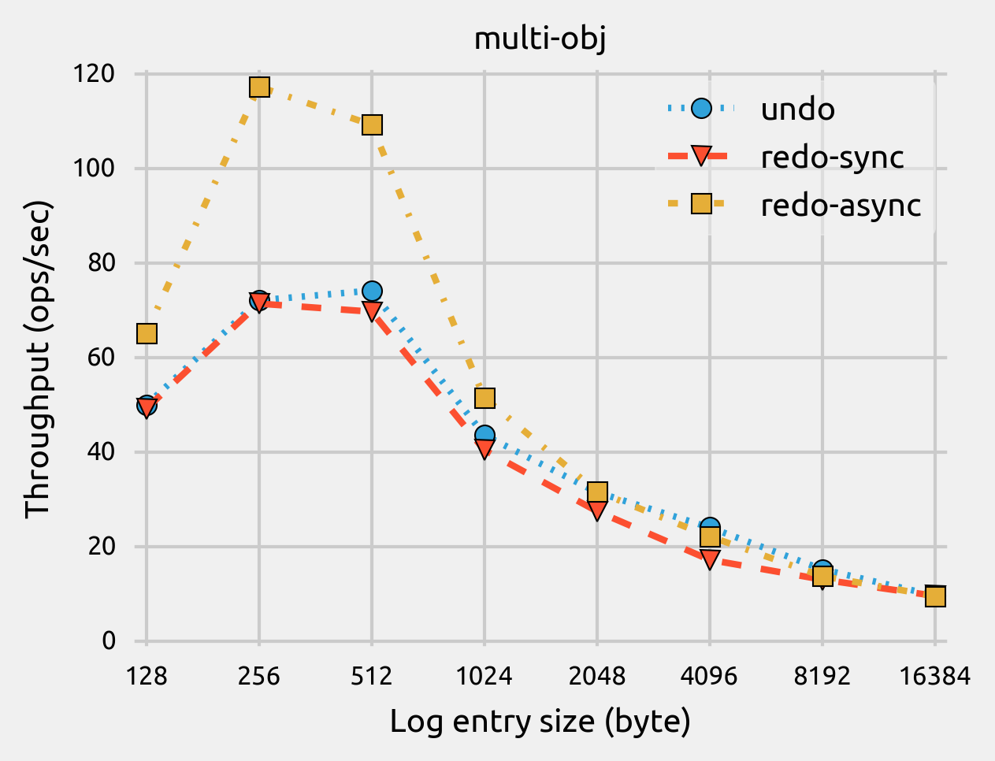
Empirical Study of Redo and Undo Logging in Persistent Memory
Hu Wan¹ Youyou Lu² Yuanchao Xu^{1,3} Jiwu Shu²
¹College of Information Engineering, Capital Normal University, Beijing, China
²Department of Computer Science and Technology, Tsinghua University, Beijing, China
³State Key Laboratory of Computer Architecture, Institute of Computing Technology, Chinese Academy of Sciences, Beijing, China
Motivation
Evaluation Approach
At the end of each trial, the correct category was revealed and the subjects recorded the accuracy of their category guess.
Observation 2
Atomic, consistent, and durable transactions are widely used to ensure the crash consistency in persistent memory.
We are motivated to conduct empirical performance study and revisit the performance of redo and undo logging methods in the context of persistent memory.
Undo logging is more sensitive to the read-to-write ratios, compared to redo logging.
Experimental Setup
Intel Xeon® E5-2637 v3 processors
32GB DDR4 DRAM
32GB SMARTTM DDR4 NVDIMM
PM-aware FS: EXT4 w/ DAX
NVML v0.4
Transactional object store system: libpmemobj & libpmem libraries
Application
File I/O
Load/Store
User space
PM Library (NVML)
VFS
Kernel space
Logging Method | Redo Logging | Undo Logging
Ordering constraints on writes | ☺ [1, 2, 3, 5] | ☹ [1, 2, 3]
Overhead for read operations in a transaction | ☹ [1, 3, 6] | ☺ [1, 4, 6]
Commit/abort cost | ☹ / ☺ | ☺ / ☹
PM-aware FS
MMU mappings
Persistent Memory (NVDIMM)
Redo & Undo Logging Implementation
Undo Logging & Redo Logging
Undo log transaction: original implementation in libpmemobj.
Redo log transaction: based on libpmemobj with sync and async log truncation similar to Mnemosyne [2].
A
B
C
store flush & fence persistent pending released
UNDO
Time
DATA
A
A₀
A₁
A₁
▲Throughput of single-obj workload with varied log entry sizes and read-to-write ratios.
▲Throughput of multi-obj workload with varied log entry sizes and read-to-write ratios.
B
B₀
B₁
B₁
C
C₀
C₁
C₁
Findings
Observation 3
Enabling asynchronous log truncation significantly boosts transaction performance, especially for log-heavy transactions.
Observation 1
LOG
A’₀
A’₀
A₀
Redo logging significantly outperforms undo logging for workloads in which a transaction updates large number of different objects, while it underperforms undo logging for workloads with intensive read operations.
B’₀
B’₀
B₀
Acknowledgments
C’₀
C’₀
C₀
Time
National Natural Science Foundation of China (61502266)
Beijing Municipal Science and Technology Commission of China (D151100000815003)
China Postdoctoral Science Foundation
State Key Laboratory of Computer Architecture (CARCH201503).
REDO
DATA
A
A₀
A₁
A₁
References
B
B₀
B₁
B₁
[1] S. R. Dulloor, S. Kumar, A. Keshavamurthy, P. Lantz, D. Reddy, R. Sankaran, and J. Jackson, “System software for persistent memory,” in EuroSys'14.
[2] H. Volos, A. J. Tack, and M. M. Swift, “Mnemosyne: Lightweight persistent memory,” in ASPLOS'11.
[3] D. Narayanan and O. Hodson, “Whole-system persistence,” in ASPLOS'12.
[4] A. Kolli, S. Pelley, A. Saidi, P. M. Chen, and T. F. Wenisch, “Highperformance transactions for persistent memories,” in ASPLOS'16.
[5] W.-H. Kim, J. Kim, W. Baek, B. Nam, and Y. Won, “NVWAL: Exploiting NVRAM in write-ahead logging,” in ASPLOS'16.
[6] S. Kannan, M. Qureshi, A. Gavriloska, and K. Schwan, “Energy aware persistence: Reducing the energy overheads of persistent memory,” Computer Architecture Letters.
C
C₀
C₁
C₁
LOG
A’₁
A’₁
A₁
B’₁
B₁
B₁
▲Throughput of single-obj and multi-obj workloads with varied log entry sizes.
C’₁
C’₁
C₁
WanHu@CNU.EDU.CN

