Slide 1
RM-SSD: In-Storage Computing for Large-Scale Recommendation Inference
Xuan Sun¹, Hu Wan¹, Qiao Li¹, Chia-Lin Yang²,
Tei-Wei Kuo^{1, 2}, and Chun Jason Xue¹
April 6, 2022
The 28th IEEE International Symposium on High-Performance Computer Architecture (HPCA-28)
¹ City University of Hong Kong
² National Taiwan University
Notes:
Hi, everyone. This is Xuan Sun from City University of Hong Kong. I will present our work:
This is a joint work between CityU and National Taiwan University.

Slide 2



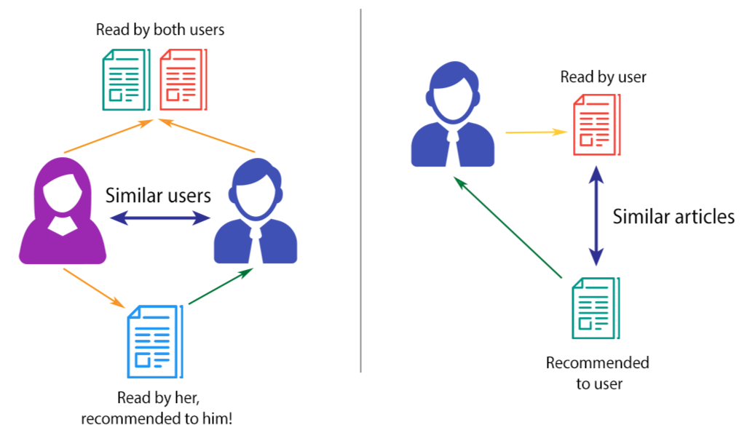



Personalized Recommendation Systems
Recommendation systems contribute:
Amazon: 35% of annual revenue¹
Netflix: 75% of all content consumed¹
Youtube: 60% of the clicks on the home screen¹
Facebook: 79% of datacenter inference cycles²
1 Dietmar Jannach and Michael Jugovac. Measuring the Business Value of Recommender Systems, Trans. Manage. Inf. Syst. 2019.
2 Gupta, et. al. The Architectural Implications of Facebook’s DNN-based Personalized Recommendation Models. HPCA 2020.
Image credit: https://towardsdatascience.com/brief-on-recommender-systems-b86a1068a4dd
Notes:
Online service providers uses Recommendation Systems to provide personalized recommendations based on users’ interests.
For example, we may easily indulge in TikTok, because it continuously recommends short videos of our interests. There’re main two types of data are used.
As we can see the left figure, the RS recommends a specific item to the similar users.
In the right figure, the RS recommends the similar item to a specific user.
Recommendation systems are playing important role for online service providers such as Amazon, Netflix, YouTube, and Facebook. As reported, Facebook spends 79% inference cycles in the datacenter.

Slide 3
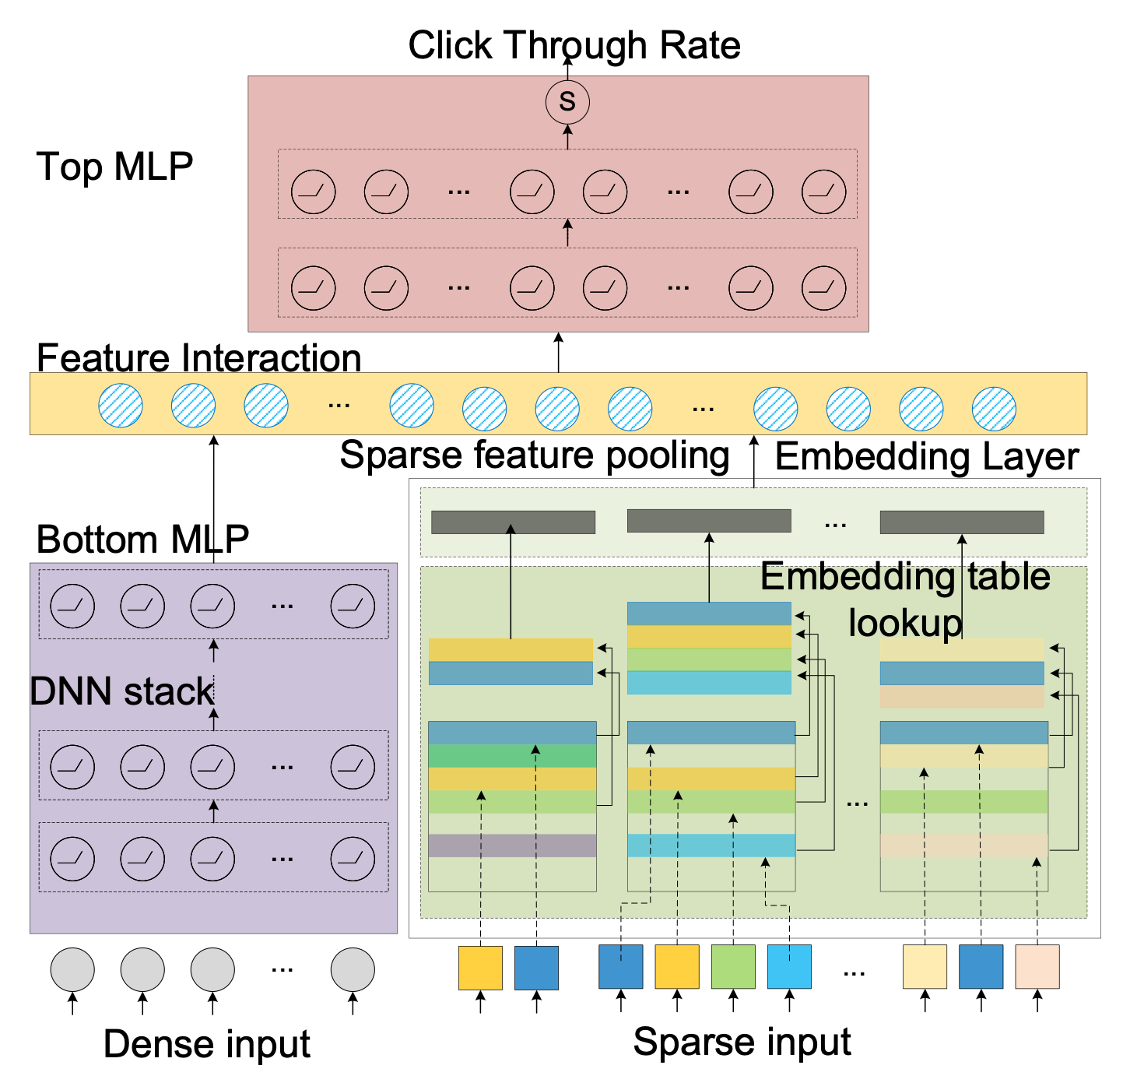
Deep Learning Recommendation Model
DLRM: Bottom MLP, Top MLP, Embedding layer, and feature interaction layer
  A typical architecture of deep learning recommendation model (DLRM).
Notes:
In recent years, DNN-based recommendation systems have received growing interests.
A typical architecture of deep learning-based recommendation model consists of bottom MLP layer, top MLP layer, embedding layer and feature interaction layers. click

Slide 4
Deep Learning Recommendation Model
Input: a collection of dense and sparse features
Output: the predicted click-through rate (CTR)
  A typical architecture of deep learning recommendation model (DLRM).
Notes:
Its inputs are a collection of dense features and sparse features. And the output is the predicted click-through rate. CTR prediction is the task of predicting the likelihood that something on a website (such as an advertisement) will be clicked.
When performing recommendation inference, the dense input will first feed into the bot MLP layer, while the sparse input feeds into the embedding layer. After that, the above two results are combined by feature interaction, which is followed by the top MLP layer. Finally, the predicted click-through rate can be calculated and ranked.

Slide 5


Deep Learning Recommendation Model
User Information
Profile
Interests
Log files
Activities
Tags
…
Dense (numerical) features
Dense features describe continuous inputs that are processed with MLP layers.
  A typical architecture of deep learning recommendation model (DLRM).
Notes:
Dense features describe continuous inputs that are processed with MLP layers. It usually represents user information, for example…user’s age…. Click.

Slide 6
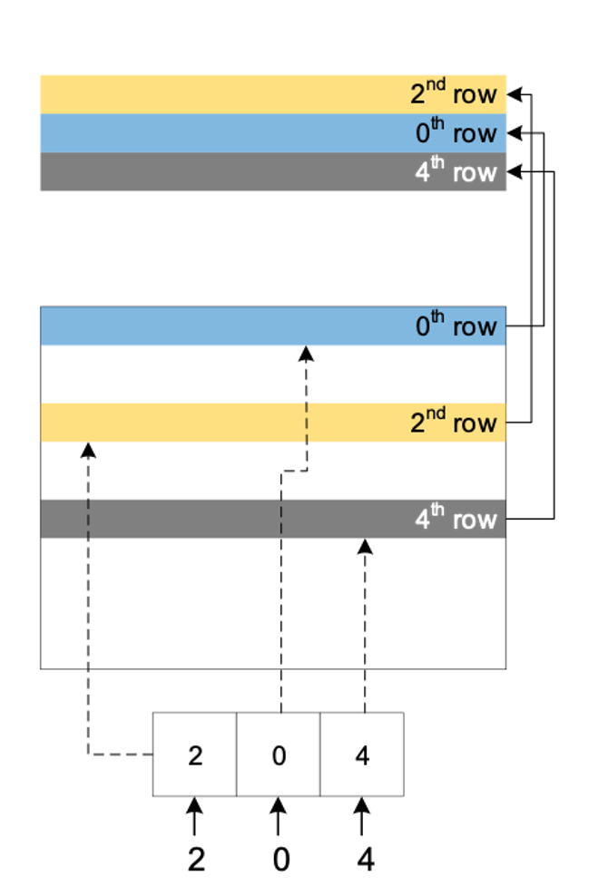
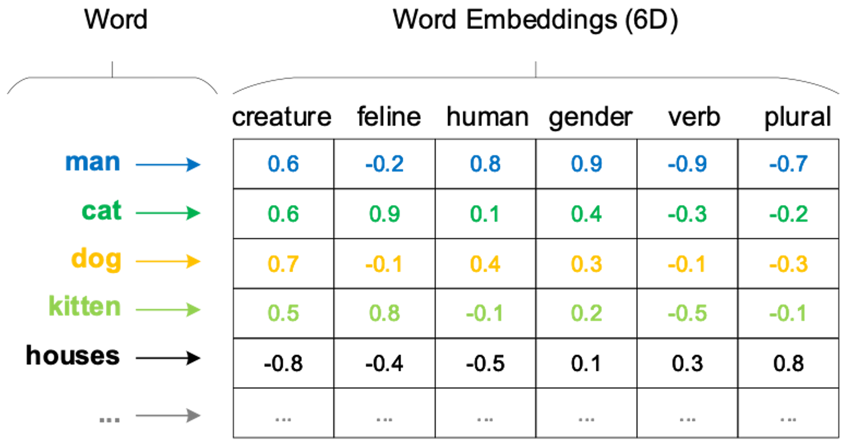
Deep Learning Recommendation Model
  Embedding table
  Embedding lookup indices
Sparse (categorical) features
  A typical architecture of deep learning recommendation model (DLRM).
An embedding table is a sort of "lookup table", indexed by the unique IDs of the sparse categorical features.
Notes:
Sparse features are transformed to a dense representation by looking up embedding tables in the embedding layer.
Each row in the embedding table is the vector of floating-point values that corresponds to a category for a sparse feature.
The number of vectors, or rows in the table, is determined by the number of categories in the given feature.
For example, for a word listed here, a categorical input may represent creature, gender, and etc
The dimension of each vector, or columns in the table, is determined by the number of latent features for the category representation.
An embedding table lookup operation reads a few vectors from the table when given a set of indices, e.g.
After that, the embedding vectors returned are aggregated into a single vector through pooling operations such as sum, dot-product, average.

Slide 7
Challenge of Large-Scale Recommendation Systems
DNN-based recommendation model keeps growing
  Embeddings: reaching TBs
  DRAM in typical server : 256GB
Total cost of ownership (TCO) is high as data grows fast
Requiring extremely large memory capacity
How about using solid-state drive (SSD) ?
  Large capacity: capacity up to 100 TB
  Rapid development of SSD : achieve low latency (up to 3us) and high bandwidth (n GB/s)
  Low cost: high density SSD is 4-8x cheaper than DRAM per bit
Notes:
Recent studies from several cloud vendors show the memory capacity scaling challenge for recommendation systems due to the large embedding size. The dim of a tb, the row of a tb, and the table number all would cause the increase of embedding size.
The embedding size can achieve TB while the DRAM size in a typical server is
It cannot be hold in memory in the near future
On the other hand, DRAM is expensive which has effect on the TCO. Click.
So, how about replace DRAM with SSD for RS. We have three reasons
First it has large capacity; Second it also develops fast. Last but not least, high density SSD is 4-8 times cheaper than DRAM per bit.

Slide 8
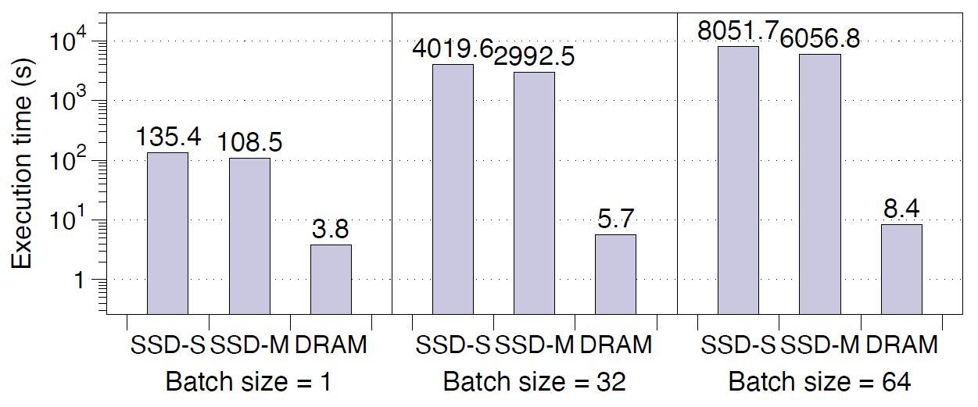
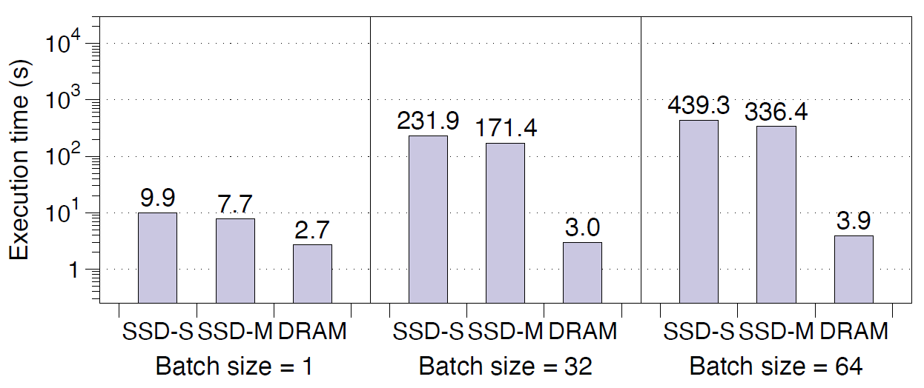
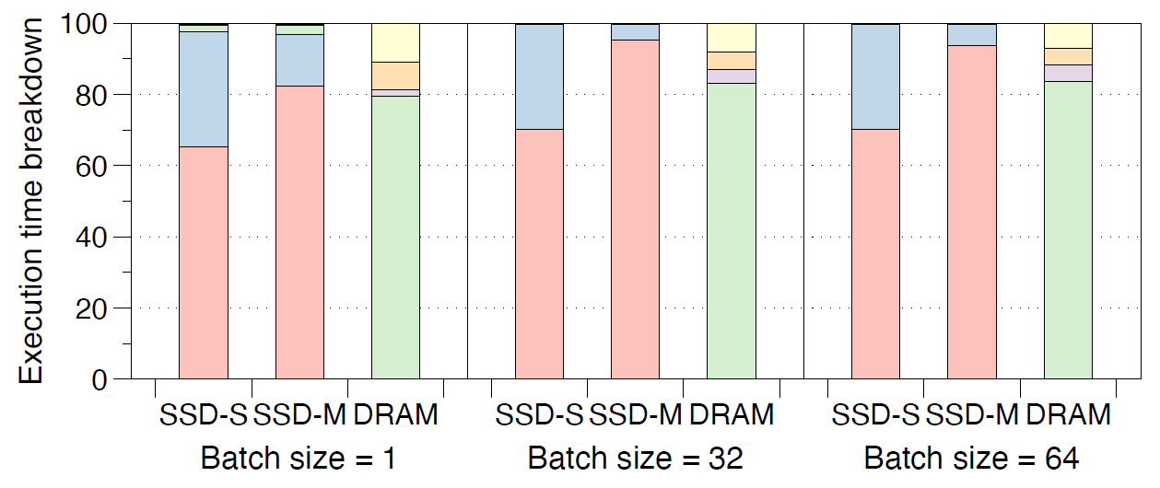
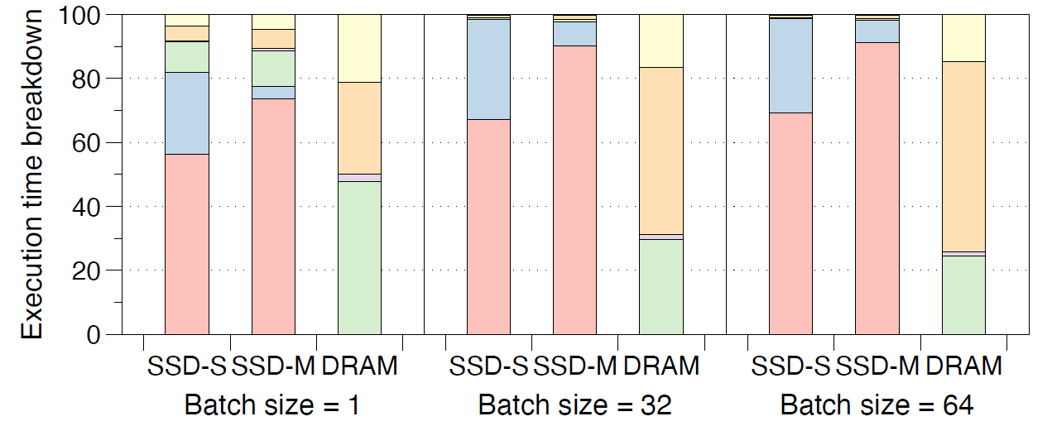
Performance Degradation of Naïve SSD Employment
959x
113x
  Embedding-dominated Model (RMC2⁵)
  MLP-dominated Model (RMC3⁵)
1. SSD-S, SSD-M and DRAM : recommendation models running with small size (1/4 size of embedding tables), medium size (1/2 size of embedding tables) and full size of DRAM
2. emb-ssd : time consummation on the SSD only (end with device driver)
3. emb-fs : time cost of I/O stack, e.g., page cache
4. emb-op : time consummation aggregation of scattered embedding vectors of in user-space
5. RMC2, RMC3 : recommendation models from Facebook
Notes:
To better understand the use of SSDs for recommendation inference, we use the RS model from Facebook to evaluate the performance under memory-capacity-limited environment.
To analyze the impact of the limited capacity, we use the Linux cgroup tool to limit the amount of memory available for the recommendation system to a specific value.
SSD-S, SSD-M and DRAM indicate that recommendation models running with
The model can be classified into Embedding-dominated and MLP-dominated according to the time portion.
It is revealed that, the performance of naïve SSD deployment has exponential gap compared with dram version, for both …… the degradation value can be from 100 to nearly one thousand.
In the corresponding breakdown figures, emb labels show that the time spent on SSD and filesystem have the dominant fraction. click

Slide 9
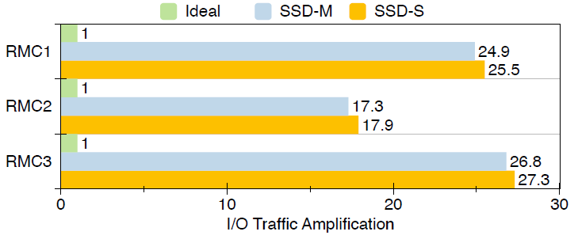
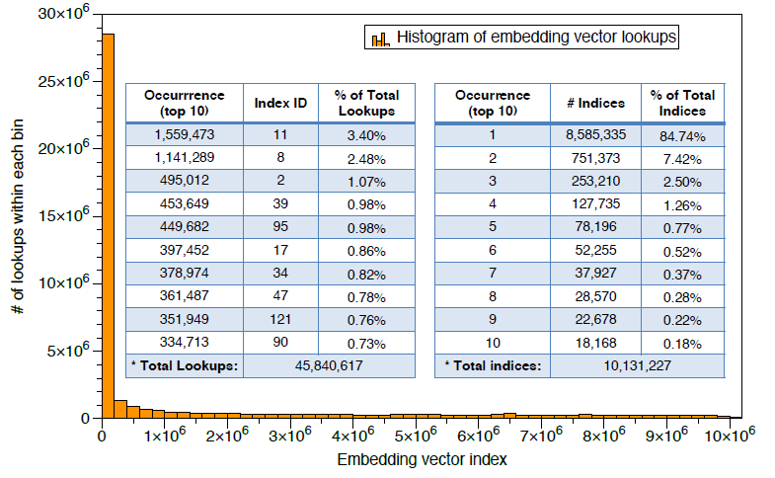
Issues of Naïve SSD Employment
Significant read amplification
  SSD: provide block access granularity
  Recommendation system: require the vector granularity data
Irregular access pattern of embeddings
  Unique access accounts for the 84.74%,
  Top 10000 frequency : 59.2%
In-Storage Computing
  Reduce I/O traffic
  Improve effective bandwidth
How about offloading embedding lookup into SSD ?
Notes:
The performance degradation comes from two parts. The first is the significant read amplification as we can see form this figure. SSD and RS have different access granularity. click
The second is the irregular access pattern of embeddings. It is found that the request access are only concentrated on very few indices, while others are nearly random. Click.
How about ….
ISC is well-suited for gather-reduce operations, which is similar to the embedding lookup operation. So we can also take advantage of this feature to reduce I/O traffic and improve effective bandwidth

Slide 10
Offloading embedding lookup is enough ?
Accelerating MLP is critical for MLP-dominated models
  FPGA acceleration for inference
Pipeline all in SSD is more efficient than host-SSD co-design
  Long inner concatenation between embedding and MLP layers
  Round-trip data communication (hundreds of ms)
  Additional data copy and reformation
Constraints: SSD is sensitive to monetary cost and energy efficiency
Call for offloading MLP layer
  MLP-dominated Model
Notes:
After that, we will ask ….Recall this breakdown figure for MLP-dominated model, MLP layer also take the great portion, which calls for the …. click
1. Accelerating MLP is critical for MLP-dominated models. As we known, FPGA is suitable for accelerating MLP layers in the deep learning inference.
2. We also note that pipelining the whole RS …. heterogeneous architecture …..
3. We should also pay attention to the constraints from SSD manufacture………. high power consumption often leads to high temperature and do harm to the flash lifetime.

Slide 11
RM-SSD:
In-Storage Computing for Recommendation Inference
  We propose an FPGA-based in-storage computing scheme with offloading the entire recommendation system into SSD (RM-SSD)
  Address embedding-dominated and MLP-dominated models
  With low-end FPGA equipped (additional 4% cost)
  Negligible overhead (μs, <1%)
Embedding Lookup Engine
MLP Acceleration Engine
MMIO Manager : user-space interface
Software driver and runtime library : easily integrated with python
  RM-SSD
Notes:
We propose an FPGA-based in-storage computing scheme for optimizing SSD-based recommendation inference by offloading the entire system into SSD. RM-SSD is the first complete solution that can address both embedding-dominated and MLP-dominated models, which is achieved with a low-end FPGA inside SSD and tiny overhead.
This is the overall architecture of RM-SSD, including …..
We use MMIO to realize the host and SSD communication, which can skip the long I/O stack for latency reduction.
We provide a C++ runtime library, which can be easily integrated with any deep learning frameworks, e.g., PyTorch, Café.

Slide 12
Embedding Lookup Engine
Embedding Vector (EV) Translator
  Bulk EV indices -> LBA
Vector-Grained Flash Memory Controller (EV-FMC)
  Reduce the access latency
  Increase the throughput of EVs reading
Embedding Vector Sum (EV Sum)
  Further reduce I/O
  Embedding Lookup Engine
Notes:
The Embedding Lookup Engine is composed of ….
Embedding Vector (EV) Translator is used to parse the embedding vector index to LBAs. We keep the index ranges and the start LBA of all extents with table ID in the DRAM on the FPGA
chip inside SSD for instant embedding vector lookup
The embedding lookup engine adopts a two-stage vector-grained read strategy, including the device stage and flash channel stage.
The Vector-Grained Flash Memory Controller is the first stage of fine-grained scheme, we only fetch the desired data from the flash buffer, instead of the convectional 4KB. It not only reduces the access latency, but also Increases the throughput of EVs reading.
And the Embedding Vector Sum is the second stage of fine-grained scheme, which perform gather–reduce operation.

Slide 13

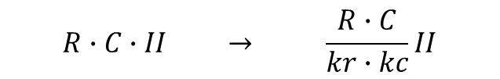
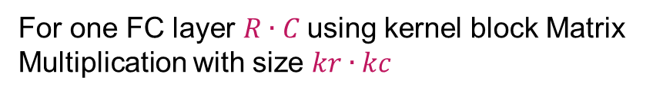
MLP Acceleration Engine
  Challenges of In-storage computing FPGA
  Low latency and high throughput
  Low-end with limited resources
  Proposed approaches：
  Basic FC Layer Design
    Partial adder tree – reduce latency
    Take utilization of Initiation Interval (II) to reuse resource - reduce resource consumption
For one FC layer $R∙C$using kernel block Matrix Multiplication with size $kr∙kc$
1
$$R∙C∙II → \frac{R∙C}{kr∙kc}II$$
$krkc (N_{fmul}+N_{fadd})→$ $\frac{krkc}{II}(N_{fmul}+N_{fadd})$
II
Notes:
Let's talk about the MLP
As mentioned in the previous slides, we have two main challenges for the RS-oriented MLP. First. we should achieve low…
Second, the proposed SSD-side FPGA solution should target low-end FPGA with limited resources.
Therefore, it is not feasible to directly apply previous research of FPGA-based MLP accelerators for recommendation systems.
We use the following four approaches to achieve this goal. The first is the basic FC layer design
To reduce the latency, we apply the adder tree to implement the sum operation in the kernel block Matrix Multiplication
To reduce the resource consumption, we utilize the Initiation Interval cycles to pipeline the kernel unit with one cycle, so that the DSP resource can be reused

Slide 14
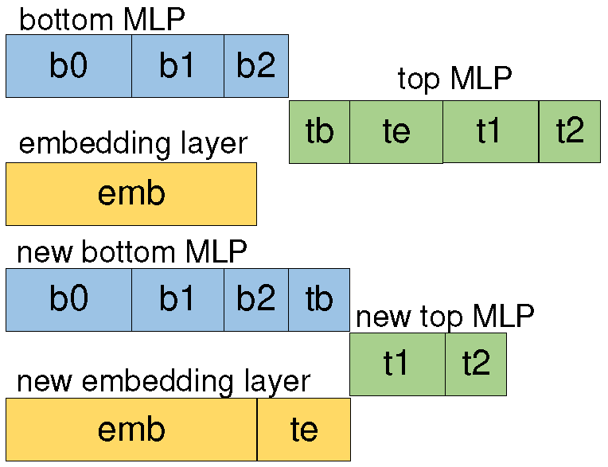
MLP Acceleration Engine (cont’d)
  Proposed approaches：
  Intra-Layer Decomposition – reduce latency
    Decompose the first layer of top MLP
t0
Ensure the computing not hindered by bottom MLP and embedding layer
Notes:
We apply Intra-Layer Decomposition for latency reduction.
As shown in the right figure, in the recommendation model, the feature interaction is performed after the bot MLP and embedding layer.
The current recommendation system handles the concatenation after both of the bottom MLP and embedding layer finish and then feeds the united vector into the top MLP layer. It is suitable for the python framework, but it does not take full advantage of the FPGA hardware with unnecessary idle cycles.
We decompose the first layer of top MLP and remap the corresponding matrix multiplication. So that the subsequent computing are neither hindered by bottom MLP nor the embedding layer
It eliminates the long inner concatenation between embedding and MLP layers.

Slide 15
MLP Acceleration Engine (cont’d)
  Proposed approaches：
  Inter-Layer Composition – reduce latency
    Fit all layers (a series of small FC + a large FC layer) of RS model on FPGA
    Compose the adjacent layers into a pair, by exchanging the scanning direction of each layer alternatively
Pair layer
(a) apply the same scan pattern. (b) exchange the scan pattern alternatively.
Notes:
We apply Inter-Layer Composition for latency reduction.
In the original processing flow, all FC layers adopt the same scan pattern for kernel streaming, which would cause the pipeline stall.
Assuming all inputs stream along the column dimension with kc first, then repeat along the row dimension with stripe kr. As a result, only after all columns of Layer i finish accumulation, the first kc columns of layer i+1 can feed the first input vector. Partial models are in the idle state.
The RS model usually consists of a series of small FC and a large FC, so that we can fit all layers on the FPGA.
We compose the adjacent layers into a pair, by exchanging the scanning direction of each layer alternatively, so that the adjacent layer can be processed in parallel

Slide 16
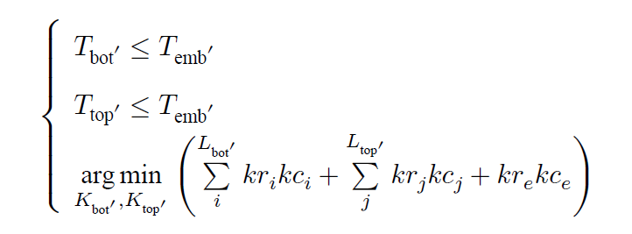
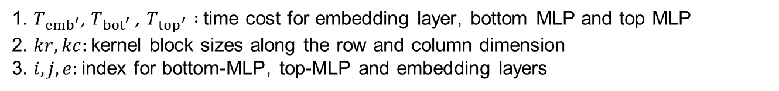
MLP Acceleration Engine (cont’d)
  Proposed approaches：
  Kernel Search Algorithm – Ensure the lowest resource utilization and the optimal throughput
    Balance the time cost of each FC layer
    Balance the non-MLP embedding with MLP layers for maximum throughput
Optimization objectives:
1. $T_{{emb}^{′}}$, $T_{{bot}^{′}}$, $T_{{top}^{′}} :$time cost for embedding layer, bottom MLP and top MLP
2. $kr, kc:$kernel block sizes along the row and column dimension
3. $i,j,e:$index for bottom-MLP, top-MLP and embedding layers
Notes:
We propose a kernel search algorithm that can efficiently decide the kernel size for each FC layer, which ensures the lowest resource utilization and the optimal throughput.
We should balance the time cost of each FC layer, to ensure that the time cost is not affected by a certain layer and not waste resource.
We should also balance the non-MLP embedding layer and MLP layers, Given an SSD and an RS model, the time cost of embedding lookup is a constant value, which cannot be optimized. Making the time consumption close to but not larger than the embedding lookup is an efficient way.
Here we list the optimization objectives, to satisfy these equations, we should carefully pick the suitable kernel sizes.
Detailed pick-up rules can be found in our paper

Slide 17
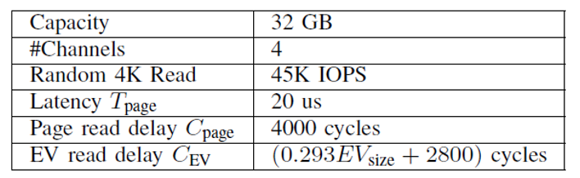
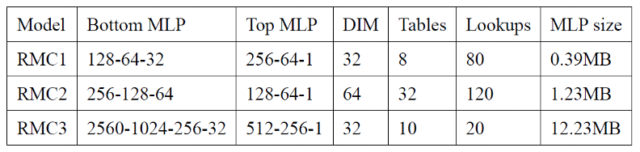
Experimental setup
Emulate SSD with FPGA on AWS F1 instance
  16*2 GB DDR emulated as flash chips with delay units
  16*2 used with conventional utility of off-chip DRAM
Host: open-source deep learning recommendation model (DLRM)
RecSSD [1]: offload embedding lookup into SSD with page-level access and utilizes the host-side and SSD-side cache to enhance the performance
MLP-naïve : offload entire RS into SSD, with conventional MLP deign applied in near-memory [2] acceleration
[1] Wilkening, Mark, et al. "RecSSD: near data processing for solid state drive based recommendation inference." Proceedings of the 26th ACM International Conference on Architectural Support for Programming Languages and Operating Systems. 2021.
[2] Hwang, Ranggi, et al. "Centaur: A chiplet-based, hybrid sparse-dense accelerator for personalized recommendations." 2020 ACM/IEEE 47th Annual International Symposium on Computer Architecture (ISCA). IEEE, 2020.
Notes:
Let’s see the evaluation parts. Since we do not have real programmable SSD
We use the FPGA platform on AWS F1 instance. The parameters of the emulated SSD are listed in the first table. The FPGA board has 4 DDR ranks. Two of them are emulated …and the other two are used….
For the host, we still use Facebook DLRM models. The parameters are listed in the second table. We can see that, MLP model of RMC3 is much larger than RMC1 and RMC2.
We compare the RM-SSD with RecSSD, It offloads
We also implement RM-SSD with naïve MLP design, which is applied in a near-memory acceleration work for RS. They still assume all embedding are stored in the main memory.

Slide 18
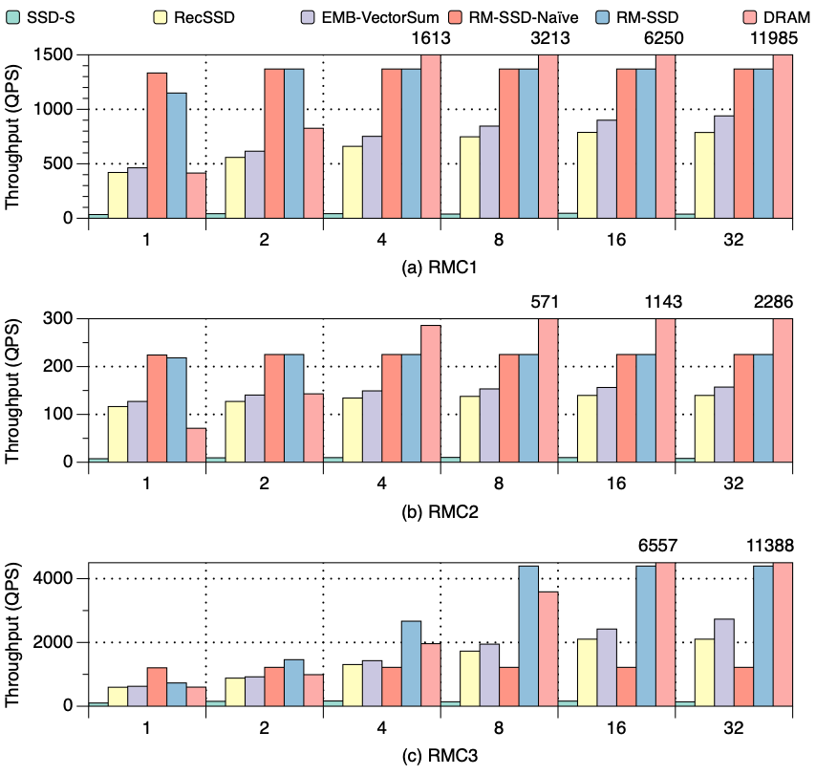
Throughput of different recommendation inferences
vs. naïve SSD (SSD-S): up to 36x throughput improvement
vs. Embedding Lookup Engine only (EMB-VectorSum): 1.5-2x throughput improvement
vs. RecSSD : up to 2.8x throughput improvement
Embedding-dominated
Batch size
MLP-dominated
EMB-VectorSum : RM-SSD running with Embedding Lookup Engine only
Notes:
Here is the throughput of three RM models. The X-axis indicates the batch size and Y-axis indicates the throughput. RM-SSD achieves up to 36 times throughput improvement compared to the baseline SSD-S. In addition to the read amplification reducing and file system bypassing, it also benefits from the newly offloaded MLP acceleration engine.
Compared with RM-SSD running with Embedding Lookup Engine only, the throughput improvement is around two. It gains from the pipeline remapping on the FPGA board.
RM-SSD can achieve up to two-point eight times throughput improvement compared with RecSSD. It has two reasons. First, for the embedding lookup module, we adopt the vector-grained access of embeddings, while RecSSD still adopts the page access. Secondly, we take advantage of the MLP Acceleration Engine.

Slide 19
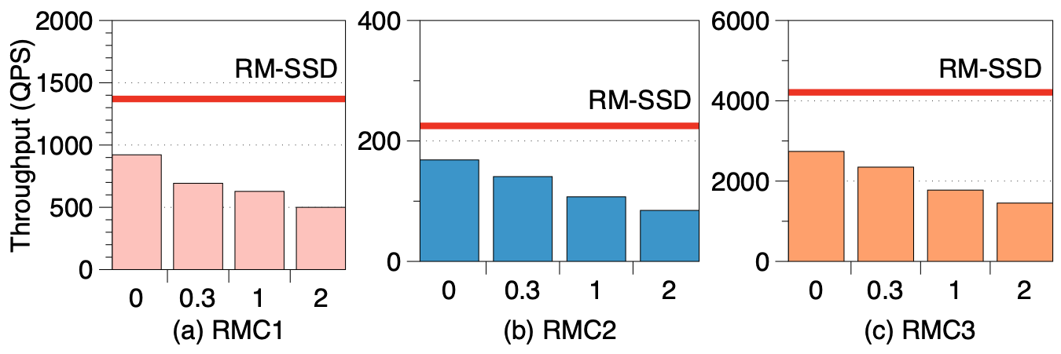
Throughput of different recommendation inferences
vs. naïve SSD (SSD-S): up to 36x throughput improvement
vs. Embedding Lookup Engine only (EMB-VectorSum): 1.5-2x throughput improvement
vs. RecSSD : up to 2.8x throughput improvement
Not sensitive to input locality
Performance comparison between RM-SSD (red-line) and RecSSD with four locality cases on input traces.
K=0, 0.3,1,2 indicates locality distribution with 80%, 65%, 45%, and 30% hit ratio
Embedding-dominated
Batch size
MLP-dominated
K
Notes:
Moreover, RM-SSD is not sensitive to the input locality. When decreasing the locality of the input trace, the throughput of RecSSD degrades accordingly, while RM-SSD maintains a constant value. The host-side cache of RecSSD is statically partitioned based on history input, which is not robust in the online running scenario.

Slide 20
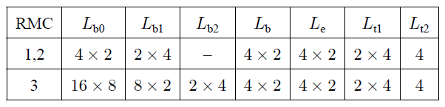
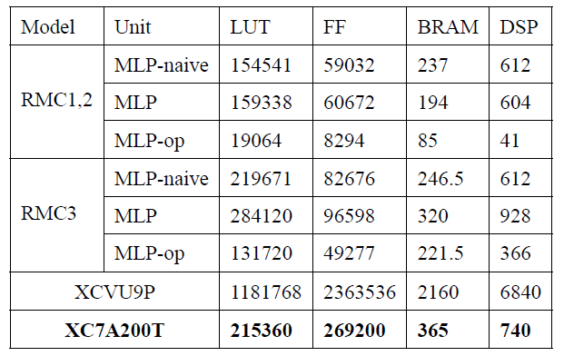
Resource Efficiency of MLP Acceleration Engine
  Kernel size of each layer
vs. MLP-naïve:
  The same performance with RMC1&2 with one order of magnitude less resource
  3.5x speedup compared to MLP-dominated RMC3 with much less resource.
  Cannot fit on low-end FPGA
  Resource consumption of MLP Acceleration Engine
low-end FPGA
-op indicates applying kernel search algorithm
Notes:
Here is the Resource Efficiency of MLP Acceleration Engine. The kernel size of each layer is listed in the first table and the Resource consumption are shown in the second table. The kernel size is the key factor of resource consumption on FPGA.
Compared to the naïve MLP design, RM-SSD can achieve the same performance with one order of magnitude less resource for RMC1 and RMC2. And three-point five speedup compared to MLP-dominated RMC3 with much less resource, so that MLP-naïve cannot fit on low-end FPGA.

Slide 21
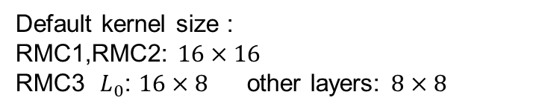
Resource Efficiency of MLP Acceleration Engine
  Kernel size of each layer
Default kernel size :
RMC1,RMC2: $16×16$
RMC3 $L_{0}$: $16×8$other layers: $8×8$
vs. MLP-naïve:
  The same performance with RMC1&2 with one order of magnitude less resource
  3.5x speedup compared to MLP-dominated RMC3 with much less resource.
  Cannot fit on low-end FPGA
vs. MLP (default kernel):
  The same performance for all models
  Compared to MLP-dominated RMC3 with half resource.
  Cannot fit on low-end FPGA
  Resource consumption of MLP Acceleration Engine
low-end FPGA
-op indicates applying kernel search algorithm
Notes:
Compare with MLP design with default kernel size. RM-SSD can achieve the similar results. They achieve the same performance for all models. MLP with default kernel consume double resource. It also cannot fit on a low-end FPGA.

Slide 22
Conclusion
Problems: current recommendation system is facing DRAM capacity bottleneck.
We propose RM-SSD: an in-storage computing prototype with a low-end FPGA for ofﬂoading the entire recommendation system into SSD for recommendation inference.
RM-SSD leverages a low-end FPGA to speed up both the embedding-dominated and MLP-dominated models with high resource efficiency by eliminating the read amplifications of embedding lookup and accelerating the recommendation system-oriented MLP layers.
RM-SSD can achieve 36x throughput improvement compared with the naïve SSD and 2.8x improvement compared to the latest work with negligible overhead.
Notes:
To conclude, we found the problem that

Slide 23
RM-SSD: In-Storage Computing for Large-Scale Recommendation Inference
Xuan Sun, Hu Wan, Qiao Li, Chia-Lin Yang,
Tei-Wei Kuo, and Chun Jason Xue
xuansun-c@my.cityu.edu.hk
This presentation and recording belong to the authors.
No distribution is allowed without the authors' permission.
Notes:
That’s all. If you are interested in our work, you can come to the session eight-A on HPCA or email me. Thank you !

Slide 24
Thank you!

